Slide 1
IDEAL CLINIC PROGRAMME
Ideal clinic Dashboard Version 15
Presenter: Annie Jautse
Date: 15 September 2015

Slide 2
Contents
Composition of dashboard
Components and sub components
Method of measurement
Scoring
Responsibility
Definition of weights
Ideal Clinic categories
Status determination roles
212 Elements

Slide 3
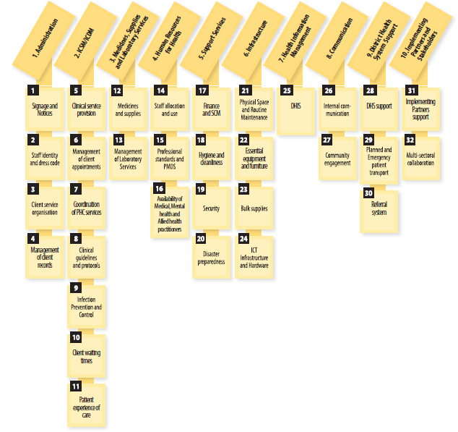
Components and sub components

Slide 4
Method of measurement
Key | Method of Measurement
& | Check applicable documents e.g. policies, guidelines, standard operating procedures, data, etc
? | Ask staff members and or clients for their views or level of understanding
K | Observations and or conclusion
H | Test the functionality of equipment/ systems

Slide 5
Responsibility
Key | Description
NDoH | National Department of Health
P | Province
D | District
HF | Health Facility

Slide 6
Definition of Weights
Vital
Extremely important (vital) elements that require immediate and full correction. These are elements that affect direct service delivery and clinical care to patients and they may have immediate and long-term adverse effects on the health of the population.
Essential
Very necessary (essential) elements that require resolution within a given time period. These are process and structural elements that indirectly affect the quality of clinical care given to patients.
Important
Significant (important) elements that require resolution within a given time period. These are process and structural elements that affect the quality of the environment in which health care is given to patients.

Slide 7
1. Administration
1. Signage and Notices
Elements |  | W | MM | R
1 | Road signs informing of the location of the facility are visibly posted from the nearest arterial road up to the facility entrance | I | K | P
2 | Display board reflecting the facility name, service hours (e.g. 24 hour, 8 hour, public holidays and weekends), physical address, contact details (physical address, postal, telephone, facsimile or electronic mail) and service package details at the entrance of the facility | I | K | D
3 | The GUN FREE, NO SMOKING, NO ANIMALS (except for service animals) and NO HAWKERS sign is clearly sign posted at the entrance of the gate | I | K | D
4 | Display board indicating a disclaimer on searches | I | K | D
5 | Photos of political leadership of health are visually displayed | I | K | D
6 | The Mission, Vision, Belief, Goals of the health facility are displayed for patients to clearly see | I | K | D
7 | The organogram with contact details of the managers displayed | I | K | HF
8 | All service areas including reception and toilets within the facility clearly signposted | I | K | HF

Slide 8
1. Administration
2. Staff identity and dress code
Elements |  | W | MM | R
9 | There is a prescribed dress code for all service providers | I | & | P
10 | All staff members comply with prescribed dress code | I | ?K | HF

Slide 9
1. Administration
3. Client service organization
Elements |  | W | MM | R
11 | There is appropriate access for people with disabilities | V | K | D
12 | Staff are scheduled such that helpdesk services are available at all times | I | K& | HF
13 | There is a process that prioritizes the frail, elderly and high - risk clients | I | K | HF
14 | A functional wheelchair and stretcher are always available | V | ?K | HF

Slide 10
1. Administration
4. Management of client record
Elements |  | W | MM | R
15 | There is a single client record irrespective of health conditions | I | K& | HF
16 | Client record content adheres to ICSM prescripts | E | K& | HF
17 | There is a single location for storage of all client records | I | K | HF
18 | Client records are filed in close proximity to client registration desk | I | ?K | HF
19 | There is a standardised client record filing system in place | I | K | HF
20 | The retrieval of a client’s file takes less than five minutes | I | ?K | HF
21 | There is an SOP for archiving and disposal of clients’ records available | I | & | NDoH
22 | The SOP for archiving and disposal of clients' records is adhered to | I | K | HF
23 | Priority stationery (clinical and administrative) is available at the facility in the right quantities | I | & | HF
24 | The facility has been re-organized with designated consulting areas and staffing for acute, all chronic health conditions and preventative health services. | E | K | HF

Slide 11

Thank you
www.health.gov.za
www.idealclinic.org.za
idealclinic@health.gov.za

