Slide 1
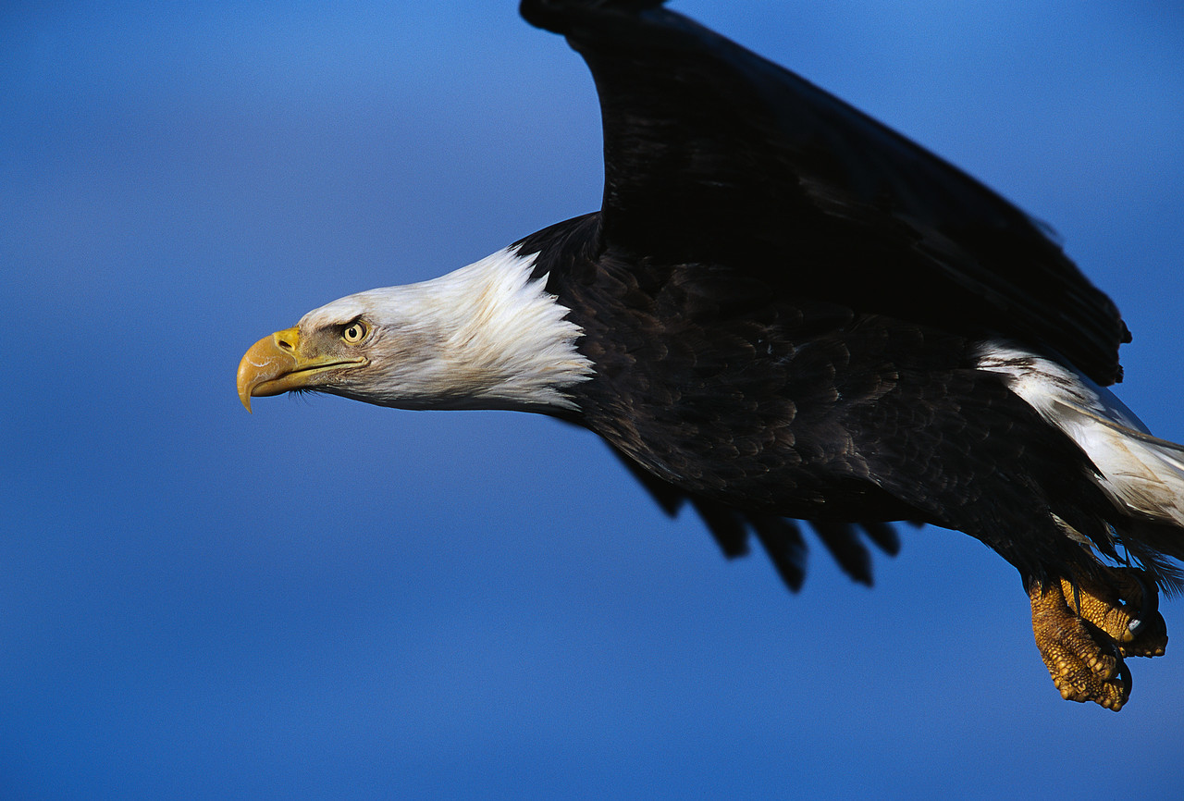

The Story of The Eagle…
This show was edited by Mike:
ruppi_scifi@yahoo.de

Slide 2
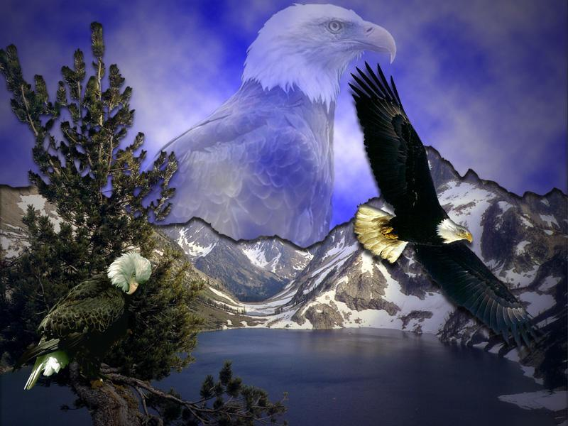
The eagle has the longest life-span
of its’ species
Notes:
The eagle has the longest life-span of its’ species

Slide 3
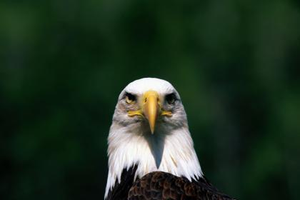
It can live up to 70 years
But to reach this age,
the eagle must make a hard decision.
Notes:
okay

Slide 4
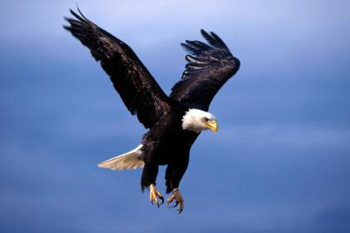
In its’ 40’s
Its’ long and flexible talons can no longer
grab prey which serves as food
Notes:
In its’ 40’s
Its’ long and flexible talons can no longer grab prey which serve as food

Slide 5
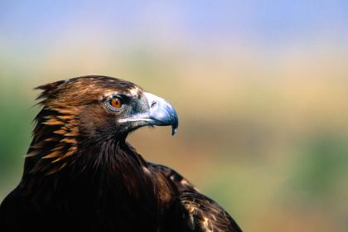
Its’ long and sharp beak becomes bent
Notes:
Its’ long and sharp beak becomes bent

Slide 6
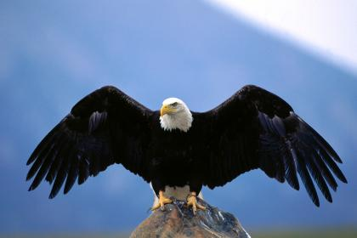
Its’ old-aged and heavy wings,
due to their thick feathers,
become stuck to its’ chest and
make it difficult to fly.
Notes:
Its’ old-aged and heavy wings, due to their thick feathers, become stuck to its’ chest and make it difficult to fly

Slide 7
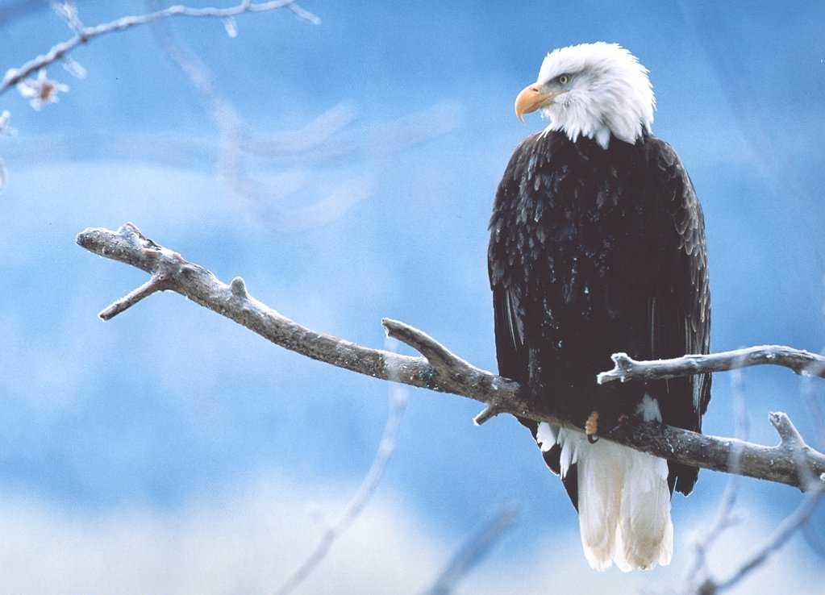
Then, the eagle is left with only two options: die or go through a painful process of change which lasts 150 days.
Notes:
okay

Slide 8
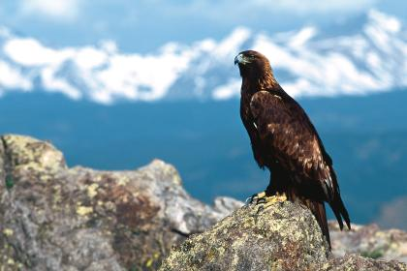
The process requires that the eagle fly
to a mountain top and sit on its’ nest.
Notes:
The process requires that the eagle fly to a mountain top and sit on its’ nest

Slide 9
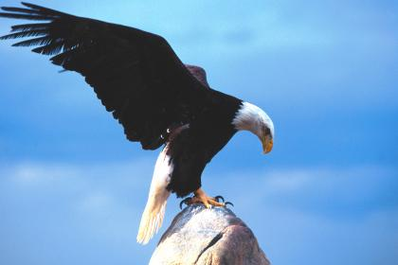
There the eagle knocks its’ beak against
a rock until it plucks it out.
Notes:
There the eagle knocks its’ beak against a rock until it plucks it out

Slide 10
After plucking it out, the eagle will wait for a new beak to grow back and then it will pluck out its’ talons.
Notes:
After plucking it out, the eagle will wait for a new beak to grow back and then it will pluck out its’ talons

Slide 11
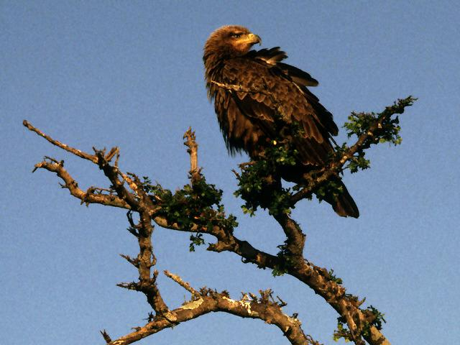
When its’ new talons grow back, the eagle starts plucking its’ old-aged feathers.
Notes:
When its’ new talons grow back, the eagle starts plucking its’ old-aged feathers

Slide 12
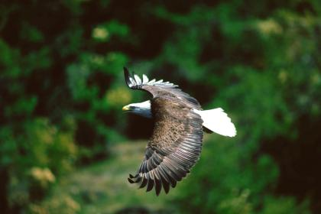
And after five months, the eagle takes its’ famous flight of rebirth and lives for
30 more years
Notes:
And after five months, the eagle takes its’ famous renewal flight and lives for ….
30 more years

Slide 13
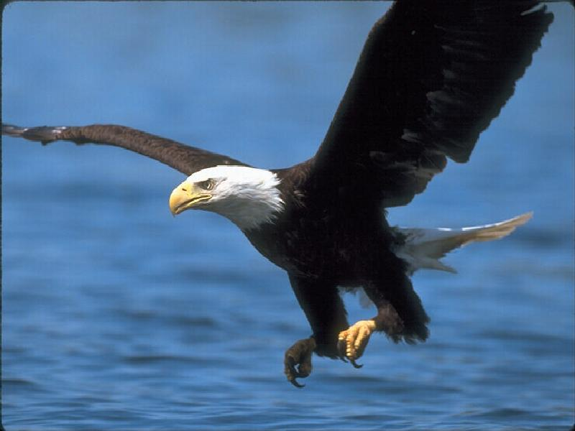
Why is change needed?
Many times, in order to survive
we have to start a change process.
We sometimes need
to get rid of old memories,
habits and other past traditions.
Only freed from past burdens,
can we take advantage of the present.
Notes:
Why is renewal needed?
Many times, we have to retreat for awhile and start a renewal process
To continue taking successful flights, we sometimes need to get rid of memories, habits and other past traditions
Only freed from past burdens, can we take advantage of the valuable outcomes from a …
RENEWAL

Slide 14

Please Share
with your friends
Click here to
repeat show

