Slide 1


Primary Health Care (PHC)
Laboratory toolkit
Session 2

Slide 2
Session 2 Objectives
By the end of Session 2 you will be able to:
  Describe the step-by-step process as outlined in the PHC Laboratory Handbook
  Highlight new or amended processes, procedures or practices.
  Explain impacts on PHC service delivery of pre and post-analytical errors.
Notes:
Workshop process
Delegates need to recap on the constituents of the PHC toolkit .
Give a background and rationale of why the whole process was initiated
Share the main objective of the handbook

Slide 3
Session format
PHC Laboratory Handbook overview
  Understanding the PHC Laboratory Handbook in a patient-centric PHC service
PHC Laboratory Handbook Step by Step Guide Section 1 - 8
  Principles, procedures and processes;
  Implementation guidelines

Slide 4
PHC Laboratory Handbook Overview
Session 2

Slide 5
Placing laboratory services within a patient-centric PHC health service
Notes:
Workshop processes
Delegated need to understand that the toolkit /handbook is a guide on how best to use the laboratory as a component of the integrated healthcare services.
Use of clinical guidelines or standard treatment guidelines to identify the appropriate laboratory tests that need to be performed using a patient-focused consultation and management approach
Part of the integrated clinical services management (ICSM)
This enhances a rational application of the selection of appropriate tests from the Essential Laboratory List (ELL)

Slide 6
PHC Laboratory Handbook
The handbook is a tool that aims to improve the clinic-laboratory interface
The PHC Laboratory handbook and the NHLS national laboratory handbook
The PHC laboratory handbook does not replace the NHLS national laboratory handbook
PHC laboratory handbook aims to:
Provide guidance for the selection of appropriate laboratory tests, specimen collection and preservation, storage, recording and tracing of courier collections.
Define available platforms to obtain lab results
PHC laboratory handbook helps to prevent or minimise:
Incorrect test selection
Incomplete/ poorly completed request forms
Unlabelled and leaking specimens
Contaminated / aseptically collected specimens
Unnecessary tests duplications
Tracing and retrieval of results

Slide 7
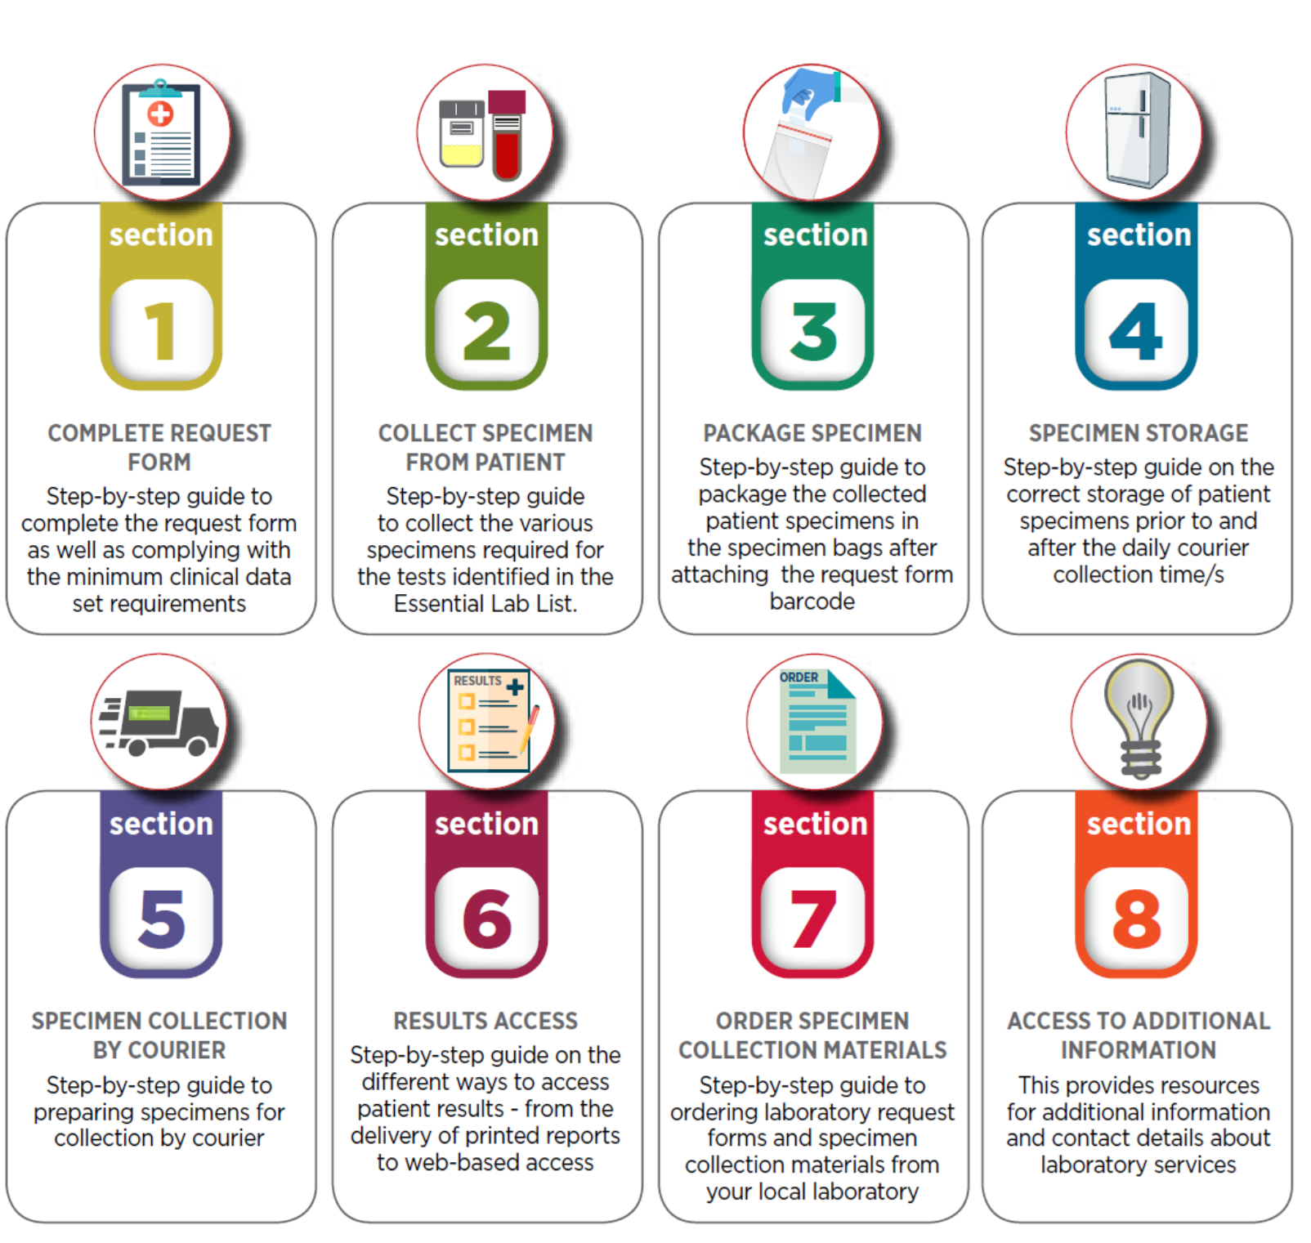
Overview of the PHC Laboratory handbook
The handbook consists of eight (8) sections
Each section describes the steps of each of the core elements
Notes:
Pre reading : PHC handbook
This step-by-step guide is develop to simplify the process of identifying, collecting and submitting laboratory specimens by primary health care (PHC) facilities to their local NHLS laboratory.
It has been developed to enhance the appropriate use of the diagnostic laboratory services as part of an Integrated Clinical Services Management (ICSM) approach.
Delegates are expected to familiarise themselves with high level processes

Slide 8
PHC Laboratory Handbook Step by Step Guide Section 1 - 8
Session 2

Slide 9
Section 1: Complete request form
Complete request form
Identify test/s to be performed
Clinical assessment
Efficiency considerations:
Laboratory investigations:
Should be requested for specific clinical indication, not as a routine procedure;
Do not replace clinical examinations;
Should not be repeated because results are not available
Important principles to inform test identification:
Which test to request?
Was the test requested previously, is there any reason to repeat?
Will the result modify or change the diagnosis, management or treatment?
Key assumption is that the following have been done to inform the selection of the laboratory tests:
Clinic assessment
Examination

Slide 10
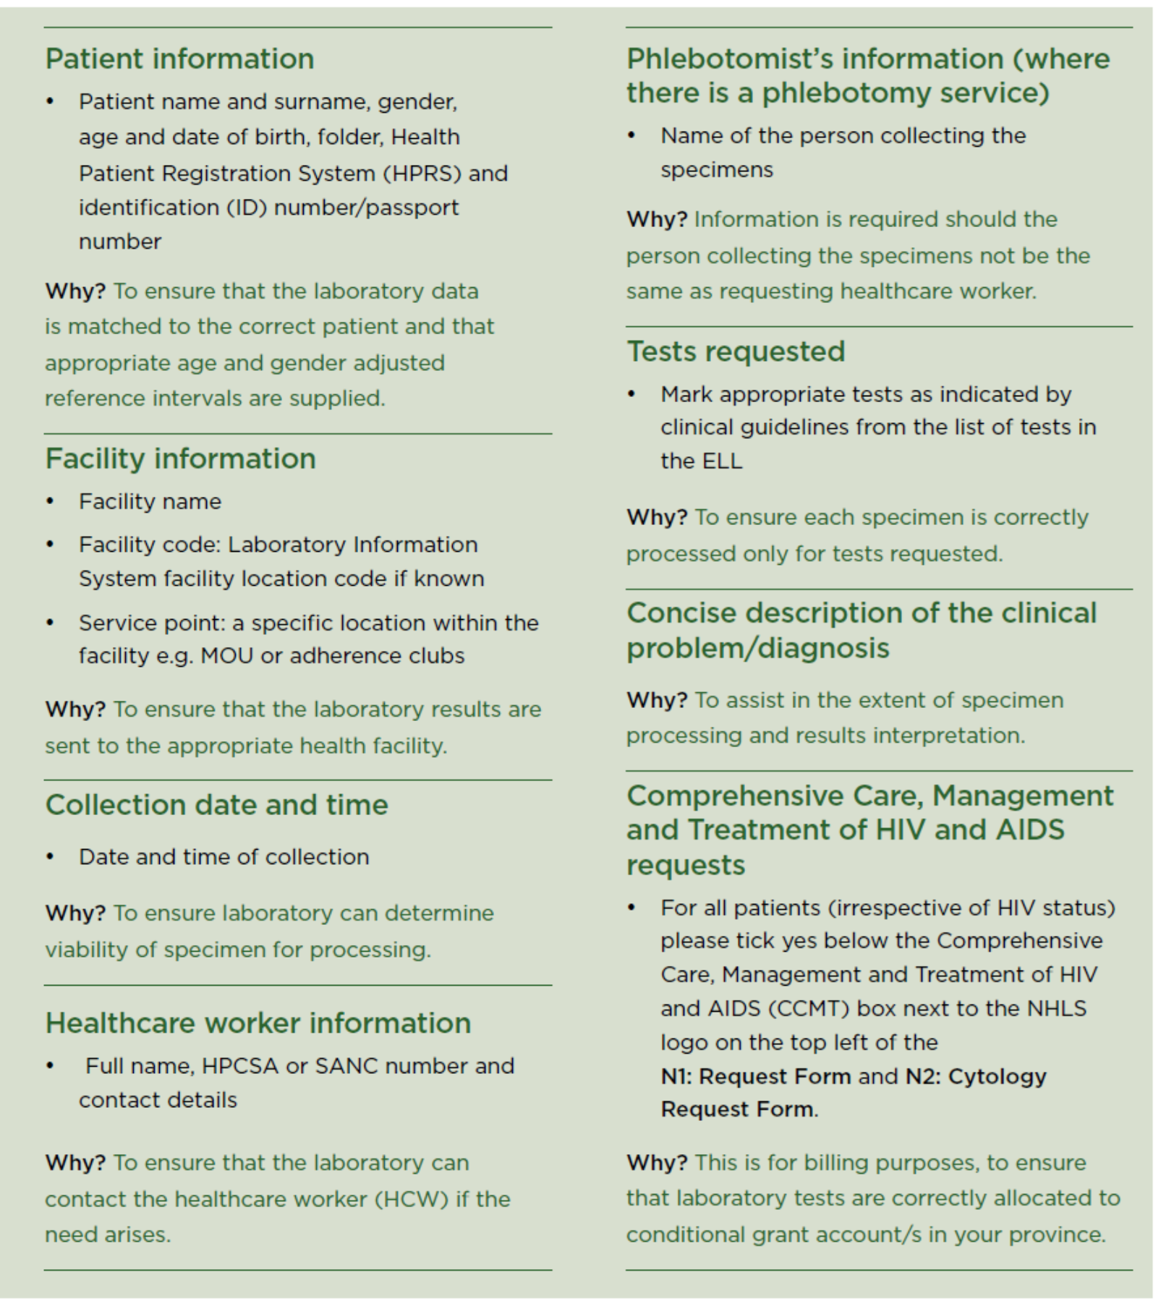

Slide 11
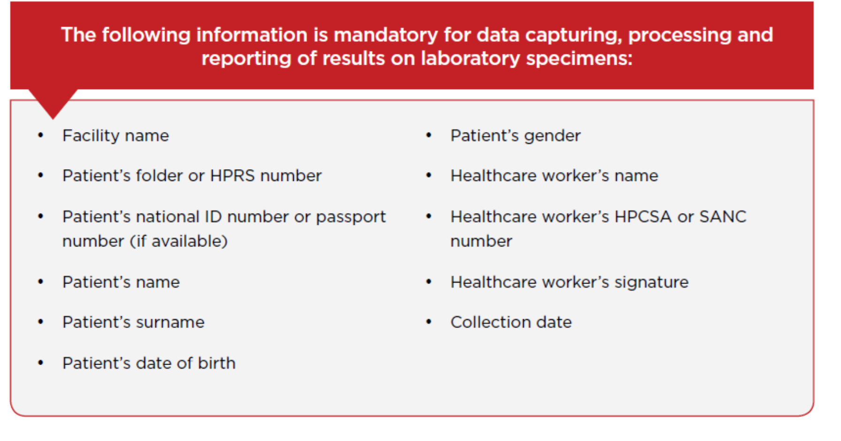
Mandatory Information to be provided

Slide 12
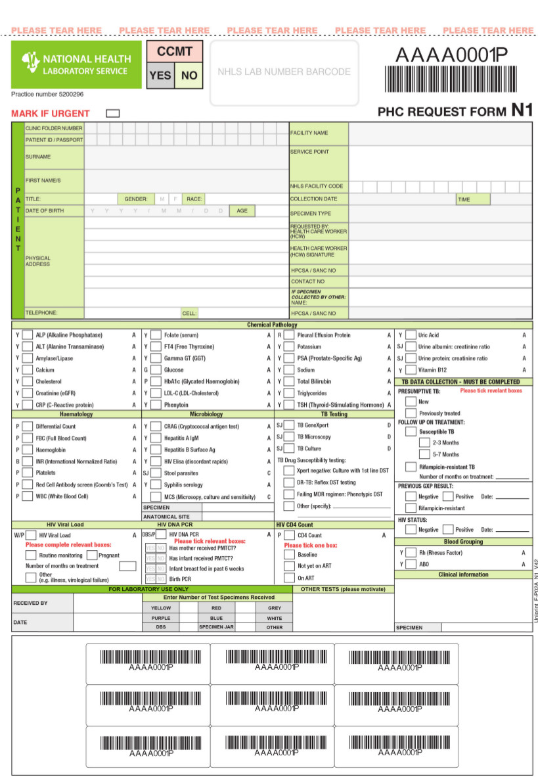
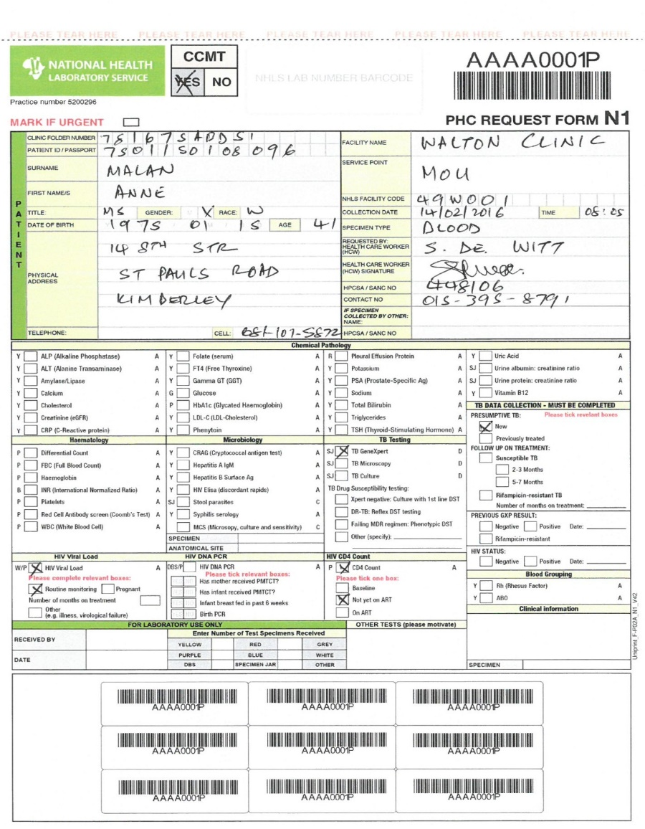
N1 PHC request form

Slide 13
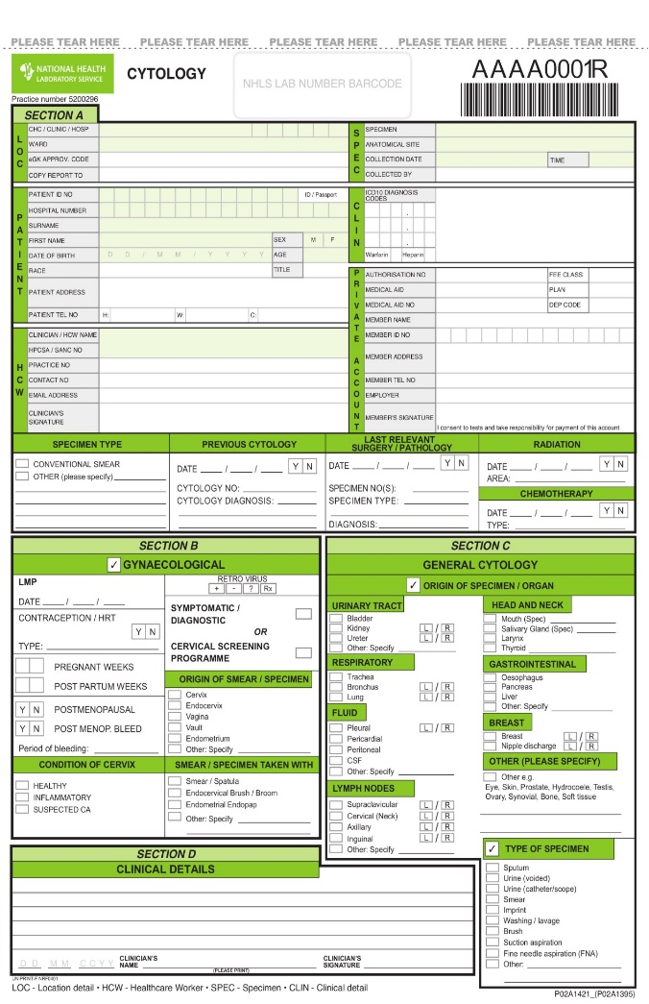
N2 Cytology request form

Slide 14
Classroom exercise: Section 1 Complete the Request Form
In your group
Use the PHC Lab Handbook – go to Section 1: Complete the Request Form. Have a look at the two forms provided- N1 and N2.
1. With reference to the N1 Form, what do you notice about:
  a) The language/terminology;
  b) The tests listed;
  c) Data elements related to HIV and TB;
  d) The Bar codes
2. Comparing the N1 and N2:
  What is the difference between the two forms?
3. What are the potential benefits or improvements that can be derived from the use of these two forms?

Slide 15
Classroom exercise- expected responses Section 1 Complete the Request Form
a)Terminology used is facility based and not hospital based, examples:
  Folder number instead of hospital number
  Facility name instead of clinic name
  b) The tests listed reflect the Essential Laboratory List (ELL). The ELL:
  identifies all laboratory tests that can be requested by PHC facilities (with and without a doctor).
  details estimated turnaround times, specimen types, specimen collection tubes, specimen storage conditions and special instructions for each test.
  c) There are additional data elements to be captured for HIV and TB
  d) The barcodes will now be used in the facility for recording in the facility specimen register

Slide 16
Classroom exercise- expected responses Section 1 Complete the Request Form
  The N1 form list all the routine tests from the ELL, while N2 form is used specifically for Cytology
  The potential benefits include:
    Streamlining the interface between examination and diagnostic will enable better patient management;
    Ideal clinic goal
    Integrated

Slide 17
Section 2: Specimen Collection
Efficiency considerations:
NOTE
All specimen collection procedure have special precautions that are critical to avoid improper collection
Key Resources to guide specimen collection and handling
PHC Essential Laboratory List (ELL)
Key to specimen handling
Step-by-step procedures outlined in the PHC Lab Handbook
Important principles guide specimen collection:
Verify the identity of the patient and make sure that this is correct
Follow guidelines for specimen collection
Check specimen container/s for expiry dates where available

Slide 18
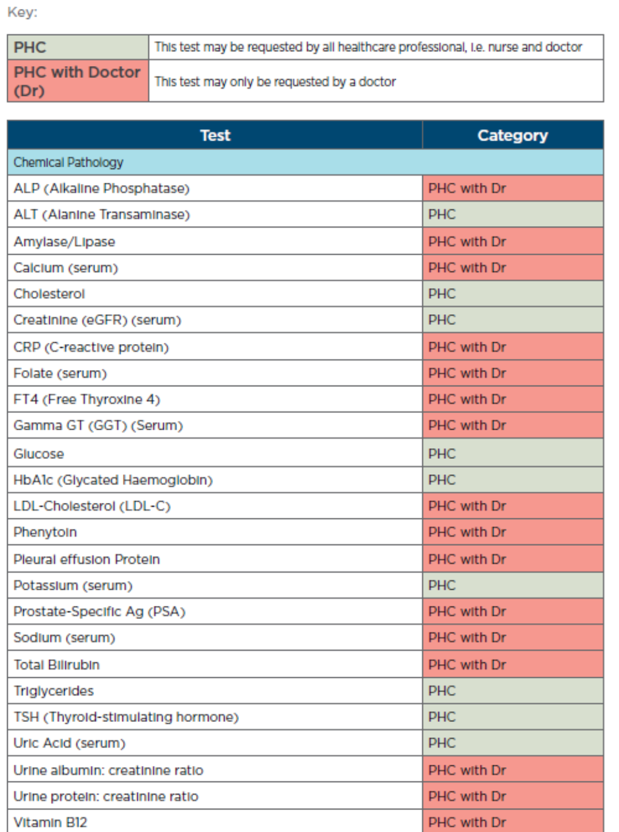
PHC Essential Laboratory List (ELL)
Notes:
Workshop Process
Delegated need to be familiar with the detailed PHC Essential Laboratory List (ELL) (refer to handbook page……)
The ELL identifies all laboratory tests that can be requested by PHC facilities (with and without a doctor).
The ELL details estimated turnaround times, specimen types, specimen collection tubes, specimen storage conditions and special instructions for each test.

Slide 19
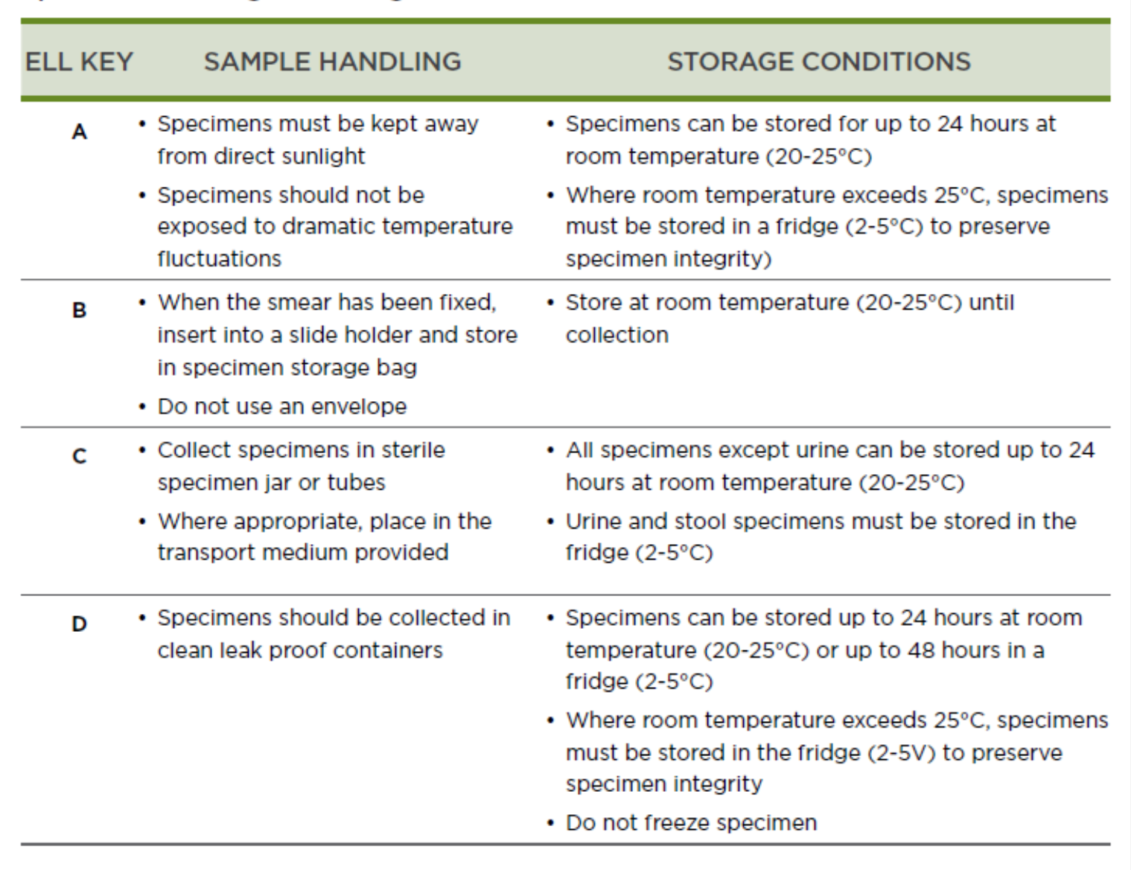
Key to specimen handling
Notes:
Workshop processes
The table is meant to give an overview of the conditions and duration for specimen storage
This should be used as a checklist to avoid sending specimen that are likely to be rejected based on noncompliance with storage and duration

Slide 20
Standard infection control precautions
Identify and assemble the individual specimen collection materials required i.e. Vacutainer, test/tube/s, sterile specimen jars etc. to perform the tests requested
Wash hands using soap and water or disinfectant
Dry hands thoroughly
Put on gloves
Follow strict aseptic technique when collecting specimens
Collect recommended specimen quantities for the requested test to avoid specimen rejection due to insufficient specimen

Slide 21
Specimen collection procedure
Venipuncture | Blood collection | Neonates
Microbiology | Cytology | EID

Slide 22
Classroom exercise 2: Section 2 Specimen Collection
In your group
Use the PHC Lab Handbook – go to Section 2: Specimen Collection
1. Review the step-by-step procedure
2. Identify any new information, observation or insights

Slide 23
Section 3: Package Specimen
Package Specimen
Record test request in patient folder
Label Specimen
Place a barcode from the N1/N2 request form in the lab investigation section of the patient folder for tracking purposes
Indicate the date of test request
Note how this is different from the current procedure
Write the patients name, surname and clinic folder or HPRS number clearly using a pen or marker on each specimen
Peel off barcode label/s from the N1/N2 request form and attach to specimen
Place the barcode horizontally for for Vacutainer
All specimens must be placed in the appropriate compartment/s of the specimen plastic bags provided
Add the N1/N2 request form in the space provided

Slide 24
Label Specimen

Slide 25
Record test request in patient folder

Slide 26
Package specimen

Slide 27
Section 4: Specimen Storage
Storage of Specimen
Record in the N4 facility specimen register
Specimen Storage condition for each ELL test must be adhered to
There are two parts to the N4 Register
Cover Page
  Register number
  Start and end date and Facility name
Register
  For each sample enter the date, folder number and tests submitted
  Attach the barcode label from N1/N2 request form
  Note how this is different from the current procedure

Slide 28
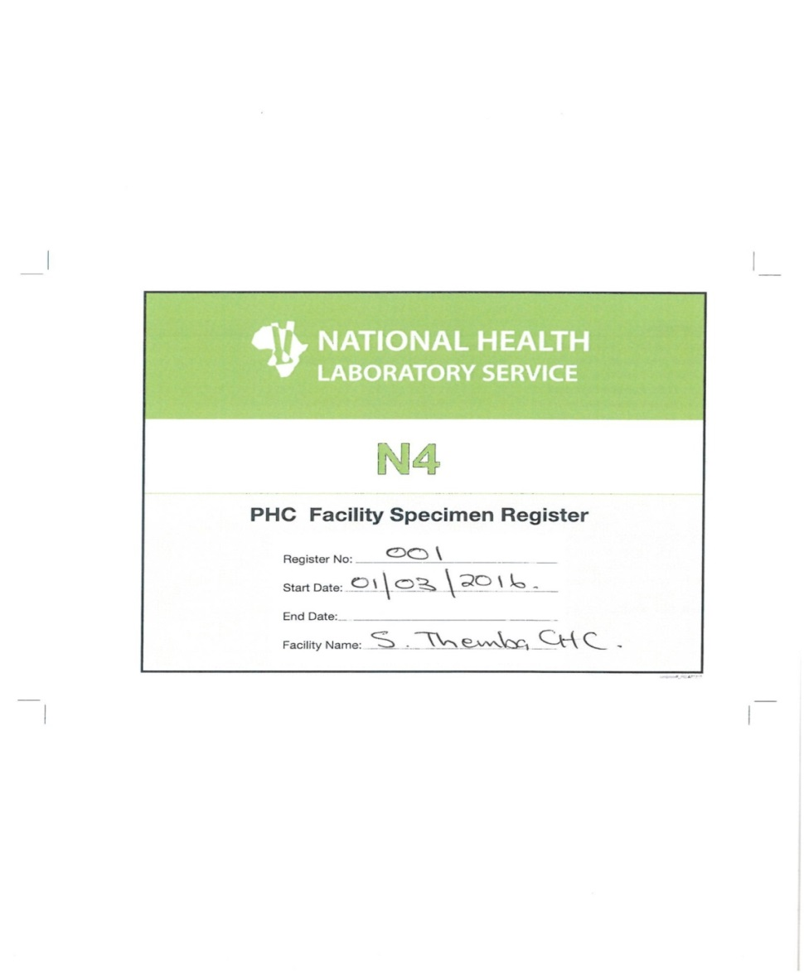
Example of completed PHC Facility Specimen Register (N4) cover
Notes:
Delegated need to be familiar with the PHC facility specimen register and ensure that the specimens are always recorded for accountability and follow-up purposes

Slide 29
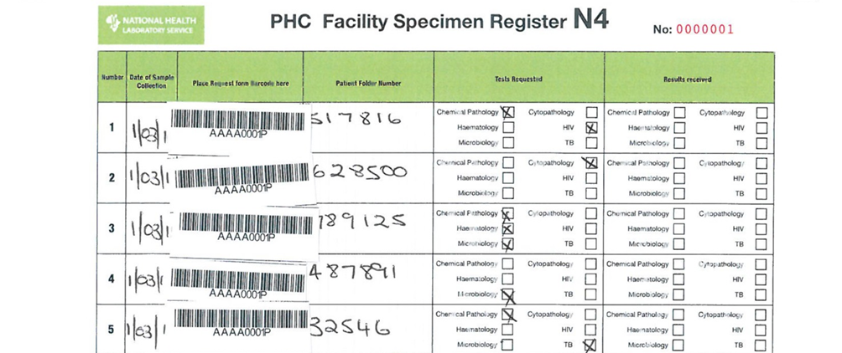
Example of a Specimen Facility Register (N4) with patient samples captured prior to courier collection

Slide 30

Section 5 specimen collection by courier
Handover samples to the courier
Courier Collection
Staff must check to ensure that the number of specimen packages from the specimen collection box, fridge or cooler box correspond with the number of entries in the N4:PHC Facility Specimen Register
Handover specimens
Draw a line in the N4:PHC Facility Specimen register after the last specimen entered.
Sign the NHLS courier log sheet to confirm specimen collection
A courier service is provided by the NHLS to collect patient specimens on a daily basis (or as agreed with the district management team (DMT))
The courier should arrive daily at the scheduled time. If not, follow the escalation procedure to alert the laboratory manager.

Slide 31
Example of completed N4 register after courier collection

Slide 32
Section 6: Manage laboratory results
File Results in the Patient Folder
Review Results
Access Results
Open envelop ensure it becomes to correct facility
Screen all report to identify abnormal results
Record date and time of review and update the N4 register to indicate which test results were delivered
Results can be accessed via:
Telephone
Printed (Routine/Primary mechanism)
SMS
NHSL WebView Portal
File results in the patient folder
Update the Laboratory Test Results form in the Patient Folder
Update the N4 Register to indicate which results have been received
  Note how this is different from the current procedure

Slide 33
Results access methods

Slide 34
Section 7: Order Specimen Collection Materials
Receive the specimen
collection materials
Hand completed N3 form to the courier
Complete N3 form
Review the Facility Specimen Register (N4) entries
Conduct a stock take of specimen collection
materials
Receive the specimen collection
materials delivered by the NHLS courier.
Update the section “Materials Received by
Facility
Ask the courier to complete the section collection by courier before handing over the form
Using the information
obtained from the stock take
and review of the Facility
Specimen Register (N4)
complete the Specimen
Collection Order Book (N3).
Review the N4 Facility Specimen
Register to assess
the quantity of request forms and
specimen collection used in the last two weeks.
Conduct a stock
take of all specimen collection materials in the health facility.
Notes:
For each new N3 register used, please provide the following information in the space provided:
• Register number: please number each register sequentially, i.e. 1, 2, etc.
• Start and end date: period during which the book was used
• Facility Name: add your facility name

Slide 35
PHC Order Book: Materials for Specimen Collection (N3)

Slide 36
PHC Order Book for Specimen Collection (N3) Cover

Slide 37
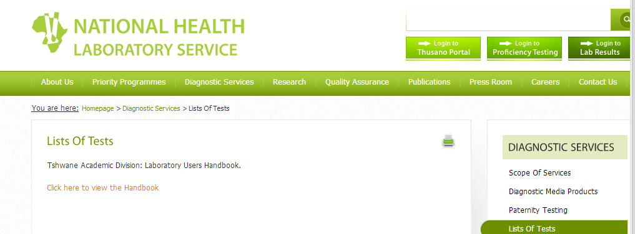
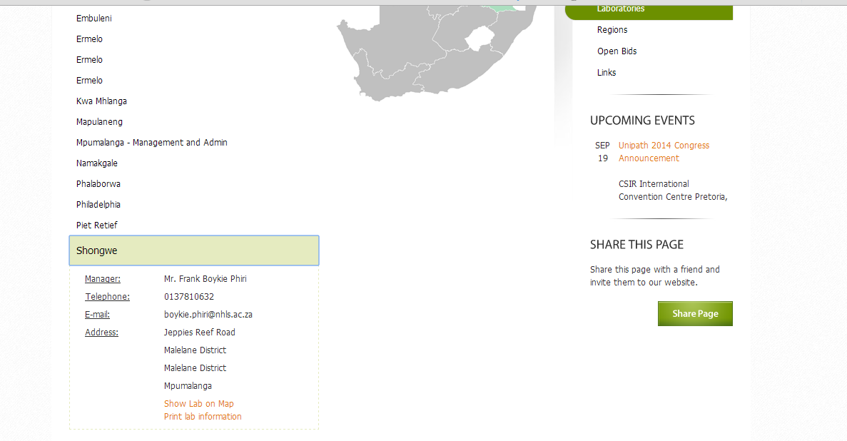
Section 8: Access to additional information
This section provides resources for additional information and contact details about laboratory services:-
Using the NHLS website to obtain details about national laboratory handbook (for all levels of care) and laboratory contact details.

Slide 38
Discussion

