Slide 1


Welcome to the Primary Health Care (PHC) Laboratory Toolkit Training of Trainers

Slide 2
Background and Rationale for the development of the Primary Health Care (PHC) Laboratory Toolkit
Session1

Slide 3
Session Objectives
By the end of the session you will be able to:
Describe the development and health care context of the PHC Laboratory Toolkit
Describe the Ideal Clinic Initiative (ICI)
Elaborate on current Clinic-Laboratory Interface (CLI) challenges
Describe the rationale behind the development of the PHC Laboratory Toolkit to address CLI challenges
Explain how the PHC Laboratory Toolkit attempts to address Ideal Clinic Goals and Clinic –Laboratory Interface challenges

Slide 4
Session Format
Context: PHC Laboratory Toolkit
Ideal Clinic Initiative
Current Clinic-Laboratory Interface Challenges
Rationale for the development of the PHC Laboratory Toolkit to address CLI challenges

Slide 5
Context: PHC Laboratory Toolkit

Slide 6
National Development Plan (NDP)
1
2
3
4
5
6
7
8
9
Quality Healthcare for all
Health System
Challenges
Ineffective
Waiting times
Inefficient
1
Ideal Clinic Initiative
10
2
Fragmented services
Social determinants of Health
3
Medical Supplies & Laboratory Service
14
Management of Laboratory Services
9
Clinic-Lab Interface (CLI) Challenges
Vertical Services
Burden of disease
4
8
5
7
6

Slide 7
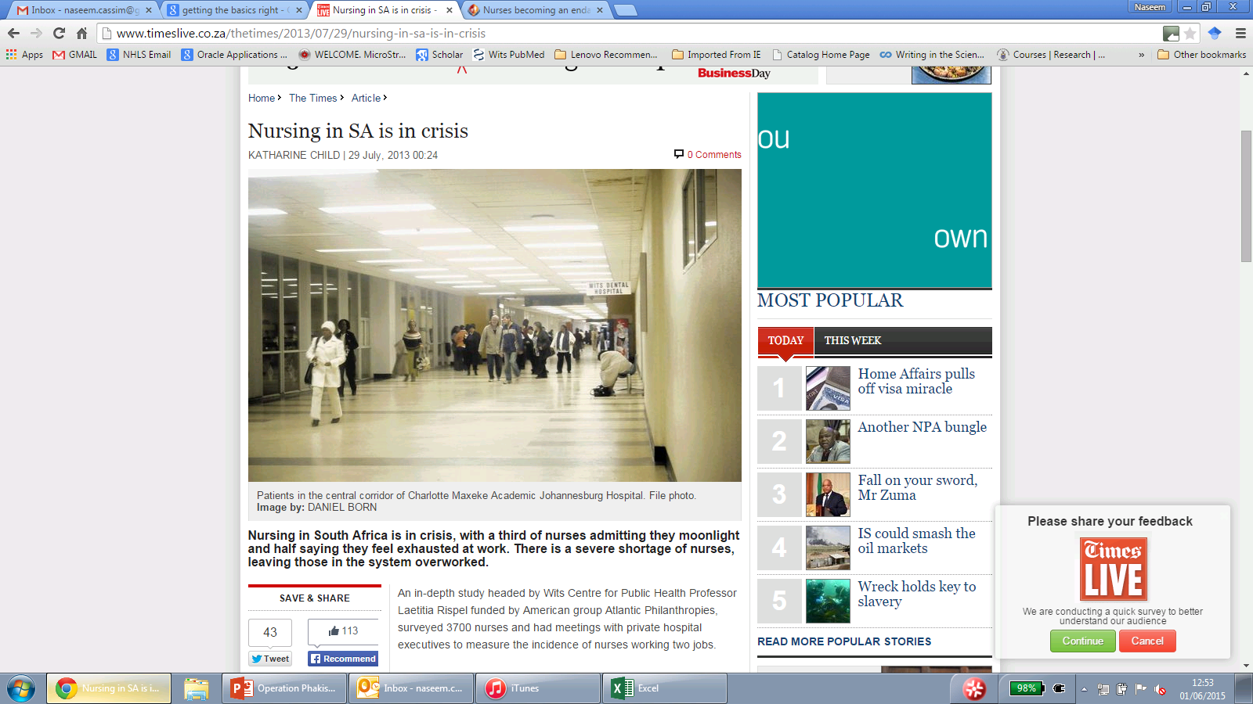
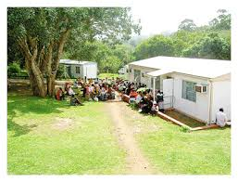
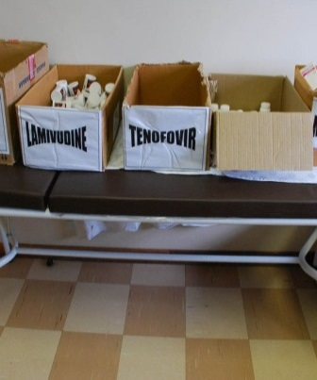
Current status of PHC services
Patients experience low-quality service delivery, with non-integrated care that is not aligned with the patient’s needs
Patient waiting time in clinics is 2-5 hours, with on average 79% of time in clinic spent waiting
80% of clinics are not “fit for purpose”, with obsolete or inadequate infrastructure
Essential (medical) supplies are often missing at clinic level, because of a broken and unresponsive supply chain

Slide 8
Ideal Clinic Initiative (ICI)

Slide 9
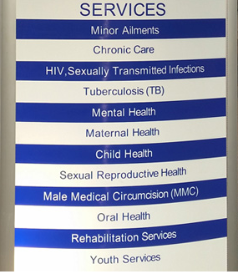
What is the Ideal Clinic Initiative (ICI)
The Ideal Clinic initiative aspires to transform PHC services by:-
  Strengthening the public healthcare system
  Ensuring consistently good quality of care is delivered
A fundamental building block of National Health Insurance (NHI)

Slide 10
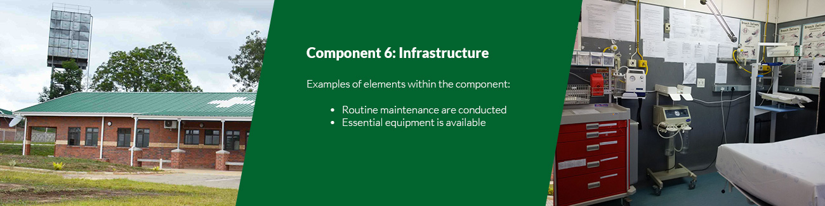
What is the Ideal Clinic Initiative (ICI)
The ‘Ideal Clinic’ (IC) initiative aims to systematically improve and correct deficiencies in Primary Health Care (PHC) facilities in the public sector.
To achieve this an Ideal Clinic requires good infrastructure, adequate staff, adequate medicine and supplies, laboratory services, good administrative processes and adequate bulk supplies.
Additionally stakeholder support is required to ensure the provision of quality health services to the community

Slide 11
Key aspects of the Ideal Clinic Initiative ICI
Range of services (PHC package of care)
Provision of good quality integrated health services to the community
A clinic with good infrastructure
Adequate staff
Adequate medicine and supplies
Good administrative processes and adequate bulk supplies
Use applicable clinical policies, protocols, guidelines as well as partner and stakeholder support

Slide 12
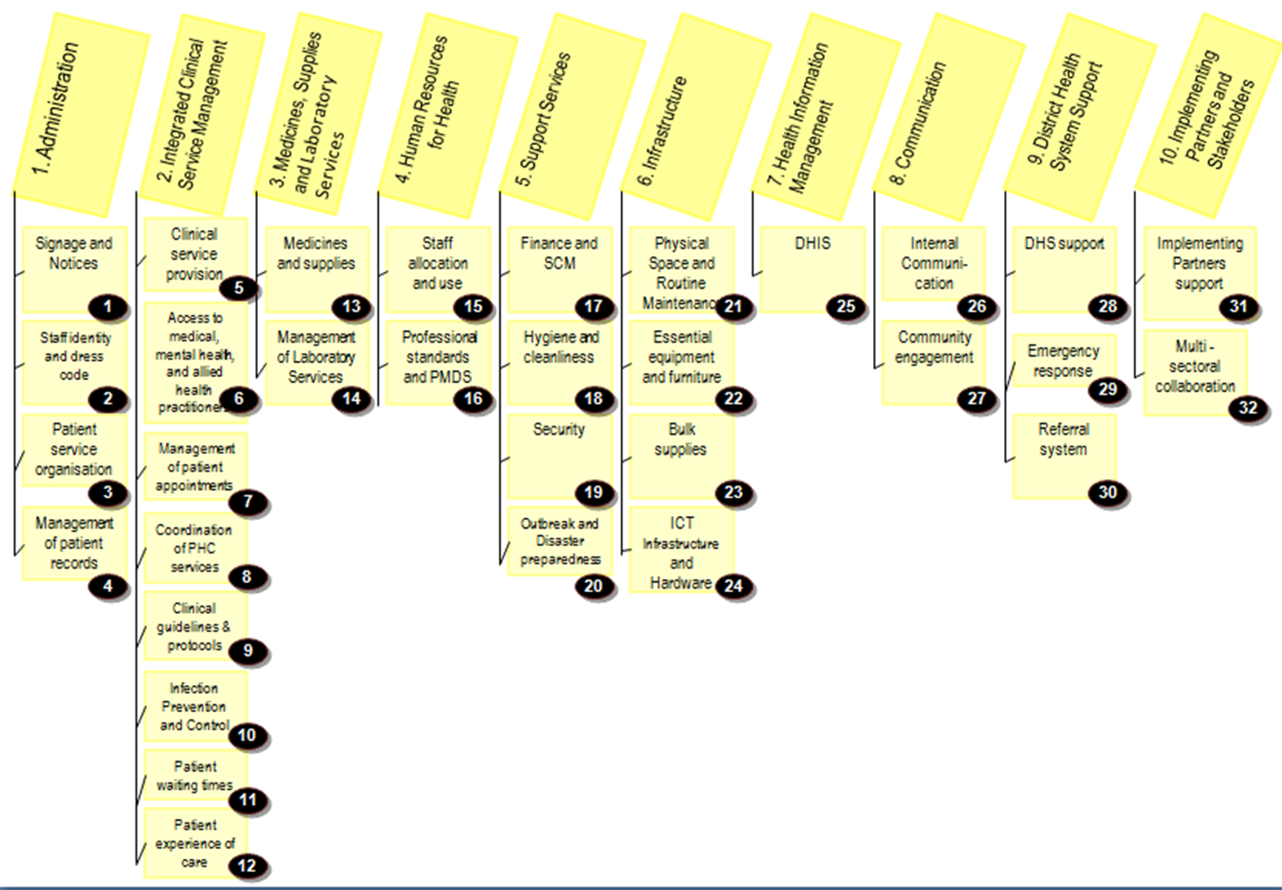
Ideal Clinic dashboard components and sub-components

Slide 13
Current Clinic-Laboratory Interface (CLI) challenges

Slide 14
What is the Clinic-Laboratory Interface (CLI)
Pre-Analytical Phase
Collect samples from Patient
Label, package, store, record & prepare samples for collection
Courier collection
Results delivery
Filed delivered results
Patient management
Order specimen collection materials
Laboratory processes
Issue specimen collection materials
Analytical Phase
Post-Analytical Phase

Slide 15
Classroom exercise
Challenges: Clinic-Laboratory Interface
1.In your group, please discuss the following question-
What are the current clinic-laboratory interface challenges at both the health facility and laboratory levels?
2. After your discussion the facilitator will provide your group with post-it.
Identify the top 3-5 challenges.
Please add these at the appropriate phase on the flipchart-
Pre-Analytical, Analytical and Post-Analytical.

Slide 16
Current Ideal Clinic Initiative (CLI) Challenges
Non-standardised clinic-laboratory processes
Multiple non-integrated requests forms in distribution
Specimen collection materials availability and management
Inconsistent courier collection
Non-structured recording of laboratory results
No guidelines on the collection, storage, packaging and transportation of laboratory specimens

Slide 17
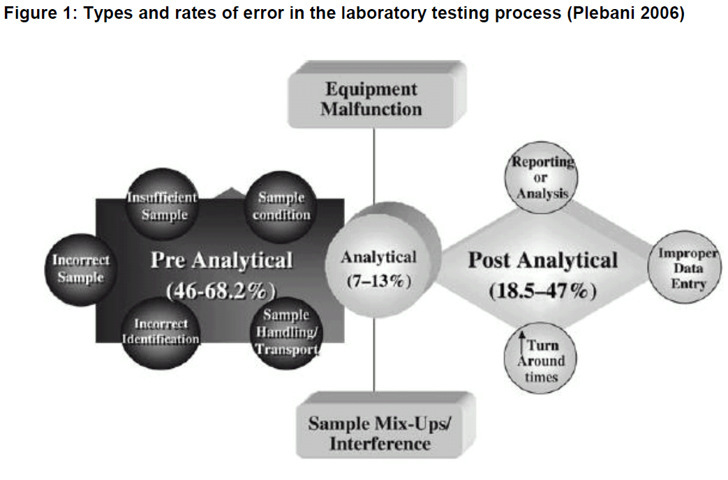
Analysis of CLI Errors
Most of the errors occur the pre and post analytical phase

Slide 18
Rationale for the development of the PHC Laboratory Toolkit to address CLI challenges

Slide 19
Rationale for the PHC Laboratory toolkit
The aim is to improve the clinic-laboratory interface (CLI) to offer an effective and efficient health care service with the broader goal of improving patient outcome
To implement standardised processes for the Clinic Laboratory Interface (CLI) in the pre and post-analytical phases.
To implement standardised practices related to:-
Integrated laboratory request forms
Process to request specimen collection materials.
Specimen recording within the health facility.

Slide 20
What is the PHC Laboratory Toolkit
The PHC Laboratory Toolkit consists of:-
  PHC Essential Laboratory List (ELL)
  PHC laboratory handbook: to provide guidance for the selection of appropriate laboratory tests, specimen collection and preservation, storage, recording and courier collection.
  N1 PHC request form: integrated request form for routine tests based on the Essential Laboratory List (ELL)
  N2 Cytology request form: request form for pap smears
  N3 Specimen Collection Materials Order Book: new standardized form for ordering specimen collection materials
  N4 Facility Specimen Register: for recording samples prior to courier collection

Slide 21
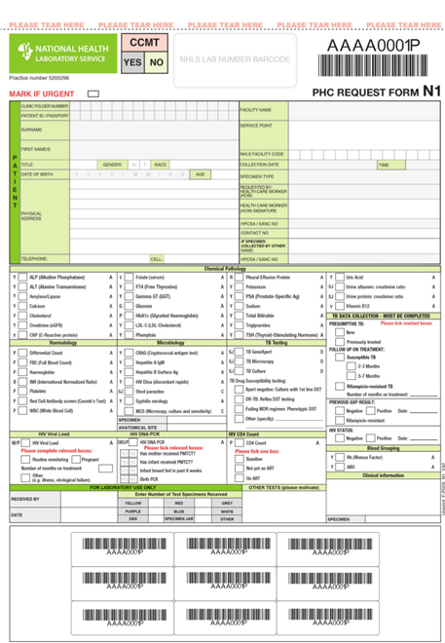
Pictures of the toolkit

Slide 22
Pictures of the toolkit

Slide 23
Pictures of the toolkit

Slide 24
Rollout-approach for the PHC Laboratory Toolkit
It is anticipated that orientation to the use of this PHC toolkit will be provided in a cascade training approach jointly by local NHLS laboratory staff and the Regional training centers ( RTCs) to health facility and laboratory staff
This toolkit has been designed to provide the facility manager with guidance to manage and monitor consistent availability of appropriate laboratory services
Provincial Training
District Training
Health Facility Training

Slide 25
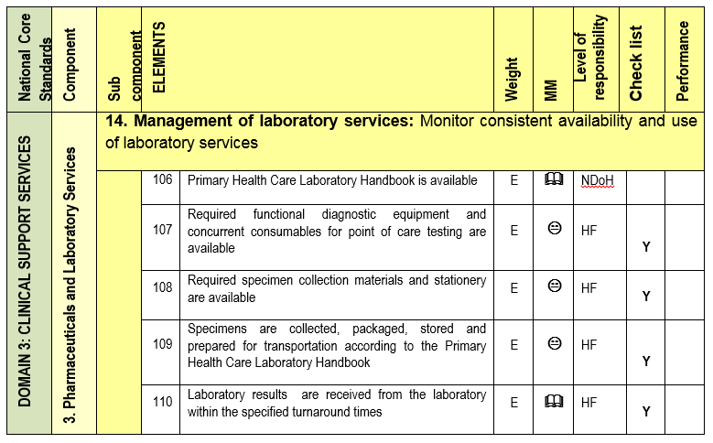
Facility level: Monitoring
Ideal clinic sub component 14

Slide 26
Facility level: Monitoring

Slide 27
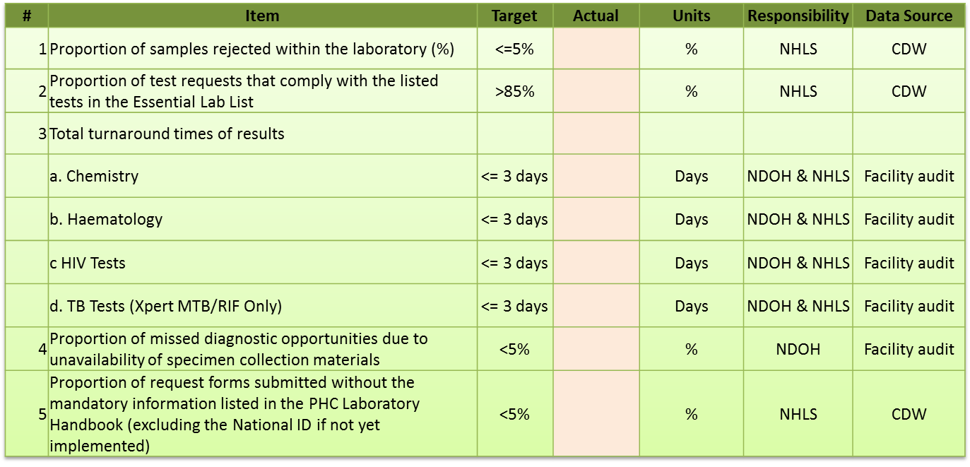
National level:
Monitoring parameters

Slide 28
Additional Reading and Resources
Health system challenges
  Current status of PHC Services
  Patient’s journey: Vertical fragmented service delivery
  Inefficient and ineffective health system results
Interventions to address health system inefficiencies and ineffectiveness
  National Development Plan (2030)
  Delivery initiatives to deliver on the NDP Goals

