Slide 1

Transforming Quality:
Synopsis of the SA Lancet National Commission Report
Professor Laetitia Rispel
SARChI Chair
NDoH Workshop on Quality
26 February 2020

Slide 2
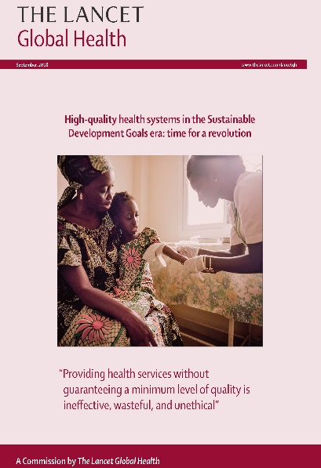
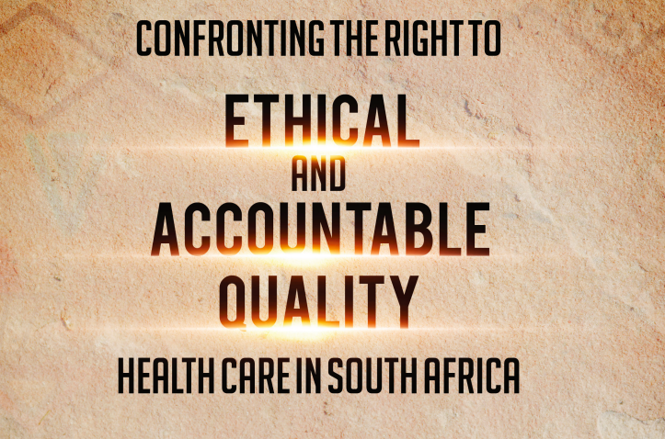
FOCUS
Sources: Kruk et al, 2018; WHO, World Bank & OECD 2018, National Academies of Sciences, Engineering and Medicine, 2018; WHO 2016; Commission on HEEG, 2016
SA Lancet National Commission, 2019.

Slide 3
Essence of 3 Global Quality Reports?

Slide 4
KEY MESSAGES
Overall health systems approach
Leadership, Management and Governance
Availability of competent HRH
Enabling Systems
Performance
Quality
UHC
Sources: Kruk et al, 2018; WHO, World Bank & OECD 2018, National Academies of Sciences, Engineering and Medicine, 2018

Slide 5
Summary of South African Lancet National Commission

Slide 6
CONCEPTUAL FRAMEWORK
VALUES
Human Rights
Equity
Social Justice
SA CONTEXT
Poverty
Social determinants of health
Quadruple burden of disease
Huge inequities
LEADERSHIP & GOVERNANCE
OUTCOMES
Universal access and coverage
Quality care
Responsiveness to patient and community needs and inputs
HEALTH SERVICE DELIVERY
Primary health care approach
Person-centredness
Community-based care
Patient participation
Safe, caring and responsive clinical care, treatment and rehabilitation
Health care provider participation
Prioritise prevention, promotion, protection
INPUTS
Financial resources
Human resources
Infrastructure
Medicines, technology, equipment and supplies
Knowledge and information
Clinical support services e.g. diagnostic/laboratory, blood products, etc.
IMPACT
Healthy populations
Equity in level and distribution of health outcomes
Social and financial risk protection
Source: Adapted from: van Olmen et al (5), page 6.

Slide 7
DEFINITION OF
HIGH QUALITY HEALTH SYSTEM
A high quality health system achieves equitable health outcomes and a long and healthy life for all
Source: SA Lancet National Commission, 2019

Slide 8
A HIGH QUALITY HEALTH SYSTEM IS
Designed to prioritise health promotion and protection, the prevention, treatment and rehabilitation of conditions that constitute South Africa’s disease burden
Accountable through effective leadership and governance
People-centred in its approach to realising good health by facilitating patient, provider and community participation in health attainment
Responsive to patient needs by providing comprehensive care in a timely, respectful and safe manner resulting in quality outcomes
Adaptive to changing health needs through the collection, analysis and dissemination of information, to support decision-making and implementation
Committed to equitable allocation and distribution of resources
Effective in ensuring quality health service delivery to all regardless of gender, sexual orientation, socio-economic status and/or geographic location
Collaborative in its interaction with partners and other sectors to address the social determinants of health for quality health outcomes
Source: SA Lancet National Commission, 2019

Slide 9

Key Diagnostic Findings

Slide 10

ENABLING
ENVIRONMENT

Slide 11
Gaps in ethical leadership, management and governance contribute to poor quality of care
FINDING1
Mismanagement, inefficiencies and incompetence
Corruption and fraud major threats to equitable access to quality health care
Failures of governance in the private health sector, including a lack of transparency and lack of accountability
Governance weaknesses in the Health Professions Council of South Africa and the South African Nursing Council
Numerous barriers to effective community participation

Slide 12
FINDING2
Poor quality of care costs lives
~60% of all institutional maternal deaths potentially preventable
Rural areas worst affected compared to urban areas
~Quarter of neonatal deaths potentially preventable
Deficiencies in the quality of care provided to individuals with hypertension and diabetes.
Mental illness contributes to premature mortality, high morbidity and loss of economic productivity- but lack of prioritisation of mental health, and under-investment in service delivery
Estimated 75% of people with a mental disorder do not receive mental health services

Slide 13
FINDING3
Malpractice cases and medical litigation are threats to the realisation of the right to health care in South Africa
Public Sector
2016-17 financial year- litigation and claims in the public health sector amounted to R1.2 billion (Auditor-General)
In 2016, South African Law Reform Commission estimated total contingent liabilities for medical malpractice ~R40 billion
Private health sector
Long-term average claim frequency for doctors was 27% higher in 2015 compared to 2009
Medico-legal cases handled secretly, and kept out of the public domain

Slide 14
Human resources for health (HRH) crisis will undermine the achievement of high quality universal health coverage
FINDING4
Staff shortages
Inequities and mal-distribution between urban and rural areas and between the public and private health sectors
Unprofessional behaviour,
Poor staff motivation and performance
Public sector-lack of knowledge and skills of doctors and nurses were contributory factors in the potentially preventable maternal deaths
Private sector-nurses’ failure to follow guidelines, unresponsiveness to patients, and lack of knowledge contributed to medico-legal claims

Slide 15
FINDING5
Gaps in health information system to measure or monitor quality and its improvements
Enabling legislative and policy environment for the development of a health information system to measure quality
Numerous health measurement platforms exist
Information primarily on health system inputs, processes, service delivery
Insufficient focus on outcomes and impact
Data quality remains a significant barrier
Health information systems are partially electronic and not interoperable

Slide 16
Fragmentation and limited impact of quality of care initiatives
FINDING6
Numerous and encouraging quality improvement initiatives
Impact is limited because of fragmentation across health conditions, levels of care and between the public and private health sectors

Slide 17
Recommendations

Slide 18
RATIONALE
Recognition of progress since 1994
Improvement in overall health outcomes
Enabling legislative framework for quality
  Constitution with its emphasis on human rights and social justice
  National Health Act
  Office of Health Standards Compliance as juristic institution
What set of recommendations?
  Encourage an overall health systems approach?
  Focus on entire health system?
  Practical and build on existing initiatives?
  Recognise stewardship role of National Government?

Slide 19
Enhance governance
and leadership
for quality and equity
Revolutionise
quality of care
Measure, monitor
and evaluate to
ensure a
high quality health system
Four Overarching Recommendations
Invest in, and transform
human resources for health
in support of
a high quality health system

Slide 20


TRANSFORMING QUALITY
Competence, Compassion, Caring, Code of Ethics, Life-long Learning, Accountability
Values & Ethics
Core Competencies
Role Models
Mentoring
Social Accountability
Health care providers
The Academy
Managers
Policy-makers
Health worker education or training institutions
Research the Gaps
Generate Evidence on relationships
Behaviour
Change
Implement!
Leadership, Management and Governance- ‘Public Good’ & Accountability
Creation of Enabling Environments
Feedback and use information/ evidence to inform decision-making

Slide 21
CONCLUSION
High quality UHC is moral and ethical imperative
Planned National Health Insurance (NHI) system major opportunity for transformation
Implementation of recommendations will require:
  Leadership
  Investment
  Accountability

Slide 22
REFERENCES
Kruk, M. E., Gage, A. D., Arsenault, C., Jordan, K., Leslie, H. H., Roder-dewan, S., … Pate, M (2018). The Lancet Global Health Commission on high-quality health systems in the Sustainable Development Goals era : time for a revolution, 6 1196–1252. https://doi.org/10.1016/S2214-109X(18)30386-3
National Academies of Sciences, Engineering, and Medicine. Crossing the global quality chasm: Improving health care worldwide. Washington, DC: The National Academies Press, 2018. https://doi.org/10.17226/25152
South African Lancet National Commission. Confronting the Right to Ethical and Accountable Quality Healthcare in South Africa: Lancet National Commission Consensus Report. Pretoria, DOH, 2019.
WHO, OECD, & World Bank. Delivering quality health services: a global imperative for universal health coverage, 2018. Retrieved from ttp://documents.worldbank.org/curated/en/482771530290792652/pdf/127816-REVISED-quality-joint-publication-July2018-Complete-vignettes-ebook-L.pdf

