Slide 1
Quality & National Health Insurance: A Clearer Perspective
Dr Nicolas Crisp
26 February 2020

Slide 2
What is National Health Insurance (NHI)?
NHI (National Health Insurance) is a health financing system that is designed to pool funds to provide access to quality affordable personal health services for all South Africans, based on their health needs, irrespective of their socio-economic status
NHI aims to achieve Universal Health Coverage (UHC) for all South Africans
  Cover more people
  Cover greater range of services
  Less cost to user at point of care (and improve quality of care)

Slide 3
Why do we need NHI?
Health care is a human right that every one of us is entitled to
  This is also a widely accepted international principle
  This right should not depend on one’s financial status
Presently totally inadequate two-tier health system with poor outcomes in comparison to inputs
  Fragmented, poor, inefficient, understaffed and ill-equipped public sector serving about 85% of the population
  Fragmented, over-serviced, over-specialised, expensive, private sector serving about 15% of the population
It is not possible to address one part of the dichotomy without addressing the other, they are mutually dependent
The whole system needs a ‘face-lift’
Recognise both systemic change required and local change required

Slide 4
How will NHI work?
NHI will pool public resources into one NHI Fund
NHI Fund will purchase services (benefits) on behalf of the whole nation from both the public and private health sectors
The NHI Fund contracts directly with service providers
The public (Users) must register with clinics and doctor/family practitioners to obtain services

Slide 5
What will NHI look like? (Big picture)
Big picture
Purchaser of health care
NHI Fund Office
Public Entity
Administrative purchasing units
Providers of health care
Public
Private
PHC/Hospitals
Accreditation
(Private Medical Aids)

Slide 6
When will NHI be implemented?
As soon as the Bill passes through the National Assembly and National Council of Provinces
It will be implemented in phases and fully implemented in 2025/6 Financial Year
An implementation plan is being finalised in preparation for the passage of the NHI Bill
Many years of concentrated and consistent work
Broken up into manageable phases and parts each of shorter duration

Slide 7
Objects of the NHI Bill
Achieve universal access to quality health care services (S27 of the Constitution)
Establish the NHI Fund and to set out its powers, functions and governance structures
Provide a framework for the NHI Fund strategic purchasing of health care services
Create mechanism for the equitable, effective and efficient utilisation of the resources to meet needs of the population
Prevent or limit unethical and unlawful practices in relation to the Fund and its users

Slide 8
Aim of the Bill
Achieve the progressive realisation of the right of access to quality personal health care services (Universal Health Coverage)
Pool financial resources and ensure risk protection
Provide quality of health care services, universality and social solidarity
Single purchaser of health services and end fragmentation
Create a single national health system
Ensure portability of health care services to enhance access

Slide 9
The NHI Fund
Must purchase health care services, determined by the Benefits Advisory Committee
Chief source of income is money appropriated annually by Parliament in order to achieve the purpose of the Act from money collected and in accordance with social solidarity in respect of—
  general tax revenue, including the shifting funds from the provincial equitable share and conditional grants into the Fund;
  reallocation of funding for medical scheme tax credits paid to various medical schemes towards the funding of the National Health Insurance;
  payroll tax (employer and employee); and
  surcharge on personal income tax introduced through a money Bill by the Minister of Finance and earmarked for use by the Fund, subject to section 57

Slide 10
Beneficiary users of NHI
South African citizens (includes all children regardless of origin) permanent residents, refugees, inmates, designated foreign national
An asylum seeker or illegal migrant, and foreigners with no travel insurance are only entitled to
  emergency medical services
  notifiable conditions services
  Foreigners who hold travel insurance are covered by own policy

Slide 11
Registration of Health Service Users
Everyone must register as a user with the Fund at an accredited health care service provider or health establishment
  parent must register his or her child as a user
  child born to a user is registered automatically at birth
  Persons aged 12 and 18 years may apply for registration if not registered as a dependent
  A supervising adult must register a child in the child-headed household concerned
  If no supervising adult, any employee of an accredited health care service provider or health establishment must assist the child to be so registered
Biometrics as prescribed, including fingerprints, photographs, proof of habitual place of residence
Possible new prescripts for foreigners by the Minister, in consultation with the Minister of Home Affairs

Slide 12
Complementary Cover
Third party payment for personal health care service benefits not reimbursed by the Fund, including any top up cover offered by medical schemes registered in terms of the Medical Schemes Act (as amended) or any other voluntary private health insurance fund

Slide 13
Health care services coverage
The Fund will contract accredited providers and health establishments at PHC and at hospital level, based on the health needs of users and in accordance with referral pathways
A user must receive services at a provider or health establishment at which he/she is registered
  must first access health care services at a PHC level as the entry into the health system
Services will be portable where not possible to use services at a facility where he/she is registered
Where not possible to provide services, the provider must transfer the user to another appropriate provider or competent on such terms as may be prescribed
  must adhere to the prescribed referral pathway; and
  is not entitled to health care services purchased by the Fund if he or she fails to adhere to the prescribed referral pathways

Slide 14
NHI Fund as purchaser
Fund will purchase health services for all based on need:
  Fund must transfer funds directly to accredited and contracted central, provincial, regional, specialised and district hospitals (including private hospitals) based on a global budget or Diagnosis Related Groups
  Funds for PHC must be transferred to Contracting Units for Primary Health Care at the sub-district level (capitation)
  Emergency medical services provided by accredited and contracted public and private health care service providers must be reimbursed on a capped case-based fee basis with adjustments made for case severity, where necessary
  Public ambulances services will be reimbursed through the provincial equitable allocation

Slide 15
Accreditation of service providers
Health care service providers and health establishments will be accredited to deliver health care services (benefits) at the appropriate level of care
Proof of certification by the Office of Health Standards Compliance (OHSC) and of registration by a health professional Council
NHI Fund must ensure that providers meet the needs of users and must ensure service provider compliance with prescribed specific performance criteria

Slide 16
Payment of health care service providers
The Fund
  must determine the nature of provider payment mechanisms and adopt additional mechanisms
  must ensure that health care service providers are properly accredited before they are reimbursed
  in the case of specialist and hospital services, payments must be all-inclusive and based on the performance
  emergency medical services must be reimbursed on a capped case-based fee basis with adjustments made for case severity, where necessary

Slide 17
NHI Fund Functions
SEVEN main functions, each in a component, some also supporting committees that will report to the Minister:
  Governance and Administration, including
    CEO Office (Incl Board & Committees)
    Corporate Services
    Finances (CFO)
  NHI Fund
  Health Care Benefits & Provider Payment Design
  Health Product Procurement
  Digital Information
  Risk & Fraud Management
  User & Service Provider Management

Slide 18
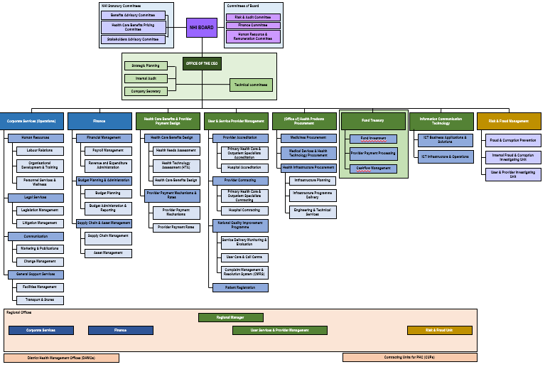
NHI Fund organisation
BOARD – Accounting Authority
CEO – Accounting Officer
FUND
Administration of core agency functions
Corporate services
Decentralised administration functions

Slide 19
Role of health departments
National Department of Health – policy, standards, coordination
Provincial Departments of Health – stewardship over public and private providers
Municipalities – non-personal health services and intersectoral interactions

Slide 20
District Health Management Offices & Contracting Units of Primary Health Care (CUP)
DHMO must manage, facilitate, support and coordinate the provision of PHC services for personal health care services and non-personal health services at district level in compliance with national policy guidelines and relevant law
CUP manages PHC services, such as prevention, promotion, curative, rehabilitative ambulatory, home-based care and community care in a demarcated geographical area (needs in terms of the demographic and epidemiological profile)
  is a preferred unit with which the Fund contracts for the provision of PHC services within a defined area
  is comprised of a district hospital, clinics or community health centres and ward-based (accredited public and private health care service providers at primary care facilities)
  manage contracts entered with accredited health care service providers, health establishments and suppliers in a prescribed manner
  monitor the disbursement of funds to health care service providers, health establishments and suppliers

Slide 21
What will NHI cost?
Need not be any more than what the people in the country spend today!
8,2% to 8,8% of GDP (depending on source)
  Public around 4,0%
    About R3 155 per person per year
    About R219bn pa increasing by about R4bn pa
  Private around 4,55%
    About R235bn pa
The aim must be to spend every Rand more efficiently and appropriately to the need of the patients
Transitional costs

Slide 22
Contentious Issues
Role of medical schemes
Role of provinces
Capabilities of the State to manage NHI Fund
Centralised procurement

Slide 23
Private Sector preparation for NHI (HMI Report)
MANY negative comments in the executive summary documenting:
  Inefficiencies
  Over servicing
  Anti-competitive behaviour
  Poor or undocumented health care outcomes
  Transfer of costs
  Poor accountability
NDOH/PDOHs need to work with private players, regulators and professional councils to address most pressing issues
  Hospitals
  Medical Scheme Administrators
  Medical Schemes
  PHC providers
Overlaps with Public System challenges – Social Compact actions

Slide 24
Public Sector preparation for NHI
Actions from the Social Compact
Pillar 1: Human Resource Operational Plan
Pillar 2: Supply Chain of Medicines, Medical Products and Equipment
Pillar 3: Health Infrastructure
Pillar 4: Private Sector Engagement
Pillar 5: Improve the quality and quantity of health services provided including improved access to primary health care
Pillar 6: Public Sector Financial Management
Pillar 7: Governance and Leadership
Pillar 8: Community Engagement
Pillar 9: Robust Health Information Systems

Slide 25

THANK YOU

