Slide 1

National Quality Improvement Plan

Slide 2

OUTLINE OF THE PRESENTATION
National Quality Improvement Plan - Quality Learning Centres Implementation
Introduction and objectives of the plan
Quality Learning Centres
The approach to the work
The standards
Implementation

Slide 3

PRESIDENTIAL HEALTH COMPACT 2019
116
User Group Constituencies
78 Health Professional Organisations
18 Committees of Health Sciences Deans
16 Government Departments
14
Civil Society Organisations
11 Allied Health Professional Organisations
11
Traditional Healer Organizations
6
Statutory Councils
5
Science councils
4
Academic and Research Organisations
4
Public Health Entities
4
Labour Organisations
1Organised Business Association

Slide 4
Support to improve the health system: Presidential Health Compact
Augment Human Resources for Health (HRH);
Ensure improved access to essential medicines, vaccines and medical products through better management of supply chain, equipment and machinery;
Execute the infrastructure plan to ensure adequate, appropriately distributed and well maintained health facilities;
Engage the private sector in improving the access, coverage and quality of health services;
Improve the quality, safety and quantity of health services provided with focus on primary health care;
Improve the efficiency of public sector financial management systems and processes;
Strengthen the governance and leadership to improve oversight, accountability and health system performance at all levels;
Engage and empower the community to ensure adequate and appropriate community-based care; and
Develop an information system that will guide the health system policies, strategies and investments.

Slide 5
Introduction
We need to move from a mindset of compliance for the sake of compliance to a new mindset of continuous improvement to improve joy in work and patient outcomes
We need to strengthen the systems, processes and environments that help to sustain improvement and the quality of services
Lay out the roadmap to improve the quality of the health system in an incremental fashion, recognising that some establishments will need more time and investment.

Slide 6
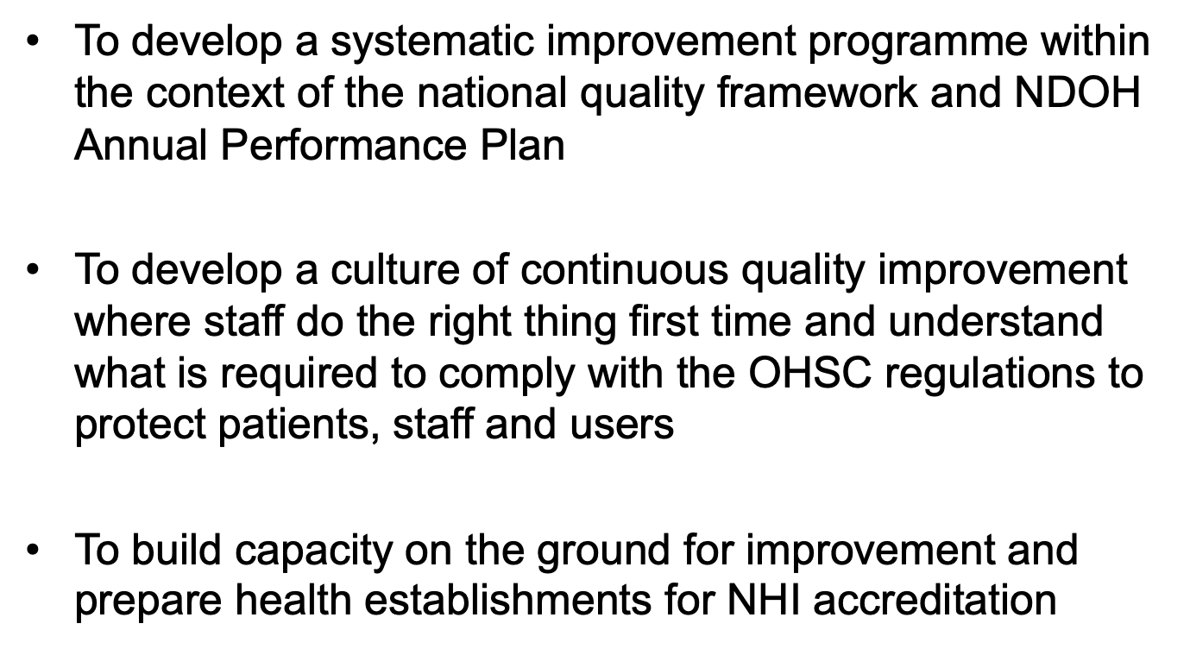
Objectives of the plan

Slide 7
Accreditation Steps for NHI
Step 1: Meet regulation requirements
Step 2: Meet Licensing requirements
Step 3: Meet certification requirements
Step 4: Meet NHI requirements

Slide 8
Step 1:Meet regulation requirements
Adhering to broad statutory framework that governs all rules, laws and regulations affecting health care service delivery and which are enforced by law

Slide 9
Step 2 : Meet Licensing requirements
Private health care facilities by the Provincial DoH in terms of regulations (e.g. R158 and R187);
Licensing/registration of non-health establishments by DSD such as old age homes, frail care centres, and community psychiatric facilities;
Licensing by NDoH of individual practices such Radiology;
Licensing/registration of professionals by Professional Councils (in order to practice)

Slide 10
Step 3: Meet certification requirements
The OHSC ensures compliance with norms and standards and manages complaints. A key aspect of NHI will be the requirement that the contracted facilities attain the minimum requirements of the national norms and standards for health service providers as determined in the national framework agreement drawn up by the OHSC.

Slide 11
Step 4 : Meet NHI requirements
The purposes of accrediting health service providers are to:
Improve the quality of health care by establishing optimal achievement goals in meeting standards for health care organisations;
Stimulate and improve the integration and management of health services;
Establish a database of health care organisations;
Reduce health costs by focusing on increased efficiency and effectiveness of services;
Provide education and consultation to health care organisations, managers, and health professionals on quality improvement strategies and best practice in health care;
Strengthen the public’s confidence in the quality of health care;
Reduce risks associated with injury and infections for patients and staffs; and
Ensure that only providers willing to provide a range of services under NHIF requirements with respect to payment rates, health information, location and compliance with clinical protocols and guidelines are accredited.

Slide 12
Step 4 : Continued
Since South Africa is to be compared with other countries, the principles developed by the International Society for Quality in Health Care (ISQua), in collaboration with over 40 countries are used to guide the content and structure of the standards.
The underlying philosophy of the standards is based on principles of quality management and continuous quality improvement and aims to accommodate legal and ethical aspects of service delivery. Standards are grouped to provide specific indicators of performance, which can be used as points of reference in evaluating actual performance compared to targeted objectives.

Slide 13
Step 4 : The potential benefits of participation in accreditation programmes
Assistance in improving organisational quality;
Increased reputation among end-users;
The right to participate in reimbursement programmes;
An approved supplier status for some clients;
Higher reimbursement from payers; and
Information about competitor’s relative quality

Slide 14
Accreditation Standards:

Slide 15



The Trajectory Towards Excellence
4. Health establishments meet
NHI Accreditation requirements
3. Health establishments embed a culture of continuous quality
improvement to improve patient care
2. Health establishments meet requirements of Ideal Clinic and Ideal Hospital
1. Health establishments meet the requirements set out in a legal OHSC Regulations. Minimum requirement for health care organisation to operate

Slide 16
Quality Learning Centres
A Quality Learning Centre is a cluster of facilities in a geographic area made up of hospitals, clinics and family practitioner practices that will be the focus for learning and disseminating knowledge and skills. The proposal is to have four centres in each province.
Provinces are key to enabling the programme and ensuring that the necessary personnel, equipment and supplies are available. (Recognising the current challenges)
There will be different models depending on the location – urban vs rural
Regional Hospital
District Hospital
Clinic
Clinic
Family Practitioner
Family Practitioner
District Hospital
Clinic

Slide 17
Selection for criteria for facilities in Quality Learning Centres
Identify better performing hospitals that can be ready in the shortest time:
Facilities with committed and engaged leadership
Close to compliance with OHSC regulatory standards, Ideal Clinic, Ideal Hospital
Some experience in implementing hospital wide and / or multiple quality improvement programmes
It will be essential to work closely with the Provincial Departments of Health to identify the best sites

Slide 18
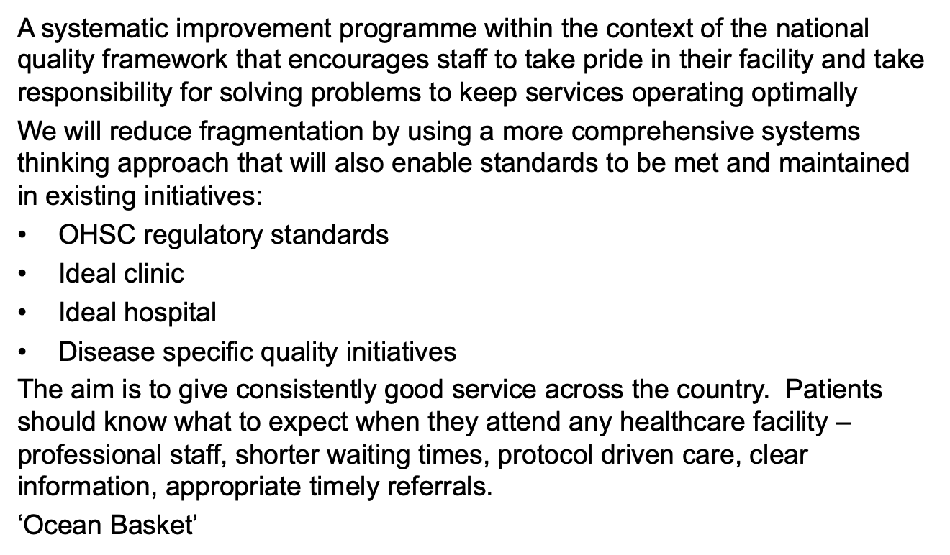
Approach

Slide 19
Approach
The Norms and Standards Regulations applicable to different categories of health establishments are an excellent quality assurance mechanism to promote and protect the health and safety of users and health care personnel
NHI accreditation is seeking to ensure the highest possible standard care for all
Internationally accredited system-based standards, together with a comprehensive continuous quality improvement approach will help to deliver this

Slide 20
Examples of the system-based accreditation standards
5.3. Occupational Health and Safety
5.3.1. An occupational health and safety system is implemented.
Standard Intent
In countries where occupational health and safety legislation has been promulgated, healthcare facilities must ensure the safety of patients, personnel and visitors in accordance with such legislation and/or internationally accepted occupational health practices.
Criteria
5.3.1.1. A Health and Safety Committee is constituted in terms of country-specific legislation.
5.3.1.2. Occupational health services are provided in accordance with country-specific legislation and/or documented processes.
Documented processes should address the following:
• Protective clothing and equipment for personnel
• Vaccination of personnel against identified high-risk infections
• Needlestick injuries
• Manual handling injuries (patient care personnel and support personnel, for example, personnel in storage areas)

Slide 21
Example of system-based accreditation standards
9.5 Transfer, external referral, and discharge processes
9.5.1 Patients who require specialised consultation, investigations and/or treatment at other healthcare organisations are referred or transferred.
Criteria
9.5.1.1. Patients are transferred to another healthcare facility to receive ongoing treatment in accordance with documented processes.
9.5.1.2. Patients are referred to another organisation in accordance with documented processes.
9.5.1.3. When a patient is transferred, a written transfer summary of the patient’s clinical condition and the interventions performed by the transferring facility are provided to the receiving healthcare facility in accordance with documented processes.
9.5.1.4. A copy of the referral notes or transfer summary is available in the patient’s record.

Slide 22
Difference between regulatory and system-based standards
The Norms and Standards Regulations for infection prevention and control programmes
(1) The health establishment must maintain an environment which minimises the risk of disease outbreaks, the transmission of infection to users, healthcare personnel and visitors.
(2) For the purpose of sub-regulation (1) a health establishment must-
(a) ensure there are handwashing facilities in every service area
(b) provide isolation units or cubicles where users with contagious infections can be accommodated etc
Accredited Healthcare Facility Standards
Documented processes to reduce the risk of healthcare-associated infections to patients and healthcare workers are developed and implemented in line with the facility's risk management system and country-specific legislation and/or accepted practice guidelines.
Systematic, proactive surveillance activities are conducted to reduce healthcare-associated infections and to determine endemic rates of infection.
The implementation of correct handwashing procedures is monitored.

Slide 23
Benefits of the approach
Lay out the roadmap to improve the quality of the health system in an incremental fashion, recognising that some establishments will need more time and investment
Enable an accreditation process to be tested as an integral part of the quality improvement in preparation for the implementation of the NHI
It could enable facilities to be ready for testing contracting for the provision of services under NHI

Slide 24
THANK YOU

