Slide 1
1
Ideal Hospital Realisation and Maintenance
National Quality & ICRM 5-year Review Presentation
C M Ngoepe: DHS
24-25 February 2020

Slide 2
Presentation outline
Purpose of the presentation
Background
Link to OHSC
Milestones
  Development of IHRM-F
  APP
  NIDS
  Baseline Assessment
  Review of the IHRM-F
  Adaptation of the software system
Way forward

Slide 3
The purpose of the presentation is to provide a brief update in the implementation Ideal Hospital Realisation and Maintenance (IHRM-F) Programme
Purpose of the presentation

Slide 4
1. National Health Facilities baseline audit 2012
2. Learned lessons from the success of the Ideal clinic gave impetus to the IHF process (using the same methodology)
3. Former Minister appointed the intervention teams to the hospitals in the provinces. The results were used to accelerate the development of the IHF
4. A team was set up to consult the provinces on the IHF
5. Ministerial Priorities
Background

Slide 5
Link to OHSC
OHSC has 586 measures
IHF elements and checklist match to 562 measures
24 OHSC measures relating to case management, billing, outsourcing of labour and other specific services are not applicable at the current stage
Joint provincial consultations covering both the private and public sectors
Joint finalization of the District Hospitals measures and tools

Slide 6
Milestones

Slide 7
Milestones…
‘Building the bridge as we go along’…
APP
NIDS
Baseline Assessment
Modification of the framework and Software
Draft IHRM manual
and Framework
Guideline for web based software
Workshops
1. Briefing
2.Implemenation
3. Troubleshoot on software
Baseline Assessment
1. District hospitals
2. Other levels of hospitals
IHRM Monitoring system developed
6
5
4
3
2
1

Slide 8
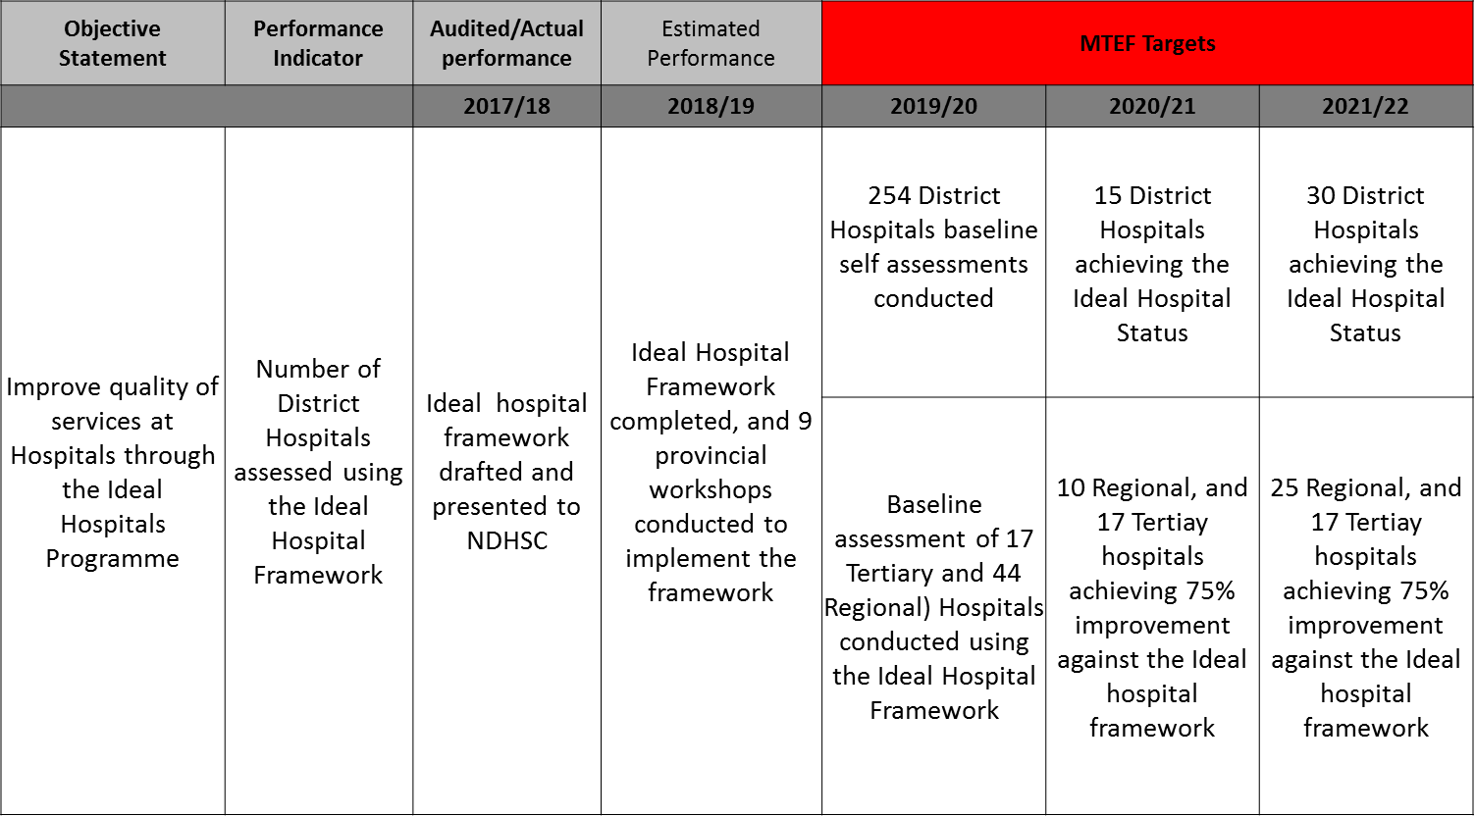

1. IHRM-F captured in the APP
Milestones…
Milestones

Slide 9
1. IHRM-F captured in the NIDS
Emergency headcount – total
•Casualty headcount - Emergency
•Casualty headcount - non-Emergency
•Sexual assault case seen – new
•Ideal hospital status determinations conducted by PPTIHRM (District/Reg/Tertiary/Central & Specialised hospitals)
•Hospitals that obtained Ideal hospital status
•Hospital public
•OPD headcount not referred new
•OPD headcount referred new
•OPD headcount follow-up
•Expenditure – total
Milestones… NIDS

Slide 10
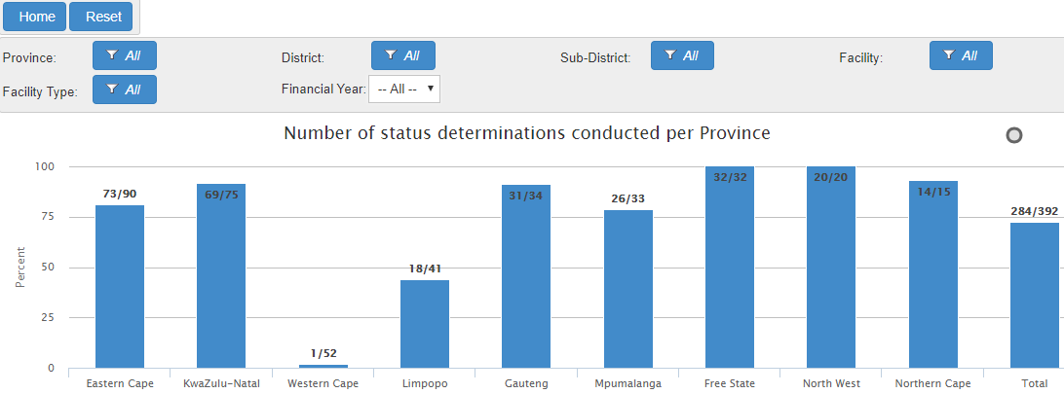
Overall Baseline Assessment
Overall
Milestones -Baseline Assessment

Slide 11
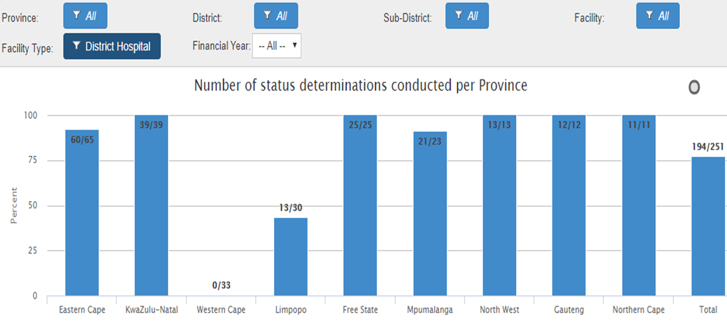

Milestones -Baseline Assessment…
District Hospitals

Slide 12
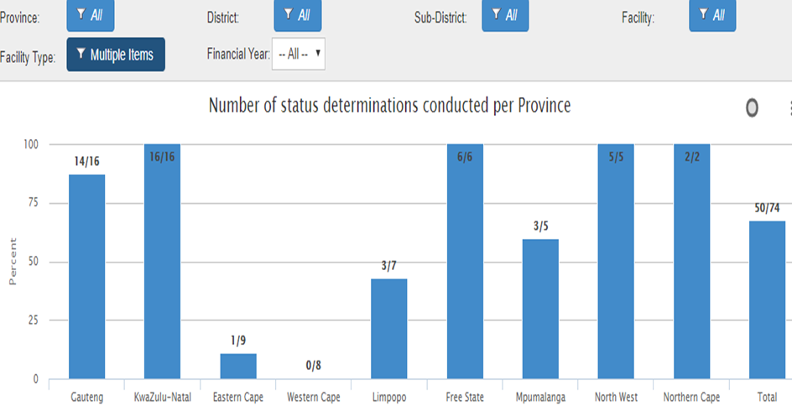
Milestones -Baseline Assessment…
Regional, Tertiary & Central Hospitals

Slide 13
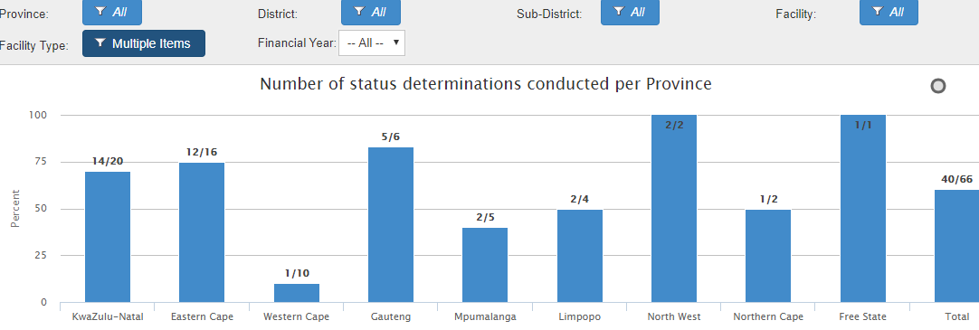
Specialized hospital services
Milestones -Baseline Assessment…

Slide 14
IHRM-F Review ( Content )
1. Inputs from workshops collected and collated
2. Formal Letters and OHSC (Call for final inputs)
IHRM-F Review ( Software)
1. Functional areas adjusted according to the level of Hospitals
2. Allow hospital to select areas available in their facilities
3. Reports ( progress per area, aggregate reports/ select areas
4. Add a filter for a period
5. User accounts ( form to be implemented from 1st of April 2020)
Review of the Framework and the software

Slide 15
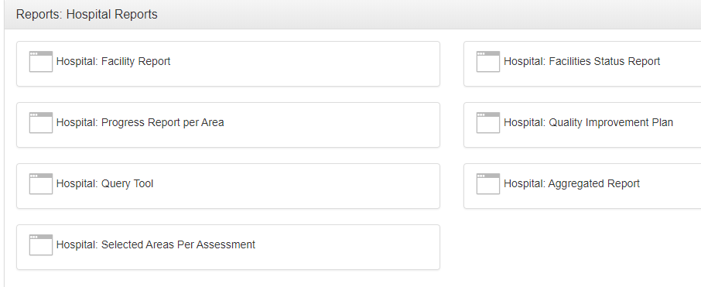


Additional Hospital reports

Slide 16
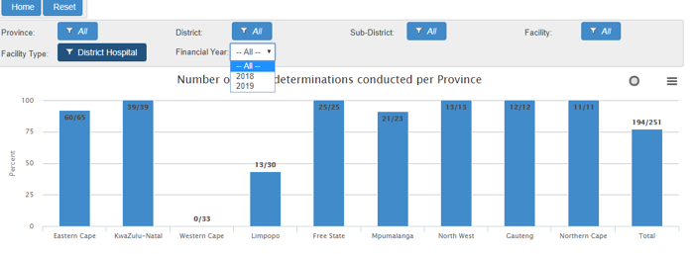
Filter for a period of Capturing added
NB. To determine when the assessment was done -System will record the date of the assessment when the last functional area is submitted by the CEO

Slide 17

2013: Where does ICRM come from?

Slide 18
Way Forward
Receive and consolidate the inputs from the provinces
Liaise with OHSC in finalization of the Measures/ and tools for District Hospital
Facilitate the process of final approval of IHRM-F
4. Institutionalizing
  Establishment of IHRM-F/ICRM Teams
  Annual CQI Cycle (Plan, Do, Study & Act)
  Annual update of Profiles (Inputs on Hospitals profile)

Slide 19
Thank you

