Slide 1
Ideal Clinic Realisation and Maintenance Programme and Quality Workshop
Revised Ideal Clinic and CHC Frameworks
Ronel Steinhobel
Directorate: Quality Assurance
Date: 27 February 2020

Slide 2
Presentation Outline
A. Revision of Ideal Clinic Framework and new CHC Framework
Legislative background
Rational for revision of Ideal Clinic and CHC Frameworks
Improving quality
Process followed to align Ideal Clinic and CHC frameworks with Norms and Standards Regulations Applicable to Different Categories of Health Establishments
Revised Ideal Clinic and CHC components and sub-components
Inputs received from HODs
Way Forward
B. Facility profiles
C. New developments on the Ideal Health Facility software

Slide 3

Revision of Ideal Clinic Framework and new CHC Framework

Slide 4
Legislative background
Health Amendment Act of 2003, Chapter 10
Norms and Standards Regulations Applicable to Different Categories of Health Establishments
  Published on February 2018.
  Purpose: “Promote and protect the health and safety of users and healthcare personnel.”
Procedural Regulations pertaining to the functioning of the Office of Health Standards Compliance (OHSC) and Handling of Complaints by the Ombud
  Published 13 October 2016
  Purpose: Set out procedures and processes of the OHSC for certification of health establishments and investigation of complaints by the Ombud.

Slide 5
Legislative background (cont.)
Procedural Regulations pertaining to the functioning of the OHSC
  Chapter 2, section 4: Collection of or request for information:
  All health establishments must submit to the OHSC information relating to norms and standards by 31 March of each year (this is a financial year).
Details of the health establishment (Name of health establishment; legal status; physical address; contact details, names and contact details of the person in charge; category of health establishment; health district in which the health establishment falls; services offered; operating days and times); and
Results of the most recent annual self-assessment against norms and standards.

Slide 6

Rational for revision of frameworks
Ideal Clinic programme commenced in 2013.
Rolled out to all provinces in 2015
National Department of Health’s internal mechanisms to:
  set a platform for delivering of quality services
  prepare clinics and Community Health Centres (CHCs) for certification by OHSC.
  Must align current Ideal Clinic framework and new CHC framework (aligned with Clinic framework, added elements for Maternal Obstetric Unit, Emergency Unit, Pharmacy and Rehab) with Regulated Norms and Standards published in 2018.

Slide 7

Improving Quality
Defining Quality = Setting of Standards
(Norms and Standards Regulations)
Improving Quality
Analyse
Measuring Quality
Lancet Sept 2018: Study conducted in 137 countries found that an estimated 8.6 million people died due to lack of access to health care services and provision of poor quality of care. Of these deaths, 5 million deaths occurred due to poor quality of health care and 3.6 million deaths occurred due to people having no access to health care.

Slide 8
Process followed to align Ideal Clinic and CHC framework with Regulations
Measures for Regulations for Clinics and CHCs were drafted in collaboration with the OHSC.
Ideal Clinic and CHC frameworks were updated to ensure that it is aligned with the Regulations
Revised Ideal Clinic and CHC frameworks shared with technical staff in provinces for inputs - October 2018 and January 2019
Letters to request inputs sent to Provincial Heads of Health in September 2019
Workshops arranged by OHSC to consult with provinces were held in
February 2019 (clinics) and August 2019 (CHCs)
Served at Technical Committee of the National Health Council on 6 February 2020 Approved for implementation on 1 April 2020

Slide 9
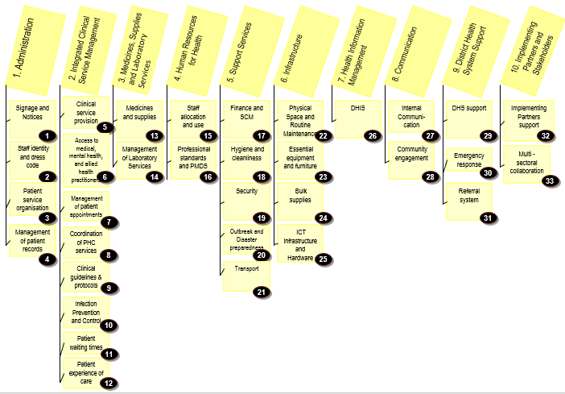
Revised Components and Sub components of Frameworks

Slide 10
Summary of concerns raised by provinces on revised Frameworks
  WISN
  Staffing needs have been determined in line with WISN
  changed to – Ideal Framework
  Staffing needs have been determined in line with workload requirements – Norms and Standards
  Staff appointed is in-line with WISN – Ideal Framework
  Personnel are appointed in line with determined requirements – Norms and Standards
Emergency Trolley
Restore the emergency trolley after each usage (Clinics):
Fruitless expenditure as not all equipment/consumables are used. A lot of the equipment requires advance life support training and some is for prem babies who is rarely treated at clinics.
Classification of CHCs
Package of services varies hugely. Software will make provision for NA.

Slide 11
Way forward
Clinics (Version 19) and CHCs (version 1) capture status determination and facility profiles on existing web-based information system (www.idealhealthfacility.org.za ) from 1 April 2020
To reduce the burden on facilities to conduct multiple assessments, a report will be developed on the software (Report for Regulated Norms and Standards) that will extract the scores from the Ideal frameworks
OHSC will have access to the web-based information system to retrieve Report for Regulated Norms and Standards status determination (SD) and Facility profiles
Note: For SDs – Aggregated reports only show latest SD captured according to priority of the SD role
Facilities do not need to submit any information to OHSC

Slide 12
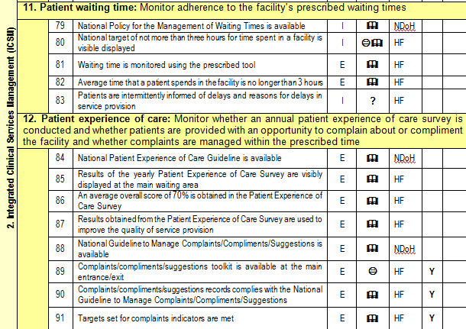
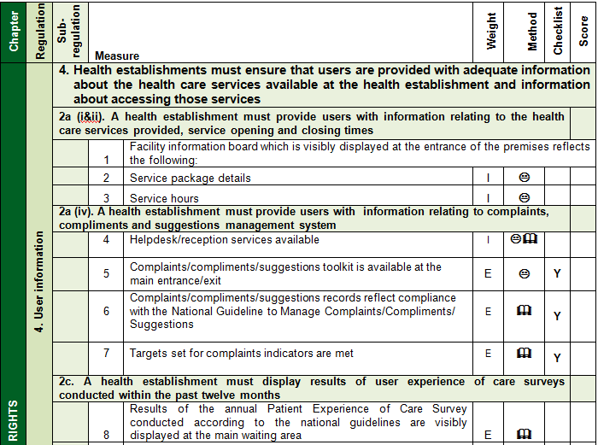
Ideal Framework used to generated report according to Regulations
Ideal Frameworks
Norms and Standards Regulations
Note: Ideal Clinic and CHC frameworks contains extended measures, only a subset of these are Regulated. Therefore the need to develop a separate report that will extract the measures into the chapters according to the Regulations.

Slide 13

Facility profiles

Slide 14
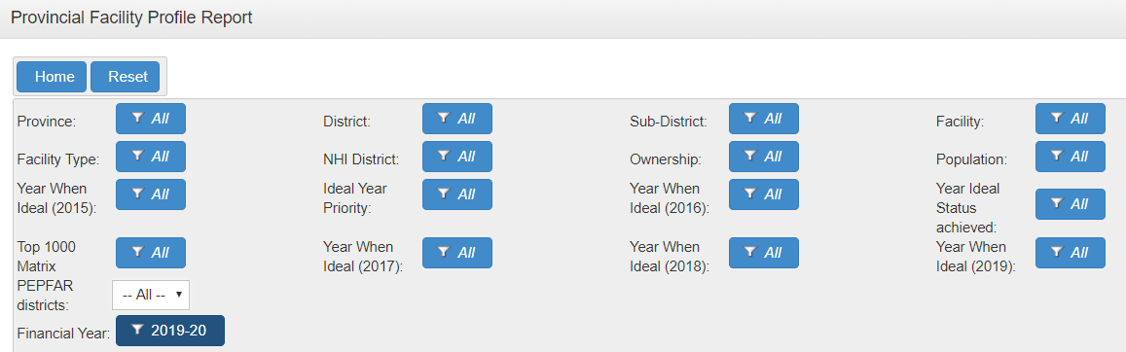
Facility profiles
Facility profiles reviewed in July 2019 - Low rate of submission.
If the person in charge, referred to in Chapter 2, section 4 of the Regulations, fails to provide the OHSC the required information within the specified period, the OHSC must refer the matter to the head of the national or provincial department of health.

Slide 15


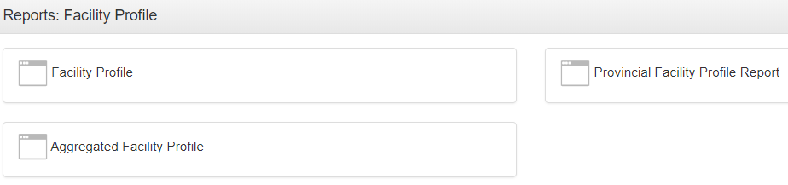
Facility profiles
How to check how many facilities have submitted and
which ones have not submitted
Obtain a list of facilities that have not submitted
Obtain a table of how many facilities have submitted

Slide 16
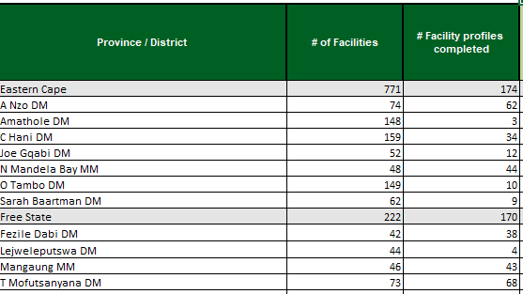
Provincial Facility Profile Report

Slide 17
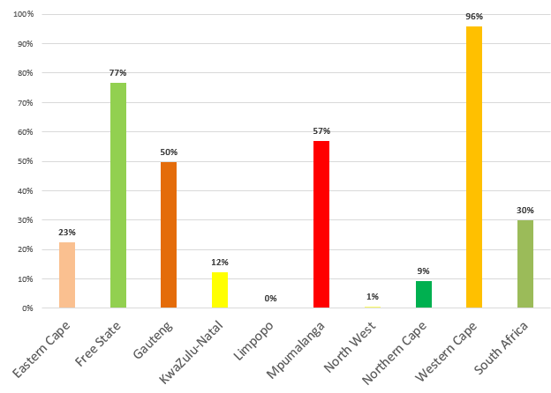
Facility profile submission

Slide 18
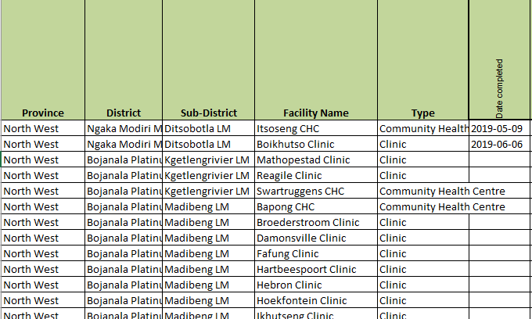
Aggregated Facility Profile Report
Sort on column for Date Completed
Blank rows have not submitted

Slide 19
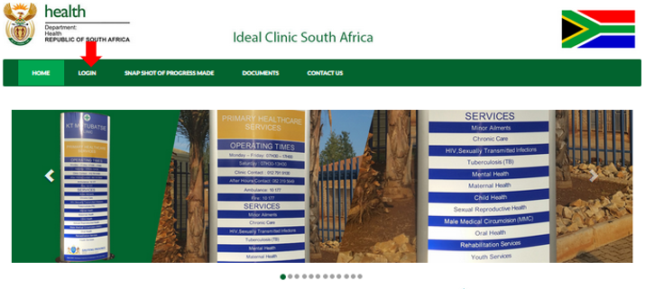
New developments on the Ideal Health Facility software

Slide 20
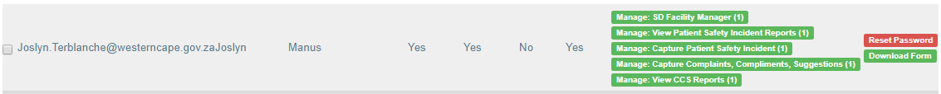
New developments on software
User accounts
Delegate functionality to manage user accounts to provinces:
Create new accounts
Revise existing accounts
Enable accounts that have been deactivated (accounts not accessed in 3 consecutive months)
Piloted in Western Cape. Will be rolled out in phases to provinces.
New user account registration form – one form for each user to ensure that Auditor General (AG) requirements are met. AG will audit provinces once the functionality has been given to provinces.
Implement from 1 April 2020.

Slide 21
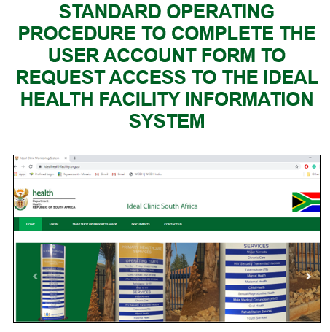
Standard Operating Procedure for user account form
One form per user for all the modules on the software
PDF format
Modules:
Ideal Clinic
Ideal Hospital
Complaints, compliments and suggestions
Patient Safety Incidents

Slide 22
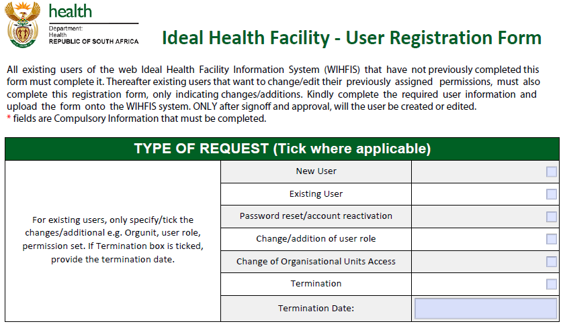
New user account form

Slide 23
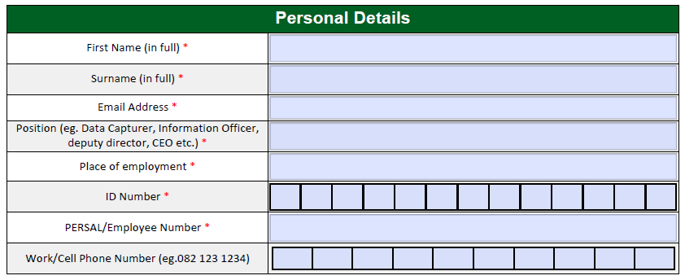
New user account form (cont.)

Slide 24
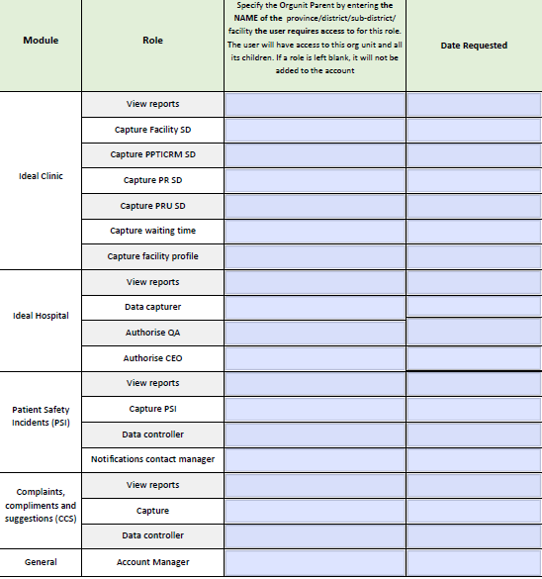
New user account form (cont.)
Super Account Manager -
2 per province.
Super Account Manager can create other Account Manager user accounts

Slide 25
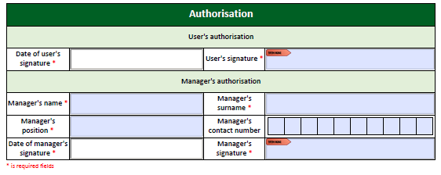
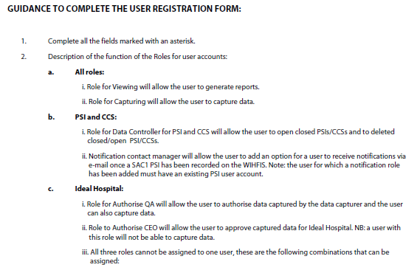
New user account form

Slide 26


Modules for Patient Safety Incidents and Complaints, compliments and suggestions
Software developed to assists facilities to comply with National Guidelines and the Norms and Standards Regulations

Slide 27
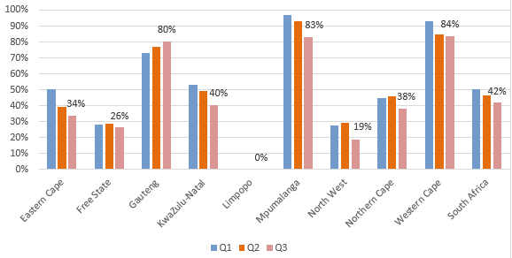
Compliance Rate for Patient Safety Incidents

Slide 28
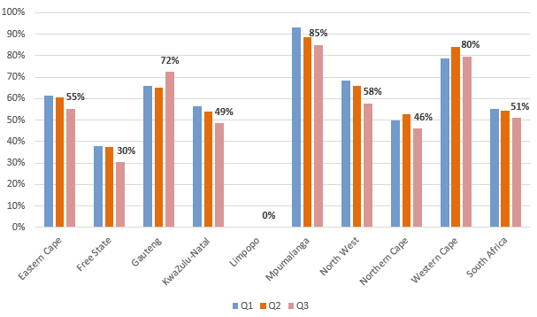
Compliance Rate for Complaints 2019/20

Slide 29

The end
Thank you!

