Slide 1
IDEAL CLINIC REALIZATION AND MAINTENANCE(ICRM)
5 YEAR REVIEW.
Presenter: E.M Mere
27th February 2020
North West Province

Slide 2
PRESENTATION LAY-OUT
Provincial Overview
Districts layout
NW Health Facilities
Progress from 2015 to date
Facilities lost status
Facilities that never achieved status
Critical success factors
Establishment and functionality of PPTICRM
Critical Role players
Assessment objectivity
Lessons learned
Challenges and improvements strategies

Slide 3
OVERVIEW OF THE NORTHWEST PROVINCE
North West lies in the north of South Africa on the Botswana border, fringed by the Kalahari Desert in the west, Gauteng province to the east and the Free State to the south. It covers an area of 104 882km² and has a population of 4 027 160. Much of the province consists of flat areas of scattered trees and grassland. The Vaal River flows along the southern border of the province.

Slide 4
Cont…
After the inception of ICRM , in 2015 the NW Province appointed PPTICRM comprising of Provincial QA, Districts QA, Districts Finance Managers,Sub –District Manager, Local Area Managers, and representation of Operational Managers.
The team participated in inter- Provincial Peer Reviews (KZN),coming back they were appointed as champions.

Slide 5
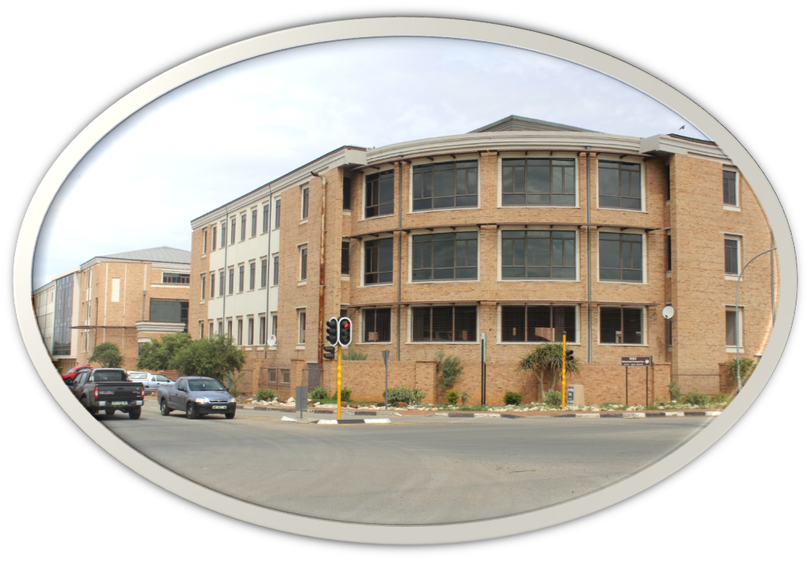
NW DEPARTMENT OF HEALTH PROVINCIAL OFFICE

Slide 6
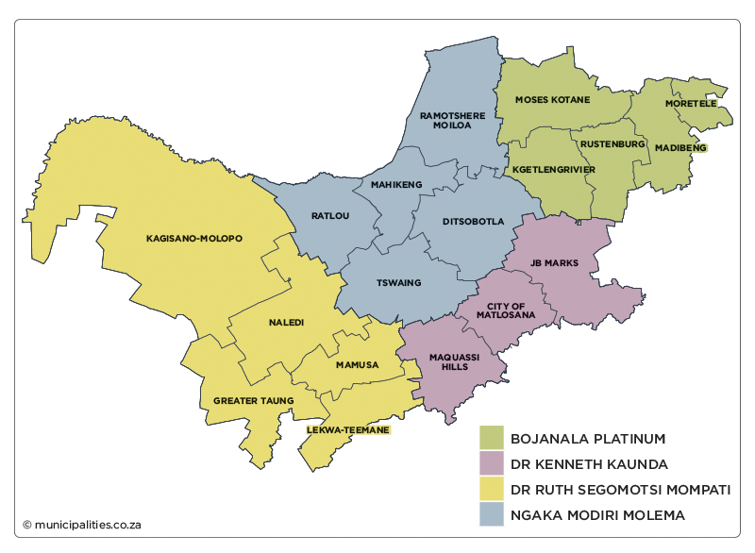
Districts and Local Municipalities in the North West Province

Slide 7
NW Health facilities
OrgUnitType | nw Bojanala Platinum District Municipality | nw Dr Kenneth Kaunda District Municipality | nw Dr Ruth Segomotsi Mompati District Municipality | nw Ngaka Modiri Molema District Municipality | Grand Total
Clinic | 118 | 31 | 50 | 81 | 280
Community Health Centre | 9 | 10 | 12 | 16 | 47
District Hospital | 3 | 1 | 4 | 5 | 13
EMS Station | 5 | 4 | 6 | 5 | 20
Health Post |  | 1 |  | 6 | 7
Mobile Service | 19 | 16 | 19 | 23 | 77
Provincial Tertiary Hospital | 1 | 1 |  |  | 2
Regional Hospital |  | 1 | 1 | 1 | 3
Satellite Clinic | 1 | 3 |  |  | 4
Specialised Clinic | 7 | 3 | 6 | 7 | 23
Specialised Hospital |  | 1 |  | 1 | 2
Grand Total | 163 | 72 | 98 | 145 | 478

Slide 8
Progress from 2015 to date
Districts | Total no. of facilities | Total no. scaled up | Total IC | % IC
BOJANALA | 119 | 63 | 41 | 35%
DR KK | 40 | 37 | 13 | 33%
DR RSM | 60 | 37 | 27 | 45%
NMM | 89 | 44 | 26 | 29%
PROV | 308 | 181 | 107 | 35%

Slide 9
Facilities lost status
Districts | No. of facilities lost status | Total IC | % IC
BOJANALA | 22/63 | 41/119 | 35%
DR KK | 24/37 | 13/40 | 33%
DR RSM | 11/37 | 27/60 | 45%
NMM | 18/44 | 26/89 | 29%
PROV | 75/181 | 107/308 | 35%

Slide 10
Facilities never achieved status
DISTRICTS | FACILITIES | CHALLENGES
Bojanala (08) | Kgabalatsane, Rabokala, Hoekfontein, Molorwe, Welgeval, Pitsedisulejang,Boitekong ,Mankaipaya,. | Infrastructural challenges ( toilets for people with disabilities , waste storages, essential equipment's, backup water and electricity, small ,old facilities) . non compliance to ICSM Prescripts.
Dr KK (01) | Wolmaranstadt Clinic
Dr RSM (03) | Manthe CHC, Upper Majeakgoro and Mokgareng Clinic
NMM (03) | Groot Marico ,Dithakong and Braaklaagte clinics
TOTAL | 15 clinics

Slide 11
CRITICAL SUCCESS FACTORS
Executive management support e.g. DMT meetings at facility level
Delegation of Professional Nurses as quality assurance coordinators.
Fortnightly teleconferences chaired: DDG.
Procurement of equipment including those that were donated by NDoH and partners( Aurum).
Appointment of supporting Parents from Provincial Office for each District by DDG .
Formulation of equipment and maintenance committees
Inter-facility peer reviews.
Quarterly meetings with assessors and champions chaired by the DDG .
Roadshow by DDG engaging with Operational Managers.

Slide 12
Critical role players for achievement of ICRM
Role players | Responsibilities
Executive Managers( Provincial and Districts) | Resource mobilization
Sub-Districts Management Teams ( Sub-District Managers, Local Area Managers, Corporate Managers ) | Lead and monitor implementation
Developmental Partners | Support with resources
Governance structures | Oversight role , community awareness /buying
District Clinical specialists | Strengthen clinical managements ( ICSM, Clinical Audits ,Trainings )
Program Managers ( Provincial ,District ) | Strengthen clinical managements ( ICSM, Clinical Audits ,Trainings
Operational Managers | Daily implementation ( Utilize ICRM as facility management tool)

Slide 13
Assessments objectivity
Formal Appointment of permanent Provincial assessors with clear TOR.
Code of conduct for assessors
Improve process of capturing ,e.g. electronic gadgets.
Mixed inter districts teams.

Slide 14
Relationship between Ideal Clinic , OHSC and NHI
Ideal Clinic facilitates compliance and quality improvement to set norms and standards.
Office of Health Standards Compliance (OHSC) monitors norms &standards to ensure accreditation of facilities towards implementation of NHI.

Slide 15
Lessons learned since inception ICRM
Standardised tool for monitoring quality of health services.
Readily available information
Equitable allocation of resources
Reorganization of health facilities ( ICSM)
Outlined level of responsibilities.
Systematic service improvement .
Team approach – Support services participation
Community participation : clinic commitees

Slide 16
Challenges and improvement strategies
CHALLENGES | STRATEGIES
Infrastructural challenges ( Small dilapidated buildings, ageing infrastructure,) | Adherence to implementation of infrastructure plan project
Durability of Medical equipment | Adherence to National Health Commodities Catalogue for Primary Health facilities.
Lack of connectivity ( Electronic monitoring systems) | Explore implementation of different connectivity platforms
Inadequate health care technology personnel. | Ring -fence budget. Creation of posts and appoint HCT Maintenance hubs per Sub-District
Lack of skilled maintenance personnel | Capacity building
Lack of commitment | Inclusion on PMAs at all levels Consequence management
Notes:
.

Slide 17
Challenges and strategies
CHALLENGES | STRATEGIES
Inadequate pharmaceuticals supplies | Fast track Invoice Tracking System.
High vacancy rate leading to increased acting positions in critical positions | Fast track filling of critical posts
Records management | Appropriate filing cabinets Expansion of Infrastructure-limited space Adherence to the Records Management Policy.

Slide 18
KEY ACTIONS TO SUSTAIN THE PROGRAMME
Continuous reorientation of staff on updated versions at District and Sub-District level
Sub-Districts peer reviews
Revive PHC forum meetings at Sub-District and local area level
Appointment of ICRM champions from District ,Sub-District and Facility level
Establishment committees for formulation and review of Standard Operating Procedures

Slide 19
KEY ACTIONS TO SUSTAIN THE PROGRAMME
Enforce implementation of MOUs through inter governmental forum meetings
Adoption of facilities by executive managers and PPTICRM.
Conducting internal survey for all operational managers in key leadership skills.

Slide 20
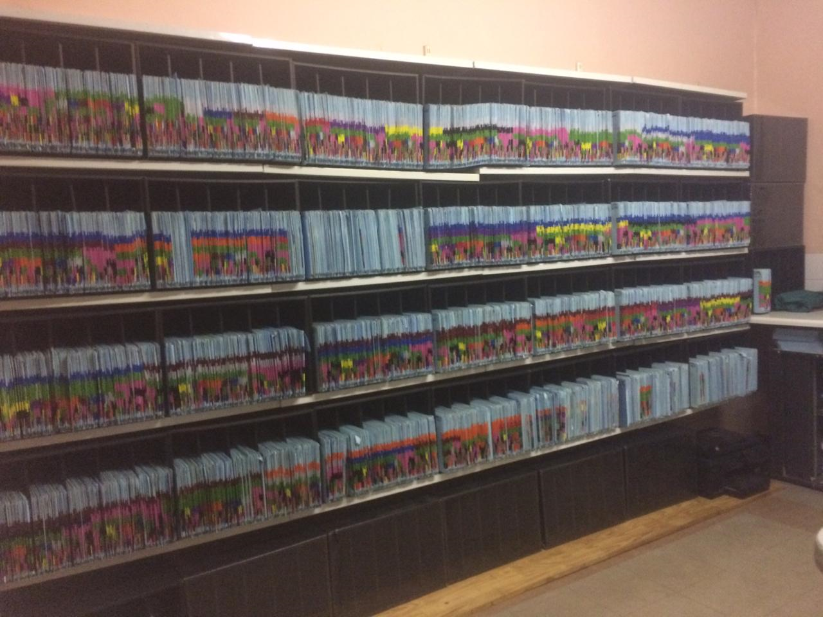

Slide 21
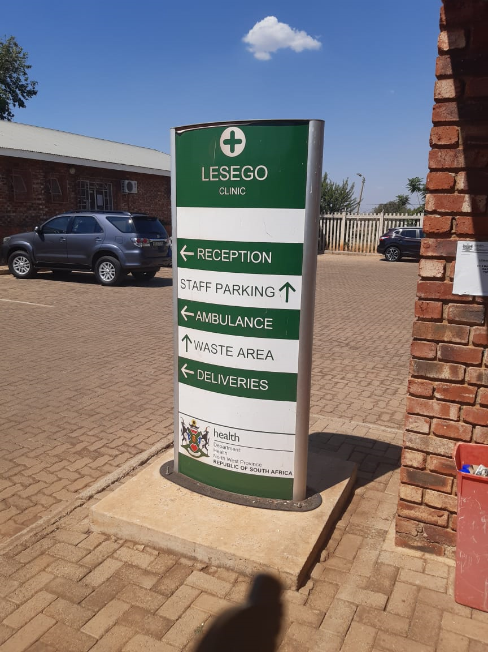

Slide 22
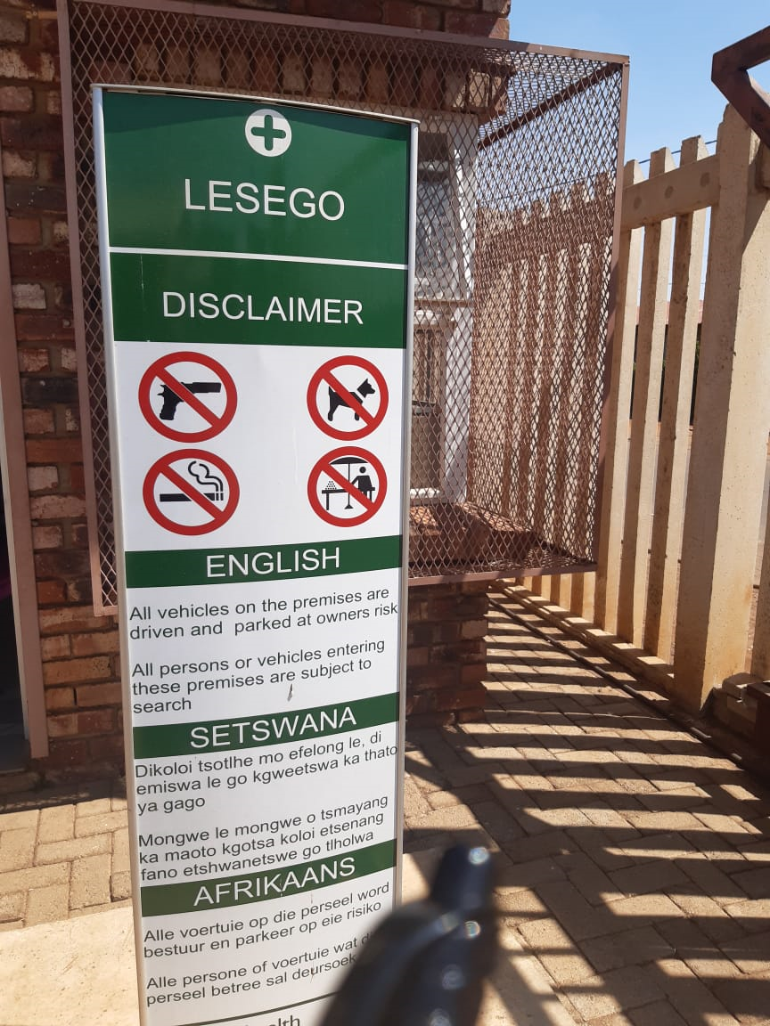

Slide 23
THANK YOU
BAIE DANKIE
RE A LEBOGA

