Slide 1

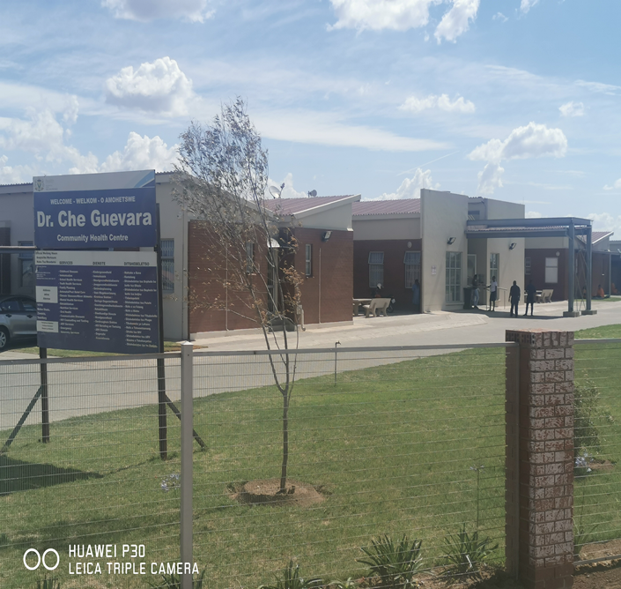
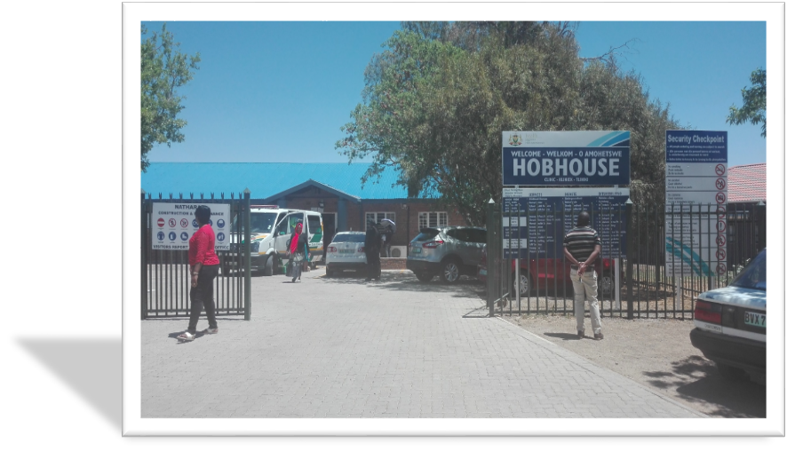
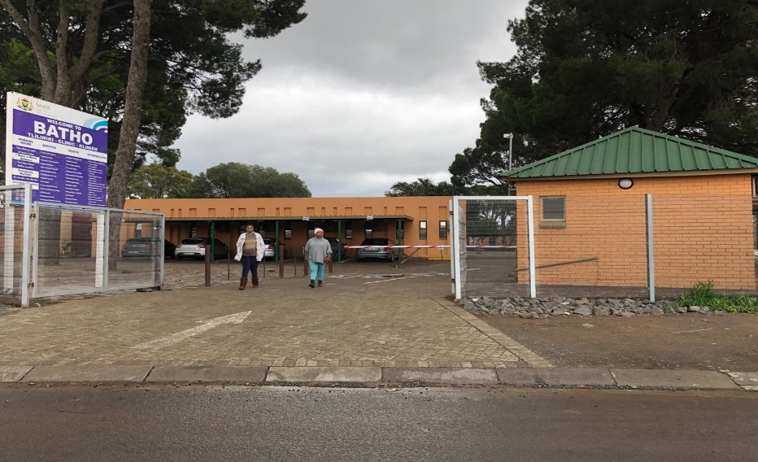
FREE STATE IDEAL CLINIC REALIZATION AND MAINTENANCE
PROGRAMME 5 YEARS REVIEW
Dr Grace London
Chief Director :DHS

Slide 2
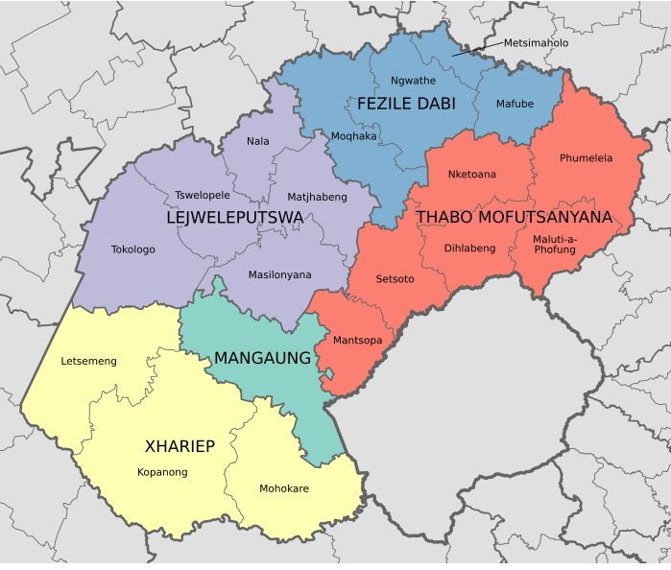
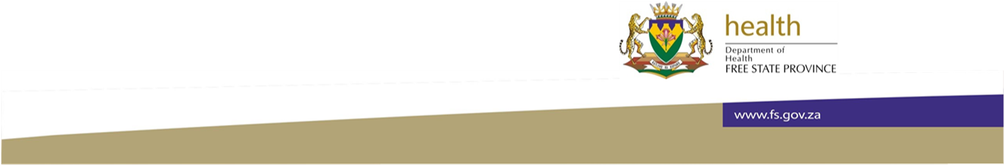
Free State province Background
42
73
44
45
2
Number of PHC facilities in Free State =222
PHC = 220
CHC =2
17
Total population = 2.9 million
Uninsured population = 2.32 million
( Stat SA population estimates 2018)

Slide 3
FS 2015/16 SD Summary per Category per district
District | No. of Facilities | No. of Facilities Assessed | Platinum | Gold | Silver | Not Achieved | Total Ideal Clinic
Fezile Dabi | 42 | 38 | 1 | 0 | 0 | 37 | 1
Lejweleputswa | 44 | 22 | 0 | 1 | 2 | 19 | 3
Mangaung Metro | 46 | 24 | 0 | 1 | 0 | 23 | 1
Thabo Mofutsanyana | 73 | 56 | 2 | 7 | 1 | 46 | 10
Xhariep | 17 | 9 | 2 | 5 | 0 | 02 | 7
Free State | 222 | 149 | 5 | 14 | 3 | 127 | 22

Slide 4
FS 2016/17 SD Summary per Category per district
District | No. of facilities | No. of Facilities Assessed | Platinum | Gold | Silver | Not Achieved | Total Ideal Clinic
Fezile Dabi | 42 | 39 | 0 | 4 | 5 | 30 | 9
Lejweleputswa | 44 | 44 | 0 | 5 | 5 | 34 | 10
Mangaung Metro | 46 | 46 | 0 | 5 | 6 | 36 | 11
Thabo Mofutsanyana | 73 | 72 | 4 | 15 | 16 | 37 | 35
Xhariep | 17 | 17 | 0 | 1 | 13 | 3 | 14
Free State | 222 | 219 | 4 | 30 | 45 | 140 | 79

Slide 5
FS 2017/18 SD Summary per Category per district
District | No. of Facilities | No. of Facilities Assessed | Platinum | Gold | Silver | Not Achieved | Total Ideal Clinic
Fezile Dabi | 42 | 41 | 2 | 8 | 11 | 21 | 21
Lejweleputswa | 44 | 44 | 0 | 1 | 14 | 29 | 15
Mangaung Metro | 46 | 46 | 0 | 7 | 13 | 27 | 20
Thabo Mofutsanyana | 73 | 73 | 1 | 16 | 42 | 14 | 59
Xhariep | 17 | 17 | 0 | 4 | 11 | 2 | 15
Free State | 222 | 221 | 3 | 36 | 91 | 93 | 130

Slide 6
FS 2018/19 SD Summary per Category per district
District | No. of facilities | No. of Facilities Assessed | Platinum | Gold | Silver | Not Achieved | Total Ideal Clinic
Fezile Dabi | 42 | 42 | 3 | 16 | 10 | 13 | 29
Lejweleputswa | 44 | 44 | 0 | 2 | 25 | 17 | 27
Mangaung Metro | 46 | 46 | 0 | 15 | 20 | 11 | 35
Thabo Mofutsanyana | 73 | 73 | 0 | 18 | 53 | 2 | 71
Xhariep | 17 | 17 | 1 | 3 | 13 | 0 | 17
Free State | 222 | 222 | 3 | 36 | 91 | 93 | 179

Slide 7
FS 2019/20 SD Summary per Category per district
District | No. of Facilities | No. of Facilities Assessed | Platinum | Gold | Silver | Not Achieved | Total Ideal Clinic
Fezile Dabi | 42 | 39 | 0 | 6 | 11 | 22 | 17
Lejweleputswa | 44 | 44 | 0 | 5 | 22 | 17 | 27
Mangaung Metro | 46 | 44 | 0 | 12 | 19 | 13 | 21
Thabo Mofutsanyana | 73 | 72 | 1 | 25 | 38 | 8 | 64
Xhariep | 17 | 16 | 0 | 2 | 13 | 1 | 15
Free State | 222 | 215 | 3 | 36 | 91 | 61 | 144
7 facilities were undergoing renovations

Slide 8
FS Overall Performance

Slide 9
FS Facilities which regressed on IC Status 2015 to date
District | Number of facilities | No of facilities Regressed
Fezile Dabi | 42 | 06
Lejweleputswa | 44 | 0
Mangaung Metro | 46 | 05
Thabo Mofutsanyana | 73 | 07
Xhariep | 17 | 2
Free State | 222 | 20

Slide 10
Facilities that never attained ideal status

Slide 11
Challenges and strategies to improve performance
Challenges | Strategies address the challenges | 5 year progress
Support services : HR facilities without Operational Manager, pharmacy assistants and data clerks s which affected Maintance of the ideal clinic status SCM Slow SCM processes Ineffective contract management ( cleaning eqipmement , poor quality of equipment ) Finance 1. Insufficient dedicated budget to essential equipment | HR :To appoint Operational Managers , pharmacy assistance and data clerks SCM 1. SCM to revaluate contracts 2. Bulk procurement of essential equipment Finance Re-infence budget towards essential equipment at PHC | OPM , pharmacy assistants and data clerks appointed districts , appointment through implementing partners in TM and LP Finance R30 million was dedicated towards essential equipment's ideal clinic Support from NDoH
TRAINING :Professional Nurses not trained on BLS, RTC have capacity challenge Budget limitations Capacity | RTC plan to train 180 PN in 4 other district , total cost of training R 400 000 EMS incorporated to assist with BLA training | EMS assist with training RTC appointed coordinators per district to strengthen capacity

Slide 12
Challenges and strategies to improve performance
Challenges | Plans to address the challenges | 5 year progress
INFRASTRCUTURE : 1.Some of the facilities has gross infrastructure and maintenance challenges 2. Infrastructure does not comply with IC requirement ( backup water and electricity , access for disability , safety and compliance ) 3. Lack of consultation for infrastructure planning | Infrastructure B5 plan aligned to ideal clinic infrastructure requirement Inter cluster discussion with infrastructure were established | Infrastructure assessment in line with ideal clinic done , progress still slow Delays on maintaince of the infrastructure
IMPLEMENTATING PARTNERS AND STAKEHOLDERS : Lack of MOU and policies | MOU between education and social development with were crafted and submitted for adoption and signature by receptive HOD . MOU still outstanding : police and Transport , Public works | MOU for education have been signed and circulated to facilities . Social Development MOU outstanding NDoH to handle MOU between SAPS and NDoH

Slide 13
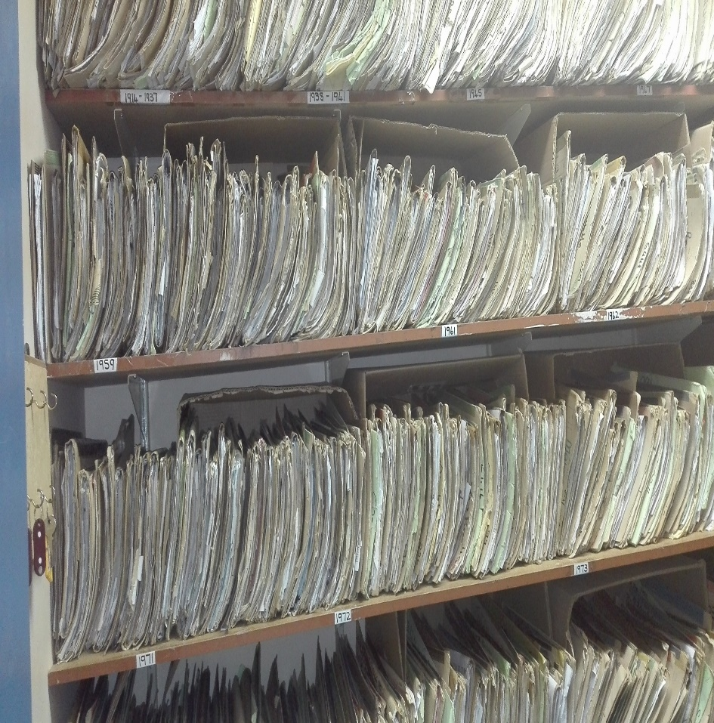
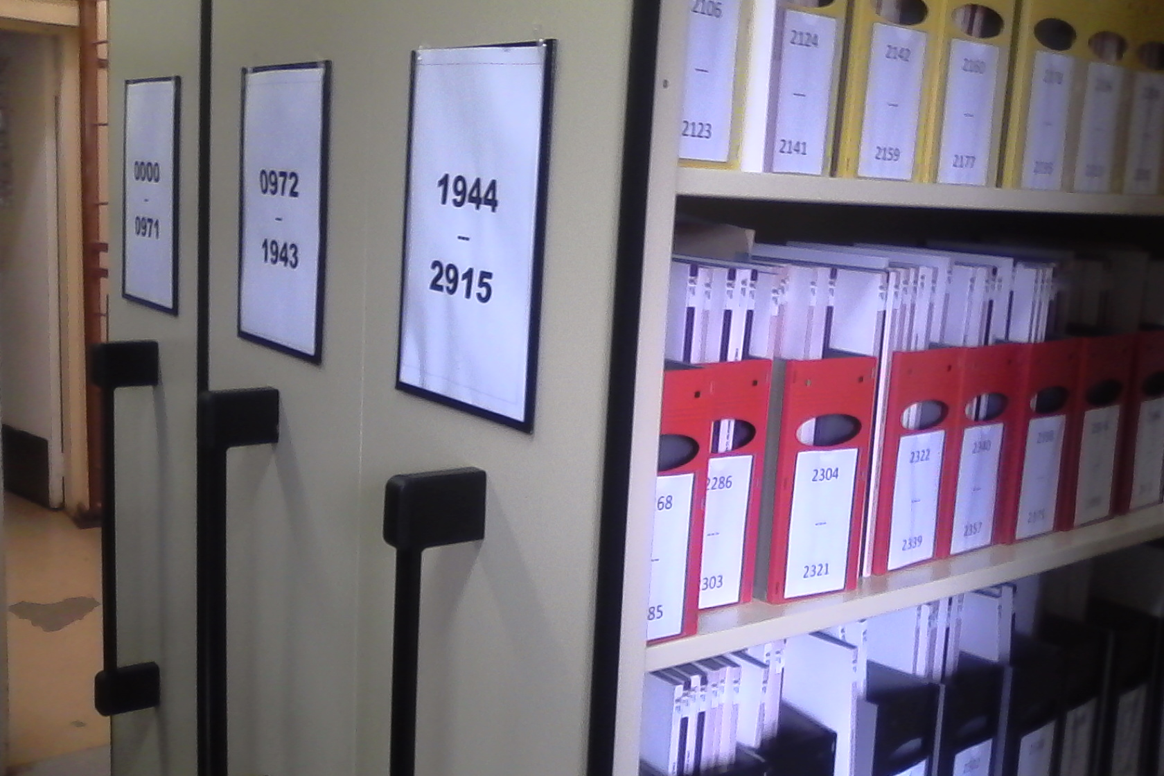
OLD FILING SYSTEM
Critical success factors
Integrated Admin personnel which improved patient registration in the HPRS as well as data collection which minimized duplication of patient records
Successful integration of management of patients appointment system, health patient registration, patient flow, filing and ICSM.
NEW FILING SYSTEM
Notes:
Corrected typo bullet two and bullet four

Slide 14
Critical success factors
Management of patient appointment system as well as standardized filling system according HPRS improved: Pre-retrieval of patient files and pre-packing of medication ,which improved the following areas :-
  Patient waiting times
  Improved patient experience of care
  Tracking of patient record
  Reduced overcrowding in the waiting areas
  Reduced number of patients returned without receiving the service
  Improved integrated management of clinical services
 | 2018 Population Estimate | Number of Individual Registrations on HPRS | % Population Registered
fs Fezile Dabi District Municipality | 506 856 | 485041 | 96%
fs Lejweleputswa District Municipality | 673 104 | 553016 | 82%
fs Mangaung Metropolitan Municipality | 814 680 | 723602 | 89%
fs Thabo Mofutsanyana District Municipality | 795 927 | 859105 | 108%
fs Xhariep District Municipality | 129 882 | 156182 | 120%
Free State Province | 2 920 449 | 2776946 | 95%
Notes:
Corrected typo bullet two and bullet four

Slide 15
Critical success factors for sustainability
Managed to improve performance of facilities by collaborating with other stakeholders such as supply chain management, asset Management, infrastructure, information management, information technology, human resource, finance, etc.
Continuous support from provincial asset management in updating facilities assets register comparing with supply chain report that are pulled from the Ideal Clinic software.
Integrated Clinical Services Management (ICSM) trainings improved integration of health programs in the facilities e.g. HIV
Receiving continuous support by NDoH Ideal Clinic Technical Advisor.
Continuous support by the DHS chief directorate to district in availing resources and chairing provincial ICRM meetings e.g. appointment of Pharmacist Assistant, Operational Managers
Managed to get buy in of ideal clinic realization and maintenance from both employees and patients
Notes:
Corrected bullet 3 ,4

Slide 16
lessons learned - I
Ideal Clinic can only be monitored on-site because sometimes information in the software may not be the same as the one in the facility (Avoid
On-site trainings are more effective in the implementation of ideal clinic initiatives.
Training enhanced understanding of facility person on integrated clinical management, HPRS, DHIS, filling, archiving and disposal of patient records.
Functionality of District PPTICRM improves the support and performance of facilities in making sure that ideal clinic initiatives are realised and maintained,
Where the clinic committees are functional, patient’s fully understand and participate in the implementation of Ideal Clinic strategies e.g. adhering to appoint dates and time.
.

Slide 17
RE ya leboha

