Slide 1
National ICRM 5 Year Review Meeting
26 – 27 February 2020
Garden Court , O.R.Tambo International Airport
Presenter: Mrs Noxolo Makinana

Slide 2
Outline
Background
Progress from 2015 to date
Critical success factors
Functionality of PPTICRM
Challenges and strategies to address the challenges
Sustainability of the programme
Other key issues of note
conclusion

Slide 3
Introduction
The ideal clinic program has brought about great improvement of the PHC system particularly with service delivery platform.
It has improved the working environment of our PHC personnel resulting in great confidence and awareness about the service delivery system
More organized approach of service provision.

Slide 4
Background
Institution | No. of facilities
Province | 773
Alfred Nzo | 74
Amathole | 148
BCMHD | 79
Chris Hani | 159
Joe Gqabi | 52
NMBHD | 48
O.R.Tambo | 151
Sara Baartman | 62

Slide 5
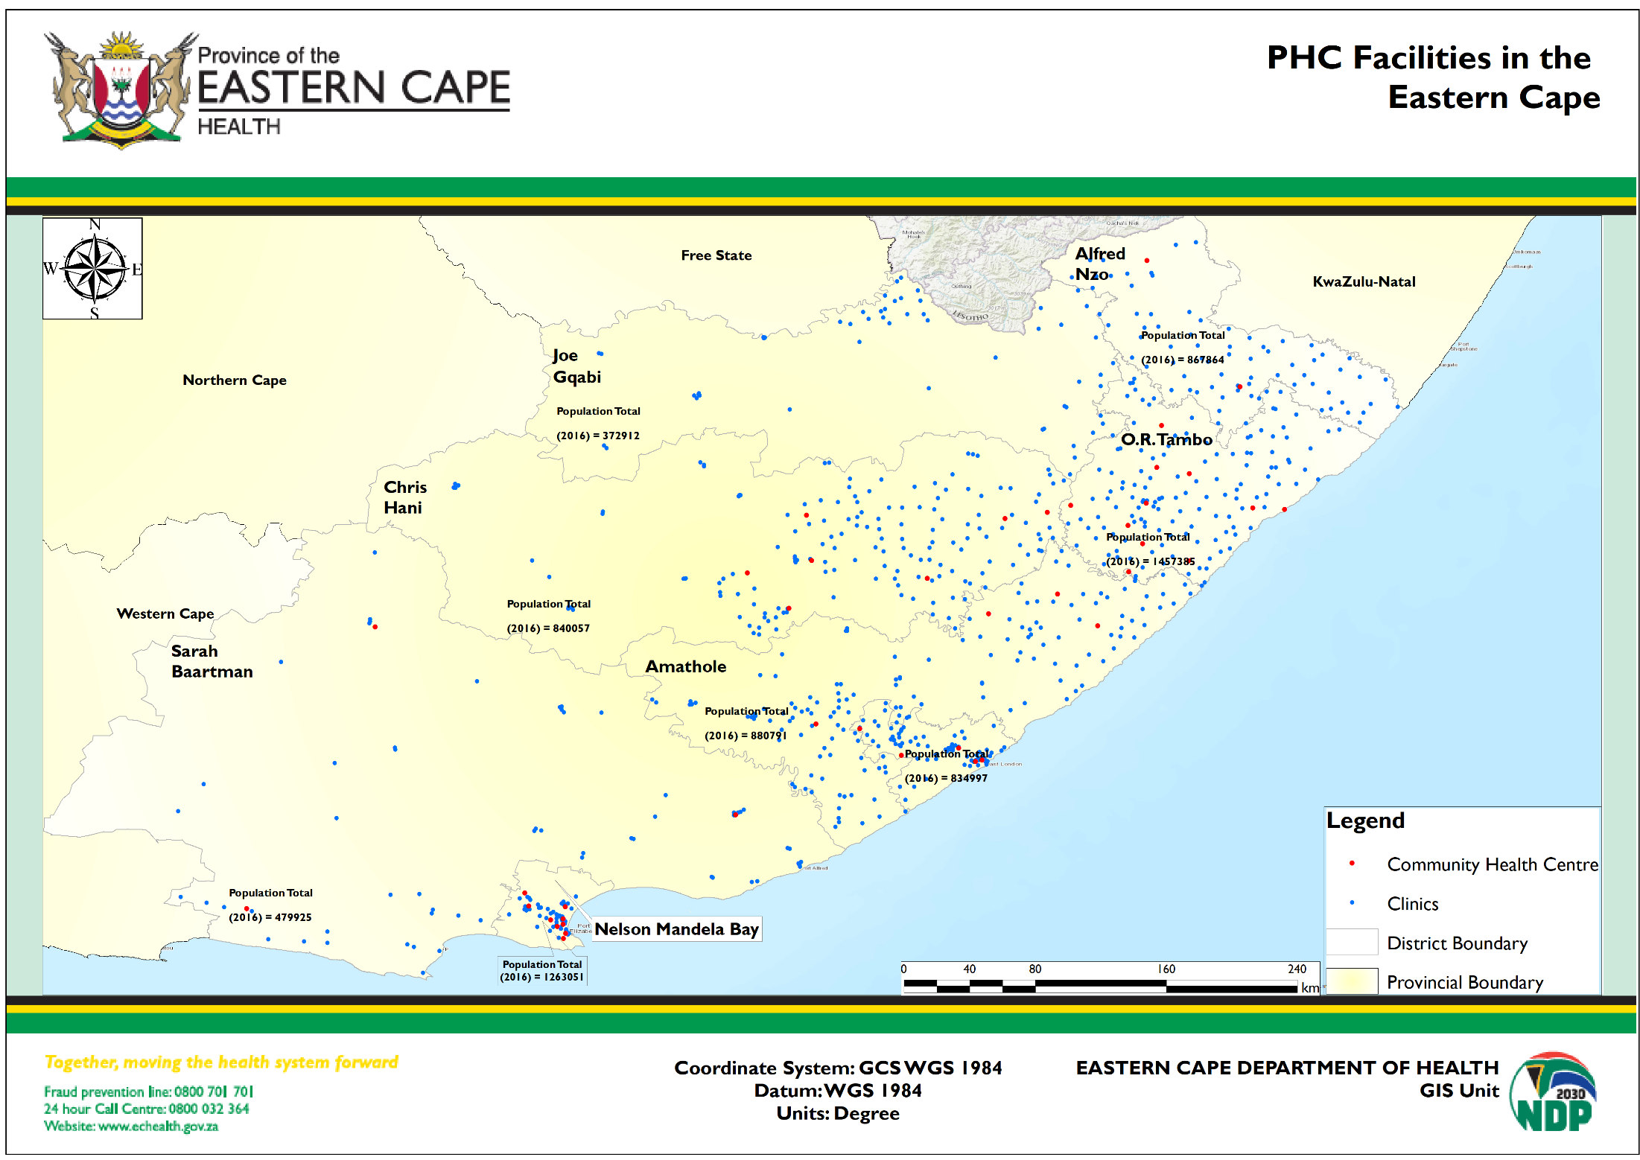
Background

Slide 6
PROGRESS REPORT 2015 TO DATE – Ideal Clinics)
District | No. of facilities | 2015/16 | 2016/17 | 2017/18 | 2018/19 | 2019/20PR
Alfred Nzo | 74 | 0 | 2 | 2 | 4 | 0
Amathole | 148 | 2 | 25 | 15 | 14 | 4
Buffalo City | 79 | 0 | 2 | 6 | 10 | 3
Chris Hani | 159 | 0 | 24 | 9 | 7 | 1
Joe Gqabi | 52 | 3 | 17 | 9 | 4 | 0
NMM | 48 | 3 | 13 | 5 | 11 | 2
OR Tambo | 152 | 2 | 34 | 14 | 17 | 1
Sarah Baartman | 62 | 2 | 24 | 4 | 12 | 2
Total | 773 | 12 | 141 | 64 | 79 | 13

Slide 7
Progress 2015/16 - 2018/19
District | # of Facilities | # Facilities with IC status | % of Facilities with IC status | # of Facilities with Silver Status | # of Facilities with Gold Status | # of Facilities with Platinum Status
Alfred Nzo | 12 | 4 | 33% | 1 | 2 | 1
Amathole | 55 | 47 | 85% | 18 | 18 | 11
Buffalo City | 18 | 8 | 44% | 7 | 1 | 0
Chris Hani | 38 | 19 | 50% | 10 | 5 | 4
Joe Gqabi | 31 | 21 | 68% | 11 | 10 | 0
NMM | 30 | 23 | 77% | 15 | 8 | 0
OR Tambo | 65 | 31 | 48% | 20 | 10 | 1
Sarah Baartman | 40 | 30 | 75% | 22 | 8 | 0
Total | 289 | 183 | 63% | 104 | 62 | 17

Slide 8
Progress 2015 to date
Facilities have reorganised consulting rooms for 3 streams
Single patient record irrespective of condition
Single location for storage of patient records – bulk filers
Implementation of appointment system and CCMDD reduced waiting times
Gradual improvement of medicine availability with SVS

Slide 9
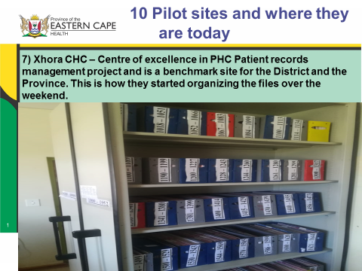
Progress cont. …

Slide 10
Critical Success Factors
NHI budget allocated to all districts
DCSTs budget procured medical equipment in districts
Huge sacrifice – use of own resources for e.g. filing ,internal signage , etc.
Ring fenced IC budget for all districts
Project for procurement of clinical records & bulk filers ongoing
Integration of PHC HT budget for PHC facilities
High commitment of operational managers in some areas
Generally, improved infrastructure e.g. O.R.Tambo (NHI district) – 8 NHI facilities including the state of the art Lusikisiki Village clinic

Slide 11
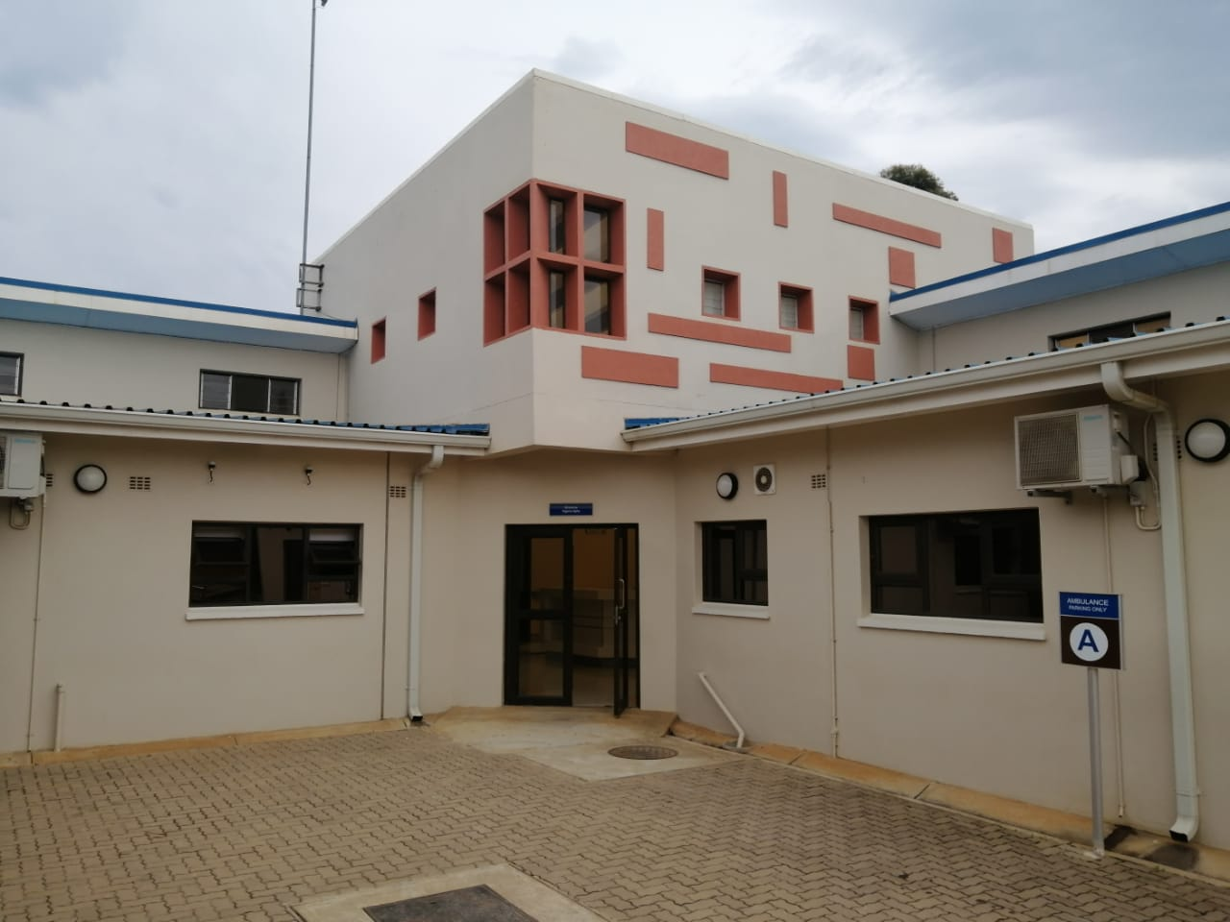
Lusikisiki Village Clinic

Slide 12
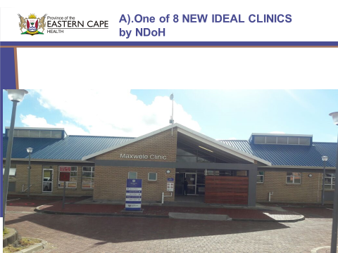
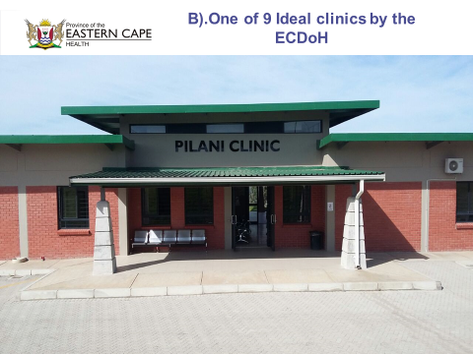
Infrastructure improvement
Aids Health Care Foundation – Supports the District in PHC Documents management e.g. procuring organisers and filing cabinets

Slide 13
Critical Success Factors
Multidisciplinary team work e.g. Q.A , DCSTs, Finance, Pharmacists, etc.
Training of facility managers on leadership and management rolled out
Training of PNs on ICSM ,BANC & BANC Plus , APC, IMCI, etc.
Involvement of clinic committees , other community members & family members (SBD)
Nurses Summit held in NMBHD improved OMs role clarification
IC – standing item on EMT meetings, directive from HOD
Provincial ICRM quarterly performance reviews with DMs (Alfred Nzo)

Slide 14
Critical Success Factors
E- Health - HPRS, electronic patient register – piloted Grey Gate way clinic
Involvement of Supporting Partners
Involvement of hospital CEOs
Gradual mainstreaming of infrastructure projects
Provincial ICRM Task Team meetings – sometimes chaired by DM
Developed MOUs
PR preparatory sessions , post PR sessions
Active involvement of NICRM Coordinator ( Dr Mthethwa)
Alfred Nzo established a facility Nerve Centre to monitor performance of indicators at facility – improvement noted

Slide 15
PPTICRM functionality
All districts established the structure from 2015 composed of district Senior Management (enablers), clinical and non clinical staff
Not vigilant in all districts - mostly functional during assessments
Constant training is done in some districts for supervisors and PHC managers on Ideal Clinic issues such as interpretation of elements and SOPs.
Role clarification workshops will be done

Slide 16
PPTICRM functionality
All Managers are expected to participate in the the PPTICRM and an appointment letter is issued.
In Sara Baartman for the past 4 years the team is consistent and members do not change, and since 2018 two new members are orientated and initiated under supervision on scoring and understanding of elements
Amathole also have a functional PPTICRM

Slide 17
Challenges
Sustaining best practices
Staff mobility
Inadequate staffing – Joe Gqabi district ,facility managers ,PNs , cleaners , etc.
QIPs not implemented consistently
Facility leadership qualification
BLS training gaps
Medical equipment maintenance
Dilapidated buildings
Municipal buildings

Slide 18
Challenges
SCM issues
Inadequate budget & under-expenditure
Human resource management issues
Information gaps on IC manual – facilities and supervisors
System for general waste disposal
Poor sanitation in rural districts
MOUs – SAPS ,DOE and DOSD draft
Social determinants – water supply , electricity, roads ,transport
Security in facilities , guard houses resulting in crime and burglaries

Slide 19
Challenges
Labour relations issues e.g. NMBHD
Interruptions by protests , weather conditions (storms)
Planning process – Scale Up Plan - provincial vs national
Facility profiles update
Inadequate use of IC Framework and software reports / information
External signage and notices
ICT
Back up electricity supply

Slide 20
Strategies to address challenges
Ongoing capacity building of facility managers and
Clinic Supervisors
Integration of IC with other programs
Strengthen PPTICRMs
Institutionalize and strengthen PR teams
Bore hole system
Improve ICT
Improve staffing

Slide 21
Strategies to address challenges
District programme managers adopting facilities
Mentorship on ICRM implementation.
Include Ideal Clinic in everyone’s KPA’s
Budget for BLS training & training material
Provincial IC Task Team – Standardization
Prioritization – scale up plan
- facilities with potential – > 60%
- < 40%
- facilities that fell off

Slide 22
Sustainability of the program
Improve leadership at facility level
Focused and evident clinic supervision and monitoring
Strengthen district PPTICRM
Motivation mechanisms for facilities with good practices
Improve resource availability
Effective management of support from Partners

Slide 23
Factors contributing to facilities losing IC status
Loss of focus on QIPs
Inadequate facility management
Lack of supervision
High staff turnover
Expiry of medical and surgical supplies
ICRM not a day to day practice
Lack of medical equipment maintenance
Inadequate infrastructure maintenance
Lack of institutionalizing the Ideal Clinic model to all the Clinic staff members.
Poor documents management and recording

Slide 24
Lessons learned
Sound intergovernmental relations and social partners
Clinical governance and leadership
Inter-district skills transfer
Empowerment of facility staff
ICSM component key to IC implementation
Drawing quality medical resources for PHC facility staff
National , province , district support
Positive attitude , professionalism determines success of this program
Consistency and accountability very critical
Peer reviews gave opportunity to draw from each others strength
Rationalization and reclassification of PHC facilities

Slide 25
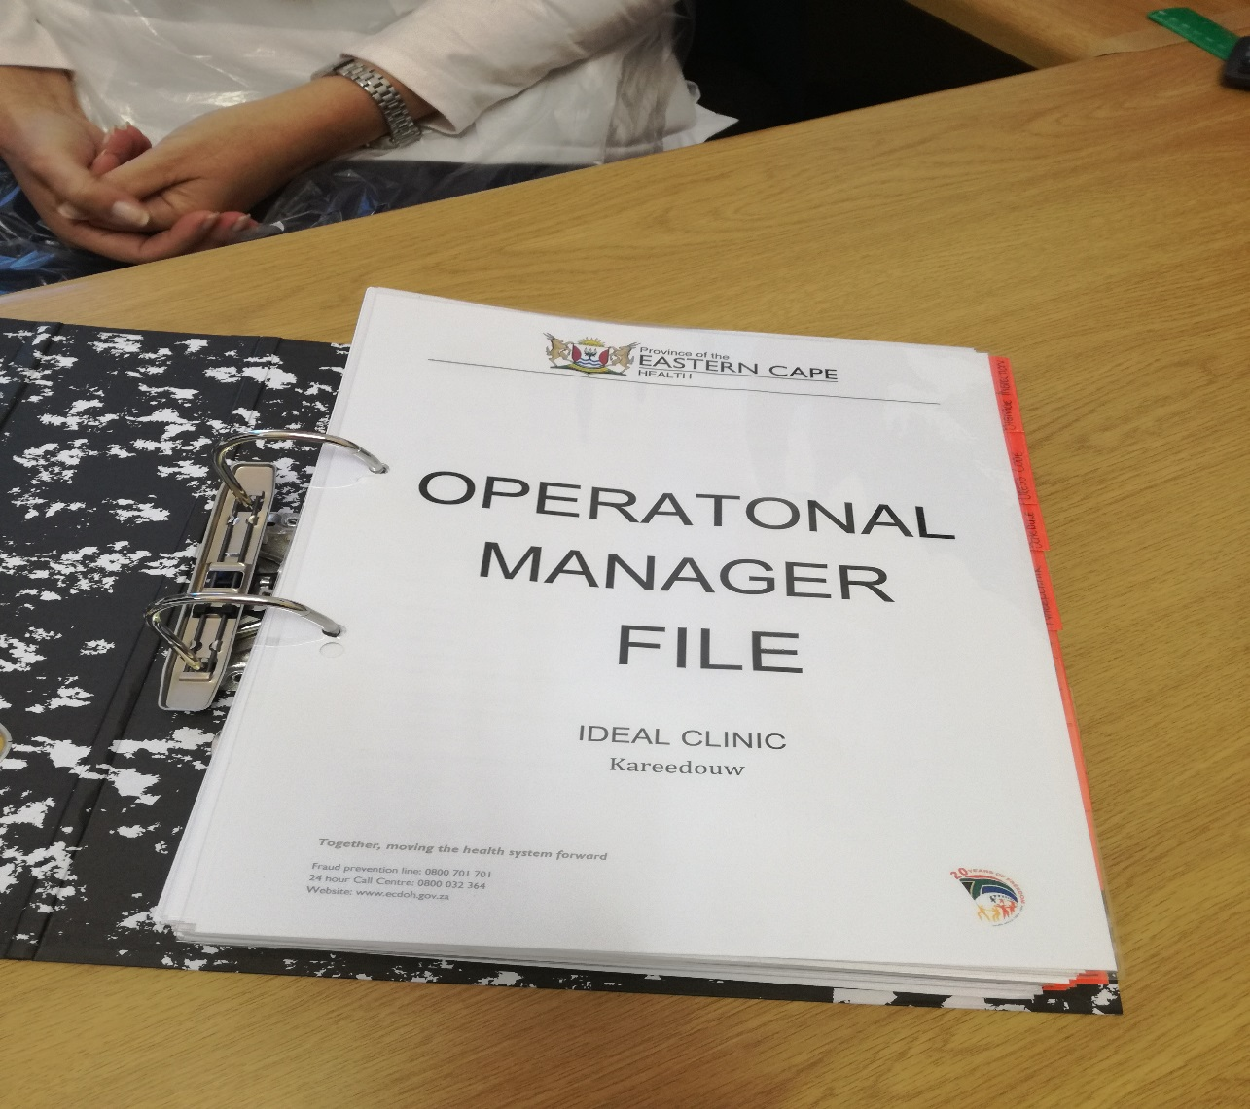
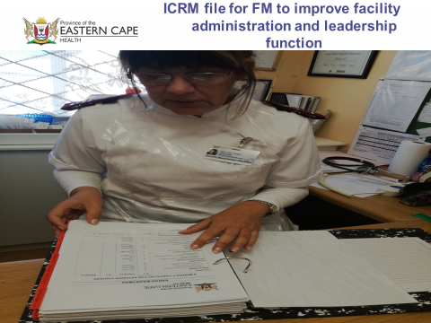
Other key improvement strategies
Aids Health Care Foundation – Supports the District in PHC Documents management e.g. procuring organisers and filing cabinets

Slide 26
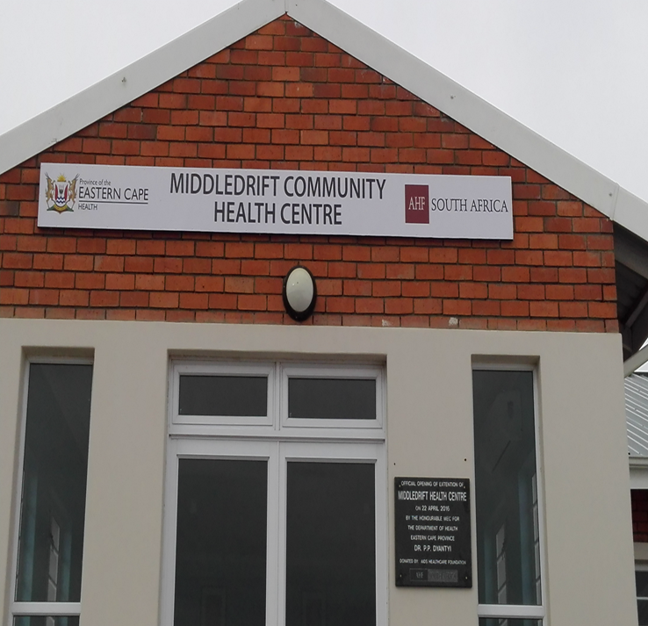
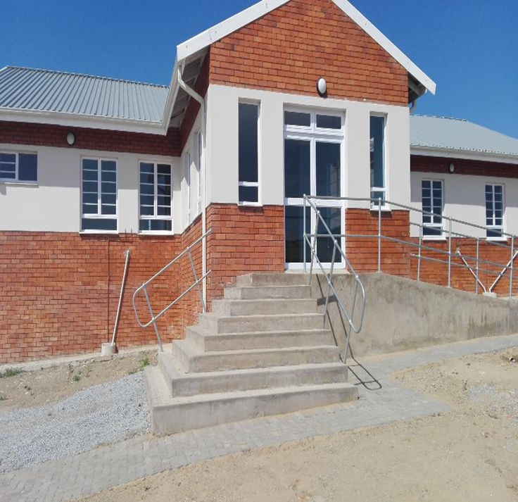
Role of partners
Aids Health Care Foundation – Built a new structure (MNCWH Stream) to extend Middle drift CHC as there was overcrowding.

Slide 27
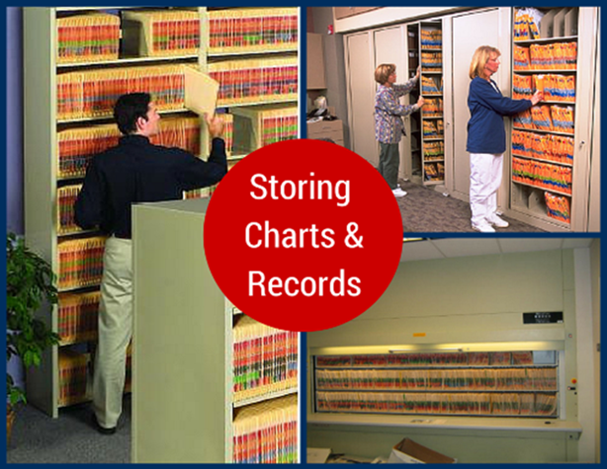
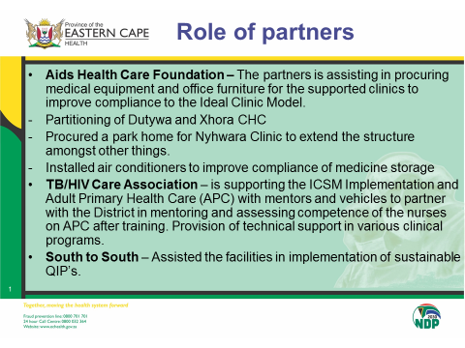
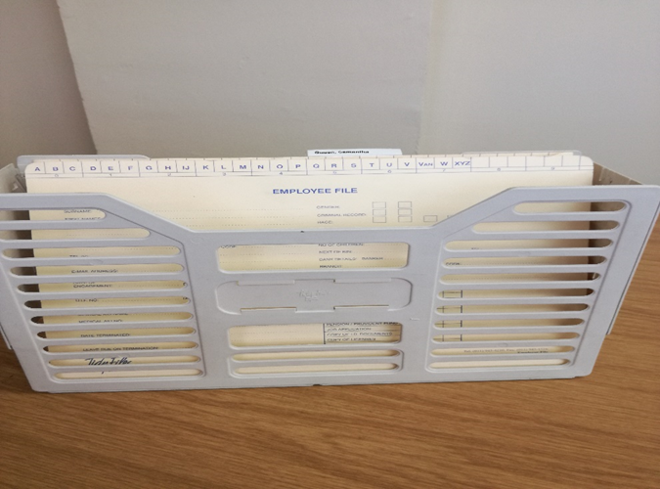
Role of partners
Aids Health Care Foundation – Supports the District in PHC Documents management e.g. procuring organisers and filing cabinets

Slide 28
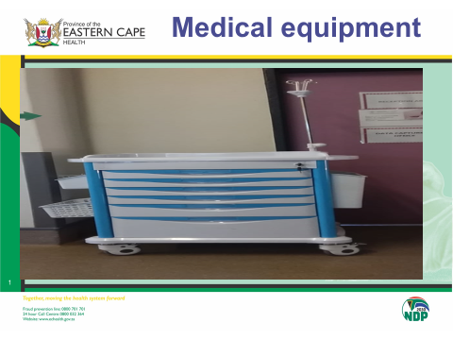
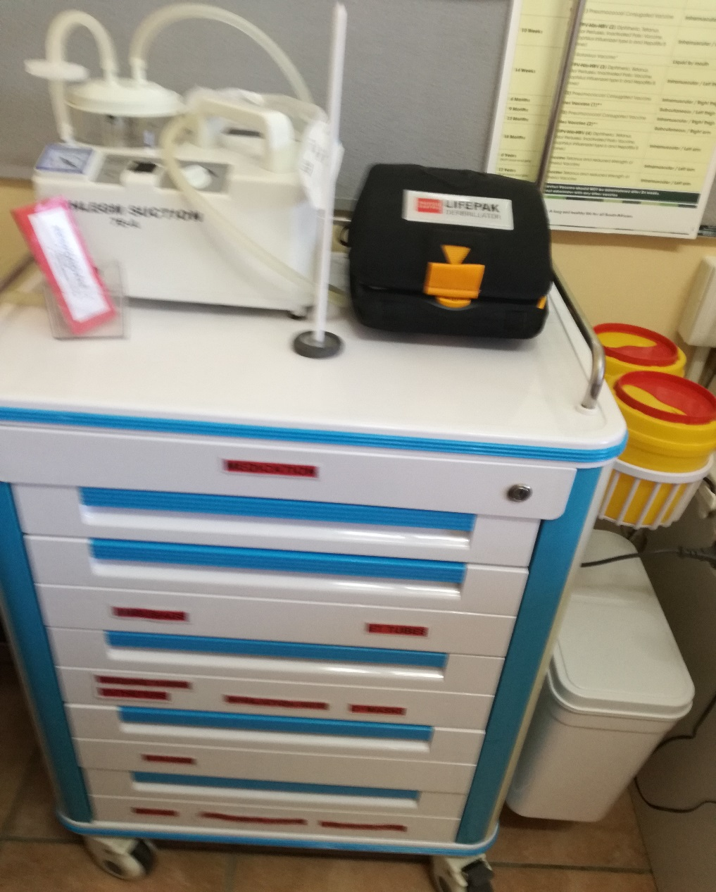
Health Technology improvement

Slide 29
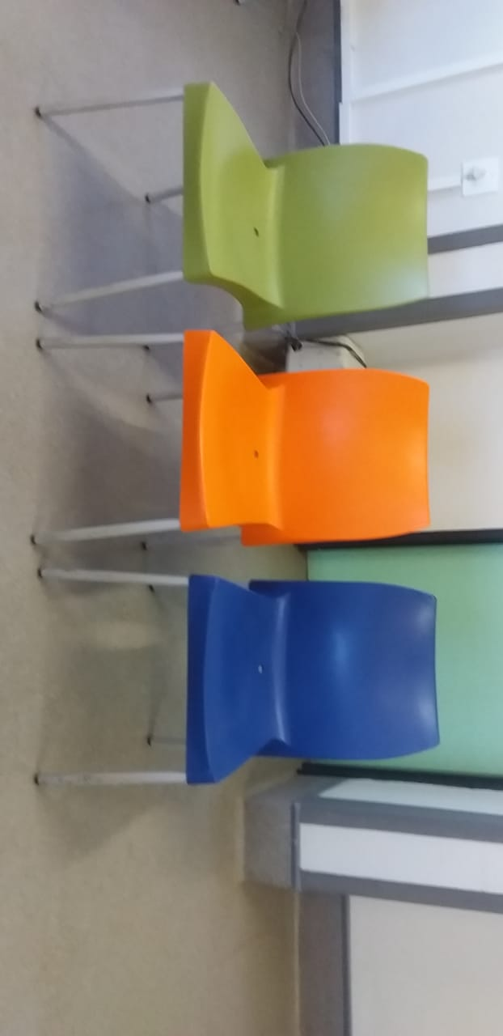
Colour coded chairs - streams

Slide 30
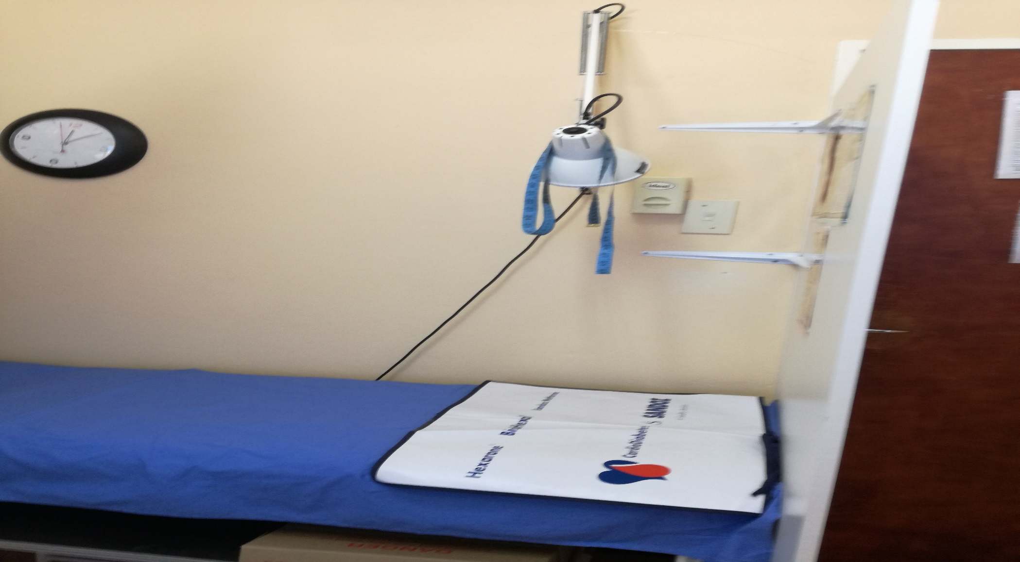
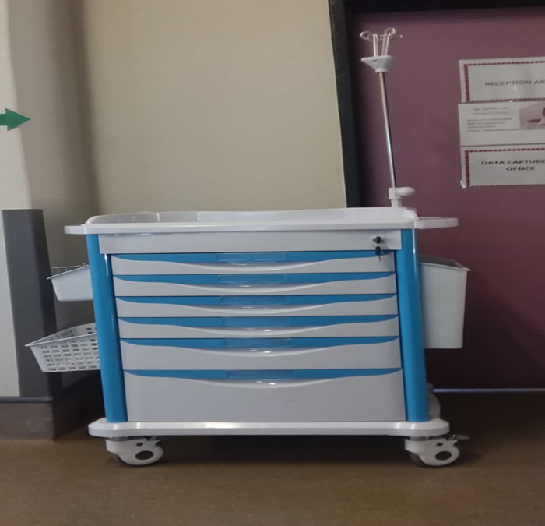
Consulting room

Slide 31
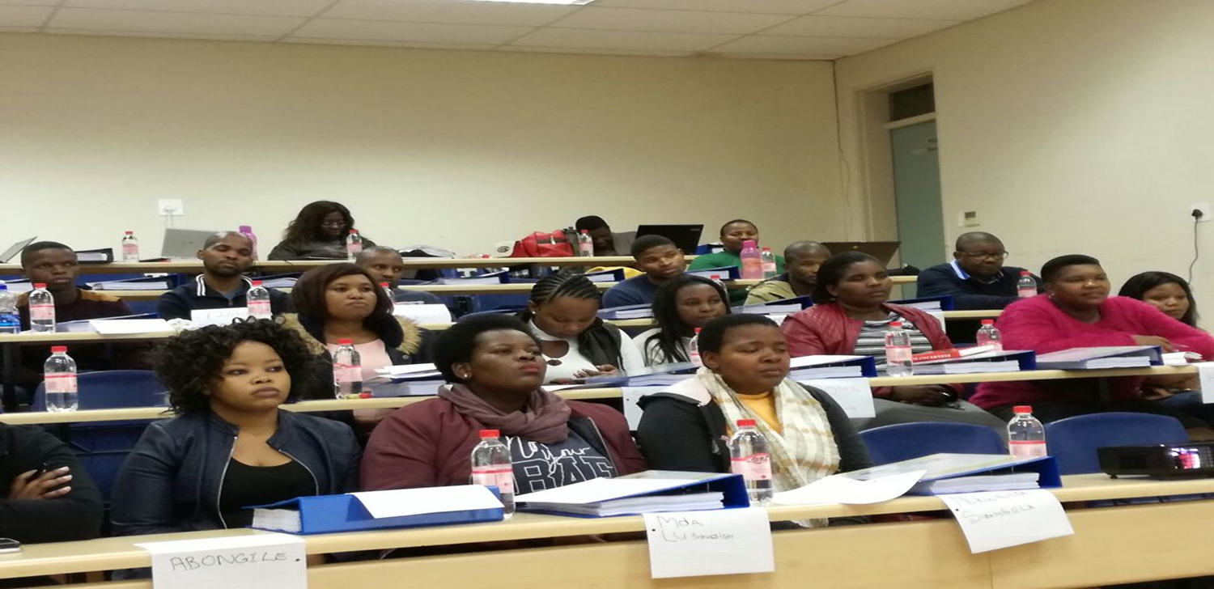
Staff capacity building

Slide 32
Critical Role Players of IC
Provincial Level
EMT
Provincial Champions
Provincial PPTICRM
Program Managers
District level
District Manager
DMT members
District Champions
District PPTICRM
DCSTs

Slide 33
Critical Role Players of IC
Clinic Supervisors
WBPHCOT
Supporting Partners
Sector departments
Facility level
Facility Manager
Facility champions
Clinic committees

Slide 34
Objectivity in conducting SDs, PR & PRU
Involvement of provincial PPTICRM
Cross facility SDs within the cluster
Revision of the manual together and iron issues of clarity and enhance standard practice
Training of PR teams
Using the IC Manual as the Bible at all levels
Verification of outcomes after baseline SDs – Clinic Supervisors

Slide 35
Relationship between IC & OHSC
Initially these were running parallel and frustrating at implementation level
Over the years gradually getting aligned
Aligned assessment tools
There`s now more understanding of the IC role vs OHSC role
If OHSC can prioritise facilities with IC status

Slide 36
Relationship between IC & NHI
Implementation of the appointment system ,CCMDD ,
HPRS
Infrastructure improvement especially the 8 NHI IC clinics in O.R.Tambo
Interdepartmental collaboration
Facility leadership
Budgeting
Medical equipment
ICT – improvement

Slide 37
Conclusion
The implementation of the ideal clinic program has yielded positive results in the primary health care system within the constrained resource environment without overlooking the identified set backs that surfaced.

Slide 38
THANK YOU

