Slide 1
ICRM – 5 year Review
Northern Cape Department of Health
Mr Riaan Strydom
Acting Chief Director: DHS and Health Programmes
26th, 27th February 2020
Garden Court, OR Tambo, Johannesburg

Slide 2
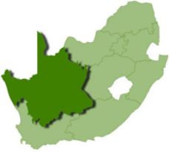
Northern Cape Province
Demographic Data
Geographical area | 372,889 Km2
Total population Northern Cape Mid-year estimates 2018 | 1,225,600
Population density (SA Mid-year estimates 2018) | 3.1/Km2

Slide 3
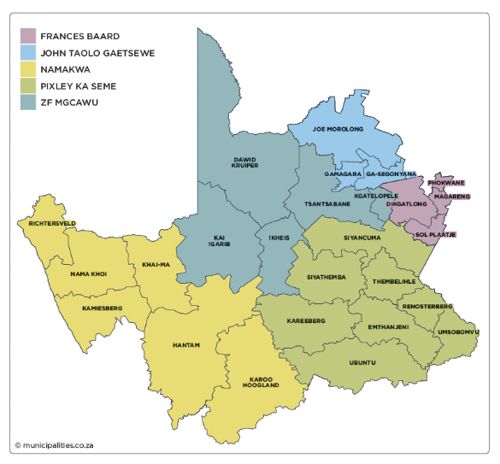
Northern Cape Province
5 Districts
  Frances Baard
  Namakwa
  ZF Mgcawu
  John Taolo Gaetsewe
  Pixley ka Seme
25 Sub-Districts
  Due to geography and other issues – some sub-districts are clubbed together
  We have on average 4 Health Area Managers per District
Clinics and CHC - 161
District Hospitals – 11
Distances – major challenge - +/-1600km

Slide 4
Progress from 2015 to date
Pixley ka Seme was the pilot site:
All 36 PHC facilities had achieved Ideal Status by the end of March 2018
5 Platinum
22 Gold
9 Silver
Ideal facilities program was rolled out over 3 years
The target for 2018-19 was 114 (72%) facilities

Slide 5
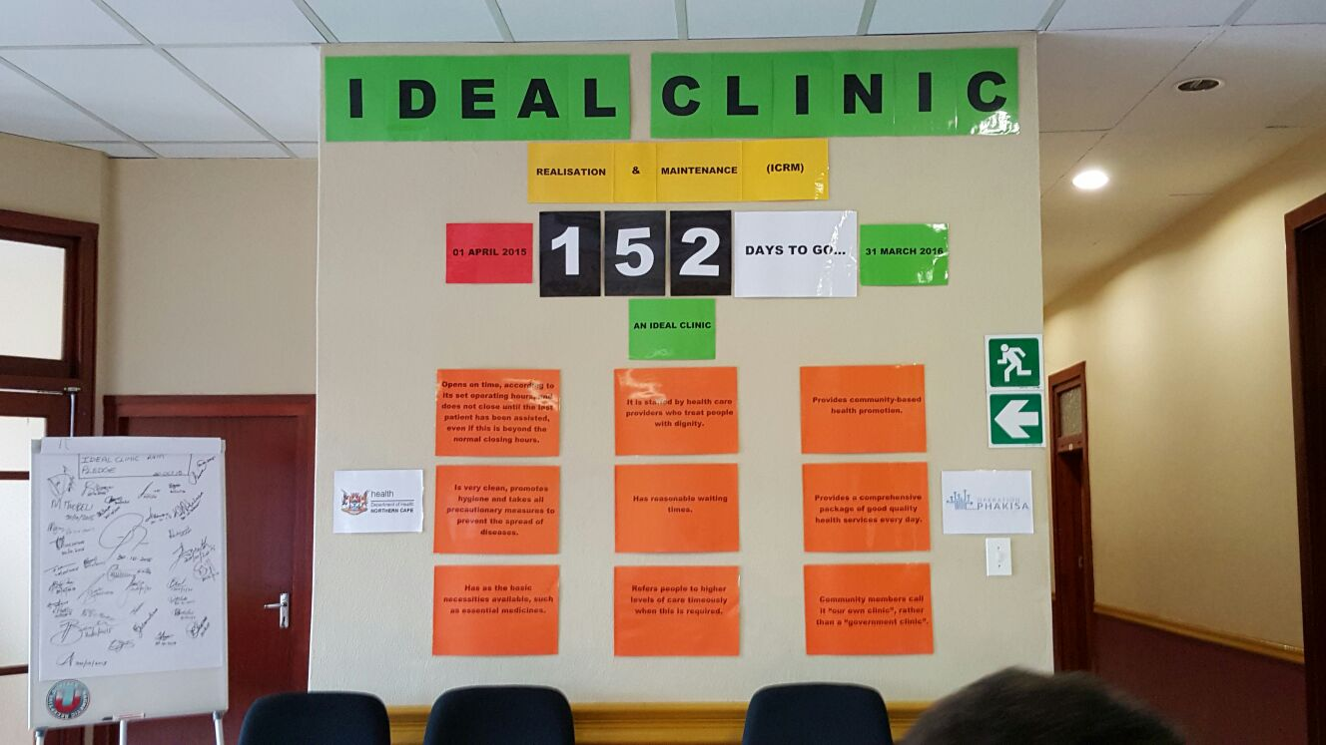

Slide 6
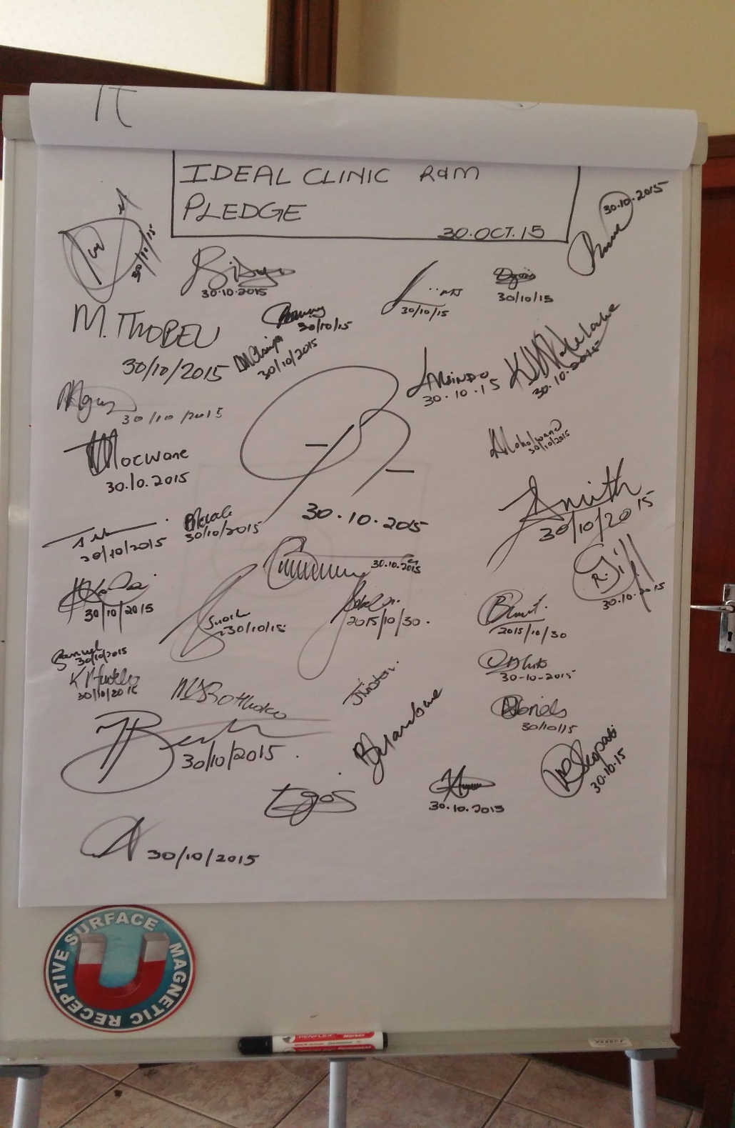

Slide 7
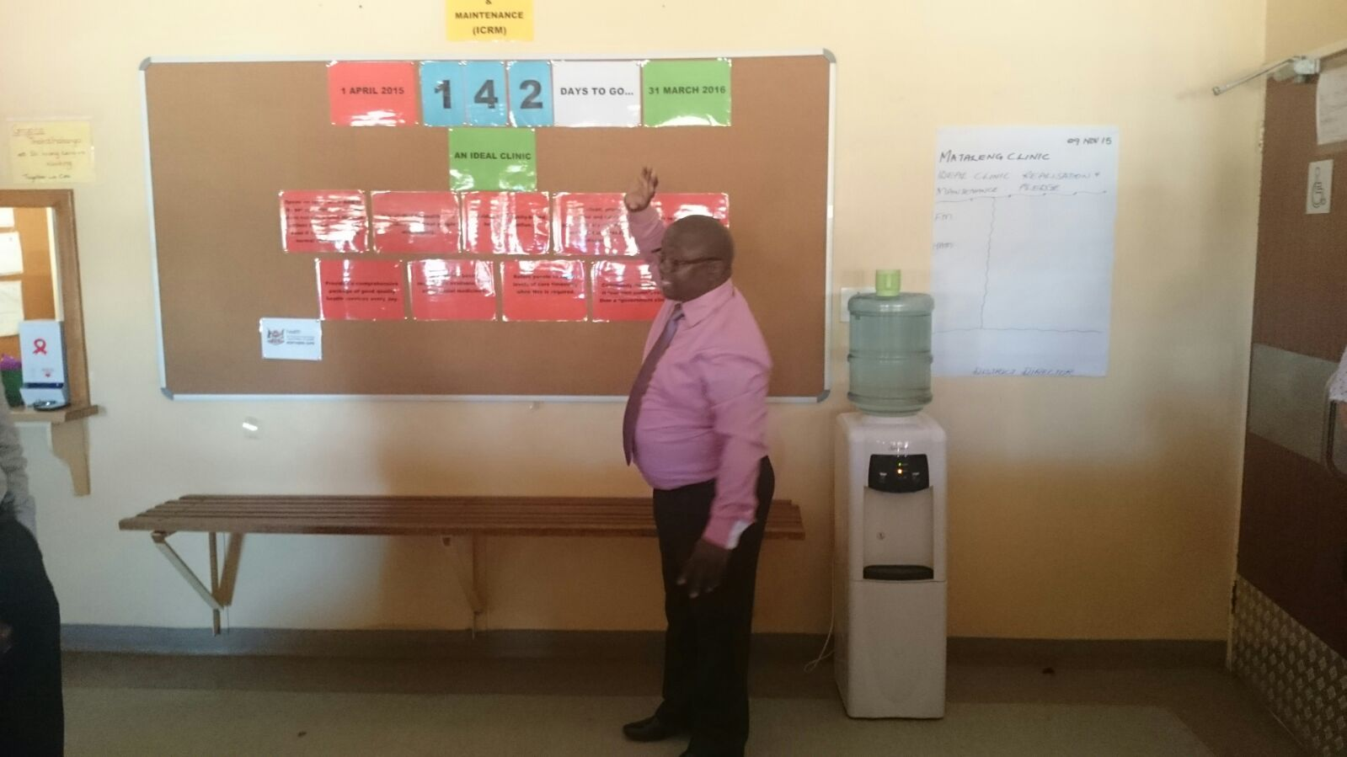

Slide 8
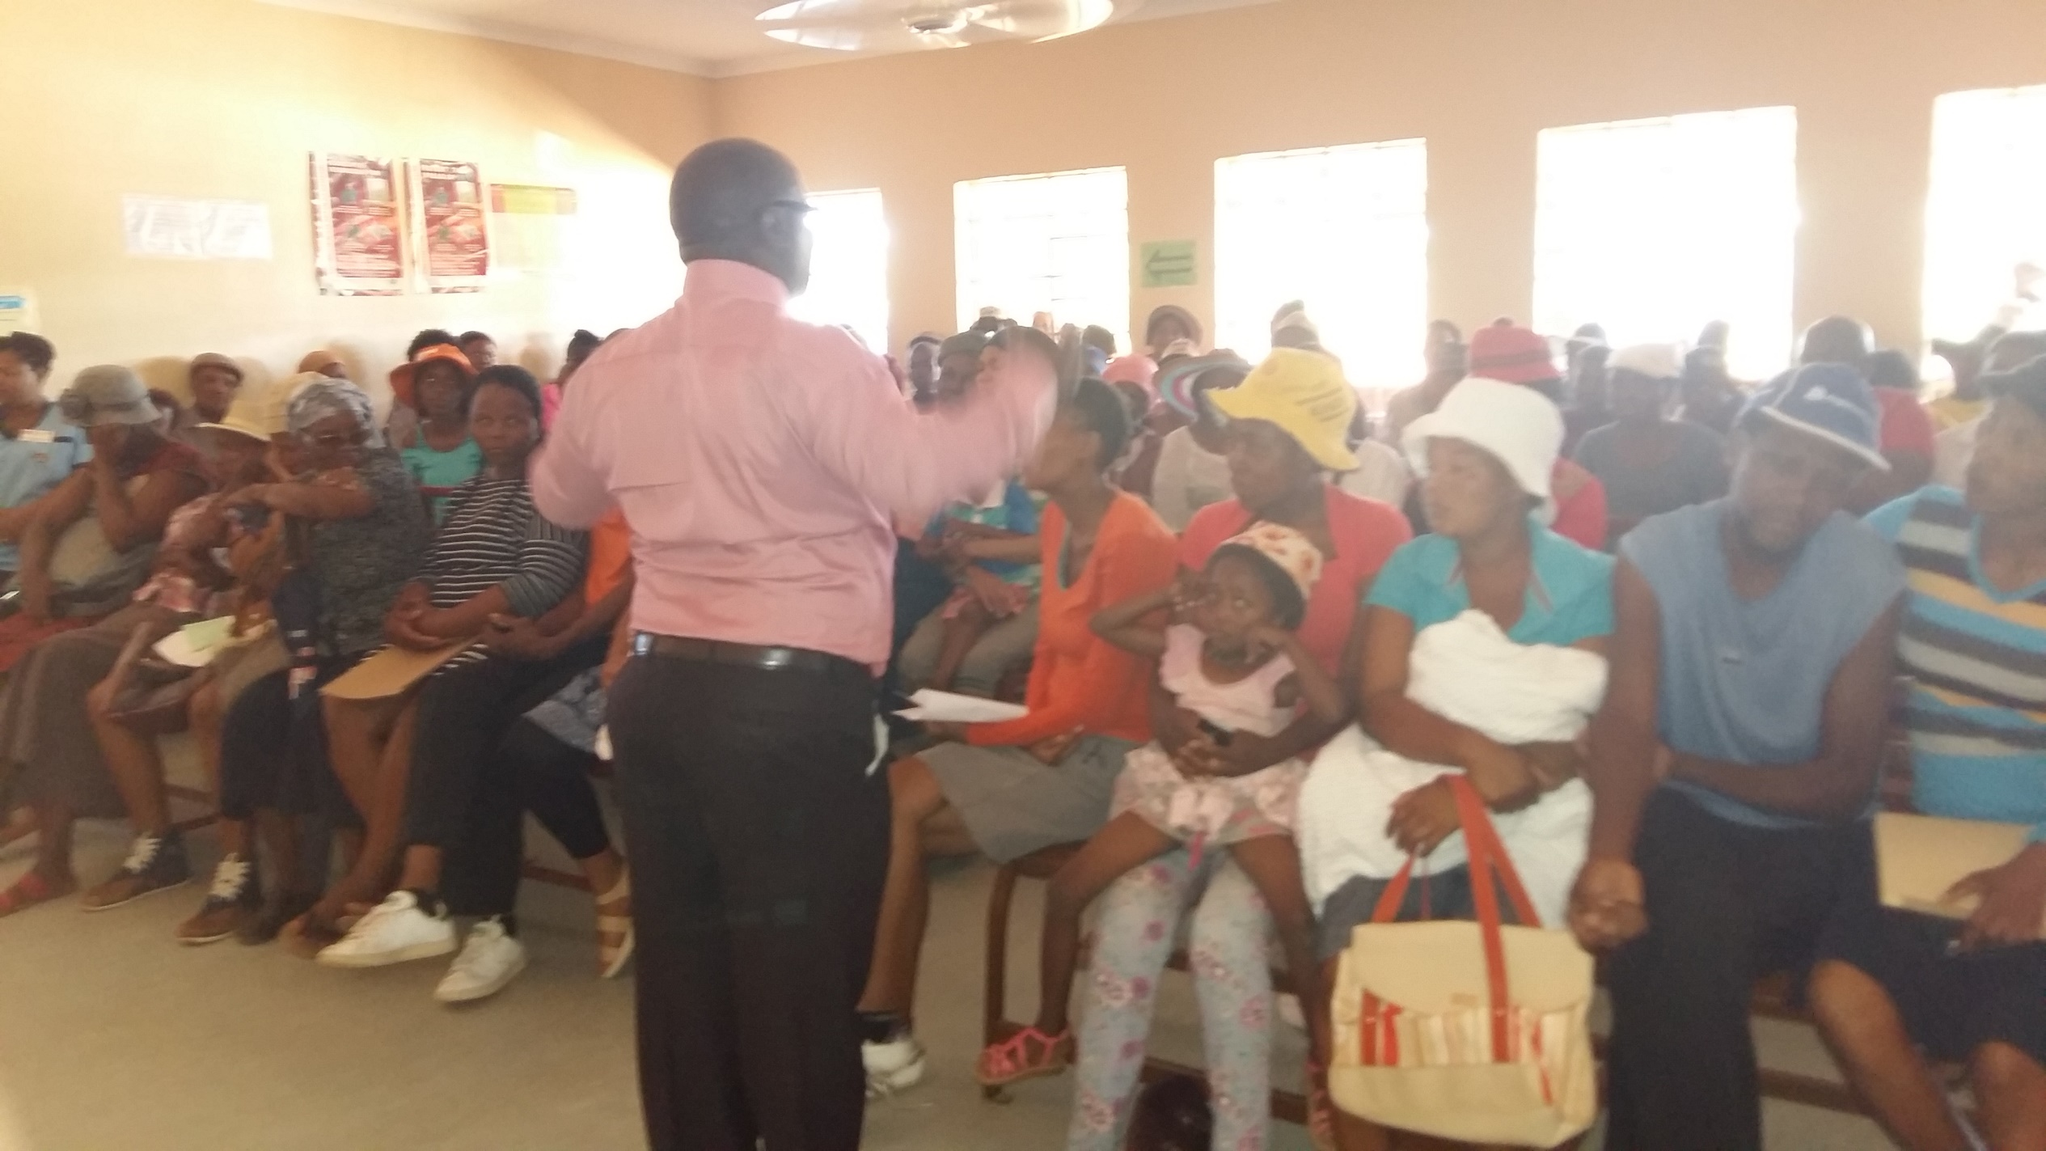

Slide 9
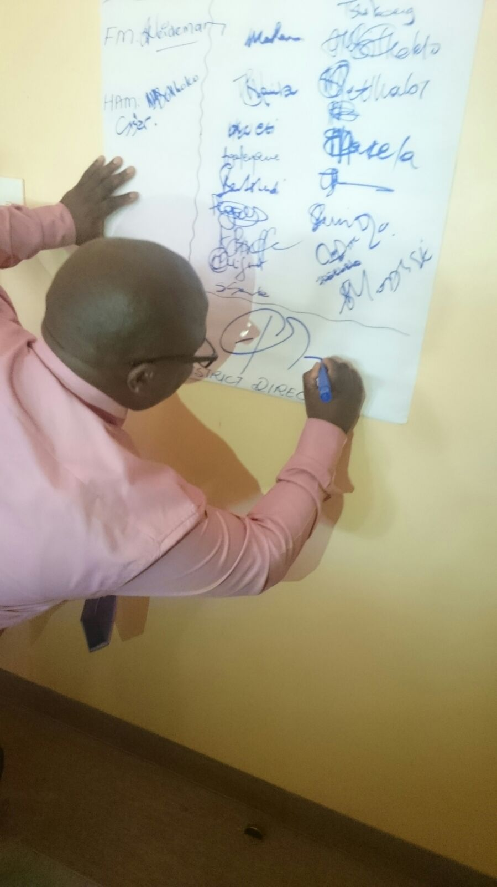
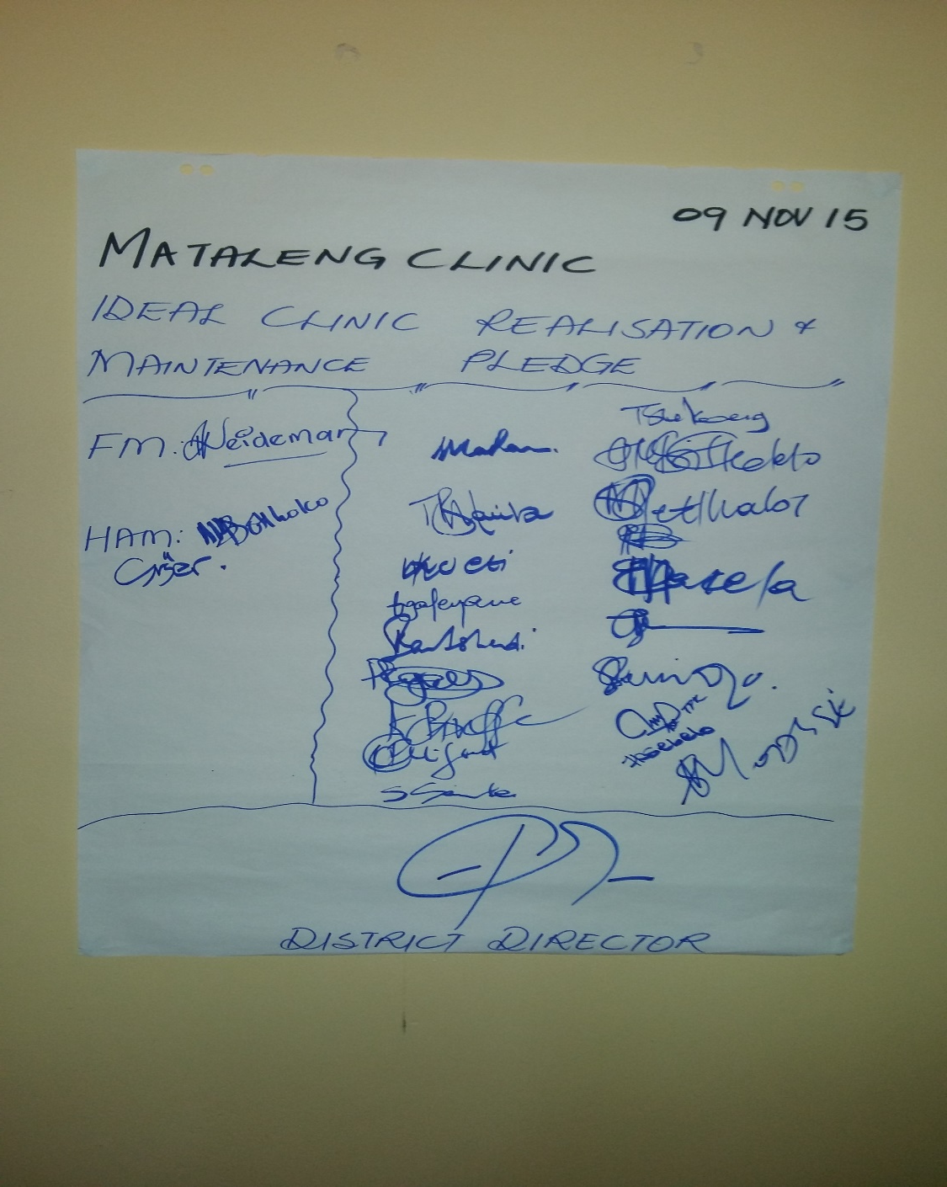

Slide 10
Facilities that didn’t achieve
48 Facilities never achieved
Infrastructure challenges and in this period some were under construction
Finance, Human Resource and Supply Chain which did not buy in.
Some facilities never had managers, other have acting managers
Facilities from before 1994 (very old) municipal building , houses
Some of the facilities were downgraded to satellites
Other facilities were merged as part of rationalisation
All facilities failed according to Staffing Norms

Slide 11
The leapfrogging approach to fast-track healthcare delivery
Leapfrogging is enabled by three types of innovation
Benefits of leapfrogging
Innovations that improve accessibility or process and are easily deployable
Accelerated implemen-tation
  Reduce time to measurable results: ICRM recommendations completely implemented
New
technology
New
operating
models
New
behavioural
patterns
Cost- effective
  Match or better current outcomes at lower cost than legacy solutions:
    Prioritised behavioural change and delivery fixes that require no funding;
    Most improvements delivered within current financial framework (without requesting additional funds)
Changes to simplify and standardise existing systems and processes, e.g., CCMDD, WBOTS, DCST
Actions that improve skills and mindsets needed to drive activities, e.g., empowerment of Facility Managers through training
Scalable
  Accommodate expansion efficiency: 161 PHC facilities, extendible to new clinics
SOURCE: World Economic Forum, Leapfrogging towards a Health System Vision

Slide 12
Prerequisites for success
  Budget approved
  Leadership across provincial and districts as well as facility managers and staff aligned on implementation plans
  PPTICRMs approved and in place
  Clinic teams staffed and trained
  Strict monitoring and evaluation of implementation plans
  Continuous change management implemented
  ‘…..scaling-up is about political and organisational leadership, about vision, values and mindset, and about incentives and accountability…… ’Hartmann and Linn, 2008, Framework and Lessons for development of effective scale up

Slide 13
Lessons from past transformations
Key success factors
  Evidence-based planning
  Stakeholder engagement incl. communication strategy
  Political leadership
  Governance
  Ownership and buy-in
  Dedicated resources (HR, FIN, SC)
  Strong monitoring and evaluation with clear targets and outcomes
Key challenges
  Poor change management
  Poor integration of health initiatives into existing health systems
  Competing priorities
  Launching health programmes without the necessary guidelines and toolkits
  Non-development of accompanying information systems during the design phase
  Poor documentation of lessons and good practices
SOURCE: Operation Phakisa Health Lab –Scale-up and Sustainability Lab

Slide 14
Description
1
Operating model
  PPTICRM to be set up at provincial, district and sub-district levels to create an enabling environment for implementation
  Governance structure at provincial, district and sub-district levels to create an enabling environment for Ideal Clinic realization and maintenance
2
  Change champions across all tiers of government to provide support within the health system and communities
  Training on change management and employee wellness
  Sharing successful change stories
  A reward system to recognise and encourage achievements
Change management
3
Stakeholder engagement
  Communication and consultation with all stakeholders
  Create awareness of and buy-in
  Create implementation partners

Slide 15
Implementation method
Definition
Examples
Ideal Clinic Accelerator
  Interventions that will be implemented at the clinic level
  Supported by existing supervisory structures, or in certain instances, a team of change agents who will take facility through pre-defined journey of change
  Supervisors/change agent team deployed for a period of time to assist with implementation
  Likely to be rolled out on a geographic basis
  Streamlining retrieval of files
  improving efficiency of patient flow
  Implementation of appointment system
  Implementation of ICSM
Transversal initiatives
  Interventions that will be coordinated at Provincial or National level
  Rolled out according to optimal pace and sequence (i.e. needs, performance)
  Roll-out of provincial call centres and communication platform
  Implementation of infrastructure programme
  Establishment of maintenance hubs
  Standardised catalogues for SCM and surgicals

Slide 16
District structure
Organisational structure
Roles and responsibilities
District Man. Team
  Mobilises resources
  Supports implementation at clinics
  Addresses bottlenecks
  Reports monthly to province
  District Manager
  Sub-District Managers
  Extended DMT
Sub-District Man.
  Coordinates activities at district, sub-district and facility
  Monitors and evaluates progress
  Reports to DMT
  Coordinates implementation at sub-district and facility levels
  Includes ICRM in implementation plans
  District manager
  Dedicated district management team champions
  Facility managers

Slide 17
  BrB
Description
Change
Initia-
tives
Role modeling
  Based on the Operation Sukuma Sakhe (OSS) “leadership sponsorship model”
  Allocate senior managers to all district to be accountable for the promotion of change management and assist with unblocking bottlenecks that are escalated from the different levels
Change management delivery units
  Role will be to monitor change and deal with bottlenecks that impede implementation
  Change champions and agents to be identified across the levels
  Will actively include and involve community representatives from the ward level
Dialogues for change
  Inclusion of change management as an agenda item in all meetings and forums; in strategic documents and as a standing item during management meetings
Training
  Facilitate training, mentorship, coaching and visible support downstream
  Change agents and PPTICRM teams to undergo change management training
  To include Training of the trainers, who will in turn cascade the training
Determine change readiness
  Perform change readiness assessment
  Results will influence selection and pace of change initiatives
Monitoring and evaluation: The change barometer
  Continuous monitoring & evaluation of the change management process to ensure that the changed behaviour is sustained through use of a change barometer

Slide 18
What were the critical success factors & drawbacks?
Received a lot of equipment through donations however no systems in place to maintain, accelerate program
There were maintenance hubs but it was stop due to centralization of processes
The staff were more at facilities and they were committed ( Although we had shortage of staff not as critical as currently)
It was a new program at District level – Buy-in from stakeholders were very good
Municipalities assisted where requested
It was functional PPTICRM - the champions could visit the facilities more often.
ICSM was better implemented
Stability in leadership
The pilot site got money for improving of health services (Good support)
The lessons learned were also took to the other Districts, policies,

Slide 19
What were the critical success factors & drawbacks?
DCST’s better co-operation and better impact on service delivery
Improvement teams moved from facility to facility and only focus on QIP’s
Continuous training - on new versions, new initiatives
Clinic committees were established and more committed
Quarterly meetings to M&E
Frances Baard had a war room with live monitoring,
Every district and facility had a master file – All staff to work from it
Good support from partners but before projects were completed partners withdrew

Slide 20
What were the critical success factors & drawbacks?
Staff changes – Retirements, resignations and new appointments
Integration of all programs is a requirement – not only DHS or only Quality but the WHOLE Department
Establish maintenance teams, clinical equipment and Infrastructure
Work closer with Infrastructure in design and projects for new facilities

Slide 21
Challenges experienced and strategies implemented
Covered on the previous slides
Distances, vastness – Video Conferencing, District-based Clinical Training Centres
Connectivity challenges from service providers - all facilities provided with equipment not connected as yet problems with signals
Compliance certificates not available
Trained trainers in Districts
Abrupt withdrawal of partners – mobilise Districts to continue

Slide 22
Sustainability of the programme
Towards the Future - UHC
Re-established Provincial , Provincial Executive chaired by HOD
During relaunched of Prov PPTICRM, All Programs were there, Clinical and non-clinical stakeholders
Having Improvement teams
Training version 19, ICSM, EWS, BLS, etc
Revise all policies and SOP’s
PPTICRM will focus on PHC and District hospital
Training for clinic committees and hospital boards
Focus on PEC and health outcomes
Performance Management to again include Quality as a KPA
Video conference facilities implemented throughout the province at District Offices
MEC Awards for best performing and best improving facility/District - 2020
Training start of 90 Pharmacy assistants across the province
Teams at Depot to pack the meds for Districts
Appoint WBOT outreach team leaders and appoint, complete WBOTS outreach teams in some Districts

Slide 23
The critical role players for the success of the Ideal Clinic
All levels
All Managers
All Coordinators
Health Area Managers
Operational managers
Staff
Governance Structures
External Stakeholders

Slide 24
How can we ensure the objectivity in conducting Baseline SD, PR and PRUs?
Good Oversight
In Assessments Teams – Allocated Team Member / Champion to verify information captured
Target maximum difference between different levels of assessment teams including OHSC
Our achievement in the past was 5% maximum difference
Accountability for incorrect reports

Slide 25
Relationship between the Ideal Clinic, OHSC & NHI
We see it as a stepping stone towards UHC and NHI
We need a strong cooperation at National level and lower down
Clarity and consistency on expectations and standards
Teamwork and Oversight
Must not be punitive
A great opportunity to improve quality, service delivery and health status of our communities

Slide 26

Promoting team work at all levels remains the key to success

Slide 27
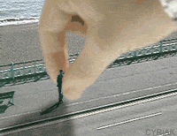
SOMETIMES IT MAY FEEL LIKE THE SYSTEM IS DOING
this to you...
Be strong and keep going on! !

Slide 28
Thank – you for listening!
“Work joyfully and peacefully , knowing that right thoughts and right efforts will inevitably bring about
right results”.
- James Allen

