Slide 1
1
ICRM 5 YEAR REVIEW
MR RAMPHELANE MOREWANE
26 FEBRUARY 2020

Slide 2
2
OUTLINE
Health challenges
NDoH Response
Results
  ICRM Programme Journey
Mechanisms for Quality Assurance
Annual ICRM Cycle
Current Status
Lost status in 4 years
Current focus areas
Recommendations
Conclusion

Slide 3
3
HEALTH CHALLENGES
Visible:
Shortage of required resources
Inhabitable physical environment
Access to services
Increasing burden of diseases
Dissatisfied patients and communities
Dissatisfied staff members
Increasing litigations

Slide 4
4
HEALTH CHALLENGES…
Emerging & re-emerging health conditions and new demands on staff
HRH capacity
Multiple directives
Budget pressures
Procurement processes
Management Support

Slide 5
5
NDoH RESPONSE
Baseline audit in 2012/13 in 10 clinics;
Facility improvement teams – root-cause analysis;
Uniform approach using same tools to allow comparability and benchmarking; and
Ten study sites identified

Slide 6
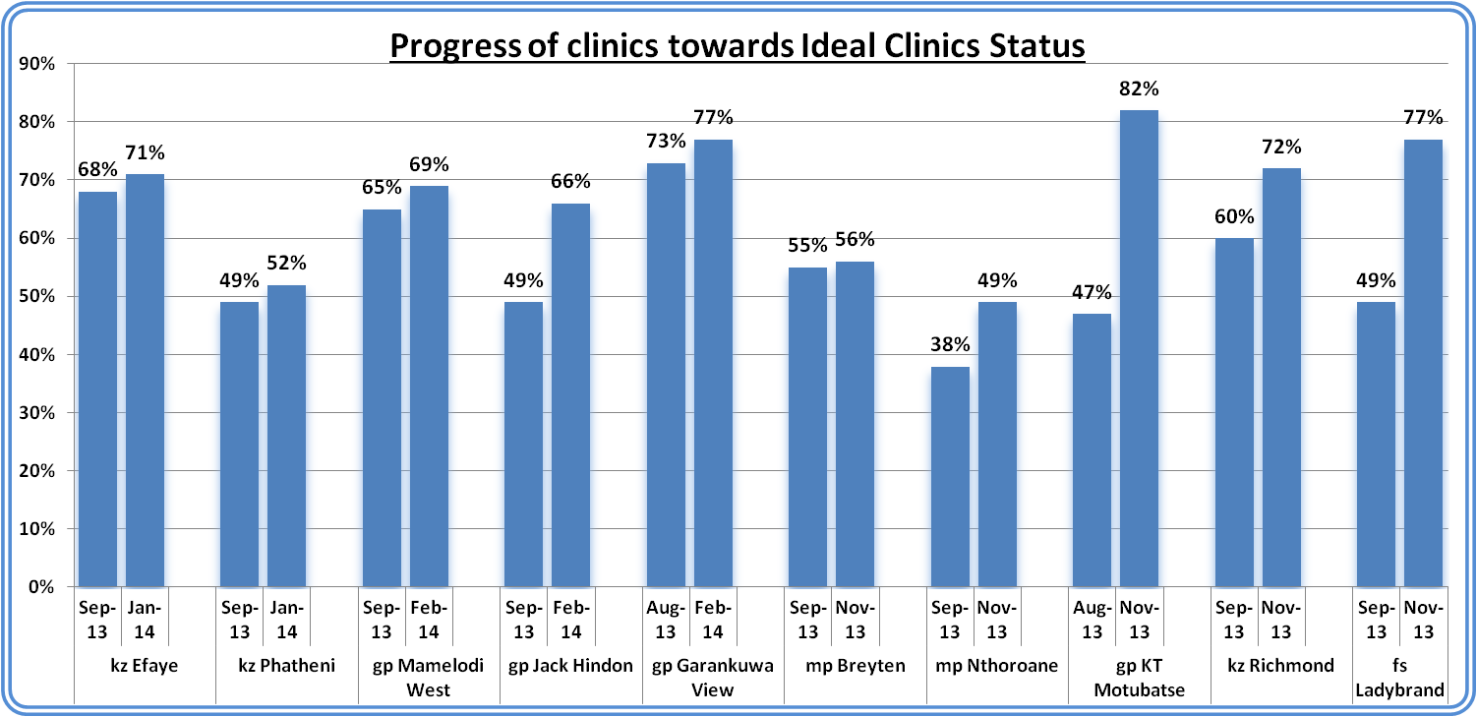
6
Responsibility
NDoH RESPONSE

Slide 7
7
  ICRM PROGRAMME JOURNEY
Start
2013
10 x Study Sites
Dr/ Nurse Teams
Ten study sites
2014
Operation Phakisa Laboratory
ICRM F/ Work, Manual & S/Ware
5 Year Review
2020
2015 -19
Programme Implementation

Slide 8
8
MECHANISMS FOR QUALITY ASSURANCE
Aligned to the OHSC
  Internal Audit
  Ideal Clinic Framework
  Ideal Hospital Framework
To assure the public that the specific Health Establishment (HE) is safe and delivers minimum standard of care as measured against the norms and standards set by the NDoH

Slide 9
9
ICRM PROGRAMME REVIEW
Programme review is a cyclic process of measuring program effectiveness and sustainability by:
  gathering evidence;
  analyzing qualitative and quantitative data;
  using this data for decision-making at all levels; and
  planning for and implementing necessary changes.

Slide 10
10
ICRM PROGRAMME REVIEW PRINCIPLES
ICRM
Mission-driven
Manageable
Meaningful
Flexible
Sustainable
Ongoing

Slide 11
11
ICRM PROGRAMME
Aims to:
Systematically transform all PHC facilities;
Meet norms and standards;
Prepare for National Health Insurance (NHI)
An Ideal clinic:
Has good infrastructure;
Adequate staff; medicines & supplies;
Good administrative processes;
Adequate bulk supplies;
Uses applicable clinical policies, protocols & guidelines; and
Has partner and stakeholder support

Slide 12
12
ICRM PROGRAMME IMPLEMENTATION
Listing and definition of the requirements for well-functioning clinics (components, sub-components & elements);
SOPs included in the ICRM Manual;
Focus & level of specificity with which the ICRM Framework (number of iterations from the first version);
Improve the quality of services at poorly functioning clinics;
The NDoH receives continuous feedback from managers and staff at provincial, district and facility levels; and
Changes required to guidelines, SOPs and systems processes.

Slide 13
13
ANNUAL ICRM PLAN-DO-STUDY-ACT CYCLE

Slide 14
14
CURRENT STATUS OF IDEAL CLINIC
Province | 2015/2016 | 2016/2017 | 2017/2018 | 2018/2019 | 2019/2020 (Preliminary results)
Eastern Cape | 14 | 139 | 157 | 249 | 15
Free State | 22 | 78 | 114 | 168 | 0
Gauteng | 89 | 215 | 291 | 330 | 6
KwaZulu-Natal | 141 | 288 | 383 | 461 | 19
Limpopo | 27 | 51 | 121 | 165 | 1
Mpumalanga | 19 | 66 | 87 | 133 | 3
Northern Cape | 3 | 67 | 89 | 92 | 0
North West | 7 | 92 | 121 | 141 | 9
Western Cape | - | 41 | 144 | 181 | 23
TOTAL | 322 | 1037 | 1507 | 1920 | 76

Slide 15
15
# FACILITIES THAT LOST IC STATUS IN 4 YEARS
PROVINCE | TOTAL # FACILITIES | # LOST IC STATUS IN 4 YEARS | # REMAIN IDEAL
EASTERN CAPE | 771 | 106 | 183
FREE STATE | 222 | 19 | 149
GAUTENG | 368 | 26 | 320
KWAZULU-NATAL | 605 | 93 | 406
LIMPOPO | 481 | 150 | 41
MPUMALANGA | 228 | 29 | 123
NORTHERN CAPE | 161 | 95 | 18
NORTH WEST | 308 | 79 | 90
WESTERN CAPE | 263 | 26 | 171
TOTAL | 3467 | 623 | 1501

Slide 16
16
ACHIEVEMENTS
Secured budget through In-Kind grant
Supported by CDC-PEPFAR through Cooperative Agreement
Well supported through Software
Equipment catalogue completed
Laboratory handbook completed
Inspired the Department to start with Ideal Hospitals
Aligned our elements with the measures of the OHSC
Passed 50% mark of the ideal clinics
Provinces were supported with equipment

Slide 17
17
CURRENT FOCU AREAS
Infrastructure
Staff availability & training
Supply chain Management
Facilities with Lost status
Equipment

Slide 18
18
CONCLUSION
District Health Management Team (DHMT) supported by provincial management is responsible for the success of ICRM Programme;
ICRM activities to be in all health worker’s Performance Agreements;
The epicentre of ICRM Programme is
  Monitoring
  Effectiveness
  Program sustainability
Service quality must be improved continuously through good knowledge management, appropriate training, interventions; and
Attained ideal status should not be lost and must be linked to improved health outcomes.

Slide 19

19
CONCLUSION
Enjoy your work and celebrate your accomplishments!

Slide 20
20
THANK YOU

