Slide 1
PATIENT EXPERIENCE OF CARE (PEC) SURVEY GUIDELINE
QA FORUM
Ms I A JAUTSE (NDoH Directorate: QA)
Date: 07 DECEMBER 2017
Venue: EC

Slide 2
Outline
Background of the Patient Experience of Care survey guideline.
Purpose
Features of the PEC survey guideline 2017
Projections
Service delivery improvement
Requirements for conducting the PEC survey
Implications for conducting the PEC survey
Summary and conclusion

Slide 3
BACKGROUND OF THE PEC SURVEY GUIDELINE
Patient involvement is a right as espoused by various pieces of legislations, policies and guiding documents, such as:
  The Constitution of the Republic of South Africa, Act 108 of 1996
  The National Health Act 61 of 2003 – NDoH must promote community participation in the planning, provision and evaluation of health services.
  The Patient Rights Charter for South Africa (1999) – patients have the right to participate in the development of health policies and in the decision making on matters affecting their health.
  DPSA prescripts i.e. Eight Principles of Batho Pele (1997),
  Ministerial Priority areas
  Operation Phakisa 2: Health Outcomes (November 2014)
  National Core Standards for Health Establishments in South Africa (2013)
  Our future – make it work: National Development Plan South Africa (2030
  Consumer Assessment of Healthcare Providers and Systems (CAHPS) 2014

Slide 4
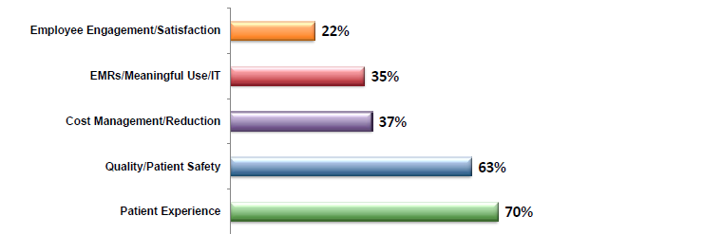
2. PURPOSE
There is evidence of a reciprocal relationship between patient satisfaction and continuity of care (which is associated with better health outcomes)*
Top three organizational priorities for health care leaders
Ref: Beryl Institute, 2013
Notes:
*Saultz JW, Lochner J. Interpersonal continuity of care and care outcomes: a critical review. Ann Fam Med. 2005. 3:159-166.
*van Servellen G, Fongwa M, Mockus D'Errico E. Continuity of care and quality care outcomes for people experiencing chronic conditions: A literature review. Nurs Health Sci. 2006. 8:185-195
*Fullam F, Garman AN, Johnson TJ, Hedberg EC. The use of patient satisfaction surveys and alternative coding procedures to predict
malpractice risk. Med Care. 2009. 47:553-559
* Luxford, K. (2012). What does the patient know about Quality? International Journal for Quality in Health Care: Journal of the International Society for Quality in Health Care, 24, 439-440

Slide 5
2. PURPOSE CONTINUED
The PEC survey seeks to determine patients’ experience of care and their level of satisfaction to guide service delivery improvements.
The PEC survey guideline describes the process to be followed to seek feedback from patients and use such feedback to:
  resolve potential problems timeously
  identify matters that require a better explanation to patients
  guide continuous education for all staff members, i.e. learning about what is important to patients
  determine reliability of other sources of information (through triangulation process) so as to inform further studies and improvements.
To ensure that provincial QA/PRO/Customer care are empowered to facilitate prepare for the PEC survey in 2018/19

Slide 6
3. FEATURES OF PEC survey guideline (2017)
3.1 Focus areas
Access to services (100%)
Medicines (95%)
PATIENT FEEDBACK
(BP & PRC)
Safety (65%)
Cleanliness and IPC (74%)
Positive values and attitudes (74%)
Acceptable patient waiting time (74%)
POSITIVE / NEGATIVE EXPERIENCE OF CARE

Slide 7
3. FEATURES OF PEC survey guideline (2017) continued
Assesses patients’ experience rather than perception of care
Timing – 2nd financial quarter – logistics, data collection, data analysis and report
Employs a descriptive, cross-sectional survey methodology
It acknowledges that not all patients pass through all areas while in hospital
3.2 Tools used to seek feedback from patients:
Out patient and inpatient questionnaires translatable in all official languages
Binary questions – weighted and unweighted
Questionnaires have built-in skip logic functions and built-in data quality control mechanism
Rigorously tried and tested in various scenarios - tested for content validity and internal consistency through statistic item-total, Chronbach’s alpha co-efficient (all scored > 0.70) and multiple regression models and analysis
3.3 Software for capturing and analyzing PEC survey data
In-built software with capacity to calculate the sample size as informed by annual head count
Paper based data collection tools require capturing into the software - alternatively electronic gadgets may be used to directly collect and capture in the web-based DHIS module for PEC
Overnight time reporting– no need to run quality control mechanisms before submitting thus significantly reduce TOT of reporting
<50-59%, >60-79%*, >80%**

Slide 8
3.FEATURES OF PEC survey guideline (2017)
3.4 Methods:
  Sampling size is comprised of random sampling of 15% of annual adult head count
  Inclusion criteria focuses on able and willing adults
  Data is collected at the end of patient’s journey through the facility– no interference with health care processes and comprises of
    Patient information page
    Consent forms – for audit purposes (double blinding)
    Data collection and capturing (using predetermined questionnaires)
  Analysis and reporting (aggregated reports)
    Patient profile and
    6 health priority areas
    Results are aggregated according to
      a unit in the facility
      a facility
      Sub/District
      province and
      national
  Service delivery improvement template – for completion by respective levels of care

Slide 9
3.FEATURES OF PEC survey guideline (2017)
3.5 MEASUREMENT OF PEC SURVEY
PEC survey rate (number of facilities that conducted PEC survey in line with the national guideline / total number of facilities during the 2nd quarter of the financial year) - to determine national average.
Patient Satisfaction rate = positive PEC (of the total number of facilities
at respective level of care, how many scored an average >80% during the 2nd
quarter of the financial year)
The PS rate is categorized according to >80%, 60-79%, <50-59%

Slide 10
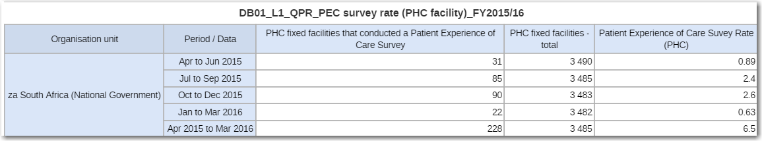
4. PROJECTIONS
3.5 PEC SURVEY RATE – National level

Slide 11
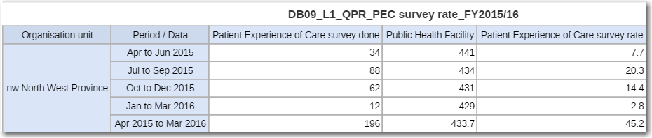
4. PROJECTIONS
3.5 PEC SURVEY RATE - continued

Slide 12
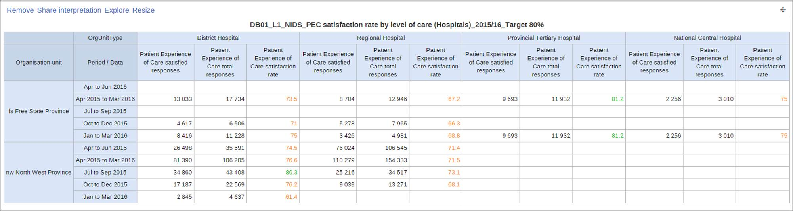
4. PROJECTIONS
3.5 PATIENT SATISFACTION RATE – aggregated according to levels of facilities

Slide 13
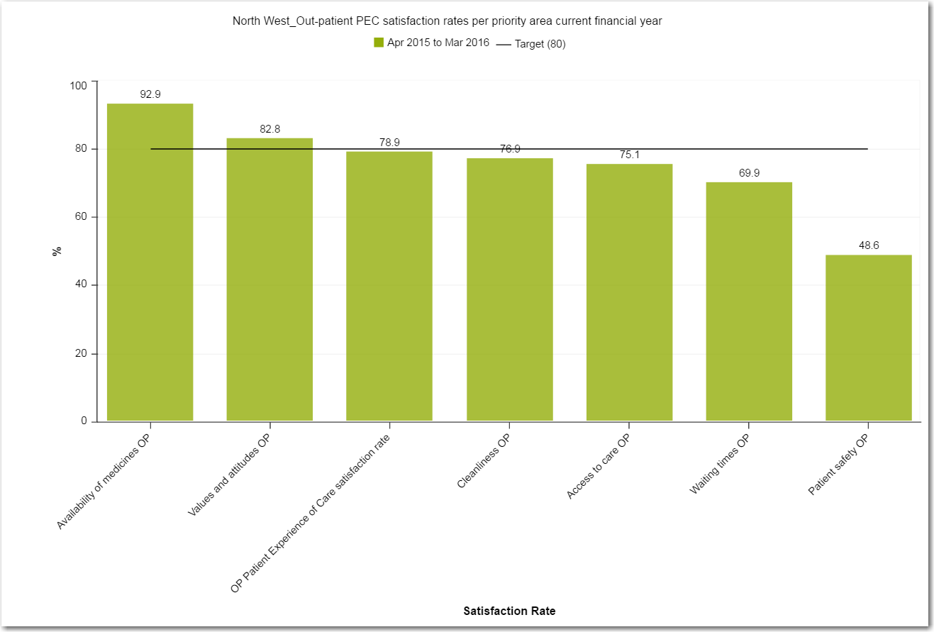
4. PROJECTIONS
3.5 PATIENT SATISFACTION RATE (OPD)– aggregated according to six priorities of care

Slide 14
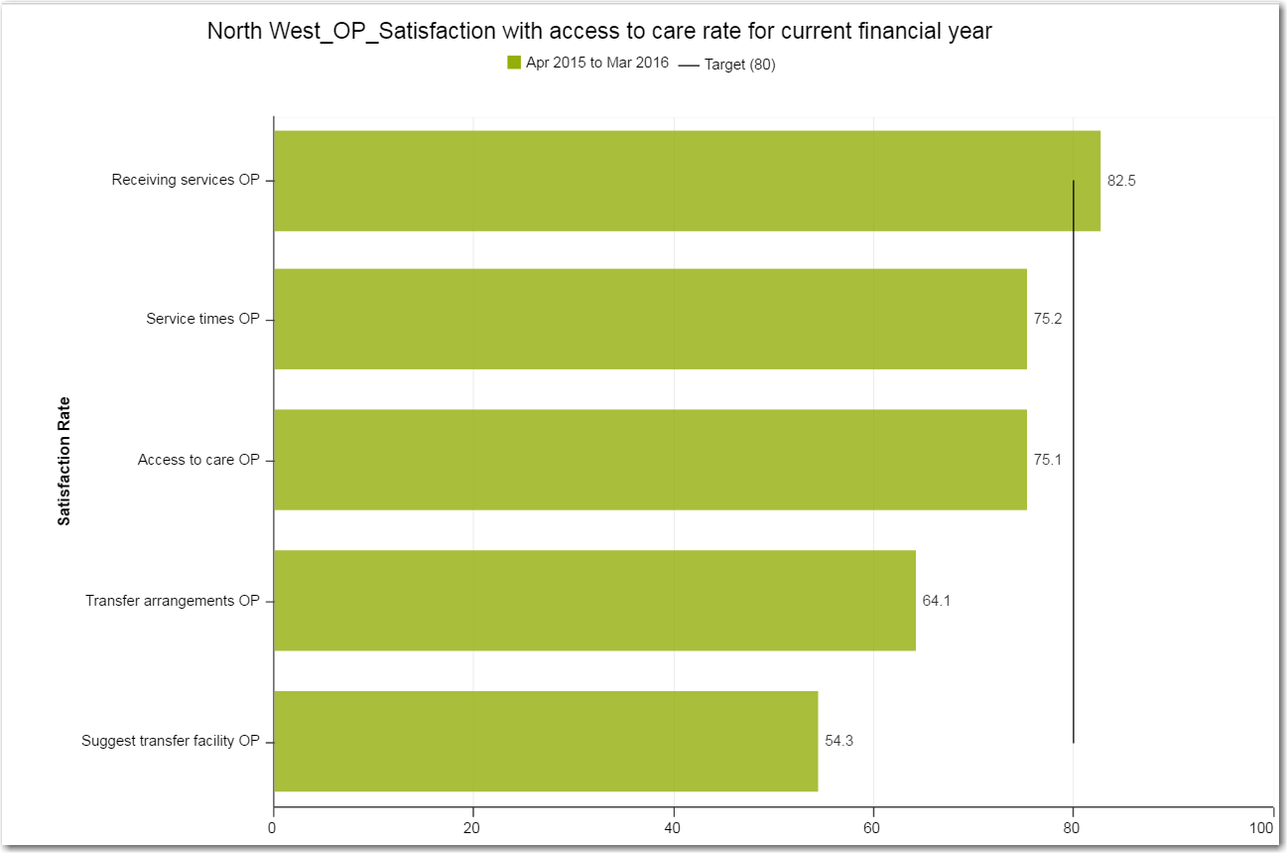
3.5 PATIENT SATISFACTION RATE (InPatient)– disaggregated according to variables of a priority area e.g. access

Slide 15
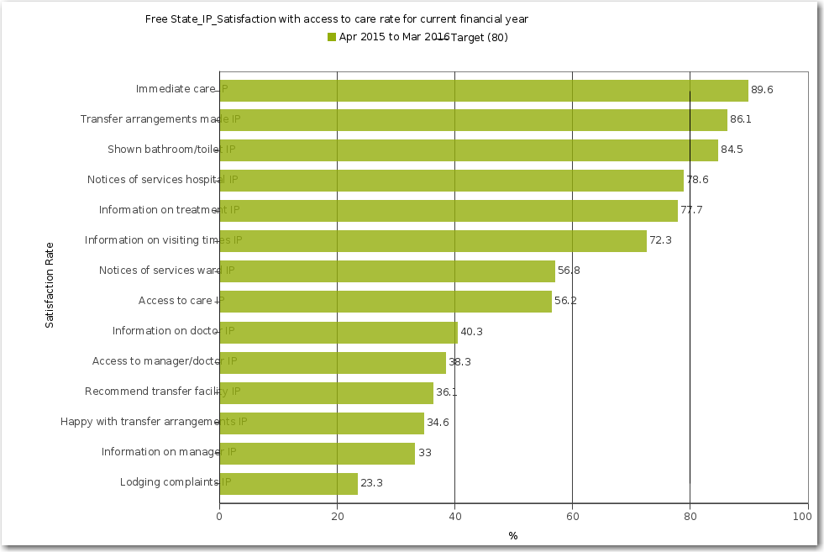
4. PROJECTIONS
3.5 PATIENT SATISFACTION RATE (InPatient)– disaggregated according to variables of a priority area e.g. access

Slide 16
5. SERVICE DELIVERY IMPROVEMENT
Priority area | Required score (%) | Score obtained (%) | Contributory factors | Remedial / improvement | Due date
Pt access | 100 | 75.1 | Insufficient access to information | Institutionalize sharing of info on: - lodging of complaints management structure treating doctor Patient involvement in transfer arrangements Orientate patients of their surroundings | 20/12/2017
Patient safety | 64 | 48.6
Availability and use of meds | 95 | 92.9
Cleanliness | 74 | 76.9
Values and attitudes | 74 | 82.8
Patient waiting time | 74 | 69.9

Slide 17

6. Requirements for conducting PEC survey
.
TIMING - 2ND quarter of the financial year
Tools
Internet connectivity
Access to WebDHIS module
Human resources:
Facilitator (QA/Customer Care/PRO manager)
Data collector
Data capturer
HI Manager
METHODS
  Logistics
  Locate patient exit areas
  Provision of information to patients
  Sampling criteria
  Interview and self completed at end of journey
  Capture in the PEC module of web-DHIS
  Report writing – includes SDI
  Publish results and SDI
  Patients continue monitoring and feedback through CCS

Slide 18

6. Requirements for conducting PEC survey cont.
Facilities
Districts
Provinces
NDoH
This guideline is intended for use in public health establishments to obtain structured feedback from patients through the services of an independent service provider.
  2018/19 and >
  2017/18 – All provinces to prepare for PEC survey
  2018/19 – PEC survey be conducted in line with the Nat PEC survey guideline
  Common timing for conducting the survey – 2nd quarter
  Utilize WebDHIS software module
  M&E
PEC survey rate
Patient satisfaction level <50-60%, >60-80%*, >80%**
Aggregated / disaggregated accordingly
Notes:
*Consumer Assessment of Healthcare Providers and Systems (CAHPS) 2014
** Operation Phakisa 2: Health Outcomes (November 2014)

Slide 19
7. IMPLICATIONS OF CONDUCTING A RELIABLE PEC SURVEY
Factors for consideration
Dedicate a budget for PEC survey
QA’s/customer care/PRO – organize and facilitate the PEC survey
Independent service provider
Access rights to WebDHIS and Internet connectivity
Information managers to assist with guidance and support ito the DHIS and information prn
Notes:
*NHIS data capturers

Slide 20
8. SUMMARY AND CONCLUSION
Obtaining structured patient feedback is one of the valuable sources of information that guides quality service delivery and is supported by various legislations.
Involving patients in the provision of care improves credibility of the public health care system improved compliance to health care options positive health outcomes reduced health costs increased life expectancy.
Results of PEC survey may be:
  triangulated with those of other sources of health information, therefore provide detailed information that can pinpoint areas that require improvement.
  further used for correlation research studies between patient characteristics and priority areas of care thereby assisting in the development/review of health policies.
Dedicate 2017/18 for preparation of full implementation of PEC survey from 2018/19

Slide 21
THANK YOU!

