Slide 1



IDEAL CLINIC REALIZATION AND MAINTENANCE (ICRM) PEER REVIEW FEEDBACK ON STATUS DETERMINATION OF FEBRUARY 2016
KWAZULU-NATAL TEAM
21 APRIL 2016

Slide 2
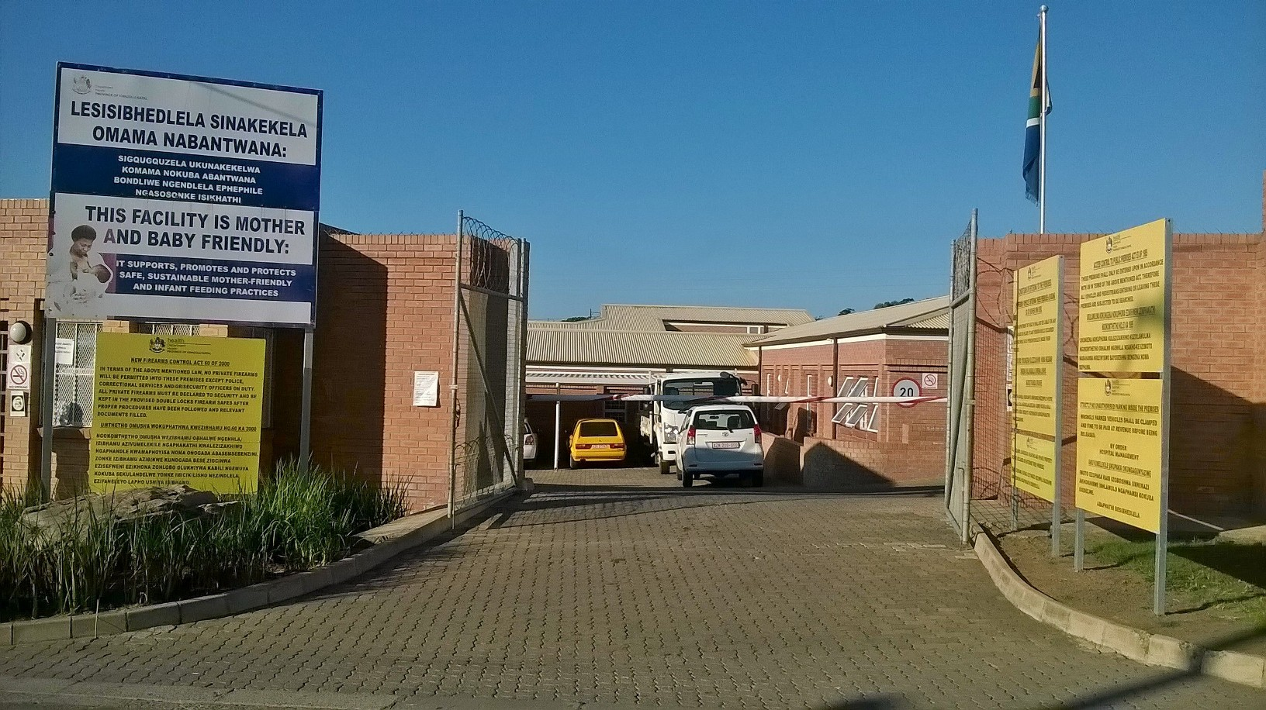
Notes:
GAMALAKHE CHC - THE TOP FACILITY IN THE COUNTRY

Slide 3
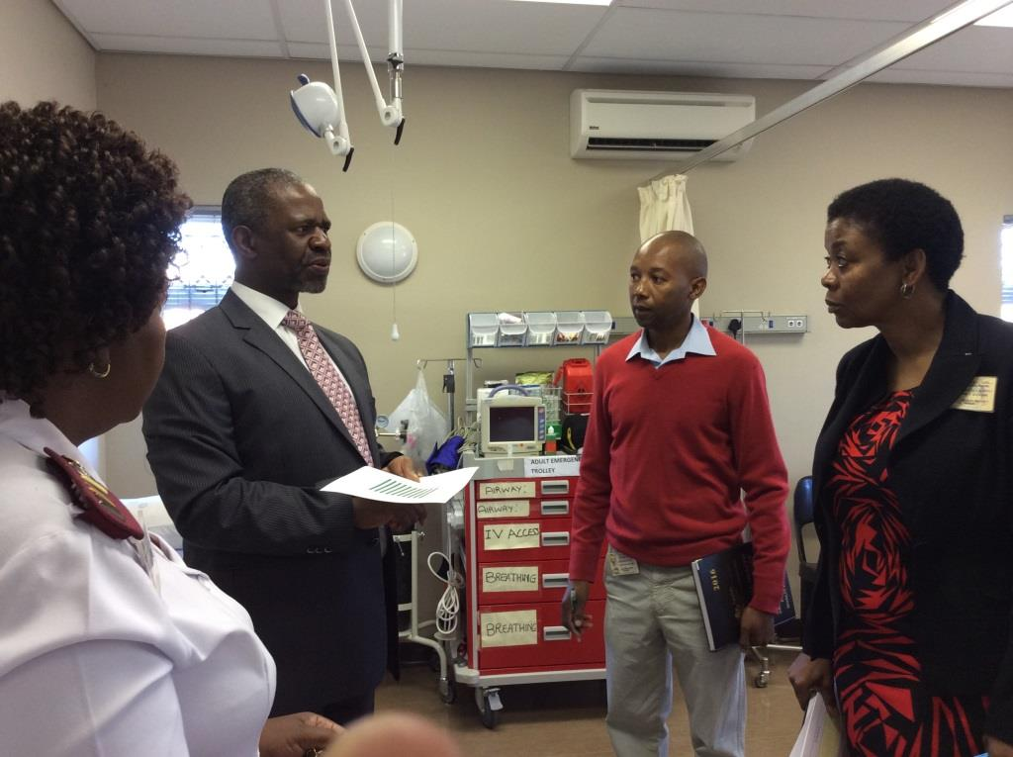
Notes:
MEC FOR HEALTH, DR. SM DHLOMO VERIFYING THE ACHIEVEMENTS IN THE TOP NHI DISTRICT -AMAJUBA

Slide 4
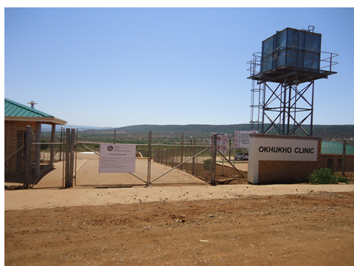
IDEAL CLINIC

Slide 5
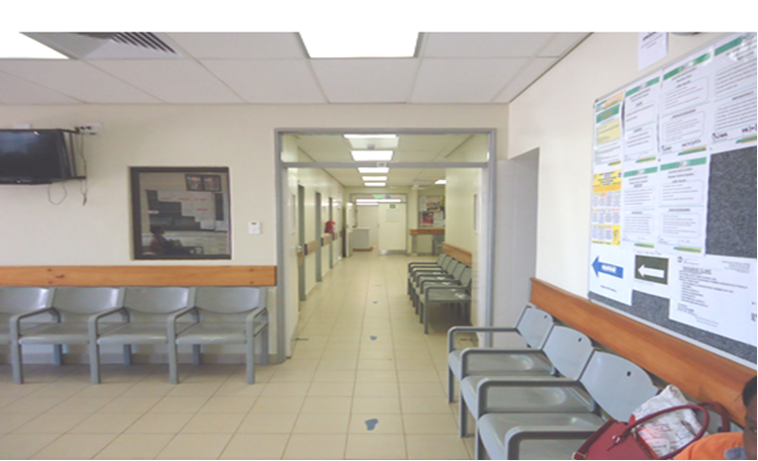
INSIDE OKHUKHO CLINIC

Slide 6
BACKGROUND
11 DISTRICTS
608 FACILITIES
3 NATIONAL HEALTH INSURANCE PILOT SITES
LESSONS SHARE AS WE GO – IDEAL CLINICS STARTED IN 3, ROLLED OUT IN ALL OTHER DISTRICTS
PARTNER INVOLVEMENT

Slide 7
PREPARATORY EVENTS
1.1 SEPTEMBER MEETING
This exercise was exhausting due to many items done in one day
Very useful as a ground setting exercise
It helped to establish inter-provincial relationships and relieved tension and anxiety
Meeting partly addressed concerns raised related to the manual though no straight answers were given

Slide 8
DECEMBER MEETING
The meeting was well planned and informative
This meeting was well organised and route mapping was very effective

Slide 9
SOFTWARE PREPARATION
Helpful and assisted in understanding
Problematic for the novice and needed patience
Needed practical experience before real capturing
There were lots of connectivity issues such that capturing was not possible since modems had not arrived
Modems provided not working
Not all teams had computers and modems (used personal & district/provincial

Slide 10
COMMUNICATION TO PEER REVIEWS
  Communication is very precise and helpful
  Good and timeous
  Queries and consents were attending to accordingly
  Encountered lots of problems, nothing communicated up until departure
  Relied on other teams to get information about tickets and communication
  Got communication from time to time especially the Province updating the teams

Slide 11
ANY OTHER COMMENTS
Communication is very precise and helpful
Good and timeous
Queries and consents were attending to accordingly
Encountered lots of problems, nothing communicated up until departure
Relied on other teams to get information about tickets and communication

Slide 12
ANY OTHER COMMENTS
Got communication from time to time especially the Province updating the team any other comments on preparation
Lots of glitches with logistics in general considering that there were lots of people moving around
Not sure of travelling arrangements up to the last hour

Slide 13
2. COMMENTS ON EVENTS/ISSUES FROM 31JAN TO 14 FEB 2016
ARRANGEMENTS FOR TRAVEL TO PEER REVIEW DISTRICTS
Excellent and on-going communication with Shuttle services
Timeous delivery of vehicles for those travelling on road
Shuttle services were in time for flights
Shuttle services well planned except on the day of return – had to wait for hours at the airport

Slide 14
2. COMMENTS ON EVENTS/ISSUES FROM 31JAN TO 14 FEB 2016
ARRANGEMENTS FOR TRAVEL TO PEER REVIEW DISTRICTS
Excellent and on-going communication with Shuttle services
Timeous delivery of vehicles for those travelling on road
Shuttle services were in time for flights
Shuttle services well planned except on the day of return – had to wait for hours at the airport

Slide 15
2. COMMENTS ON EVENTS/ISSUES FROM 31JAN TO 14 FEB 2016
ARRANGEMENTS FOR TRAVEL TO PEER REVIEW DISTRICTS
Flight tickets
Flight tickets communicated in time through SMS
Lots Challenges not sure of flights till last hour
Woke up early for the Shuttle
Well organised

Slide 16
2. COMMENTS ON EVENTS/ISSUES FROM 31JAN TO 14 FEB 2016
    Car Hire
Well-arranged except for transport to the hotel – assisted by co-ordinator who transported us from airport to the hotel
4 x 4 Vehicle was provided according to the recommendations by receiving District, however a sedan with deaf lock would have been better than a bakkie especially with extreme heat weather.
Informed about cars very late
Collected cars after hours during our time off

Slide 17
2. COMMENTS ON EVENTS/ISSUES FROM 31JAN TO 14 FEB 2016
    ACCOMMODATION
Accommodation generally good
Some accommodation arrangements that were done in December were changed and not communicated.
No proof of authorization from National – alternate arrangements made on the spot.( including sharing of rooms).
Some B & B only provided breakfast ( but gave us cash to buy our own food)
No lunch arrangements

Slide 18
2. COMMENTS ON EVENTS/ISSUES FROM 31JAN TO 14 FEB 2016
    ACCOMMODATION
Had no meals that day and informed there was never a time when national books meals for officials
Lodge closed over the weekend.
Accommodation far away from clinics and unsafe

Slide 19
2. COMMENTS ON EVENTS/ISSUES FROM 31JAN TO 14 FEB 2016
    SUPPORT OF HOST DISTRICT
    Support of contact person on arrival
Very warm welcome
Fetched from air port and given escorts to all clinics visited
Some had to rely on GPS or asking people for directions

Slide 20
2. COMMENTS ON EVENTS/ISSUES FROM 31JAN TO 14 FEB 2016
    SUPPORT OF HOST DISTRICT
Well organised dedicated staff from Districts from day one right up to the end
Support of facility managers
Good welcoming and very co-operative
Some supportive others seemed under a lot of stress
Challenges with staffing during assessment – PHC managers had to come an take over services to allow operation managers to continue with assessments.

Slide 21
2. COMMENTS ON EVENTS/ISSUES FROM 31JAN TO 14 FEB 2016
  Availability of resources for peer review
  Hard copy of peer review instrument
Provided our own material from own Districts
Data capture (modem, SIM, Data bundle, network availability
Brought our own departmental and personal modems.
Data bundles were a major challenge – relied on free hotel wi fi
Modems never received
Some facilities incorrectly linked

Slide 22
2. COMMENTS ON EVENTS/ISSUES FROM 31JAN TO 14 FEB 2016
  Availability of resources for peer review
Data bundles bought on line unfortunately no slips available to claim or refund
Ideal clinic software (access, data upload and support)
Data disappeared after capturing a few steps
Freezing of software blocking out
Username and Password released late
Uploading took lots of time and consumed lots of data bundles

Slide 23
2. COMMENTS ON EVENTS/ISSUES FROM 31JAN TO 14 FEB 2016
Opportunity to give feedback to the district management and their team was a blessing to us since this was the first time experience and we were all learning as we assess
Great opportunity for benchmarking which we did learn and took best practice back home
Annexures for assessment of standards came very late for the same understanding by teams hence we may have different interpretation and understanding.
  Any other comments on Peer Review

Slide 24
2. COMMENTS ON EVENTS/ISSUES FROM 31JAN TO 14 FEB 2016
What went well and should be part of future reviews
During Preparatory Phase
Preparatory meeting to map facilities with host districts
Involvement of the stakeholders strengthen co0operation
Assistance by District/Province and support to get necessary requirements timeously
Shuttle services to and from airport well arranged
Clear understanding of the information on the questionnaires and annexures

Slide 25
2. COMMENTS ON EVENTS/ISSUES FROM 31JAN TO 14 FEB 2016
What went well and should be
During peer review period
Exposure to best practice to other provinces
Skills sharpened and developed patience
Support without interference by district and province
Good team work strengthened in all possible way

Slide 26
2. COMMENTS ON EVENTS/ISSUES FROM 31JAN TO 14 FEB 2016
What went well and should be
Full support and two way communication with organizing teams
Continuous updates by national team
Availability of checklist as reference to access compliance

Slide 27
2. COMMENTS ON EVENTS/ISSUES FROM 31JAN TO 14 FEB 2016
What went wrong and should be improved on in future peer reviews
During Preparatory Phase
Manual sent the night before departure
Changes with accommodation none communicated in time
Incorrect spelling of participants name and contact details.
Hotel payment by agent was delayed and posed challenges for teams.

Slide 28
2. COMMENTS ON EVENTS/ISSUES FROM 31JAN TO 14 FEB 2016
What went wrong and should be improved on in future peer reviews
Delays in supply of resources such as modems and airtime
Late release of annexures that led to different interpretations of standards and effected judgement
During peer review period
Logic in the booking of venues (some too far away from facilities to be assessed).
Long distance travelling on daily basis

Slide 29
2. COMMENTS ON EVENTS/ISSUES FROM 31JAN TO 14 FEB 2016
What was your experience of Peer Review in general, good or bad?
Good - as it was a learning experience
Learnt that Provinces and Districts are unique even if trying to implement same policies that you will only understand by actually going out to other places
Decision making and inputs to be from bottom up in some extreme cases e.g. where posts are no considered critical and clinics run without managers for years due to budgetary constraints.

Slide 30
2. COMMENTS ON EVENTS/ISSUES FROM 31JAN TO 14 FEB 2016
Any Additional Comments
Continue with Peer Reviews, by going back to facilities we assessed to see milestones achieved.
Continue inter-District assessments so we continue learning from each other as a Province.
Grateful to National & Province teams for addressing the equipment challenges although delivery there of is so slow

Slide 31
2. COMMENTS ON EVENTS/ISSUES FROM 31JAN TO 14 FEB 2016
Any Additional Comments
Development of the PHC Managers on the financial management and leadership so that they are able to advocate for their needs
Essential equipment procurement and service providers also a major concern and needs attention to improve outcomes
.

Slide 32
2. COMMENTS ON EVENTS/ISSUES FROM 31JAN TO 14 FEB 2016
Any Additional Comments
Infrastructures needs special attention and intervention to allow the willing personnel to be game changers and show that ideal clinic can be achieved and can lead to quality care. “Ideal clinic has given us the push/pressure that we needed to get where we should have been. Please do not stop” OM Umgungundlovu district
KZN takes ICRM seriously -SDIP

Slide 33
2. COMMENTS ON EVENTS/ISSUES FROM 31JAN TO 14 FEB 2016
Any Additional Comments
Appreciations to:
National Team led by DDG Ms. J Hunter
Ideal Clinic team led by Ronel
National Supporter for KZN Mr. Kgwiti
Provincial Senior Management led by Mr.MM Zungu DDG NHI
KZN DM, DCST (PHC) & QA Managers & OM
.

Slide 34
KZN COMMITTED AND WILLING TO TRANSFORM!
ARE YOU?
THANK YOU

