Slide 1
IDEAL CLINIC PROGRAMME
Cross District Peer reviews – process for individual consultations
Presented: Ronel Steinhobel
Date: 8 December 2015

Slide 2
1. Confirmation of grouping of clinics
  List of facilities that will be reviewed
  Google maps to show routes
  Correct if needed

Slide 3
2. Forms for teams to complete
  Visiting district - For each team complete the following (2 forms):
  Details on team members
  Transport: air or ground
  Town from where you will be leaving
  If air travel – airport from and to
  Type of vehicle required

Slide 4
2. Forms for teams to complete
  Contact person at sub-district/district that will accompany the team to the clinics within their district
  Accommodation – in cases where different accommodation will be used put clinics in brackets next to each accommodation

Slide 5
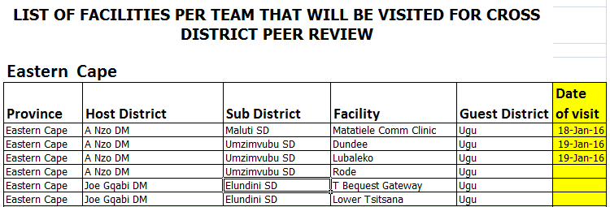
3. Form with list of clinics
Add a column to the right and add the date next to each clinic it will be visited. Copy and paste at bottom of form

Slide 6
4. Host and visiting districts plan route
Host and visiting meet and plan route
When done meet with Ronel and Chandran

Slide 7
5. Submit forms
Complete forms electronically or submit to Nomasonto that will capture data electronically.
Verify that data was captured correctly
SteinR@health.gov.za

Slide 8
Points to remember
Travel on Sunday to start with review on Monday to Friday.
Travel back on Saturday.
Districts that travel far can decide whether they want to stay over for the week-end if they need more than a week to complete SD.

