Slide 1
NDOH ORIENTATION WORKSHOP
COMPONENTS 9 & 5 session
District Health System Support and Support services
16 September 2015
Birchwood Hotel
Mr M Makhudu – Programme Director

Slide 2
FACILITATOR/CHAIRPERSON
Name
Role
Organizing the purpose, scope, and deliverables of the meeting or workshop
Keeping the group on track to achieve its goals in the time allotted
Reminding the group of the objectives or deliverables of the meeting or session
Assist the workshop members listen to each other and create solutions together
Tentatively paraphrasing or capturing verbatim individual contributions to confirm understanding and ensure they are heard by the whole group
Modise Makhudu
Gauteng PPTICRM Team Leader

Slide 3
QUOTES ABOUT IDEAL CLINIC PROGRAMME
National Health Council (NHC) agreed to roll out of Ideal Clinic realization programme on the 14th of March 2014.

Slide 4
QUOTES ABOUT IDEAL CLINIC PROGRAMME
National Health Care Facilities Baseline Audit, conducted by the department across clinics and hospitals in 2011, the country’s clinics scored an overall average of less than 50% in six key areas (cleanliness, staff attitude, drug stocks, infection control, patient and staff safety, and waiting times).

Slide 5
QUOTES ABOUT IDEAL CLINIC PROGRAMME
“Under NHI, we have got a model of what we call the prototype ideal clinic… it shows what a clinic should look like for us to be satisfied. In these clinics in the NHI pilots, we are starting to make them ideal,”

Slide 6
QUOTES FROM LEADERSHIP
“The goal of ‘Ideal Clinic’ (IC) initiative is to have a high quality PHC services universally available as in a ‘social franchise’.

Slide 7
QUOTES ABOUT IDEAL CLINIC PROGRAMME
“Soon after the audit was finalized, the department developed a concept known as the ideal clinic prototype, which will guide us on what a clinic in South Africa should look like and how it should function

Slide 8
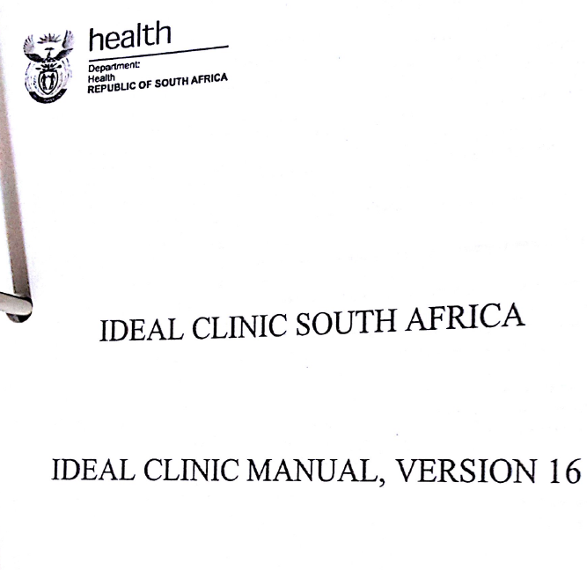
IMPORTANT DOCUMENT

