Slide 1
Free State Province
DOMAIN 4 : PUBLIC HEALTH
DOMAIN 6 : OPERATIONAL
COMPONENT 8 : COMMUNICATION
Sub COMPONENTS : 26 and 27

Slide 2
BACKGROUND
Orientation of District Management Teams
Identification of champions
Nomination and appointment of PPTICRM by MEC
Adoption of facilities by PPTICRM members.
Training of Facility Managers
Job Descriptions(KPA) revised .
Training of all facility staff members
The clinic committees and Stakeholders were involved in the orientation and training

Slide 3
VERSION 15 ASSESSMENT: XHARIEP
The ten facilities have been assessed with version 15 and captured online.
The dashboard report has been shared with facilities and stakeholders.
The role out plan to train facilities on Ideal Clinic and software (include user accounts) and to monitor and evaluate Status Determination (SD) on software (Training done)
All facilities have been given memory sticks for practical training .

Slide 4
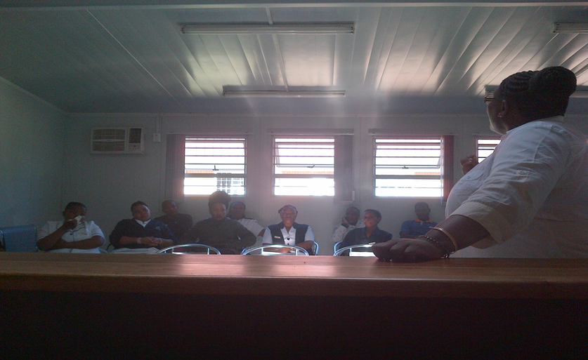
THEMBALETHU STAFF WORKSHOP

Slide 5
HEALTH SERVICE RE-ORGANISATION
All facilities have single administration point
Appointment schedule introduced
Re-organisation of patient flow
  Pre-appointment retrieval of clinical records
  Designated waiting areas
  Designated consultation area
  Designated vital signs station
Integration of care
The booking system is in place all facilities

Slide 6
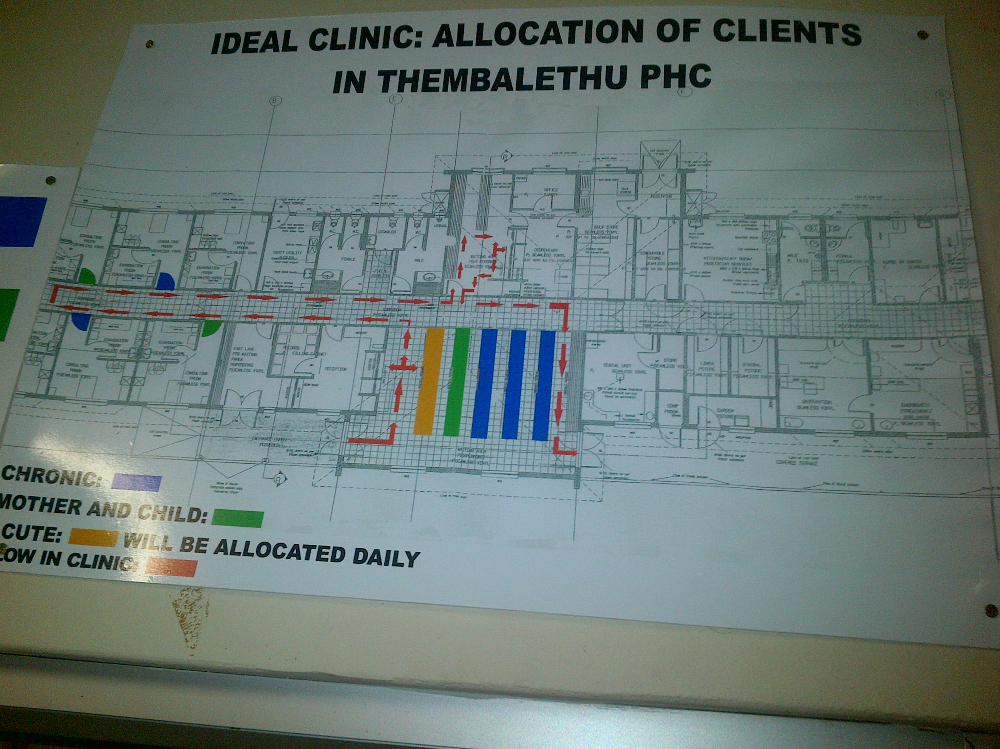
THEMBALETHU FLOOR PLAN

Slide 7
CHALLENGES
Data is not managed properly in some facilities
Policies from National is problematic
Subcomponent 32 Multi-sectoral collaboration
PC101 guide lines are not available
There are section of PC01 guide that are out dated

Slide 8
WAYFORWARD
Facilities adopted by PPTICRM members to provide progress reports on monthly basis.
PPTICRM members continue with follow up support visits
Liaise with RTC for PC101 guidelines
Linkage of partners to facilities and communities

Slide 9

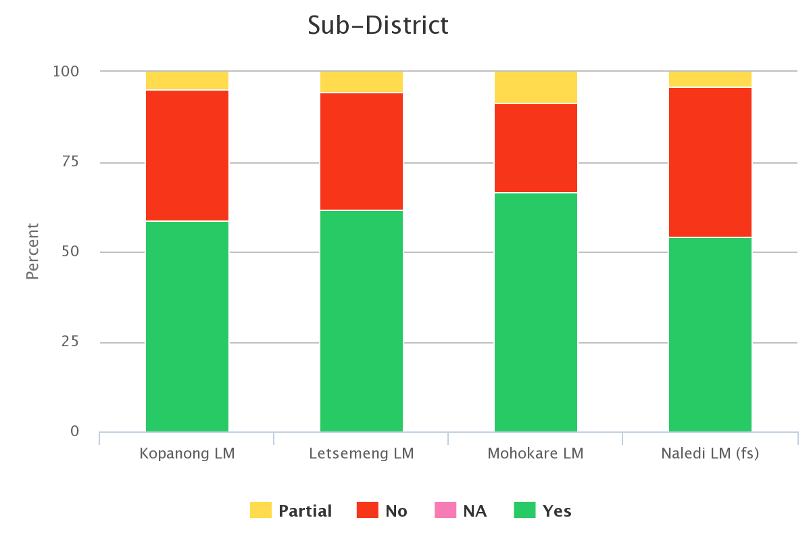
Sub District Comparison

Slide 10
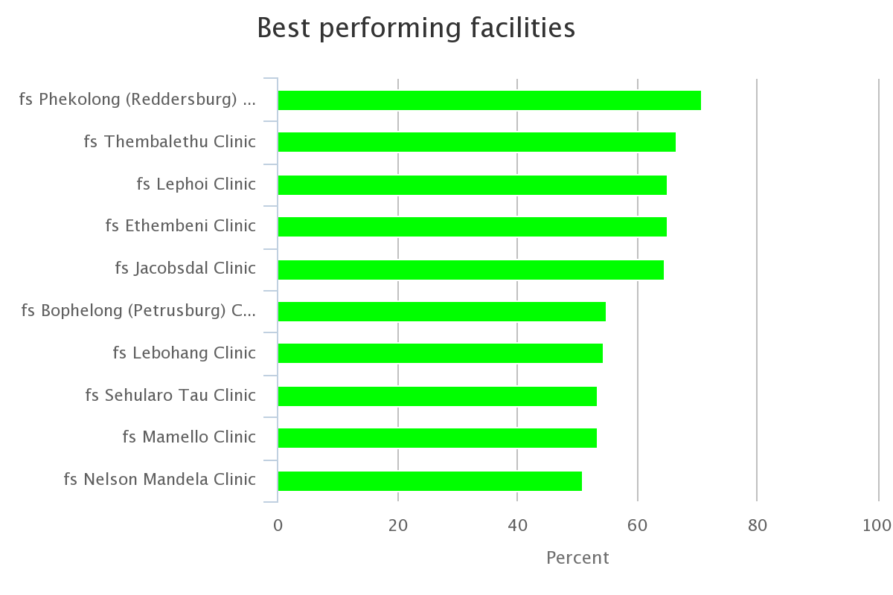
Facility Performance

Slide 11
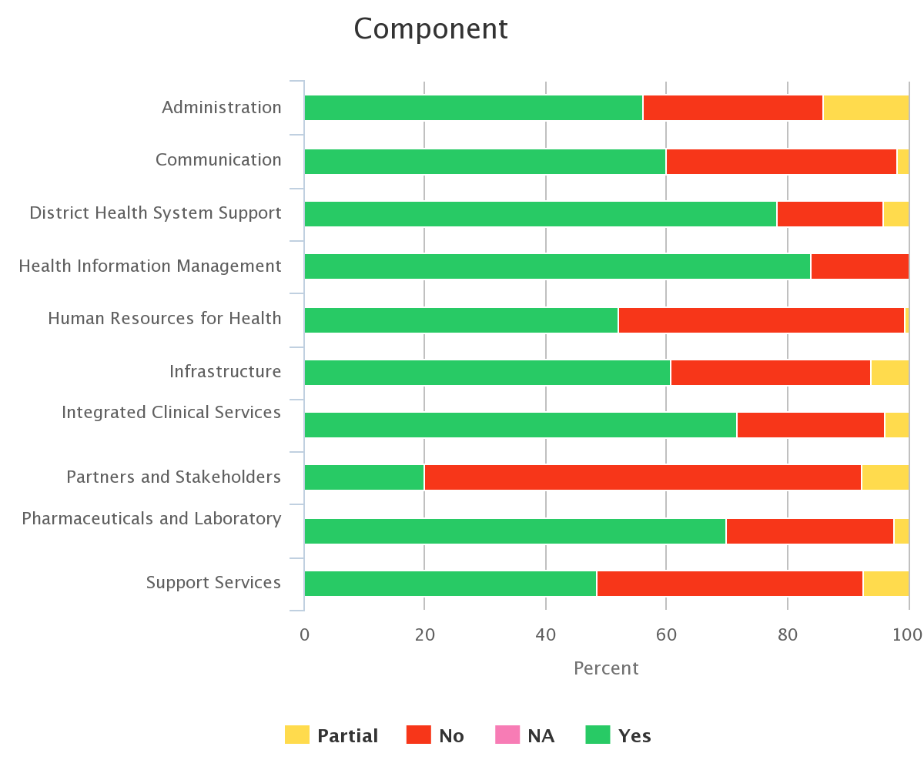
Performance in terms of components

Slide 12
IDEAL CLINIC REALISATION AND MAINTENANCE
COMPONENTS, SUB-COMPONENTS AND ELEMENTS - VERSION 15
DOMAIN 6 : OPERATIONAL | 8. COMMUNICATION | Sub Component 26. Internal communication : Monitor whether the communications system required for improved quality for delivery is in place.
 |  | ELEMENTS |  | WEIGHT | METHOD OF MEASUREMENT | PERFOMANCE | LEVEL OF RESPONSIBILITY
 |  | 182 | There are district quarterly facility performance reviews meetings | I | 􀀉 |  | D
 |  | 183 | There is at least a monthly staff meeting within the facility | I | 􀀉 |  | HF
 |  | 184 | Staff members demonstrate that incoming policies and notices have been read and are understood by appending their signatures on such policies and notifications | I | 􀀉 |  | HF

Slide 13
182 : PROCESS ( How)
Schedule dates for the quarterly performance review meetings as part of the sub-district/district annual calendar.
  There are scheduled dates for quarterly performance review meetings.
  The minutes, agenda and attendance register is submitted as evidence for district performance to the Balance Score Card.
  District annual calendars are shared with in the province.
Review each programme’s performance against predetermined targets and motivate for variations.
  Reporting template is the same for all levels.
  The facility manager must schedule a meeting with the facility staff one week before to prepare the facility’s presentation
  Develop Quality Improvement Plan for poor performance.
Deliver the facility’s presentation and answer all questions.
Make notes of activities and challenges in other facilities and any good practices that you could replicate in your own facility.
File a copy of the presentation electronically and make sure that computer content is backed up appropriately.
  Keep as evidence to be availed during assessments.
  Keep to monitor progress from quarter to quarter

Slide 14
183 : PROCESS (How)
Draw up a monthly meeting schedule
  Draw an annual calendar schedule
  Different programmes and sub-districts develop their annual meeting schedules which are used to draw the annual programme
  Facilities set meeting dates interms of facility workloads and availability of staff.
Include monthly meeting dates on the Annual Facility Calendar.
  The scheduled dates are shared within the sub- district.
  Inform staff about the dates and place the monthly meeting schedule for the year on the staff notice board. All staff (All categories within the clinic) must be available for these meetings
  Develop an agenda for the meeting
  . All staff who attended the meeting must sign the attendance register
Fixed Meetings

Slide 15
183 : PROCESS (How)
Designate a staff member to take minutes.
Minutes of the meeting will be available within three working days after the meeting and will be filed electronically in month / date order. Minutes are available for all staff to read.
Review the action points after the meeting and ensure that all activities that were agreed upon at the meeting, are executed.
File the minutes, agenda and attendance register.
  Submit the minutes, agenda and attendance register as evidence to sub- district.
Feedback

Slide 16
184 : PROCESS (How)
When new policies and notifications are received check if they replace existing policies and notices.
  Facility has a file with signed documents.
Discuss the new policies and notices with staff immediately.
Check to see that all staff members understand the changes and determine if further training may be required. If training is required, request this using the district training protocol.
  Facilities are allocated 2 hours per week to discuss the new documents( Friday afternoon)
Get all staff members to sign the acknowledgement form. Attach this to the back of the new policy or notice and file the document.
If there are further questions regarding the policies and notices seek relevant answers from the relevant source or your Local Area Manager.

Slide 17
IDEAL CLINIC REALISATION AND MAINTENANCE
COMPONENTS, SUB-COMPONENTS AND ELEMENTS - VERSION 15
DOMAIN 4: PUBLIC HEALTH | 8. COMMUNICATION | 27. Community engagement: Monitor whether the community participates in PHC facility activities through representation in a functional clinic committee.
 |  | ELEMENTS |  | WEIGHT | METHOD OF MEASUREMENT | PERFOMANCE | LEVEL OF RESPONSIBILITY
 |  | 185 | There is a functional clinic committee | I | 􀀉 |  | D
 |  | 186 | Contact details of clinic committee members are visibly displayed | I | 􀀮 |  | HF
 |  | 187 | There is an annual open day facilitated by the clinic committee | I | 􀀉 |  | HF

Slide 18
186 There is a functional clinic committee
187 Contact details of clinic committee members are visibly displayed
Establish the clinic committee according to the guidelines
  The committee is elected by the community mass meeting
  Training is conducted inline with the Provincial clinic committees manual
The committee must be functional
Functional implies that:
  Clinic committee members have been officially appointed in writing by the MEC for Health in the province.
  Clinic committee has required number of members
  Regular meetings are held
  Minutes of meetings are available
  Minutes, Agenda and Attendance register are filed and are submitted as evidence for functionality and proof for performance on Balance Score Card.

Slide 19
186 There is a functional clinic committee
187 Contact details of clinic committee members are visibly displayed
In cooperation with the office of the MEC obtain nominations of clinic committee members and complete the election process.
Develop a clear and legible list of the names of clinic committee members and all their contact details.
Place this list on patient notice board in the waiting area.
Update this list when there are changes to clinic committee members.
In cooperation with the chairperson of the clinic committee:
  Develop a schedule of monthly meetings.
  Request training for clinic committee members from the district.
  Attend clinic committee meetings, ensure that agenda developed, register is kept and minutes are taken.
Follow up actions arising out of clinic committee meetings.

Slide 20
188 There is an annual open day facilitated by the clinic committee
Arrange a meeting with the clinic committee to discuss community engagement activities and plan for open days.
Log dates agreed on with clinic committee in an annual calendar to be displayed on the notice board.
Designate a staff member to organise and market the Open Day with the clinic committee.
In cooperation with the clinic committee seek support from relevant sources.
On the day of the event in cooperation with the clinic committee, oversee the set up and activities including various health screening.
Compile a report of the event including relevant statistics of screenings conducted.
Submit the report to the sub-district/district and file the report.

Slide 21
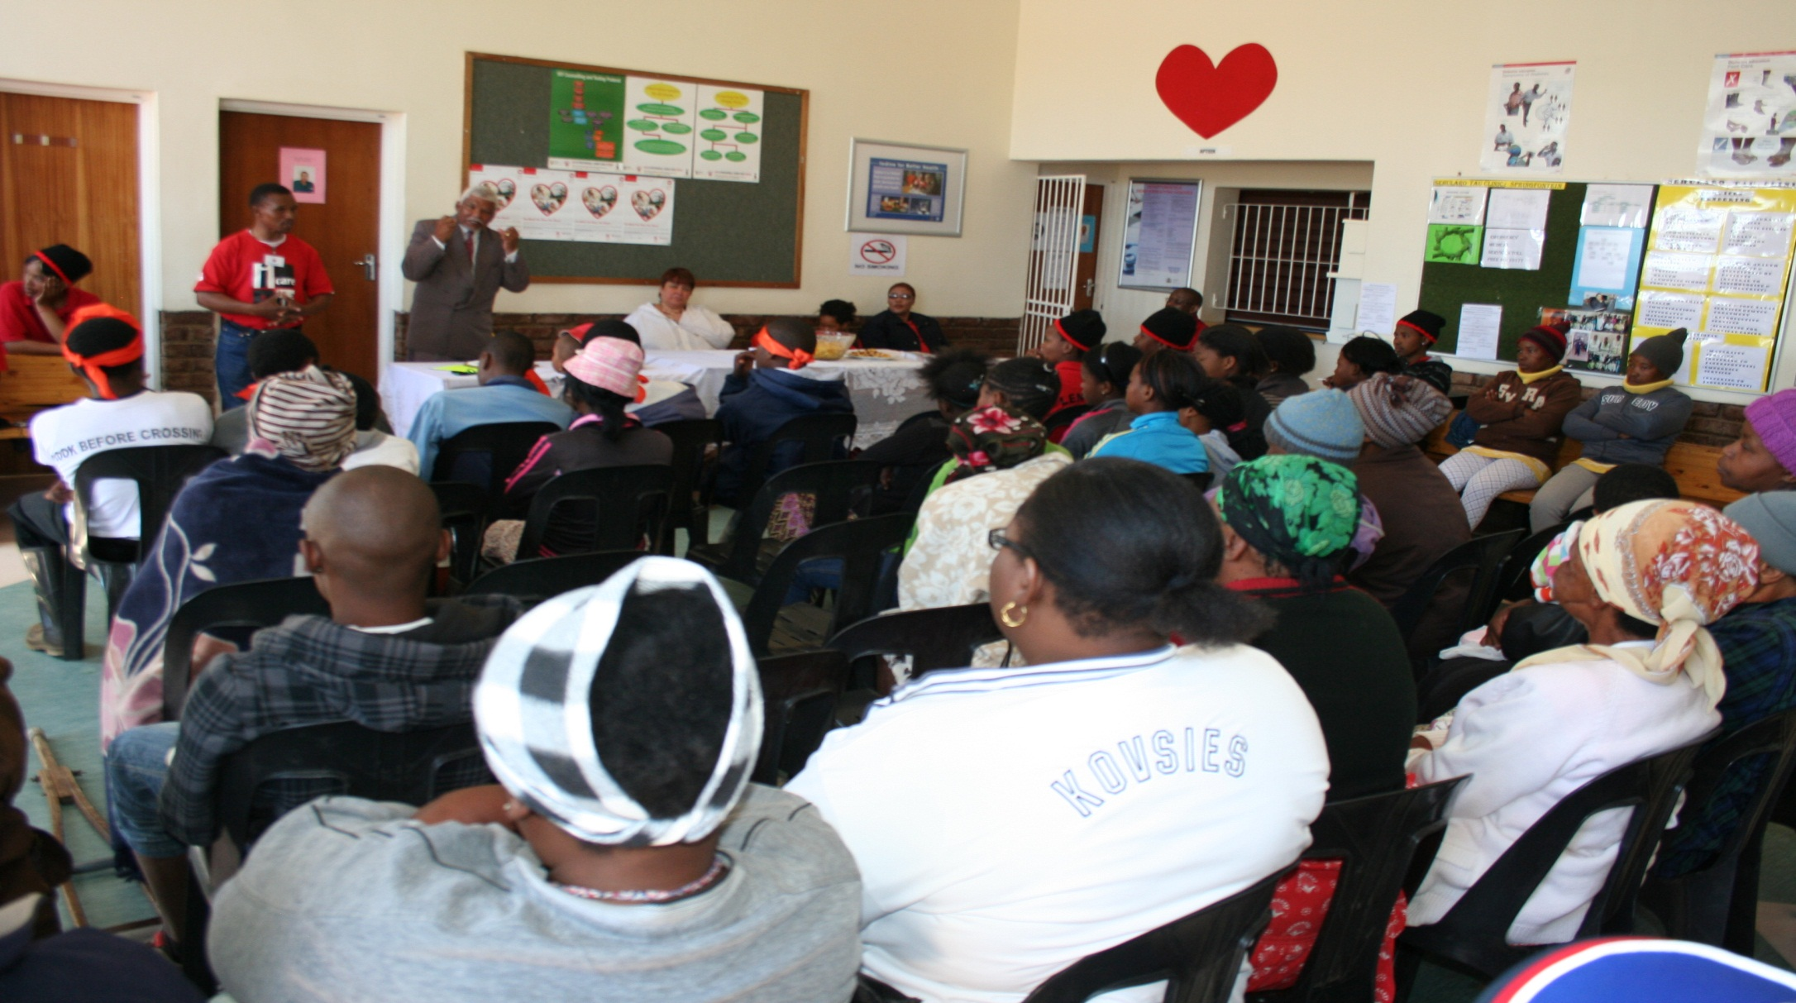
Facility Open Day

Slide 22

Means to an end

Slide 23
THANK YOU FOR THE OPPORTUNITY.
“The Task Ahead is Never as Great as The Power Behind ”. Unknown

