Slide 1
Health Information Management
Systems
Foundation To Improve Programme Performance through
Measurable Performance Indicator Outputs
“Turning Green”
Authors: L.K. Matshisi (Mr.)
Venue: Birchwood Hotel (GP)
Date: 15th September 2015

Slide 2
Layout
Background
Balancing resources with needs and demands
Traditional Approach VS Supermarket approach
Performance reviews
Success Stories
Patient Information Systems
Conclusion
Acknowledgements

Slide 3
Background
Understanding disease trends or patterns with what has to be done and HOW?
HOW using information when conducting Performance review session can contribute in changing the country’s performance Green.
HOW critical prioritisation of health care needs is, through using information for service planning and decision making.
HOW integration of service can help improve quality of care in health facilities.
HOW good quality data generated through health information systems as stipulated in DHMIS can assist management produce the desirable results.
HOW Functional Patient information systems can help improve quality of care at facility level.

Slide 4
Striving towards improved health outcomes through ideal clinic realisation
“Clinicians should not be the only ones who bare the obligation to account for clinical outcomes ”
“This can only be achieved through a shared Vision and Mission of the NDoH”

Slide 5
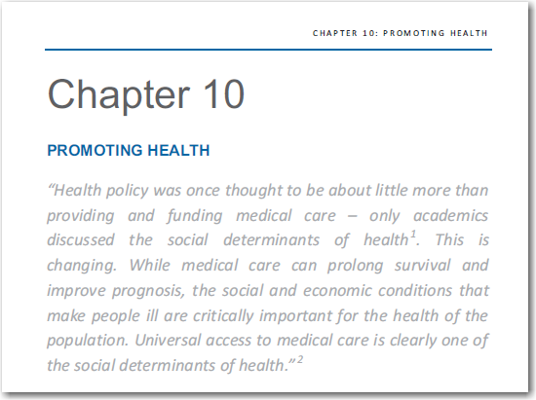
Traditional Approach
HOW can the quality of care in SA be improved

Slide 6
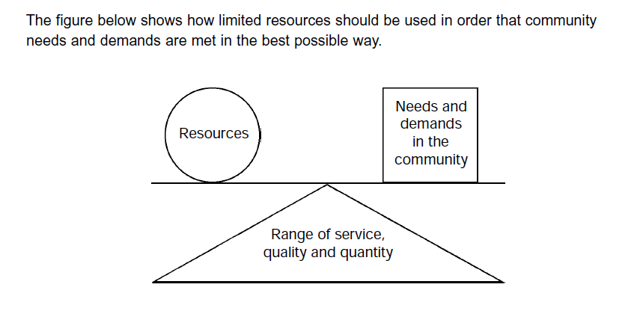

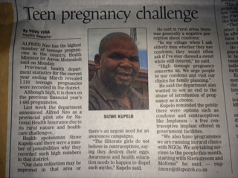
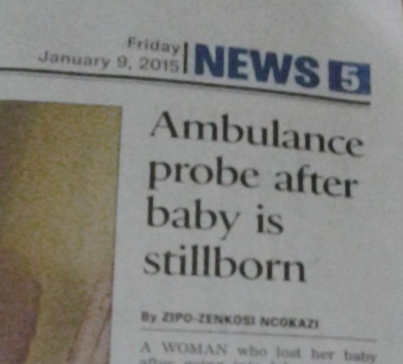
Balancing needs, demands and resources
Notes:
how does all that bare reference to ideal clinic? Please try to have a slide that links to that. And what is the importance of health information system in an ideal clinic setup.

Slide 7
Performance review organisation
“The theme may be Turning Green, but the ultimate Goal should remain focussed on an
Improved Health Information Driven Quality of Care
that all citizens of this country receive”

Slide 8
Performance review organisation
Traditional method of reviewing performance VS a Supermarket Supervision approach recommended by WHO in 2013.
Introduction and demonstration of the new approach focusing on the:-
  Significance of clustering of healthcare facilities
  Hierarchy of accountability and feedback loop.
  Pinning responsibility to Accountability.
  Significance of the sitting arrangement during review process
  Importance and the impact of encouraging conducting performance reviews at sub district level for improved programme management

Slide 9

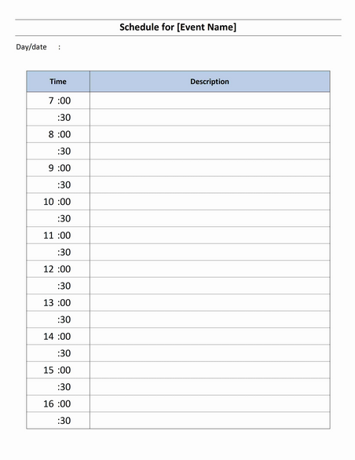
OLD TRADITIONAL APPROACH
NEVER YIELDS ANY DESIRABLE OUTPUTS!!!
KEY FOCAL AREA
Duration of reviews using the old approach
Centralised approach hindered timeous implementation of interventions at local level.
It was not easy to identify skills gap
Accountability function was superficial as it was directed to the sub district manager leaving implementers off the hook.
Discussion were around curative principles.
ONE DAY EVENT !!

Slide 10
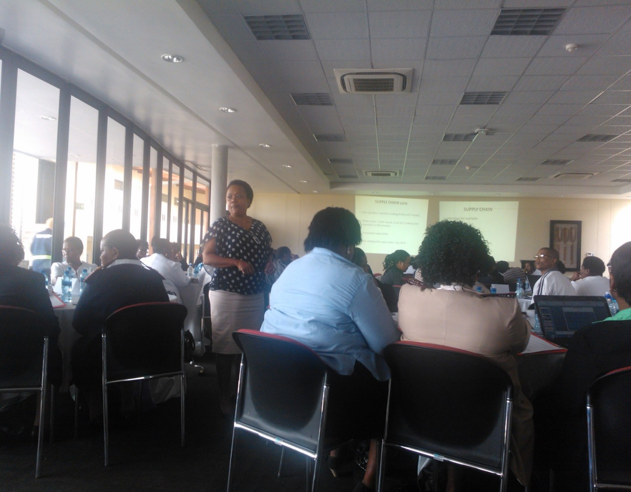

SUCCESS STORIES: NEW APPROACH
Decentralisation, Facility visits – Assessing quality of Services rendered by health facilities
KEY FOCAL AREAS
Duration of reviews using the NEW Approach
Decentralised approach acted as a catalyst for timeous implementation of interventions at local level.
SOP’s, DHMIS and NIDS Policy distribution
Data verification
Availability of approved registers.
Facility visits Informed by Data
THREE DAY EVENT !!
Enabled management to easily identify skills gaps and do onsite mentoring and coaching
Conduct data and clinical audits to enhance quality of programme management
Accountability function using this approach was directly pinned to the facility Operational Manager, Supervisor, Programme Manager concerned, Supporting Partners and Sub District Manager.

Slide 11
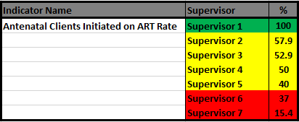
NEW APPROACH
Significance of clustering
Sub District
Average = 50.5% as against 95% Target

Slide 12
Hierarchy of accountability and feedback loop
Sub
District
Manager
Programme Manager
Operational Manager
Clinic Supervisor

Slide 13
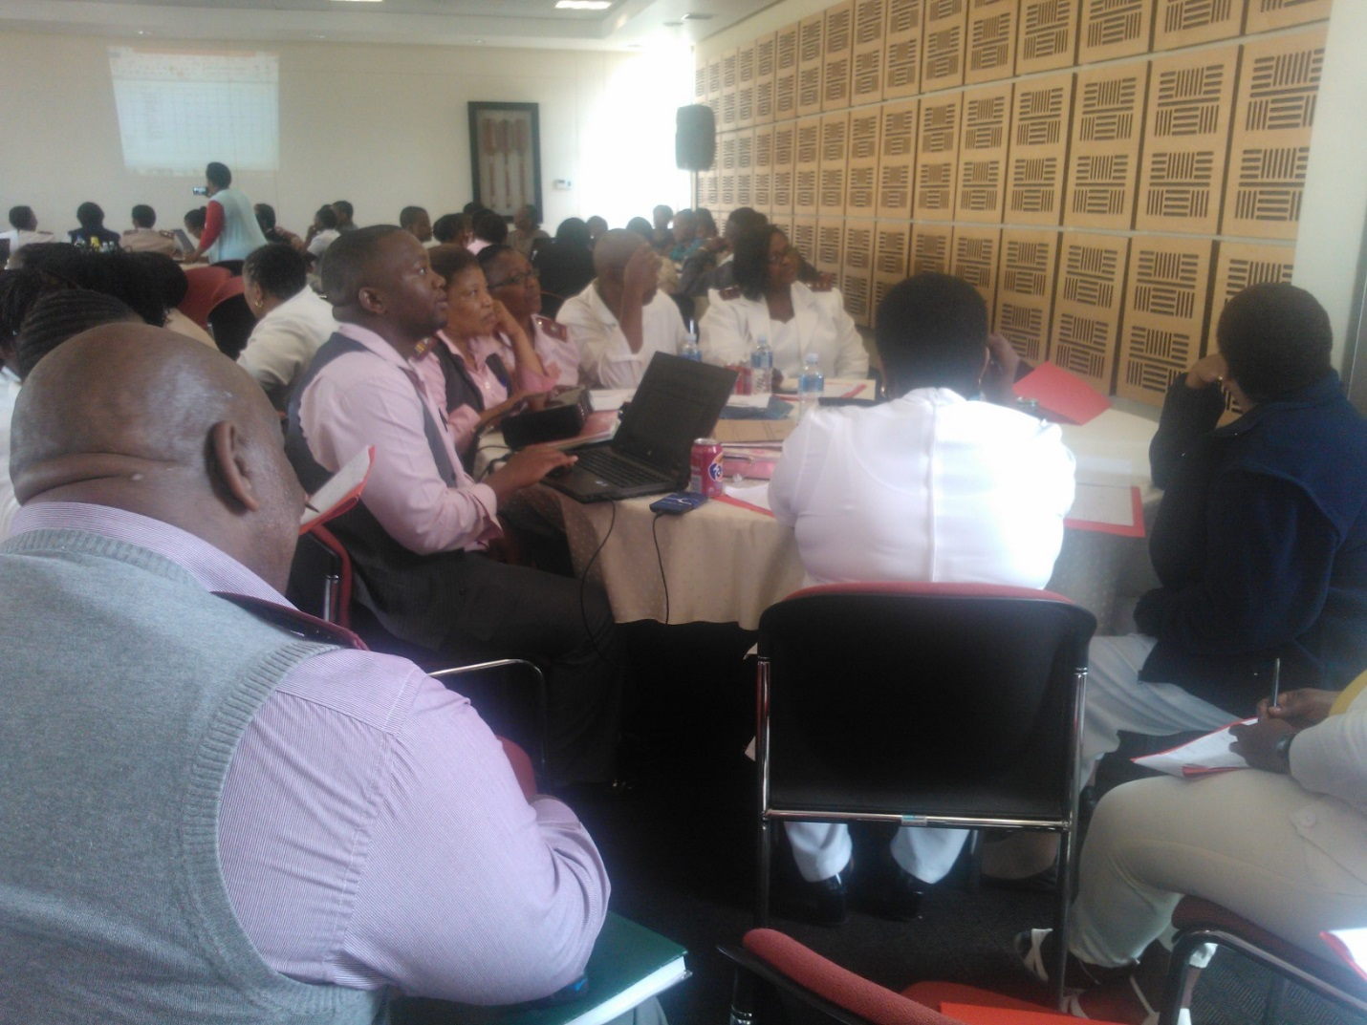
Interaction with available information
during Performance review sessions
It is through using information that:
  Resource allocation
  Information driven activities
  Visits informed by information
  Intervention done at the beginning of care rather than later (prevention focussed approach
  It is through using information that we can begin to understand the importance of integration. (Hosp with PHC, Supporting Partners and Governance Structures)
  Skills Gap
  Training Needs

Slide 14

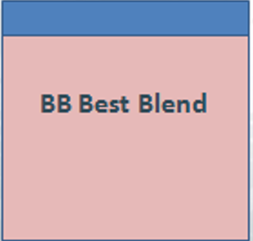
Success Stories
Record
count
Accurate Reporting

Slide 15
Computerised Patient information systems
Enabling conditions for implementation:
  Computer
  Printer
  Data Capturer
  Training
  Capturing
Signing off of ART Registers
Future plans: Comp PIS
  Reducing waiting times
  Access to Patient clinical history records
  Managing patient flow in facility
  Efficiency in services rendered
Thus resulting on improved patient satisfaction

Slide 16
In Conclusion……
Going Green
  Correct understanding of what is happening at facility level being informed by data.
  Should not come at the expense of quality of care.
  Aligning Strategic Plans with OP and PMDS Model
  Involving governance structures on information use in order to promote health.
Health information management and use thereof must always be the driving force behind improving health outputs without compromising the Quality of Care.

Slide 17
Acknowledgements
Supporting partners for Amathole Health District.
Amathole District Management Team
A Word of acknowledgement is further extended to the whole Team of implementers from all Sub Districts of Amathole.

Slide 18
END OF PRESENTATION
THANK YOU!!

