Slide 1
Calibration of The PPTICRM
Infrastructure – How to Turn Your Facility Ideal
Akosua Danso
16 September 2015

Slide 2
Outline
A Step-by-Step Guide for the Northern Cape Ideal Clinics
Merge the Infrastructure Plan and Ideal Clinic Requirements
Prepare Health Facilities for operations management
Identify type of work needed for the facilities
Create a relationship between the Project Managers and District Managers
Maintain all clinics
Success stories

Slide 3
Dashboard
Vital Elements for Infrastructure on the dashboard
Resuscitation room is well equipped with functional basic equipment for resuscitation
Oxygen supply is available
Emergency trolley is cleaned and filled up at least daily and after being used
There is sterile emergency delivery pack
There is consistent supply of clean, running water to the facility
There is functional back-up electrical supply
The back-up electrical power supply is checked weekly to determine its functionality

Slide 4
A Step-by-Step Guide
The Northern Cape’s Plan:
Merge the Infrastructure Plan and Ideal Clinic Requirements
Infrastructure
Plan
(U-AMP)
Ideal
Clinic
Requirements
Ideal Clinic

Slide 5
A Step-by-Step Guide
Identify type of work needed for the facilities:
Ideal Clinics
Upgrades & Refurbishments
Provide Standby Generators
Electrical refurbishment & CoC’s
Drilling of Boreholes & Provision of water storage tanks
Servicing of fire-fighting equipment
Provide medical gas supplies
Construction of Guardhouse & Fencing
Servicing of Medical Equipment
Procurement & servicing of Laundry Services
Plumbing & Solar
R 49 M made available for Ideal Clinics (from the Adjusted Budget)

Slide 6
A Step-by-Step Guide
Create a relationship between the Project Managers and District Managers
  This is necessary for:
  Scope identification – conduct an assessment of the facility and determine the scope in terms of ideal clinic requirements
  Monitoring & reporting – the reporting forums where the progress on the clinics are reported is the District Health Forum and at the Infrastructure Internal Meeting
  Provincial, District & Sub-district coordinating structures are necessary to bring all the components together (PPTICRM)

Slide 7
A Step-by-Step Guide
Prepare Health Facilities for operations management
3-year scale-up plan for NC
60 facilities identified for 2015/16 FY
ZF Mgcawu DM
 |  |  | 2015/16 | 2016/17 | 2017/18
Tsantsabane LM | Postdene Clinic | Clinic |  |  | 1
Kai !Garib LM | Lennertsville Clinic | Clinic |  | 1
Kai !Garib LM | Kenhardt Clinic | Clinic | 1
!Khara Hais LM | Lingelethu | Clinic | 1
!Khara Hais LM | Upington Clinic | Clinic |  |  | 1
Tsantsabane LM | Boichoko Clinic | Clinic |  | 1
!Kheis LM | Boegoeberg | Clinic |  |  | 1
!Khara Hais LM | Progress | Clinic |  | 1
Kai !Garib LM | Keimoes Clinic | Clinic |  |  | 1
!Khara Hais LM | Louisvaleweg Clinic | Clinic | 1
!Khara Hais LM | Kalksluit Clinic | Clinic |  |  | 1
!Khara Hais LM | Sarah Strauss | Clinic | 1
Tsantsabane LM | Postmasburg Clinic | Clinic |  | 1
Kai !Garib LM | Kakamas Clinic | Clinic | 1
!Khara Hais LM | Raaswater Clinic | Clinic |  | 1
!Kheis LM | Groblershoop | CHC | 1
Mier LM | Rietfontein | CHC | 1
Kai !Garib LM | Keimoes CHC | CHC |  | 1
Kai !Garib LM | Kenhardt CHC | CHC | 1
Kgatelopele LM | Danielskuil CHC | CHC |  |  | 1
Mier LM | Askham | CHC |  | 1
Total |  |  | 8 | 7 | 6
Boegoeberg Clinic:
An old Asbestos structure, too small, not functional – A new clinic will be constructed (planning)
Kakamas Clinic: too small, poor condition – refurbished and provided with park homes for additional space

Slide 8
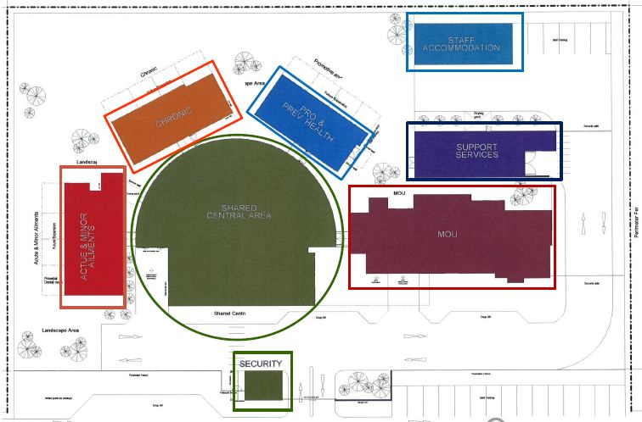
What we are trying to achieve
Awaatief Railoun

Slide 9
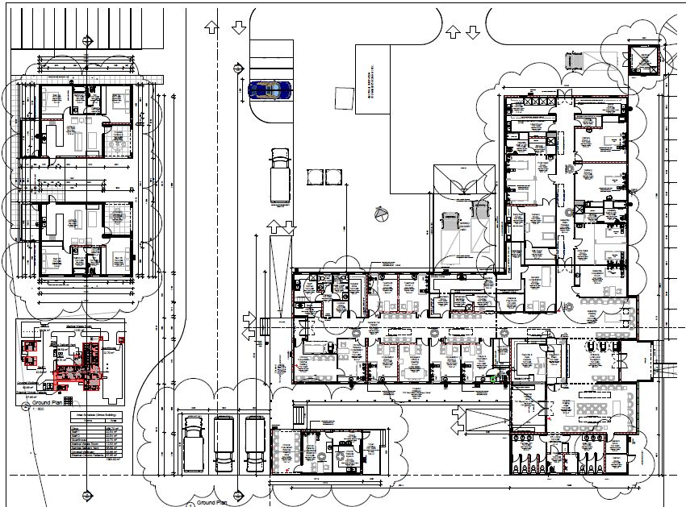
Case Study – Heuningsvlei Clinic
Medical waste storage
Staff Accommodation
MOU
CHRONIC Sub-waiting Area
MOU Sub-waiting area
ACUTE
CHRONIC
Acute Sub-waiting area

Slide 10
A Step-by-Step Guide
Maintenance
CMHs
Appoint Professional Service Providers for maintenance
Establish Maintenance Hubs and Call Centres
Term- Contractors
Deal with major and minor maintenance at all facilities in all Districts
Manage Term-Contractors
Response Times
Respond to major maintenance requests within x days
Respond to emergency requests within 24 hours

Slide 11
A Step-by-Step Guide
Success stories
The Standby Generators sub-programme has already procured 36 generators for CHC’s and clinics in 2015/16
40% of Kagung Clinic will be solar powered
All new staff accommodation are provided with solar geysers
Heuningsvlei clinic will make use of skylights to reduce electricity usage by using natural lighting
New clinics will use solar powered perimeter lighting

Slide 12
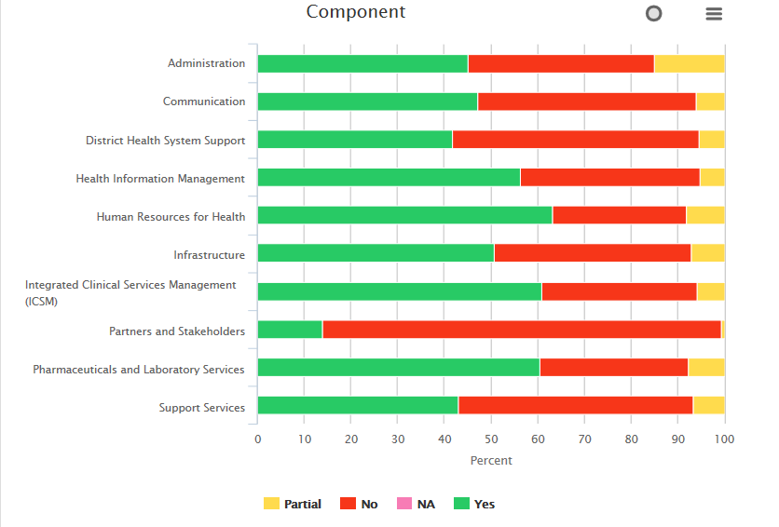
A Step-by-Step Guide

Slide 13
THANK YOU

