Slide 1

CALIBRATION OF THE PPTICRM:
COMPONENT 5; Sub Components 18 - 20
DATE : 16 SEPTEMBER 2015
VENUE : BIRCHWOOD HOTEL PRESENTED BY : Ratsietsi MAKUA

Slide 2
BACKGROUND
STATE OF AFFAIRS BEFORE
Cleaning programs unavailable
Unavailability of tools of trade
Poor record keeping (i.r.o. evidence of training)
Poor M & E
No water reservoirs
No waste cages (lockable/controlled access)
SCM limitations
Insecure facilities/property/assets
Difficulties in obtaining SLAs (security/waste management)
No facility lay-out plans
Fire drills not periodically conducted
Delays with servicing of fire-fighting equipment

Slide 3
SWOT ANALYSIS
STRENGTHS District management commitment Willingness of staff to participate Majority of facilities are in sound structural state | WEAKNESSES Structural limitations Lack of insight from staff re: processes Lack of sustenance Supervision inadequacies Limitations with SCM processes (TAT)
OPPORTUNITIES Partners’ support Community support Meaning collaboration with Local Municipality | THREATS Acts of vandalism (Palisade fences stolen) Deviations from SLAs by companies (Waste Management/Security)

Slide 4
Component 5: Support Services
5.1 Sub-Component 18: Hygiene & Cleanliness (Elements 126 – 131)
Sourced, TRAINED* and allocated EPWP volunteers to augment on the few existing F/T cleaners
Developed an:
individualised 
 action oriented &
 time specific cleaning programme,
avoiding scheduling intense cleaning during peak times.
Regular in-service provided on cleaning techniques and adherence to IPC practices.
Consistent availability of tools of trade (scrubbing machines, applicators, polishes, sealants, brooms)
M & E through actual inspections, walking the floors

Slide 5

Excellent Service Clinic
Cleaning programme for: MAKUA SR
Period : 01 July – 30 Sept 2015
TIME | ACTIVITY
07h00 – 09:00 | Damp dust emergency unit Clean and refill toilets* Refill water bottles
09:00 – 11:00 | Block A Office Cleaning
11:00 – 12:00 | Clean and refill toilets*
12:00 – 13:00 | Lunch
13:00 – 14:00 | Registry unit cleaning
14:00 – 16:00 | Intense cleaning of the toilets, waiting areas*
Signed: Supervisor : _________________Date :_____________
Signed: Officer : _________________Date :_____________

Slide 6
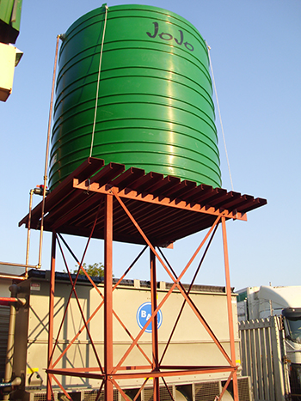
Component 5: Support Services
5.1 Sub-Component 18: Hygiene & Cleanliness (Element 132)
Water; basic commodity, Distr. Management’s responsibility
Installed functional back-up reservoirs
Weekly monitoring of the reservoir: intact, water quantity & quality by ICR Champion(s)
Determined (min/max quantities) and then ordered and availed toilet papers, liquid hand-soap and paper towels.7
These consumables are made available in all areas (staff & patients alike)

Slide 7
Component 5: Support Services
5.1 Sub-Component 18: Hygiene & Cleanliness (Element 132-134)
Ordered & availed sanitary disposal bins with FUNCTIONAL LIDS in ALL APPROPRIATE AREAS
Ordered & availed general waste bins with FUNCTIONAL LIDS in ALL STRATEGIC AREAS
  Sanitary bins = Red Liner
  General bins = Black Liner
Emptying of both bins x 2dly OR when ¾ Full
M & E through actual inspections, walk the floors

Slide 8
Component 5: Support Services
5.1 Sub-Component 18: Hygiene & Cleanliness (Element 135)
Daily inspection of functionality of all toilets conducted.
Non-functional toilets were promptly demarcated as “NOT WORKING- DO NOT USE”
Engaged Plumber(s) to attend to non-functioning ablution facilities at once.

Slide 9
Component 5: Support Services
5.1 Sub-Component 18: Hygiene & Cleanliness (Element 136-137)
Sourced, TRAINED* and allocated EPWP volunteers to augment on the few existing F/T groundsmen
Developed an individualised, action & time specific grounds maintenance programme.
Provided an appropriate basic training on essential cleaning tasks and responsibilities.
Conducted regular in-service training
Ensured consistent availability of tools of trade
M & E through actual inspections.

Slide 10


Component 5: Support Services
5.1 Sub-Component 18: Hygiene & Cleanliness (Element 138-140)
Designated x 2 access controlled waste storage areas.
ii) Obtained & communicated SOPs x both to staff
iii) Trained staff on waste segregation
iv) Infection Prevention & Control team inspected for compliance.
v) Obtained and enforced SLA with serv. providers.

Slide 11
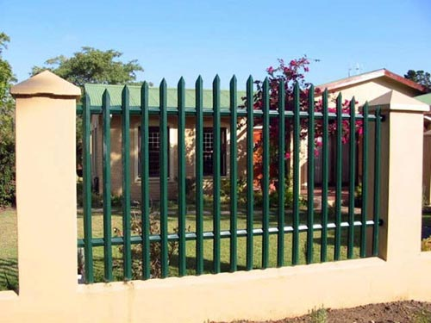
Component 5: Support Services
5.1 Sub-Component 19: Security (Element 141-144)
Requested installation of SAPS compliant perimeter fencing through district infrastructure manager.
Spec included separate gates as well
Fortnight inspections conducted with security.
Recorded, reported and acted on gaps.

Slide 12
Component 5: Support Services
5.1 Sub-Component 19: Security (Element 145)
Signed security SLA was made available.
Contents made clearly understandable to managers. The latter are able to elaborate on what is covered.
Facility & security personnel to equally have insight…..
“Safety & Security” remains standing items during periodical facility meetings:
v) Role players made aware of what is expected from them
Challenges | Measurable | Resp person | Time frame | Remarks
Specific | SMART | Name &/or designation | Specific | Post set time frame

Slide 13
Component 5: Support Services
5.1 Sub-Component 19: Security (Element 146)
FUNCTIONAL sec equip were made available as per SLA……
Dual responsibility:
ii) Periodical inspection ➔record & report deficiencies➔ corrective action ➔ escalate if non-compliant still.
DISTRICT/SUB/FACILITY | PROVIDER
Gun Safe Table & Chairs Bathrooms Telephone Adequate lighting | Torch (with spare batteries) Handcuffs Baton Pepper spray???

Slide 14









Component 5: Support Services
5.1 Sub-Component 19: Security (Element 147)
i)
ii) Prohibited items are declared, logged in controlled register & kept in lockable safe.
iii) Client keeps key.
iv) Periodical inspection ➔record & report deficiencies➔ corrective action ➔ escalate if non-compliant still.

Slide 15
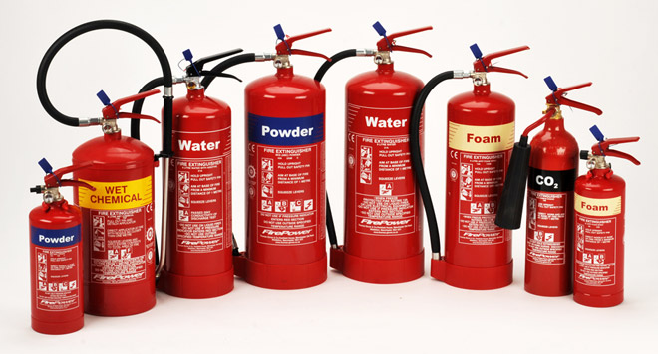
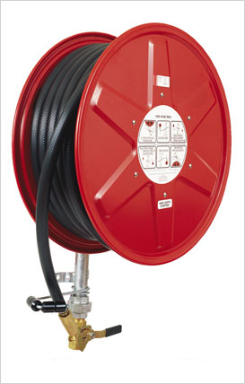
Component 5: Support Services
5.1 Sub-Component 20: Disaster Management (Element 148)
Certificates of compliance obtained (issued by local municipality after inspecting the facility’s compliance status)
Districts supplied facilities with fire fighting SLA including maintenance.
Service provider as per SLA are reminded in advance of the next service date
Immediate refilling once used.

Slide 16
Component 5: Support Services
5.1 Sub-Component 20: Disaster Management (Element 149-150)
Realistic /practical evacuation plan according to facility’s layout plan conducted.
Insight shared with staff re: what evacuation drill entails.
Then, anonymous drills, at least yearly conducted.
NB! During drills, care is exercised NOT TO COMPROMISE patient care.
Shortcomings and remedial action(s) noted and implemented PROMPTLY respectively……Important not to postpone/delay.
Drills re-run, depending on the severity of shortcomings identified.
Challenges | Measurable | Resp person | Time frame | Remarks
Specific | SMART | Name &/or designation | Specific | Post set time frame

Slide 17
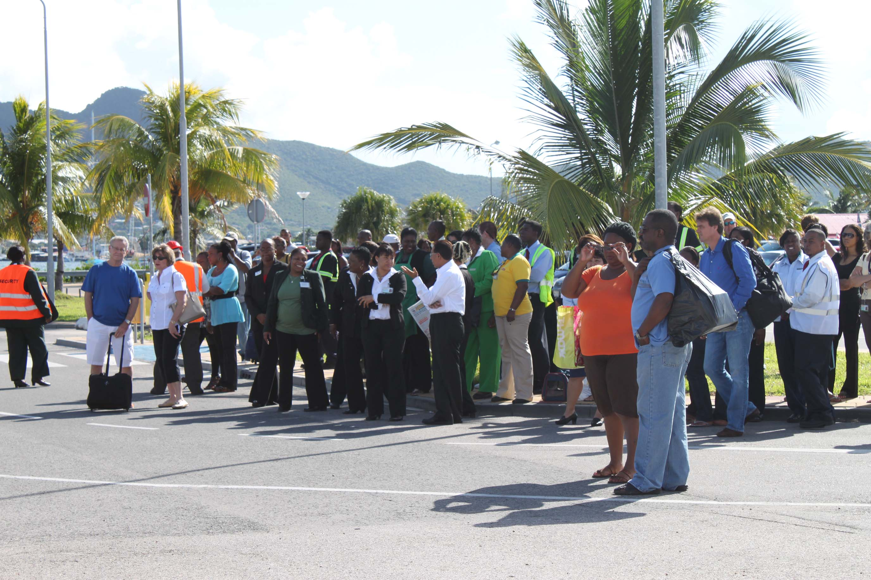

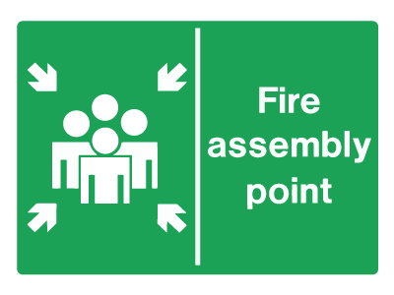
Component 5: Support Services
5.1 Sub-Component 20: Disaster Management (Element 151-152)
District/Sub-District to provided outbreak/disaster plan detailing the following:
Disaster/outbreak response team role players
Clear functions of each role player
Contact details
Then, schedule facility outbreak response plan with staff bi-annually
Each role player assisted to understand their responsibilities……….competency required here
Necessary equipment made available with very distinct labels

Slide 18
RECOMENDATIONS
Actual monitoring &/or evaluation MUST be conducted→ supervision by walking the plant.
All good practices, initiatives and/or achievements MUST be maintained.
Apply “Management with Consequences” principle where there are deviations, especially on areas that are reasonable for an Operational Manager to execute.
District Management to continually support facilities.

Slide 19
Component 5: Support Services
THANK YOU 

