Slide 1
IDEAL CLINIC PROGRAMME
Ideal clinic Dashboard Version 15
Support Services: 18-19 Hygiene & Cleanliness and Security
Presenter: Annie Jautse
Date: 17 September 2015

Slide 2
PURPOSE
To ensure common understanding of the IC elements: Hygiene, cleanliness and Security.
To share successes and challenges as experienced when implementing the elements.
To learn from one another, other success factors as experienced from elsewhere.

Slide 3
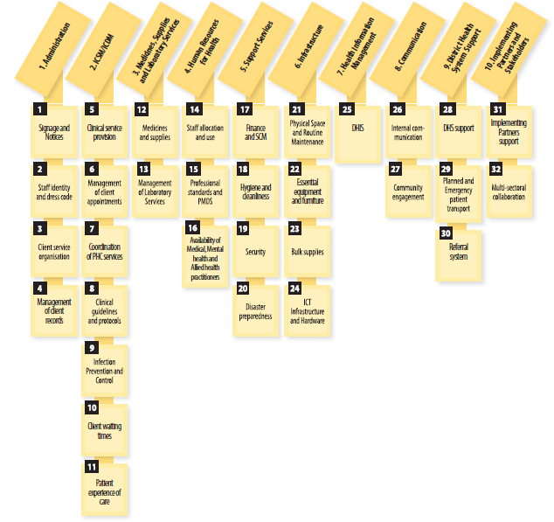
Components and sub components

Slide 4
5. Support Services
18. Hygiene and Cleanliness
Elements |  | W | MM | R
123 | There are sufficient cleaners | E | & | HF
124 | All cleaners have been trained on cleaning | E | & | HF
125 | All work completed is signed off by cleaners | E | & | HF
126 | Cleaning materials are available | E | ?& | HF
127 | Clean running water, toilet paper, liquid hand wash soap and disposable hand paper towels are available | E | ?& | HF
128 | Sanitary disposal bins with functional lids are available | E | ?K | HF
129 | General waste bins are lined with appropriate coloured plastic bags and have functional lids in all hand washing areas and consulting rooms | E | K | HF
130 | All toilets are always intact and functional | E | ?K | HF

Slide 5
5. Support Services
18. Hygiene and Cleanliness
Elements |  | W | MM | R
123 | There are sufficient cleaners | E | & | HF
124 | All cleaners have been trained on cleaning | E | & | HF
125 | All work completed is signed off by cleaners | E | & | HF
126 | Cleaning materials are available | E | ?& | HF
127 | Clean running water, toilet paper, liquid hand wash soap and disposable hand paper towels are available | E | ?& | HF
128 | Sanitary disposal bins with functional lids are available | E | ?K | HF
129 | General waste bins are lined with appropriate coloured plastic bags and have functional lids in all hand washing areas and consulting rooms | E | K | HF
130 | All toilets are always intact and functional | E | ?K | HF

Slide 6
5. Support Services
18. Hygiene and Cleanliness
Elements |  | W | MM | R
131 | Intensive cleaning of a facility is conducted during the least busy times | E | K | HF
132 | All service areas are clean | E | K | HF
133 | The exterior of the facility is clean | E | K | HF
134 | Vegetation is well trimmed | I | K | HF
135 | Waste is stored in access-controlled rooms | E | K | HF
136 | A signed waste removal service level agreement between the health department (district) and the service provider is available | E | & | P
137 | Waste is removed, regularly in line with the service level agreement | E | ?& | HF

Slide 7
5. Support Services
19. Security
Elements |  | W | MM | R
138 | Perimeter fencing is intact and complies with South African Police Service standards | I | K | HF
139 | Separate lockable pedestrian and vehicle gates are available | I | K | HF
140 | Adequate security lighting of the perimeter is available | I | KH | HF
141 | There is a standardised security guard room | I | K | D
142 | A copy of the service level agreement between the security company and the provincial department of health is available and understood by PHC facility management and staff | I | ?& | D
143 | Functional security equipment is available in security guard room as per service level agreement | I | KH | HF
144 | Registers for access control are available and up to date | I | & | HF
145 | Prohibited items appropriately controlled and accounted for before access is granted | I | K& | HF

Slide 8
5. Support Services
20. Disaster preparedness
Elements |  | W | MM | R
146 | Functional firefighting equipment is available and accessible | E | KH | HF
147 | Emergency evacuation procedure practiced annually | E | & | HF
148 | Deficiencies identified during the practice of the emergency evacuation are addressed | E | & | HF
149 | Intersectoral outbreak/disaster management plan is available | I | & | HF
150 | Annual review and staff awareness of the inter sectoral outbreak/disaster management plan | I | & | HF

Slide 9
How did you ensure that:
There is sufficient cleaning staff that is trained on cleaning and is accounting to the work.
Waste is properly managed.
There is consistent availability of cleaning materials and clean facilities.
People are safe when they are in our facilities.
Staff members are ready to manage disasters

Slide 10

Thank you
www.health.gov.za
www.idealclinic.org.za
idealclinic@health.gov.za

