Slide 1
IDEAL CLINIC PROGRAMME
Ideal clinic Dashboard Version 15
5: Finance and supply chain management
Presenter: Annie Jautse
Date: 16 September 2015

Slide 2
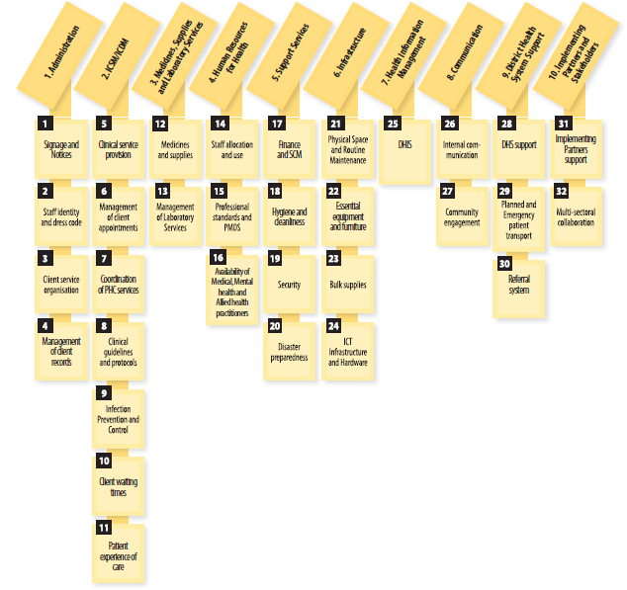
Components and sub components

Slide 3
5. Support Services
17. Finance and supply chain management
Elements |  | W | MM | R
118 | The facility manager is involved in determining the budget of the facility | I | ?& | HF
119 | The facility manager has financial delegation | I | ?& | D
120 | The budget and actual expenditure of the facility is available | I | & | HF
121 | The facility has access to an automated supply chain system for general supplies | E | ?& | HF
122 | Delivery of supplies are consistently in line with terms and conditions of the relevant contract (including set turn-around times) | E | ?& | D

Slide 4
5. Support Services
17. Finance and supply chain management
Elements |  | W | MM | R
118 | The facility manager is involved in determining the budget of the facility | I | ?& | HF
119 | The facility manager has financial delegation | I | ?& | D
120 | The budget and actual expenditure of the facility is available | I | & | HF
121 | The facility has access to an automated supply chain system for general supplies | E | ?& | HF
122 | Delivery of supplies are consistently in line with terms and conditions of the relevant contract (including set turn-around times) | E | ?& | D

Slide 5
How does one awarded financial delegation?
How should one be involved in determining, utilizing and monitoring of budget?
How does one ensure consistent availability of supplies?

Slide 6

Thank you
www.health.gov.za
www.idealclinic.org.za
idealclinic@health.gov.za

