Slide 1
Integrated Clinical Services Management
ICRM Orientation for scale up
Dr Shaidah Asmall –PHC
14.09.2015

Slide 2
Contents
Journey of a patient
Health System challenges
Rationale for Ideal Clinic
ICSM
Facility Re-organisation
Clinical Management Support
Assisted Self-management
Roles and Responsibilities
Implementation Process to Success
Change Management

Slide 3
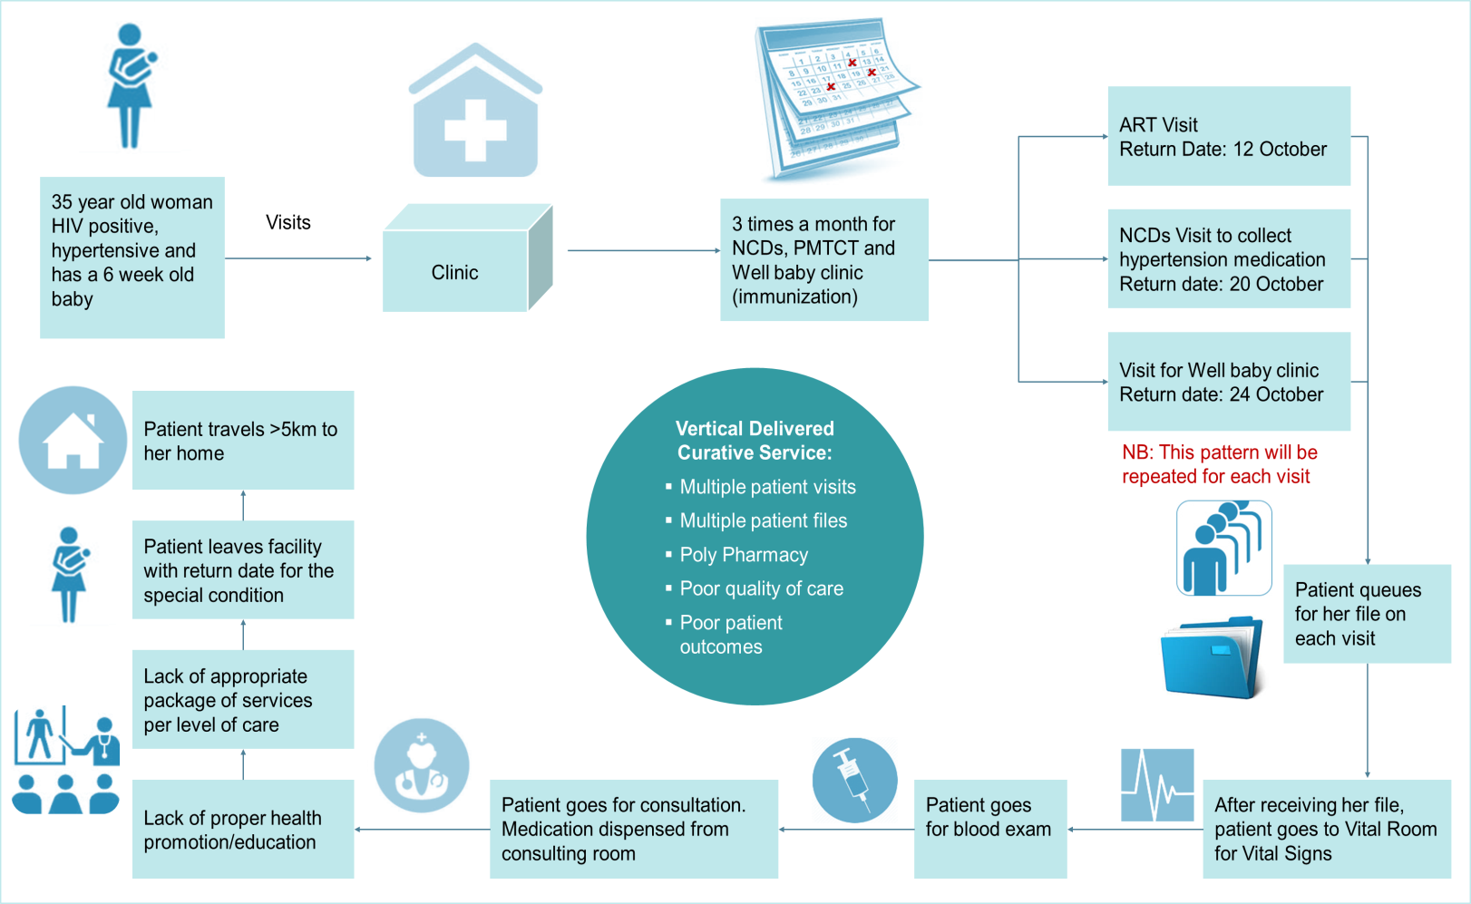

Patients experience services that are vertically delivered and curative in focus, making it time consuming and costly, with poor health outcomes

Slide 4
PHC faces numerous challenges
Patients experience low-quality service delivery, with non-integrated care that is not aligned with the patient’s needs
Patient waiting time in clinics is 2-5 hours, with on average 79% of time in clinic spent waiting
80% of clinics are not “fit for purpose”, with obsolete or inadequate infrastructure
Essential (medical) supplies are often missing at clinic level, because
of a broken and unresponsive
supply chain
Lack of strong financial management causes PHC facilities to run out
of funds early into the year
Uneven implementation of initiatives caused by inadequate institutional arrangements between provinces and national
With 46,000 vacancies, human resources in PHC are lacking, with shortages of key personnel in the clinics
Scaling up and sustaining a major PHC transformation will
be challenged by the fragmented health government structure

Slide 5
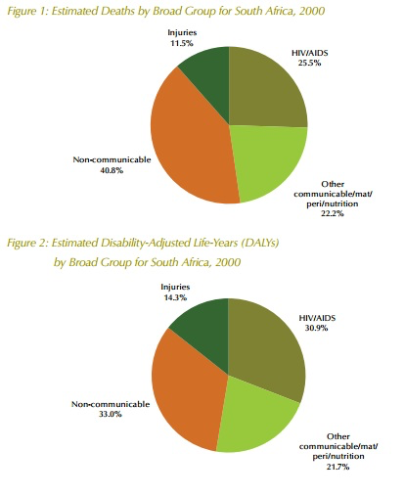
Quadruple burden of disease

Slide 6
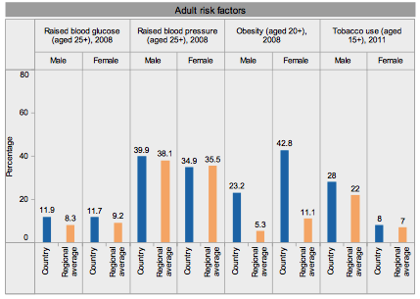
Adult risk factors (2008)

Slide 7
Successes of the South African ART treatment programme
expanded the number of clinics providing ART in the country from 490 to 3,540
rolled out a national policy of decentralized HIV services.
shifted to a nurse-initiated service delivery model at primary health centers and away from services delivered mainly by doctors at hospitals.
Number of patients receiving ART increased
  47 500 (95% CI 42 900 – 51 800) middle of 2004
  to 1.79 million (95% CI 1.65 - 1.93 million) end of June 2011.
  Approximately 2,7 million patients in 2014
  Further increase with CD4 < 500 from January 2015

Slide 8
What do we need?
The changing disease patterns require a reorientation of the health system so that it:
  Provides a comprehensive, effective and appropriate service for chronic, long-term care
  Maintains and improves the capacity of acute care services

Slide 9
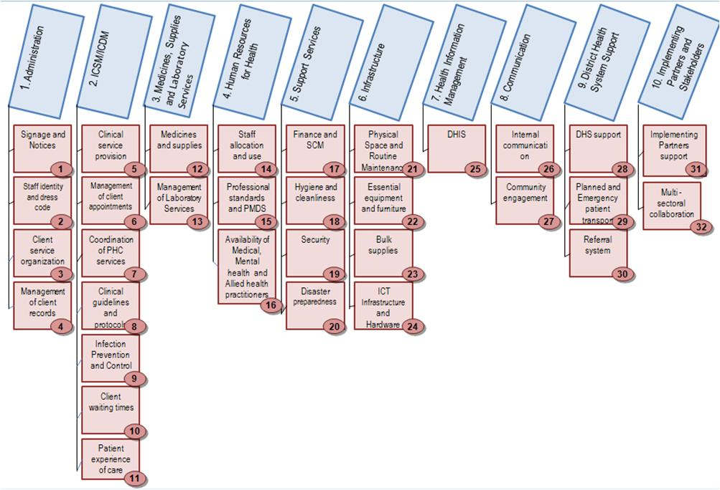
Components and Sub components

Slide 10
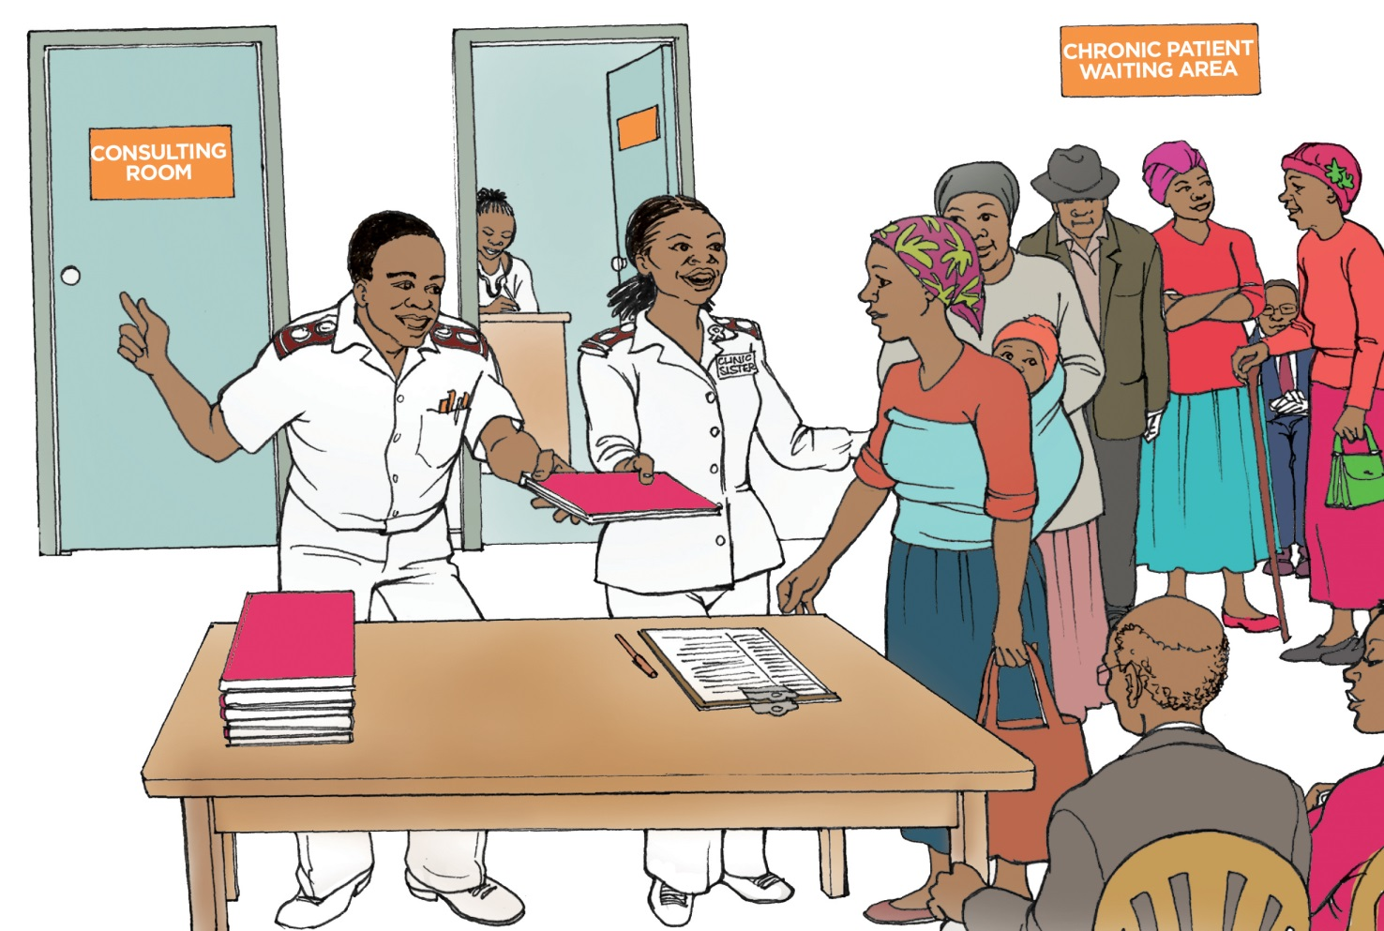
Integrated Clinical
Services Management Model

Slide 11
Integrated clinical services
WHO defined integrated service delivery as
  “the organization and management of health services so that people get the care they need, when they need it, in ways that are user friendly, achieve the desired results and provide value for money”.

Slide 12
What is the ICDM model?
A health system strengthening model
Builds on the strengths of the HIV programme
To deliver integrated care to patients with chronic diseases
Takes a patient-centric view that encompasses the full value chain of continuum of care and support
ICDM

Slide 13
Purpose of the ICDM
To achieve optimal clinical outcomes for patients with chronic diseases (communicable and non-communicable) by:
  Ensuring the coordination of care and transitioning to self-management at a community level
  Using the health system building block framework, to improve the efficiency and decrease the strain on the health care system
  Maintaining the economic productivity of the patient
ICDM

Slide 14
Anticipated benefits of ICDM Model
Enhanced operational efficiency
Improved quality of care
Better patient outcomes
ICDM

Slide 15
Clinical Services Integration
Spectrum of integration
  means blending either some of the elements of, or all aspects of one service into the regular functioning of another service. (Example TB/HIV/SRH)
  “coordination of services and the integration of care in a single process across time, place and discipline”
  Delivery of services or multiple interventions together on the same patient visit by the same health worker or clinical team

Slide 16
ICSM
Integrated Clinical Services Management
Acute and Minor Ailments
Unplanned
Chronic Disease Management
Planned appointments
MCWH-Preventive /Promotive
Planned Appointments

Slide 17
ICSM
Separates point of entry for organizational purposes
All services offered daily
Integrated services to be provided at service point- Acute services for chronic patients, Family Planning etc
No cross referrals
To treat the patient holistically and not the disease

Slide 18
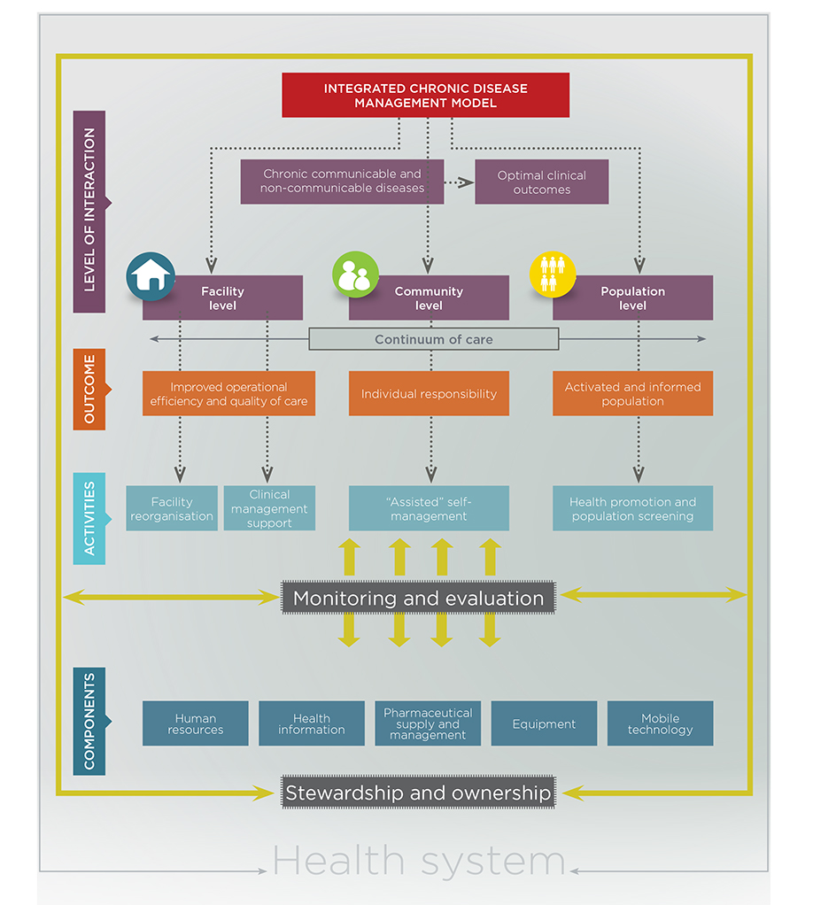
INTEGRATED CLINICAL SERVICES MODEL (ICSM))
Acute Curative Services
Adult and Children
Chronic Disease
(HIV and NCD)
Preventative Services
Health Support Services
Optimal Clinical Outcomes

Slide 19
Integrated Clinical Services Management
Optimal Clinical Outcomes
Facility
Community
Operational Efficiency
Individual Responsibility
Re-organisation
Clinical Management
Assisted Self Management
“Lean” patient flow
Appointment scheduling
Staff allocation
Integration of records & filing systems
Pre-dispensed meds/CCMDD
Clinical Algorithms
Health Promotion Compendium
Integrated Patient Record
DCST/mentoring
Supervision-clinical audits
Ward Based Outreach Team
School health team
High Risk Screening
Population Health Promotion
Meds Courier (CCMDD) ?in future
Support Groups
Adherence support

Slide 20

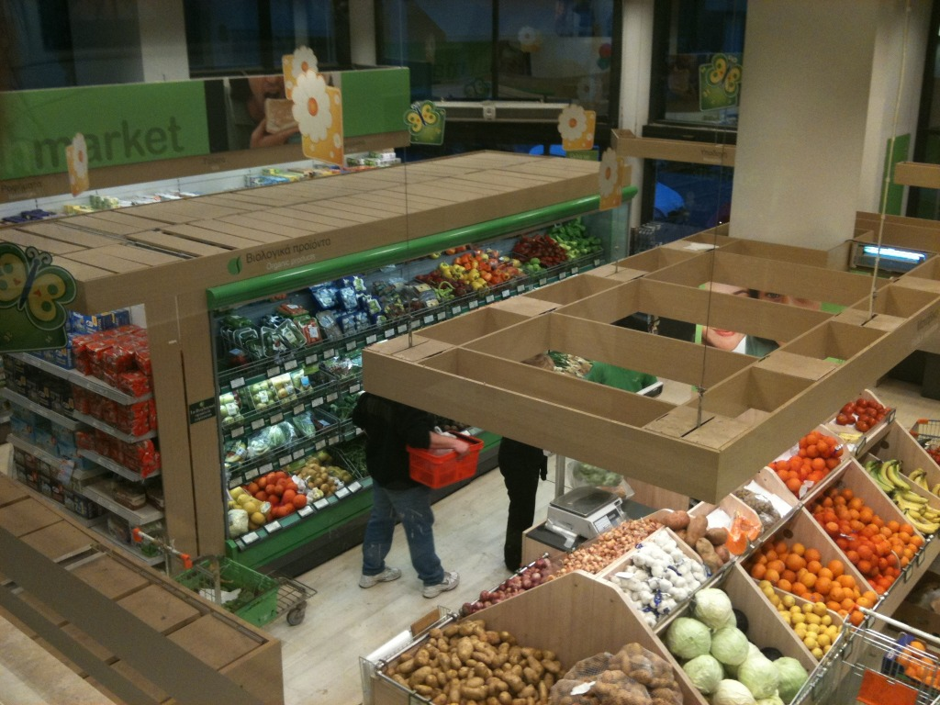
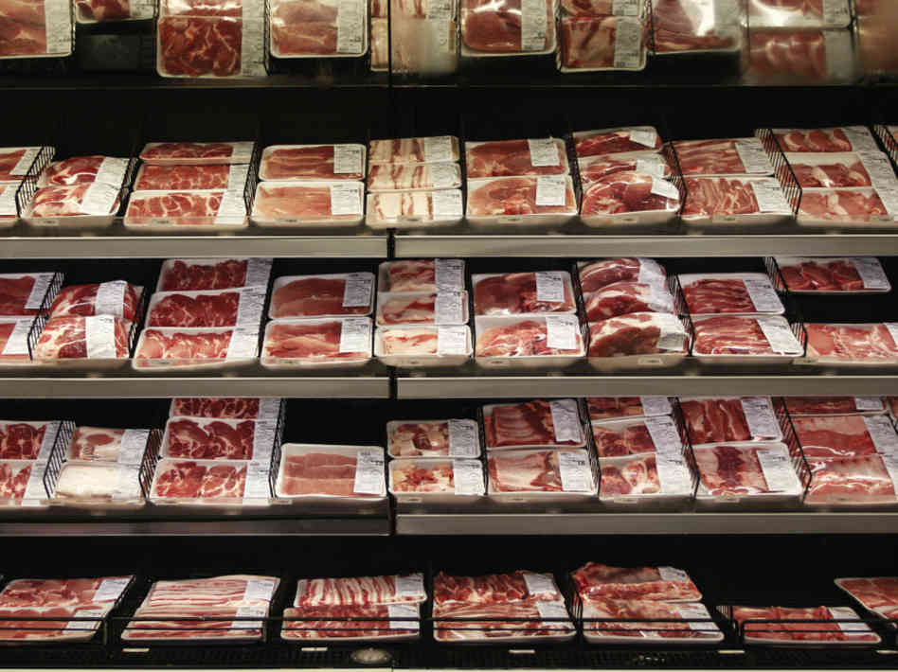
Organised system

Slide 21
Lean Principles
Sorting | Remove unnecessary items from consulting rooms and any unused items from the workspace
Set-in order / Straighten | Organise the process flow and ensure all the necessary items are in the correct place for easy access and efficient service provision
Shine | Maintain a clean environment
Standardise | Set up, Sort and Shine at all work stations
Sustain | Reinforce the importance

Slide 22
Organising the process flow:
The process flow at the facility should be organised into 3 clearly designated areas that make it easy for patients to access and exit without any cross over.
These areas should have different colour marking painted as footmarks on the floor or lines on the wall to appropriately direct patients.
The area for Acute/Minor ailments should be marked as red/orange.
The area leading to Preventive services including Maternal, Women and Child Health should be marked as green
The area for chronic patients on the ICSM should be marked as blue.

Slide 23
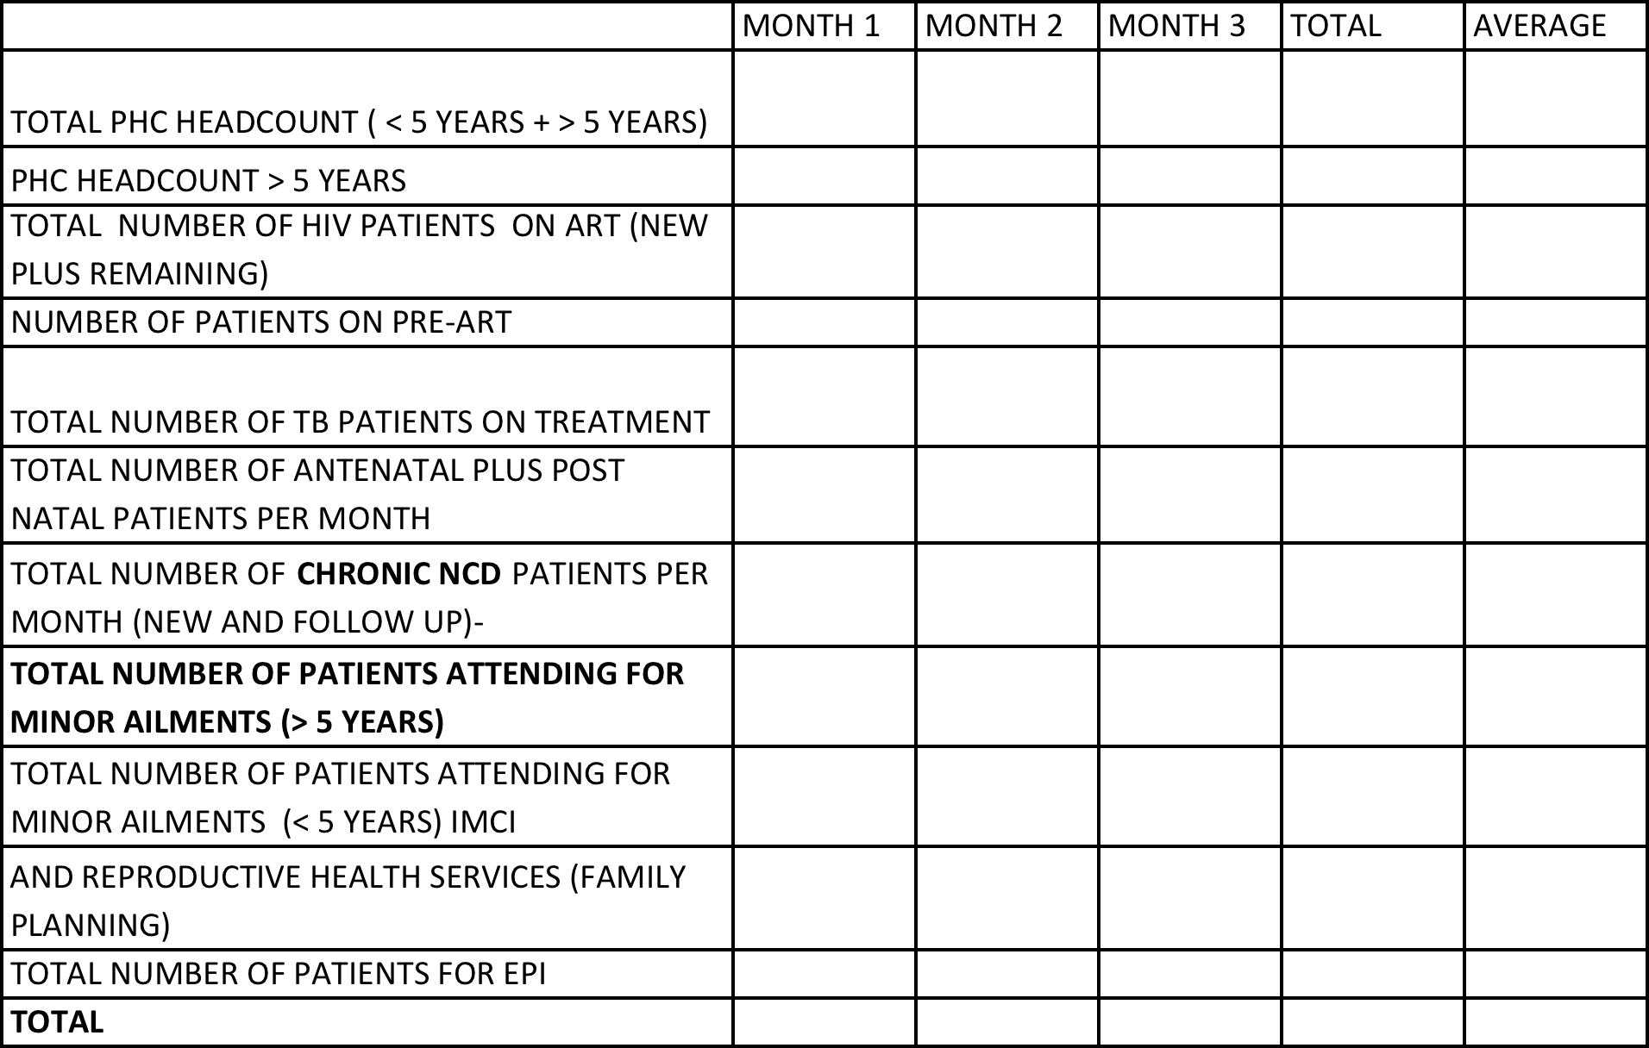
Baseline Information for Planning

Slide 24
Facility reorganization
Prior to addressing the components of the ICSM that will eliminate waste it is important to address facility environment.
Step 1: Implement the 5S of the Lean Thinking Principles as detailed by the Quality Improvement Guidelines prepared by National Department of Health

Slide 25
Number of patients to be scheduled daily
Use a 20 day per month cycle to determine the number of patients to be consulted (20 days used to cater for pension days, public holidays as well as weekends).
The booking is determined on a Monday-Friday and can be modified for 24 hour facilities and those facilities that are opened on weekends

Slide 26
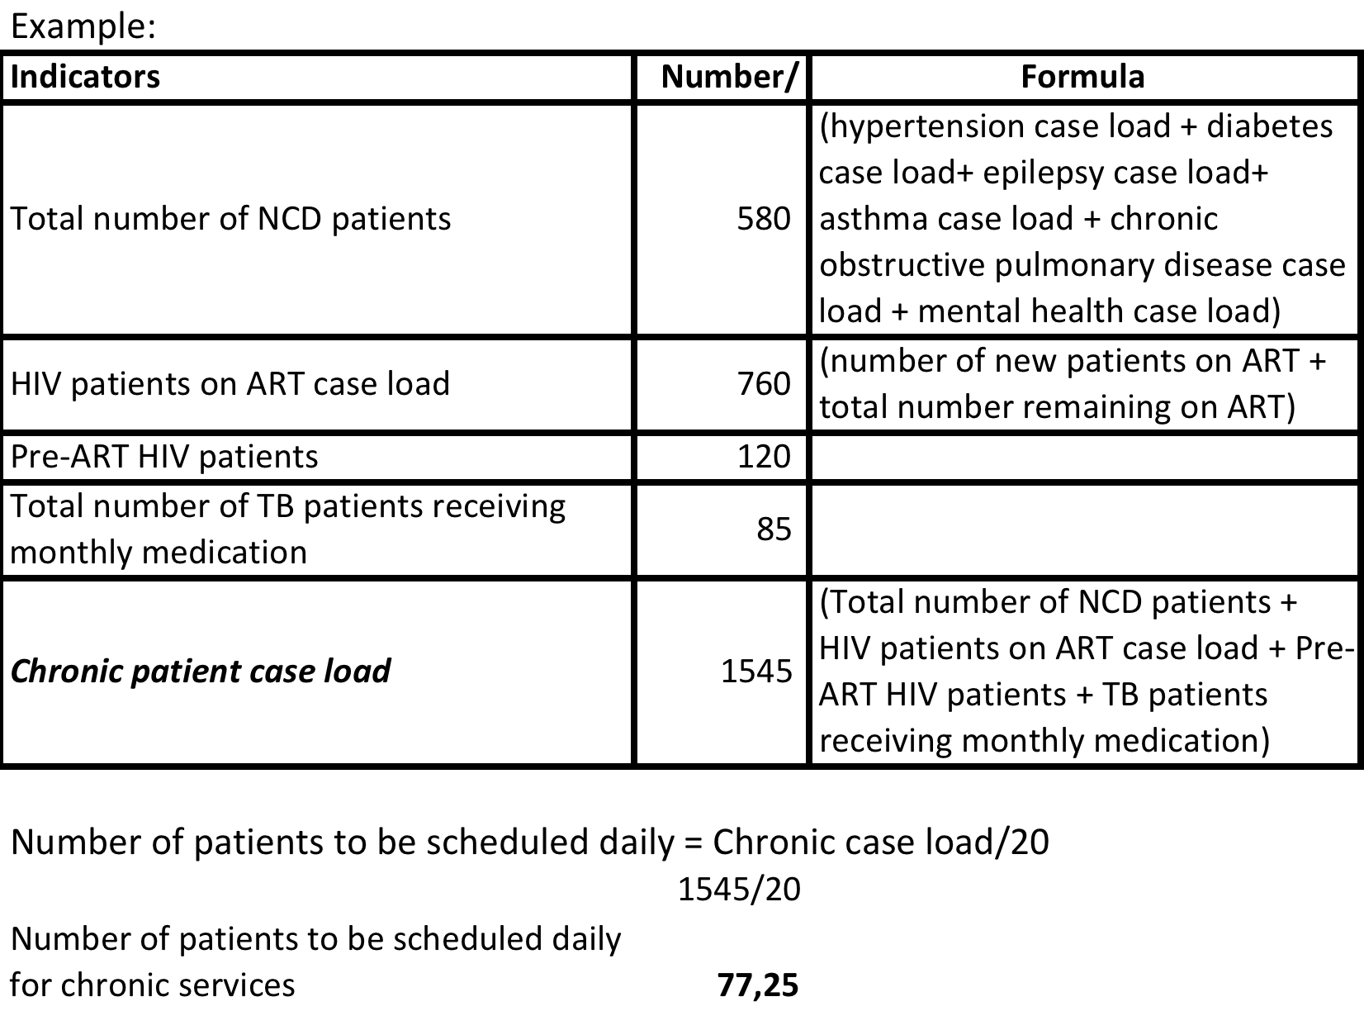
Example

Slide 27
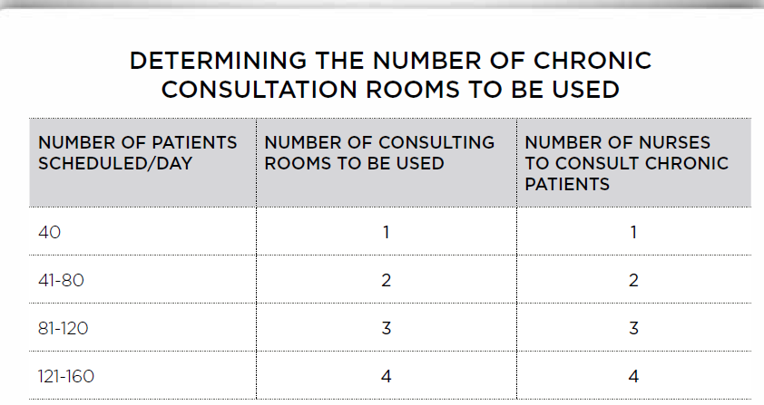

Slide 29
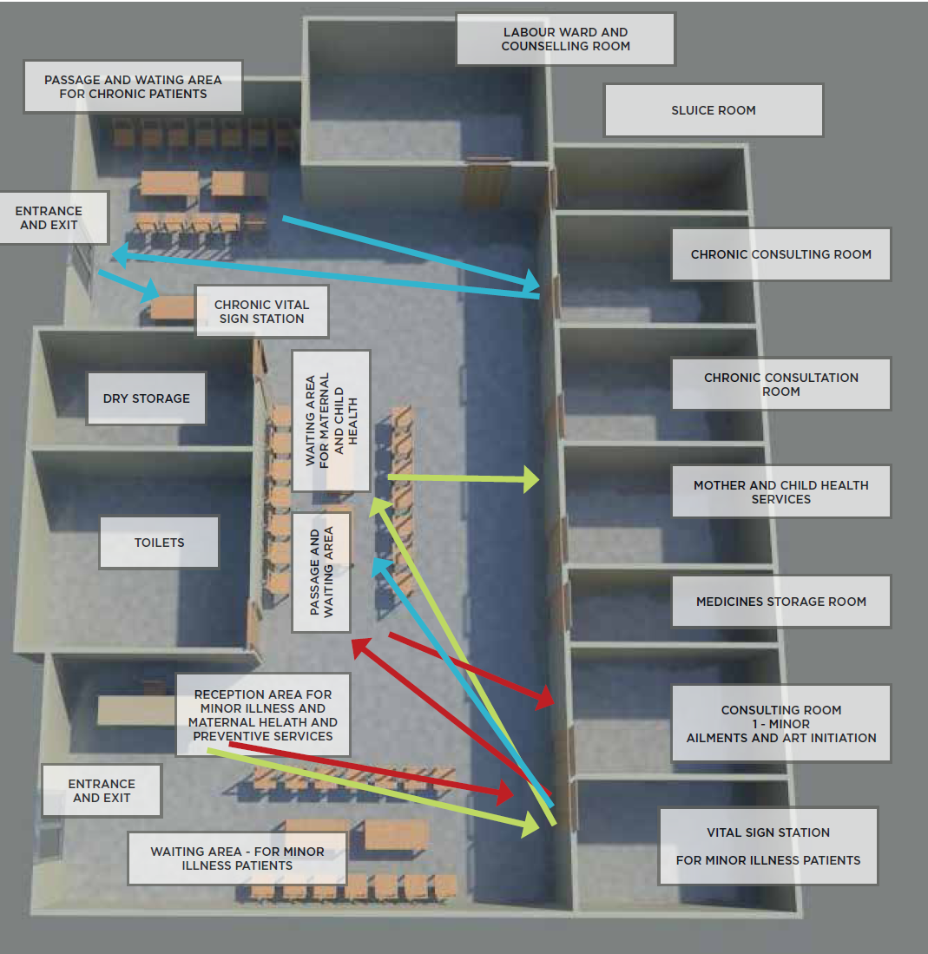
Reorganized patient flow

Slide 30
Designation of consultation room
Criteria for consulting room per stream of service
The ideal is to allocate consulting rooms that are adjacent to each other if more than one consulting room is to be used.
Ensure that there is no cross flow between patients
The patients should be able to exit after consultation easily without having to re-enter the main clinic area.

Slide 31
Additional vital signs station
  An additional vital signs monitoring station should be established for chronic patients/MNCWH.
  This vital sign station should be conveniently located between the chronic patient waiting area and consulting room.
  At facilities where less than 30 patients are booked per day, and there is sufficient equipment available, the blood pressure and blood glucose could be monitored in the consulting room

Slide 32
Triaging of patients
Acute patients-unplanned
Fast queue- Emergencies and Patients with cough
IMCI- sick children in own queue
Chronic –HIV , TB on rx, NCD
Preventive and promotive
ANC/PNC
Sexual reproductive health
Well baby (EPI)

Slide 33
Triaging of chronic patients
The patients should be further triaged after completing the vital signs into and directed appropriately
  Repeat medication with normal vital signs
  Repeat medication with abnormal vital signs
  6 month full examination
  Doctor referral

Slide 34
Triaging of MNCWH
Preventive Services- EPI/Well baby
Ante-natal- First visit- Booked early
Follow up visits- Later during day or consulted seperately

Slide 35
Determining the appointment date
Depending on the patient’s condition and availability of medication at the facility the patient will either return on:
Monthly basis if unstable or complicated patient
Every 2nd or 3rd month for a repeat prescription if patient is stable
After 6 months if the patient has been down referred to the PHC outreach team
The maximum number of patients that should be consulted daily is pre-determined.
At the beginning of each week, the professional nurses should determine and provide a 5 day period on which returning patients should be scheduled.
This should be calculated between 25 and 30 days after the current date.
All patients should then be given a choice as to the exact date that they would like to return within this period.
The date should not be imposed on the patient.

Slide 36
Appointment scheduling
If single consulting room used for each service The scheduling of patients should be done by the professional nurse in the consulting room
If more than one consulting room is being used, a number of options could be considered:
    Each professional nurse should be allocated a maximum number of patients that could be booked per day within the respective week and the professional nurse could transcribe them on the scheduling book.
    An administrative clerk could be stationed in a convenient area and schedule the patients according to the information provided by the professional nurse

Slide 37
Time scheduling of appointments
In order to avoid the batching of patients and prolonging the waiting times, patients should be offered time slots for attending the appointment.
Patient’s requiring 6 month appointments should be distributed equally across the time slots or scheduled in a specific time slot to avoid prolonging the waiting times for other patients.
The time slots should be per 2 hour session with 10-12 patients scheduled per 2 hour session.

Slide 38
Scheduling the appointment
An appointment file or register needs to be completed using the format described below.
**Patients that are to be initiated on ART can be scheduled for the afternoon sessions when NIMART trained or PALSA plus trained nurses will be available to provide them a dedicated service.

Slide 39
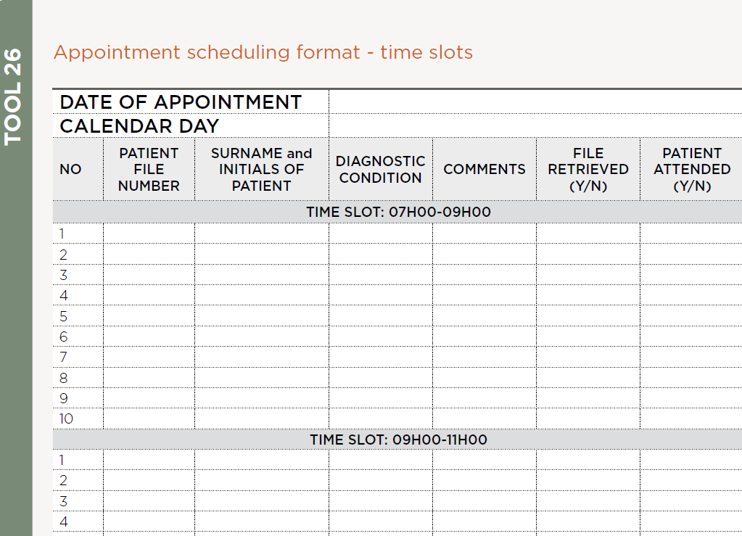

Slide 40
What happens if a patient misses a scheduled appointment?
The pre-dispensed medication will only be kept in the consulting room for a further 72 hours.
The patients record will be filed back in the main filing area after 72 hours
Should the patients come within 72 hours after their scheduled date, the patient will be consulted after all the patients allocated to that time slot have been consulted even if they arrive first.
The patient will be placed at the back of the queue for scheduled patients
Should the patient arrive after 72 hours, the patient will need to follow the normal process of retrieving their files, wait for the vital signs and be consulted after all the chronic patients have been completed.

Slide 41
Pre-appointment retrieval of patient records
Between 48 and 72 hours prior to the patient’s appointment,
  a copy of the appointment schedule should be provided the administrative clerk where available or support staff,
  Patients record should be retrieved
  tick off in the scheduling book after the record has been retrieved.
  Professional nurse should update patient records- any laboratory investigations results for outstanding investigations conducted on previous visits and place the results in the records
  Patient records should be kept in appropriate place for scheduled patients

Slide 42
Integration of clinical records
Each patient should have a single file for comprehensive care
The facility should have a single system for filing and storing clinical records of all patients
The records should not be stored per diagnostic condition but rather by the first 3 letters of the patient surname and date of birth or address e.g. ASM600108

Slide 43
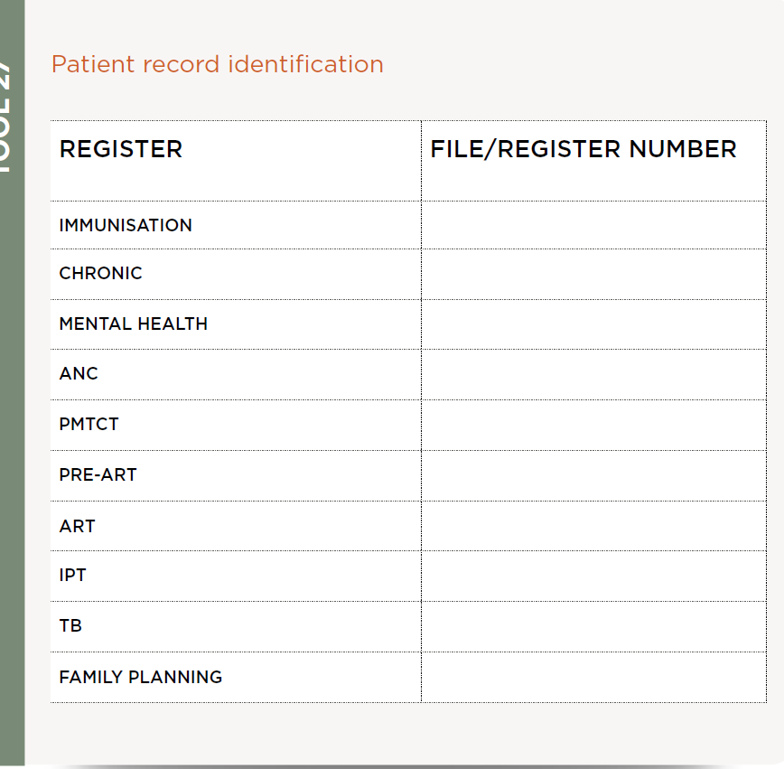

Slide 44
Contents of record
Each chronic patient file should contain the following sections:
  Chronic patient follow up records
  Continuation sheets
  Additional national stationery such as ART stationary for relevant patients
  Section for laboratory investigations
  Repeat prescriptions

Slide 45
Pre-dispensing of medication/CCMDD
Two days prior to the patient’s appointment, the patients clinical records and scheduling list should be provided to the allocated professional nurse for chronic patients or the pharmacy assistant where available
The designated professional should pre-dispense the medication according to the prescription
The medication should be pre-packed in a brown bag or clear opaque plastic bag where available.
A sticker with the patients name and file number should be placed on the external part of the bag.

Slide 46
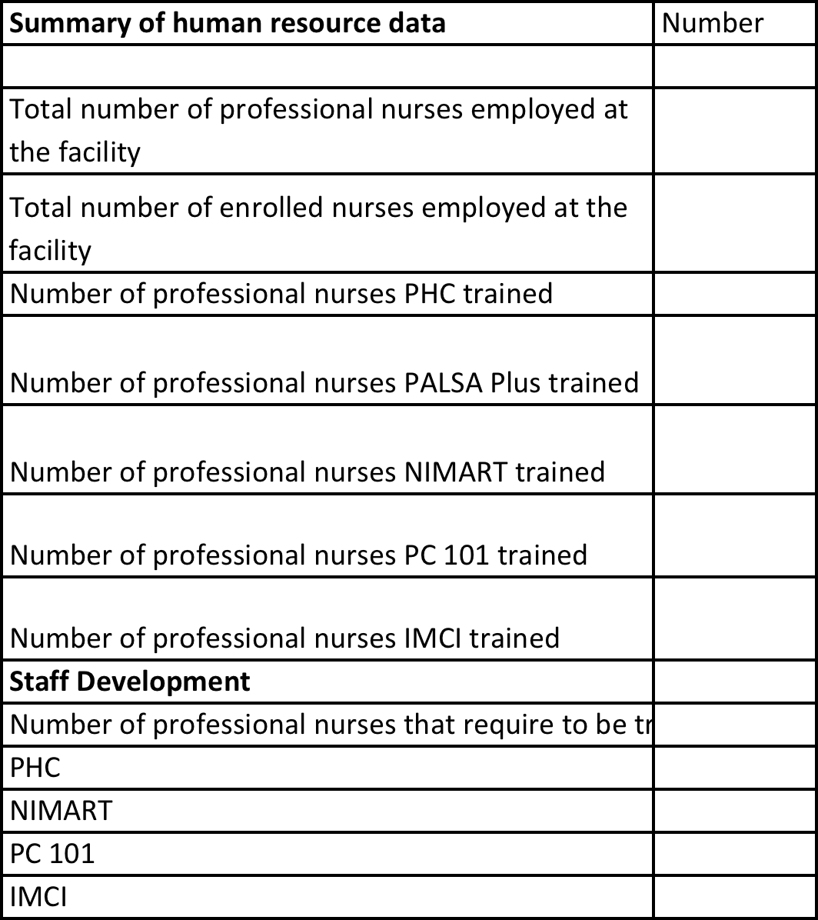
Staff Audit

Slide 47
Scheduling of professional nurses
The professional nurses allocated to consulting chronic patients should be preferably PC 101 trained or primary care trained.
In the interim period whilst all the professional nurses are being trained on PC 101, nurses with additional primary healthcare and/or PALSA Plus or NIMART training should be scheduled to consult chronic patients.
The roster system should be designed for a monthly, 2 monthly or quarterly rotations dependent on the number of trained professional nurses available and the number of chronic consultation rooms required.

Slide 48
NAME OF PROFESSIONAL NURSE | MONTH 1 | MONTH 2 | MONTH 3 | MONTH 4 | MONTH 5 | MONTH 6

Slide 49
Clinical Management Support

Slide 50
Purpose
Assist professional nurses and other health care professionals at PHC level to provide holistic care to patients in accordance with best practices and following evidence-based guidelines

Slide 51
What is CMS?
Clinical care and support:
  Evidence-based clinical guidelines
  (PHC STG/EML, PC101)
  Health promotion compendium and guidelines(in development )
Chronic patient record (to supplement clinical ART stationary)
District Clinical Specialist Team (DCST) to provide mentoring and guidance
Supervision by PHC Supervisors and programme co-ordinators

Slide 52
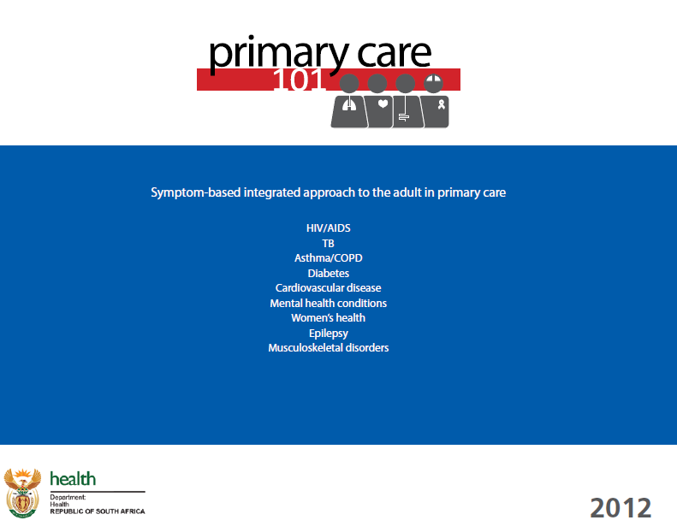

Slide 53
Chronic Patient Record
primarily a checklist to ensure that patients attending the primary care facility for chronic disease management over a 12 month period are reviewed systematically and comprehensively at each visit and the appropriate laboratory investigations are conducted.

Slide 54
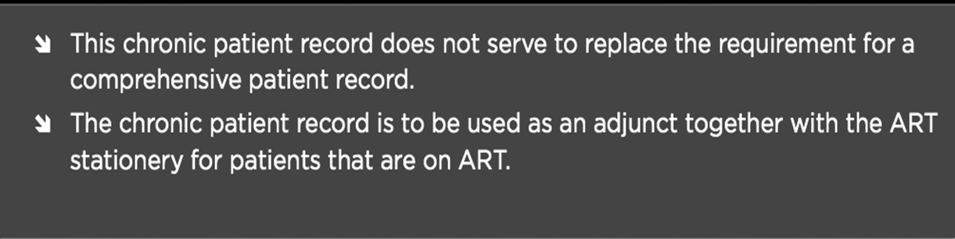
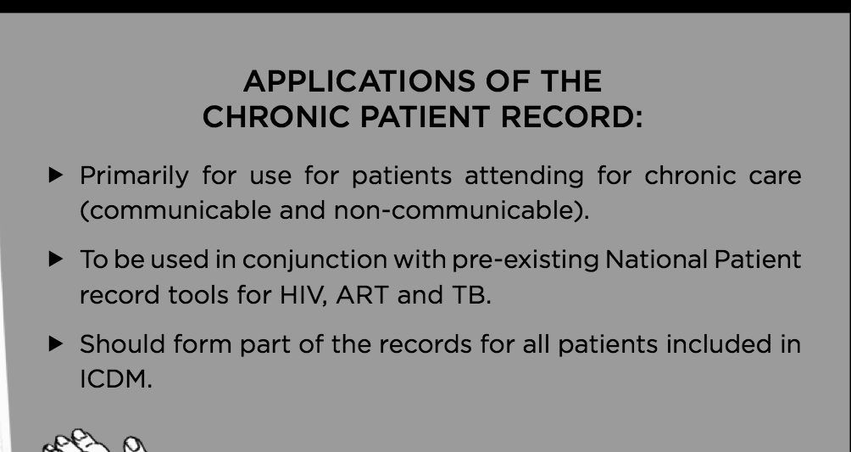
^{e}

Slide 55
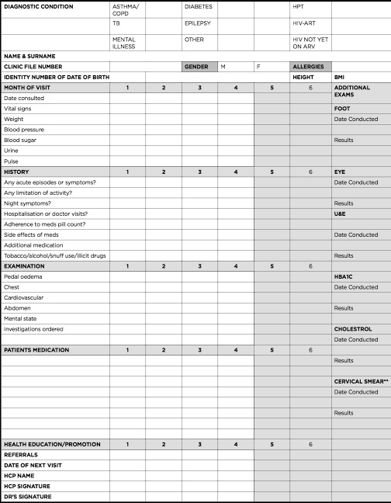

Slide 56
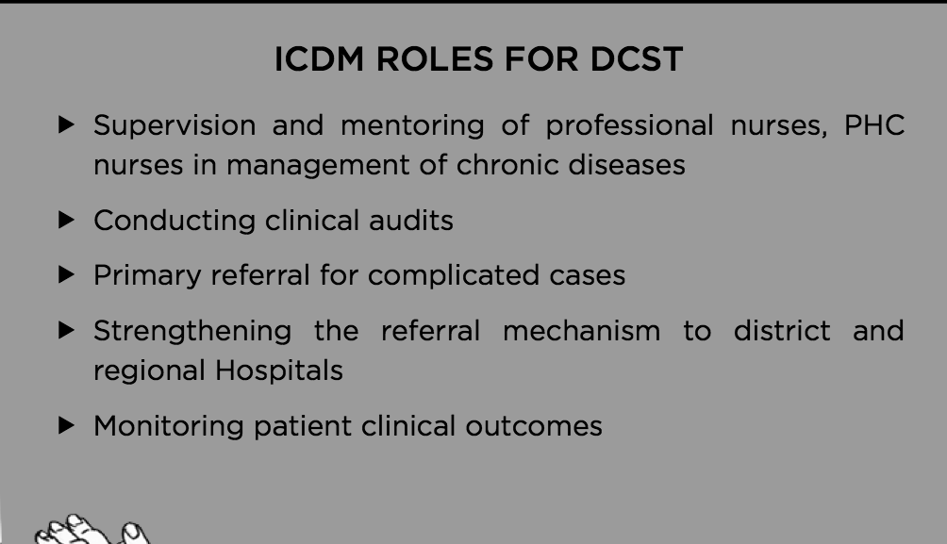
Role of DCST Team

Slide 57
“Assisted” self support management
The CHW is part of the PHC ward based team
The CHW will serve as a link between the facility and the community
The CHW will provide health education and promotion with respect to reducing the risk factors to chronic diseases as well as preventing complications. This will include but not limited to:
  Healthy eating habits and active living through appropriate exercising
  Decrease in alcohol intake, tobacco and snuff use
  Reduction in salt intake
  Adherence support
  HIV counselling
  Identification of other family members at risk
The CHW could serve as a medicine courier in
certain circumstances

Slide 58
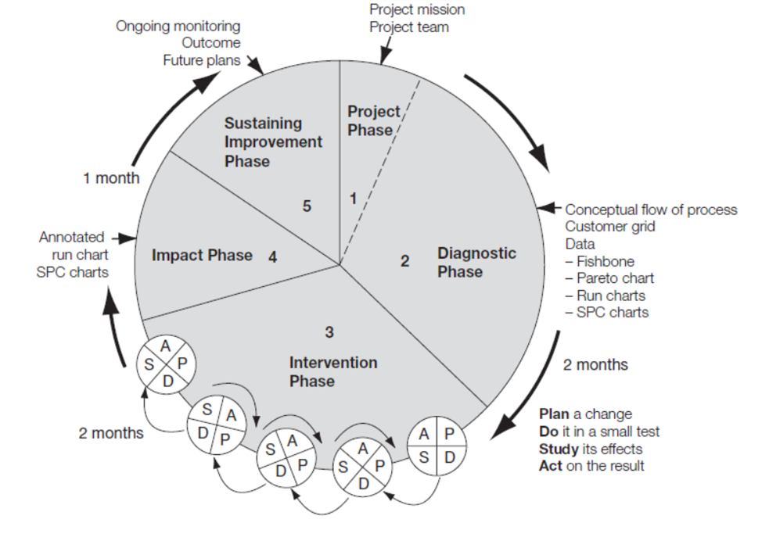
Quality improvement model

Slide 59
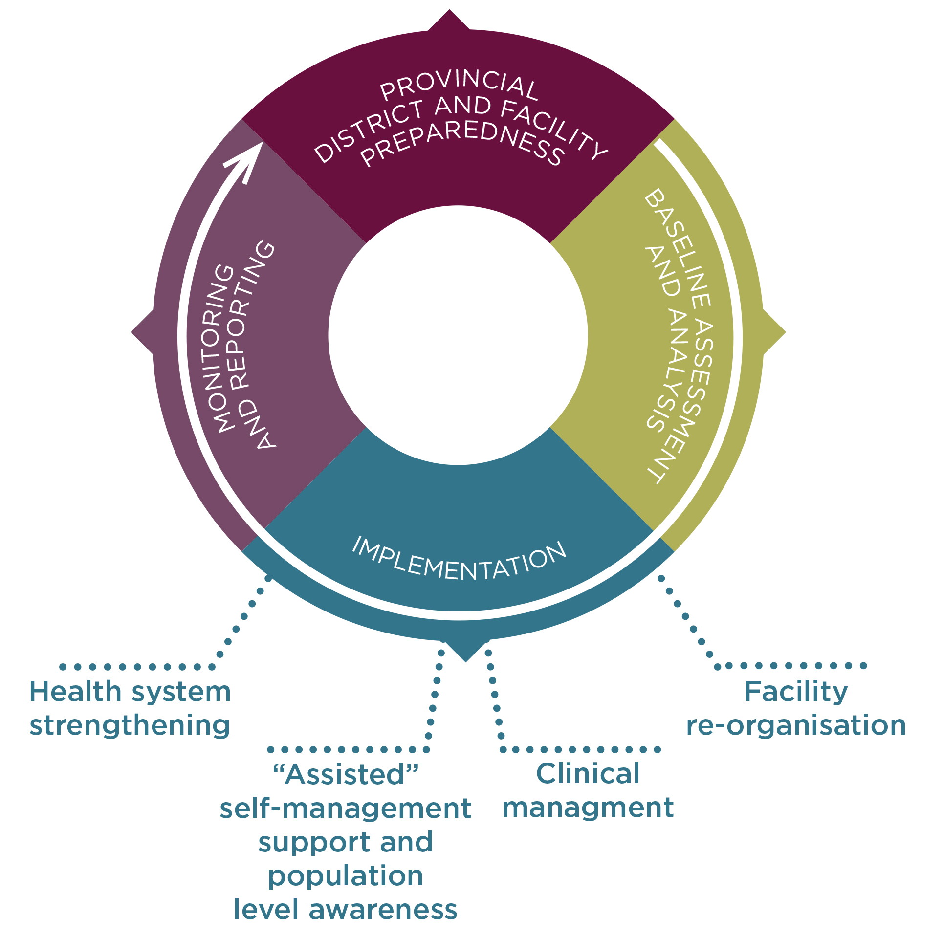
ICDM Implementation Process

Slide 60
Role of Operational Manager
Conduct staff meeting with all personnel
Brief the staff on ideal clinic components and ICSM (Create awareness) and its benefits (desire)
Brief staff on implementation steps and activities involved (Knowledge)
Establishing facility ICSM Team (Ability)
Selecting ICDM Champion (Re-inforcement)

Slide 61
Roles and Responsibilities of ICSM Champion
Maintains a harmonious relationship between the ICSM team and its stakeholders
Provides suggestions for solutions to the stakeholders who will then pick the best option
Facility trainer for PC 101, if possible
Communicates dates on the project’s development and issues to upper management
Communicates messages from the stakeholders to the facility ICSM team in case they have any concerns, requests in a change of direction or simply questions about the project’s status and progress

Slide 62
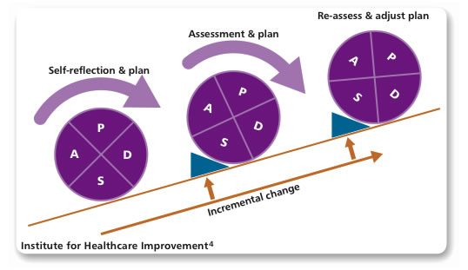
ICDM IMPLEMENTATION APPROACH
incremental step-wise approach using the Plan-Action-Do-Assessment Cycle.
Small incremental changes are standardised within the culture of the organisation.

Slide 63
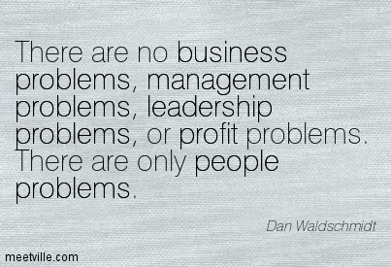

Slide 64
Change
Movement out of a current state (how things are today), through a transition state and to a future state (how things will be done).
Happens all around us - at home, in our community and at work.
internally motivated or externally motivated
Can be a dramatic departure from what we know or it can be minor.
can be anticipated or unexpected.

Slide 65

Change

Slide 66
Change
Ultimately, the goal of change is to improve the organization by altering how work is done
When you introduce a change to the organization, you are ultimately going to be impacting one or more of the following four parts of how the organization operates:
  Processes
  Systems
  Organization structure
  Job roles

Slide 67
Change versus change management
Change management is about supporting individual employees impacted by the change through their own transitions - from their own current state to their own future state that has been created by the project or initiative.
It is only when employees embrace, adopt and use the change that results are achieved

Slide 68
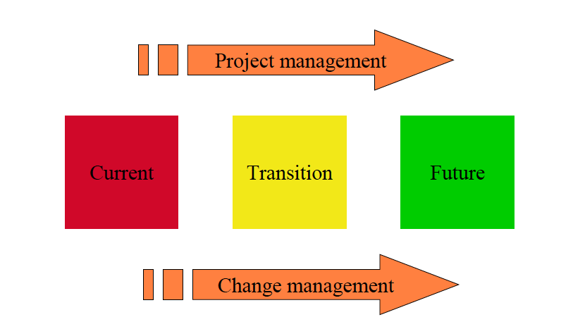
Project management versus Change Management

Slide 69
Managers perspective
Results oriented.
When a change is needed, they require action quickly.
When can the change be completed? How much improvement will be realized? How will this change impact our financial performance? What is the required investment? How will this change impact our customers? | "I need results

Slide 70
Employee’s perspective
"What will this change mean to me?"

Slide 71
Potential if change not managed properly
Employees resist the change.
Valued personnel leave the organization.
Critical projects are delayed.
Customers feel the impact indirectly through upset employees.
Productivity declines.

Slide 72
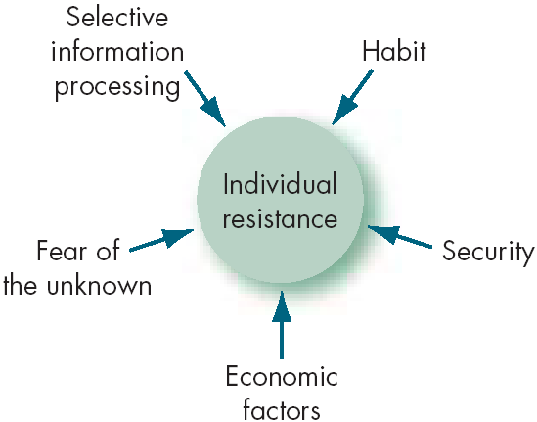
Sources of individual resistance to change

Slide 73
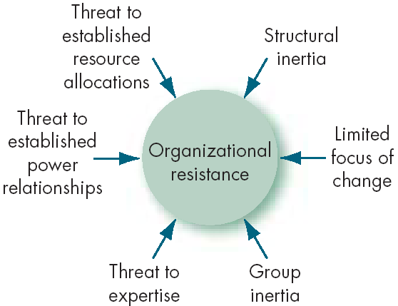
Organisational resistance to change

Slide 74
Importance of change management
Change management is not something addressed after the fact.
Change management must start at the beginning and be integrated into all facets.
Both perspectives of change management must be addressed: the managers and the employees.

Slide 75
Individual change model
A Awareness of the need for change
D Desire to support and participate in the change
K Knowledge of how to change
A Ability to implement the change
R Reinforcement to sustain the change

Slide 76
Informing the Stakeholders
THIS PROCESS SHOULD COMMENCE 4-6 WEEKS PRIOR TO THE COMMENCEMENT DATE
Immediately after the briefing of the facility manager should convene a meeting with:
All the staff at the clinic - doctors, nurses, pharmacy assistants, administrative clerks, data capturers, counsellors, general assistants, security guards and any other
Clinic committee, local chiefs and traditional healers, radio stations, newspapers
Patients - the facility manager and/or ICSM champion should address the patients daily as a collective after the morning prayers and inform them of the impending changes
The professional nurses should inform patients individually after their consultations about the impending changes
The health promoters should also brief the patients about the impending changes during their health promotion sessions conducted at various stages during the day

Slide 77
Selection of the implementation date
It is important to work backwards from a target
All the facilities within the sub-district or those identified to initiate the ICSM model should commence within the same period
All facilities should commence with implementation of the various components of the ICSM on the 1st Monday of a new month, 6 –8 weeks after the facility implementation and training workshop.

Slide 78

Notes:
Integrated Chronic Disease Management (ICDM) is a
model of managed care based on the continuum of care
that provides for integrated prevention, treatment and care of chronic patients at primary healthcare level (PHC)
to ensure a seamless transition to ‘assisted’ self-management within the community by taking a patient-centric view
that encompasses the full value chain of continuum of care and support.
To achieve optimal clinical outcomes for patients with chronic diseases (communicable and non-communicable) by:
Ensuring the coordination of care and transitioning to self-management at a community level
Using the health system building block framework, to improve the efficiency and decrease the strain on the health care system
Maintaining the economic and social productivity of the patient
By developing an individual's sense of responsibility for their own health

