Slide 1

CALIBRATION OF THE PPTICRM
Component 2: Integrated Clinical Services Model (ICSM)
Sub Components 9, 10, 11
Presenter: Dr Robert O Oyedipe
DATE: 14th SEPTEMBER 2015-17th SEPTEMBER 2015
Venue: Birchwood Hotel
Gauteng

Slide 2
Thomas Dreier > Quotes > Quotable Quote
“The world is a great mirror. It reflects back to you what you are. If you are loving, if you are friendly, if you are helpful, the world will prove loving and friendly and helpful to you. The world is what you are.”

Slide 3
Outline of this Presentation
Introduction: The Eagle Experience in Change
Focus area of this presentation
Human reaction as experienced
Support and resources we accessed
Infection Prevention and Control
Patient Waiting Time
Patient Experience of Care
Expectations and Results
Success factors
Systems that has Contributed to Quality Improvement
Challenges
Feedback from our clients
Lessons learned

Slide 4
150 days of the Eagle
The Eagle Experience for an Ideal Clinic Realization and Maintenance

Slide 5
1. Administration
2. Clinical Guidelines & ICDM
3. Medicines, supplies & lab services
4. Human Resource for Health
5. Support services
6. Infrastructure
7. Health Information Management
8. Communication
Implementing Partners & stakeholders
9. District Health Support Systems
IDEAL CLINIC COMPONENT No 2 -ICSM

Slide 6
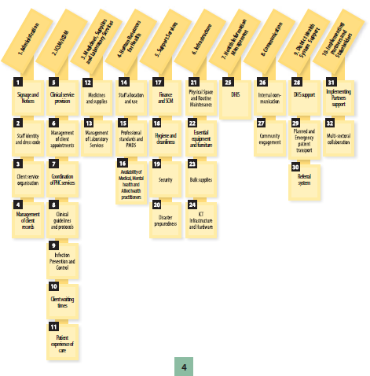
2. Focus area of this presentation

Slide 7
INTENTION
To Share with colleagues the Experiences , methods and Processes that we went through in our attempts to comply with the required elements in Sub Components 9, 10, and 11

Slide 8
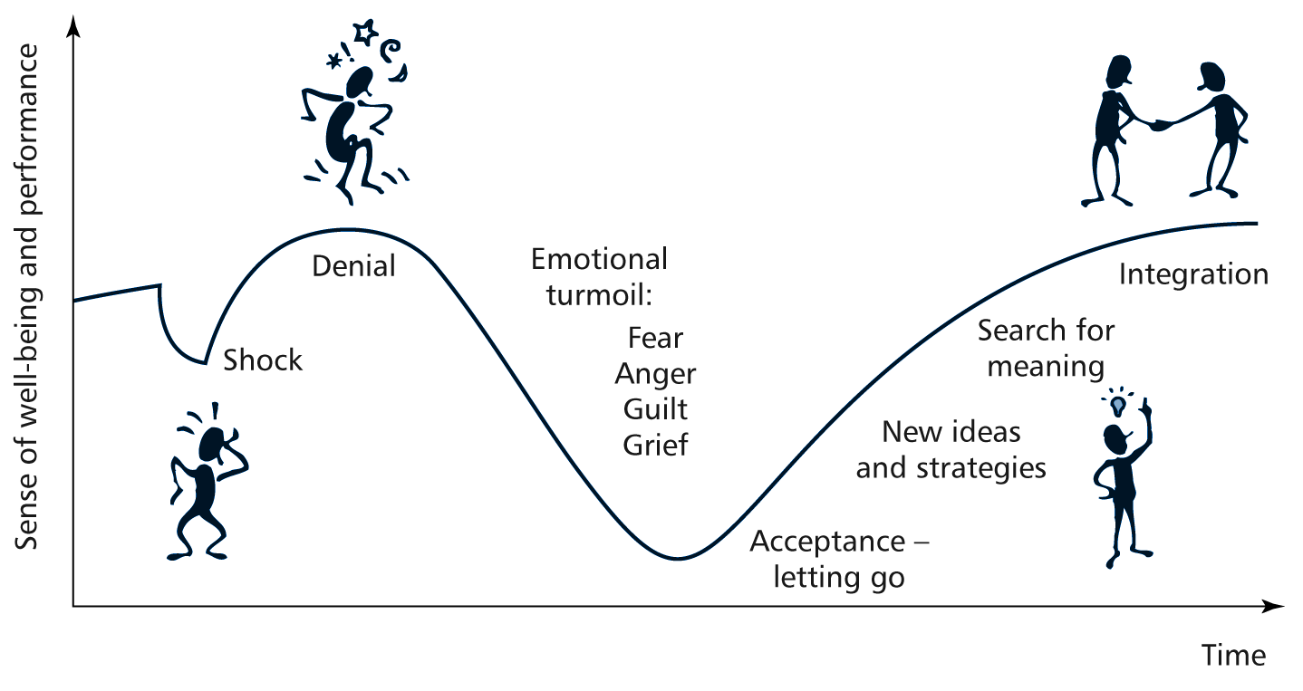
3.Change curve and Human Reactions in a Change Process
Marketing Insights Limited 2004

Slide 9
4. Support and Resources that we accessed to realize sub-components 9, 10,11
FINANCE
ICT
HR/HRD/HRM
DHIS/HIM/QA Unit
COMMUNICATION
INTEGRATED CLINICAL SERVICES MANAGEMENT
FMU/DID
SCM
EXTERNAL TECHNICAL PARTNERS
LOGISTICS
PROGRAM MANAGERS
Notes:
What are the dependencies that affect the timeline, cost, and output of this project?

Slide 10

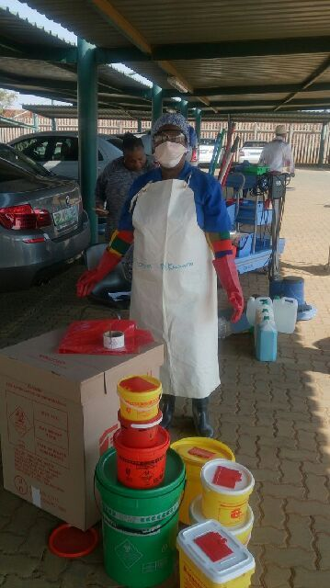
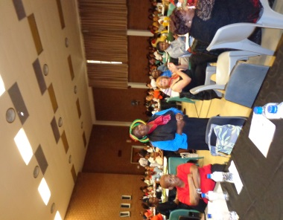
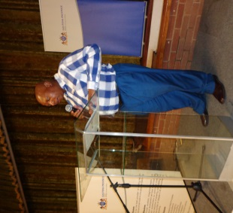
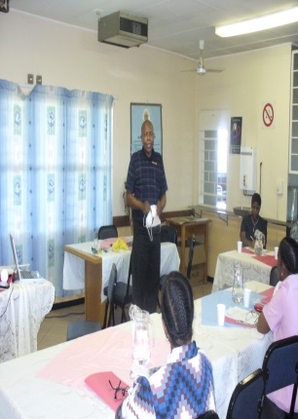
5. Infection Prevention and Control –5.1 Implementation and Realisation
Policy –Availability
Obtained from NDOH
Gauteng Dept of Health Adopted for own use and Conditions(SOP)
Implemented through the IPC unit
Procurement of Essential IPC materials
Sub District IPC Teams engage Facilities through the above methods
Engagement- Planning Training-Workshops –Continuous quality improvement monitoring and evaluation and reporting and Enforcement –Always Using the Ideal Clinic Dashboard
On the spot checks and corrective measures instituted immediately with written and verbal warnings and reports generated

Slide 11
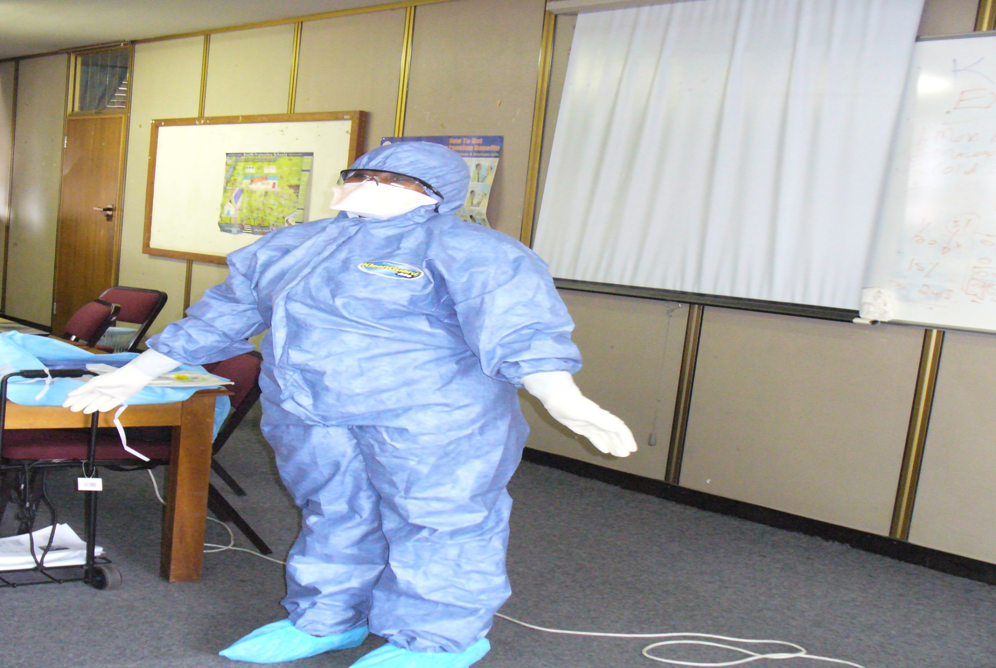
5.2 Protective clothing: FED

Slide 12
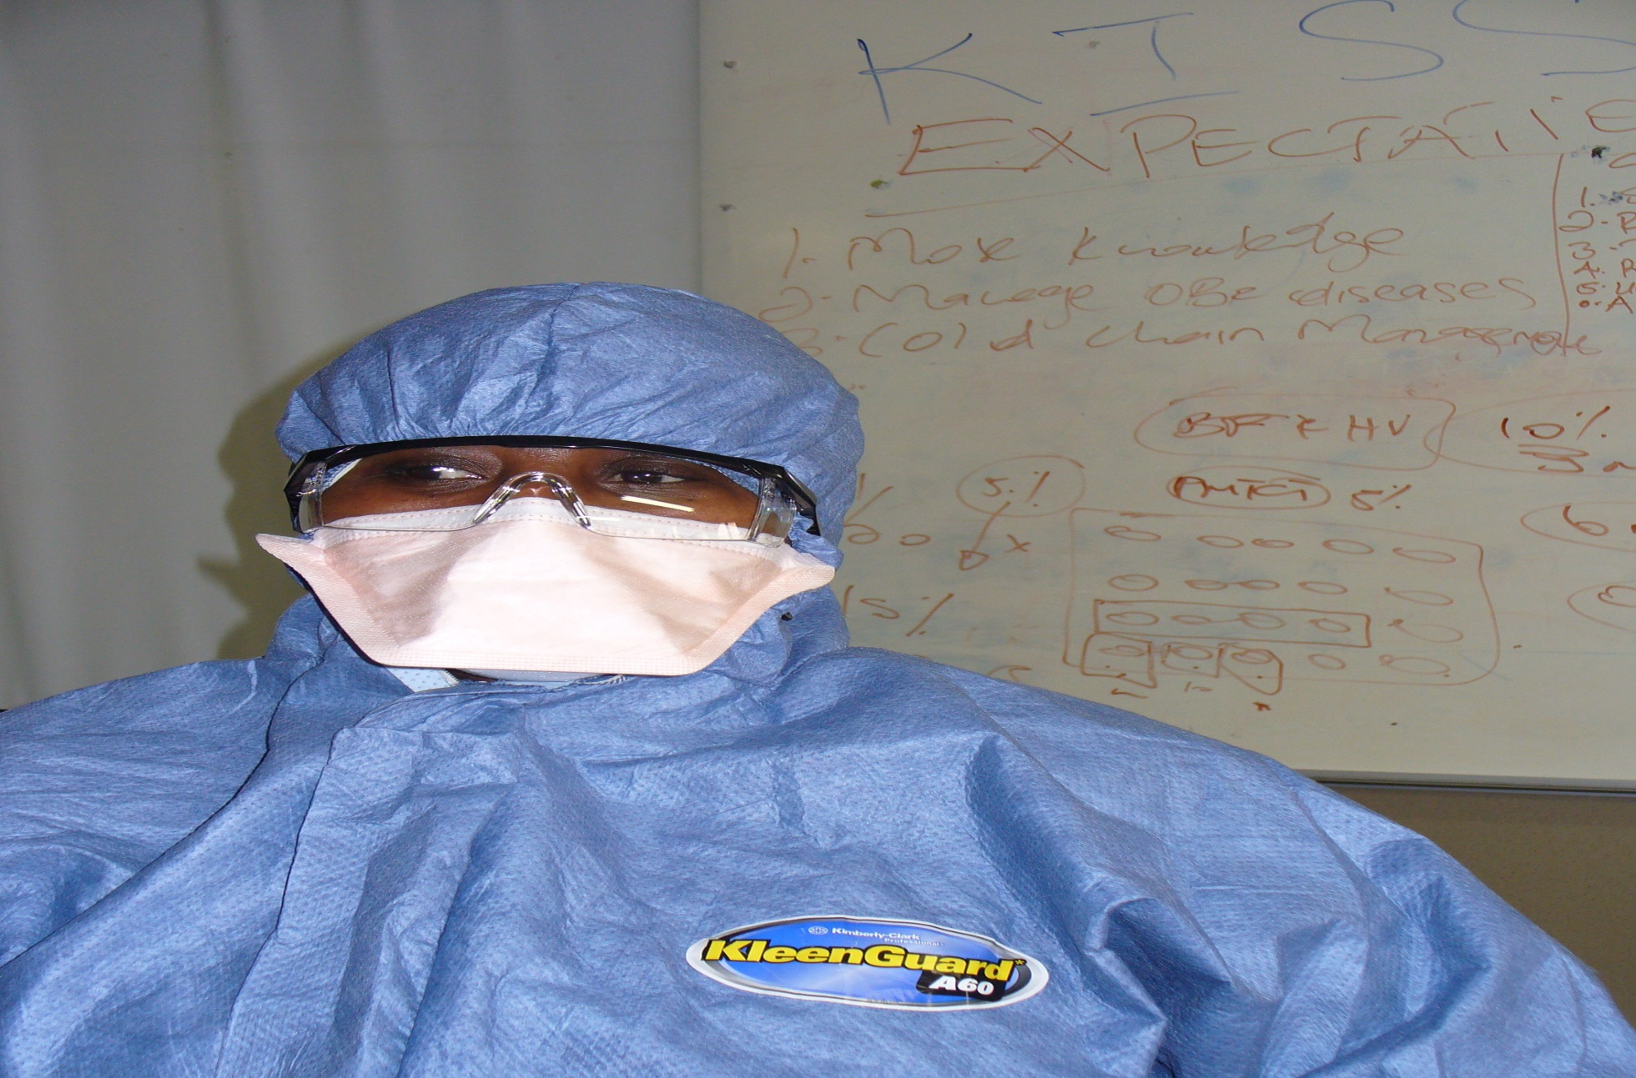
5.3 Use of n95, goggle and cap

Slide 13
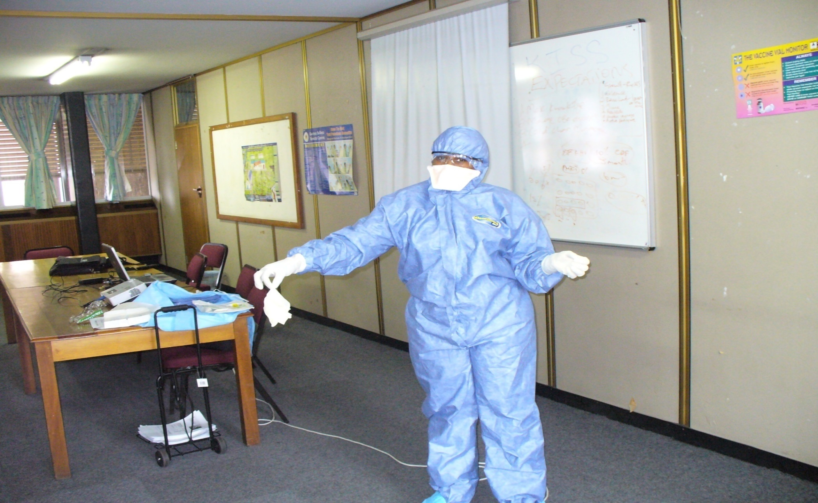
5.4Undressing. start with first pair of clovers

Slide 14
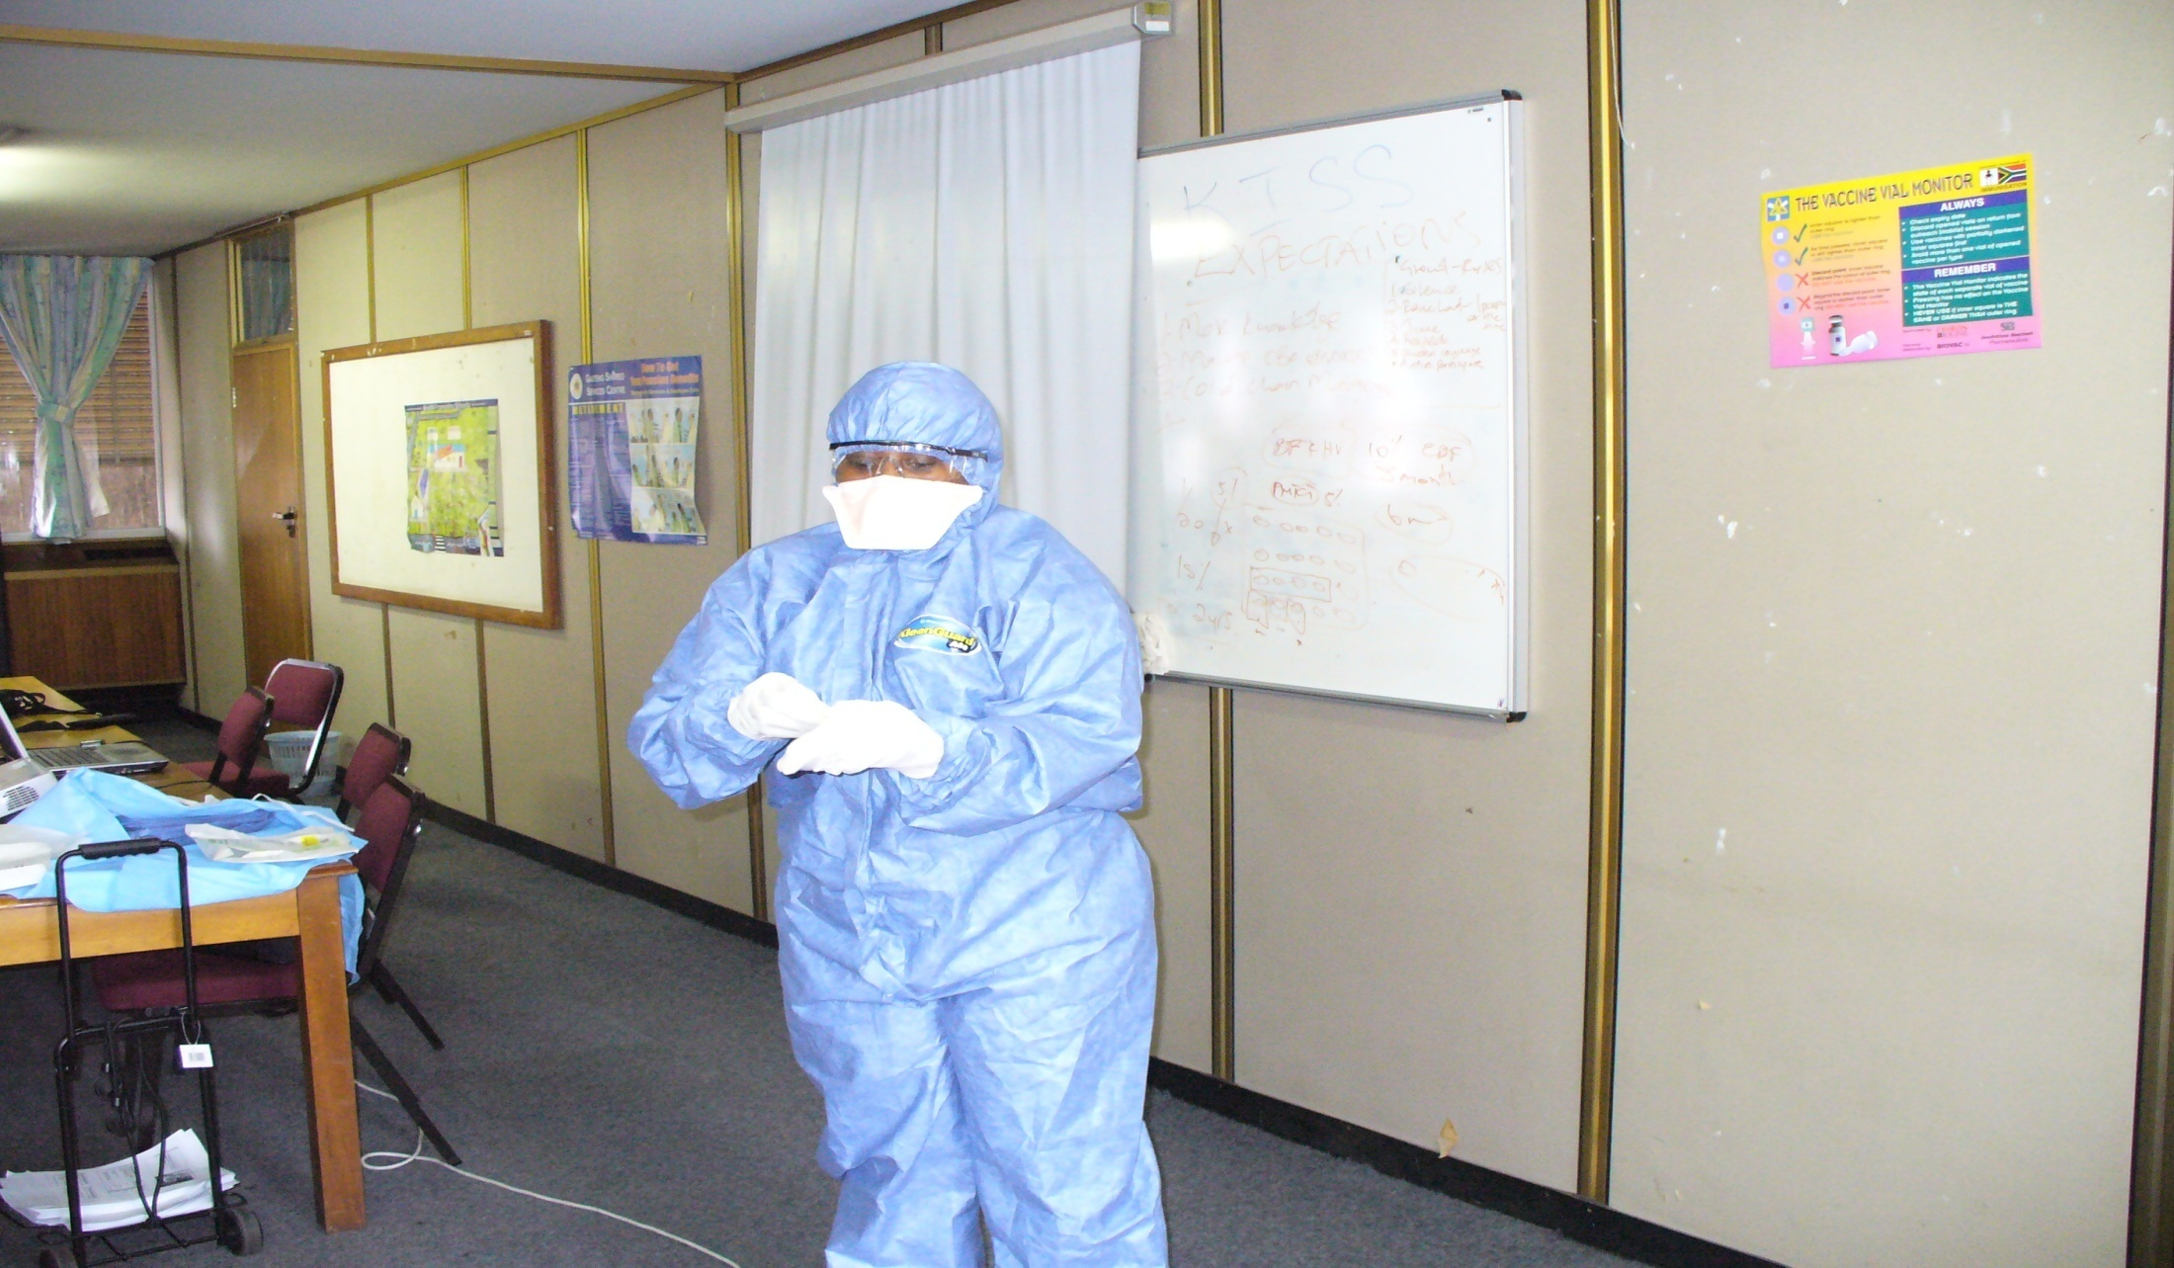
5.5 Technique of removing gloves

Slide 15
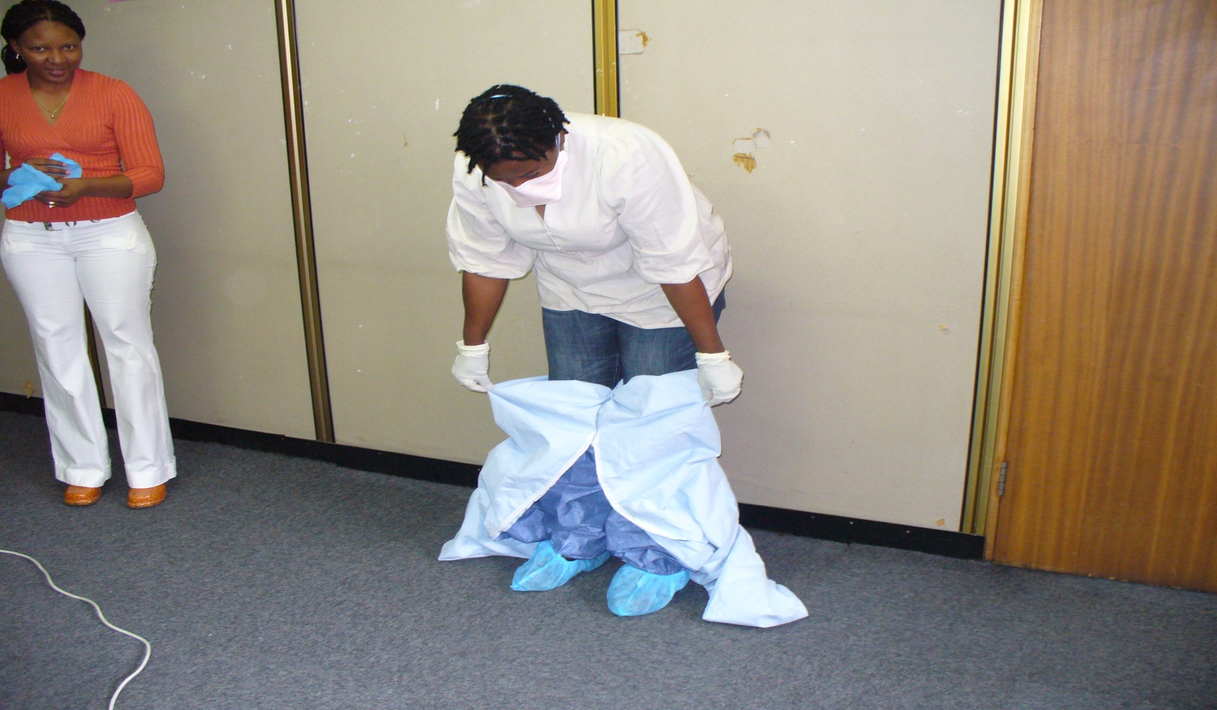
5.5 Undressing jump suit, buddy assistance

Slide 16
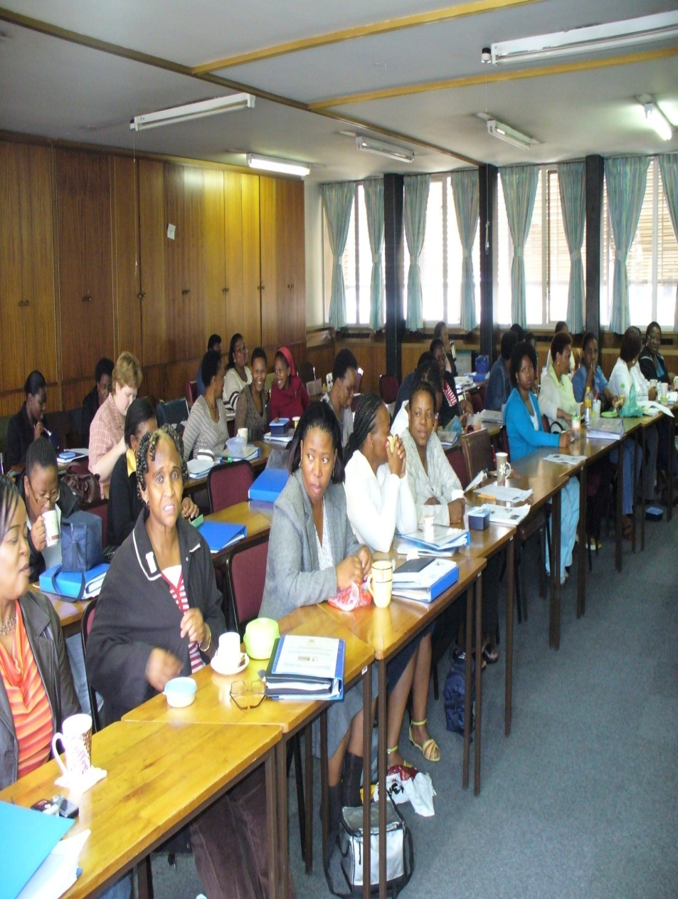
5.6 THE DIFFERNCE

Slide 17
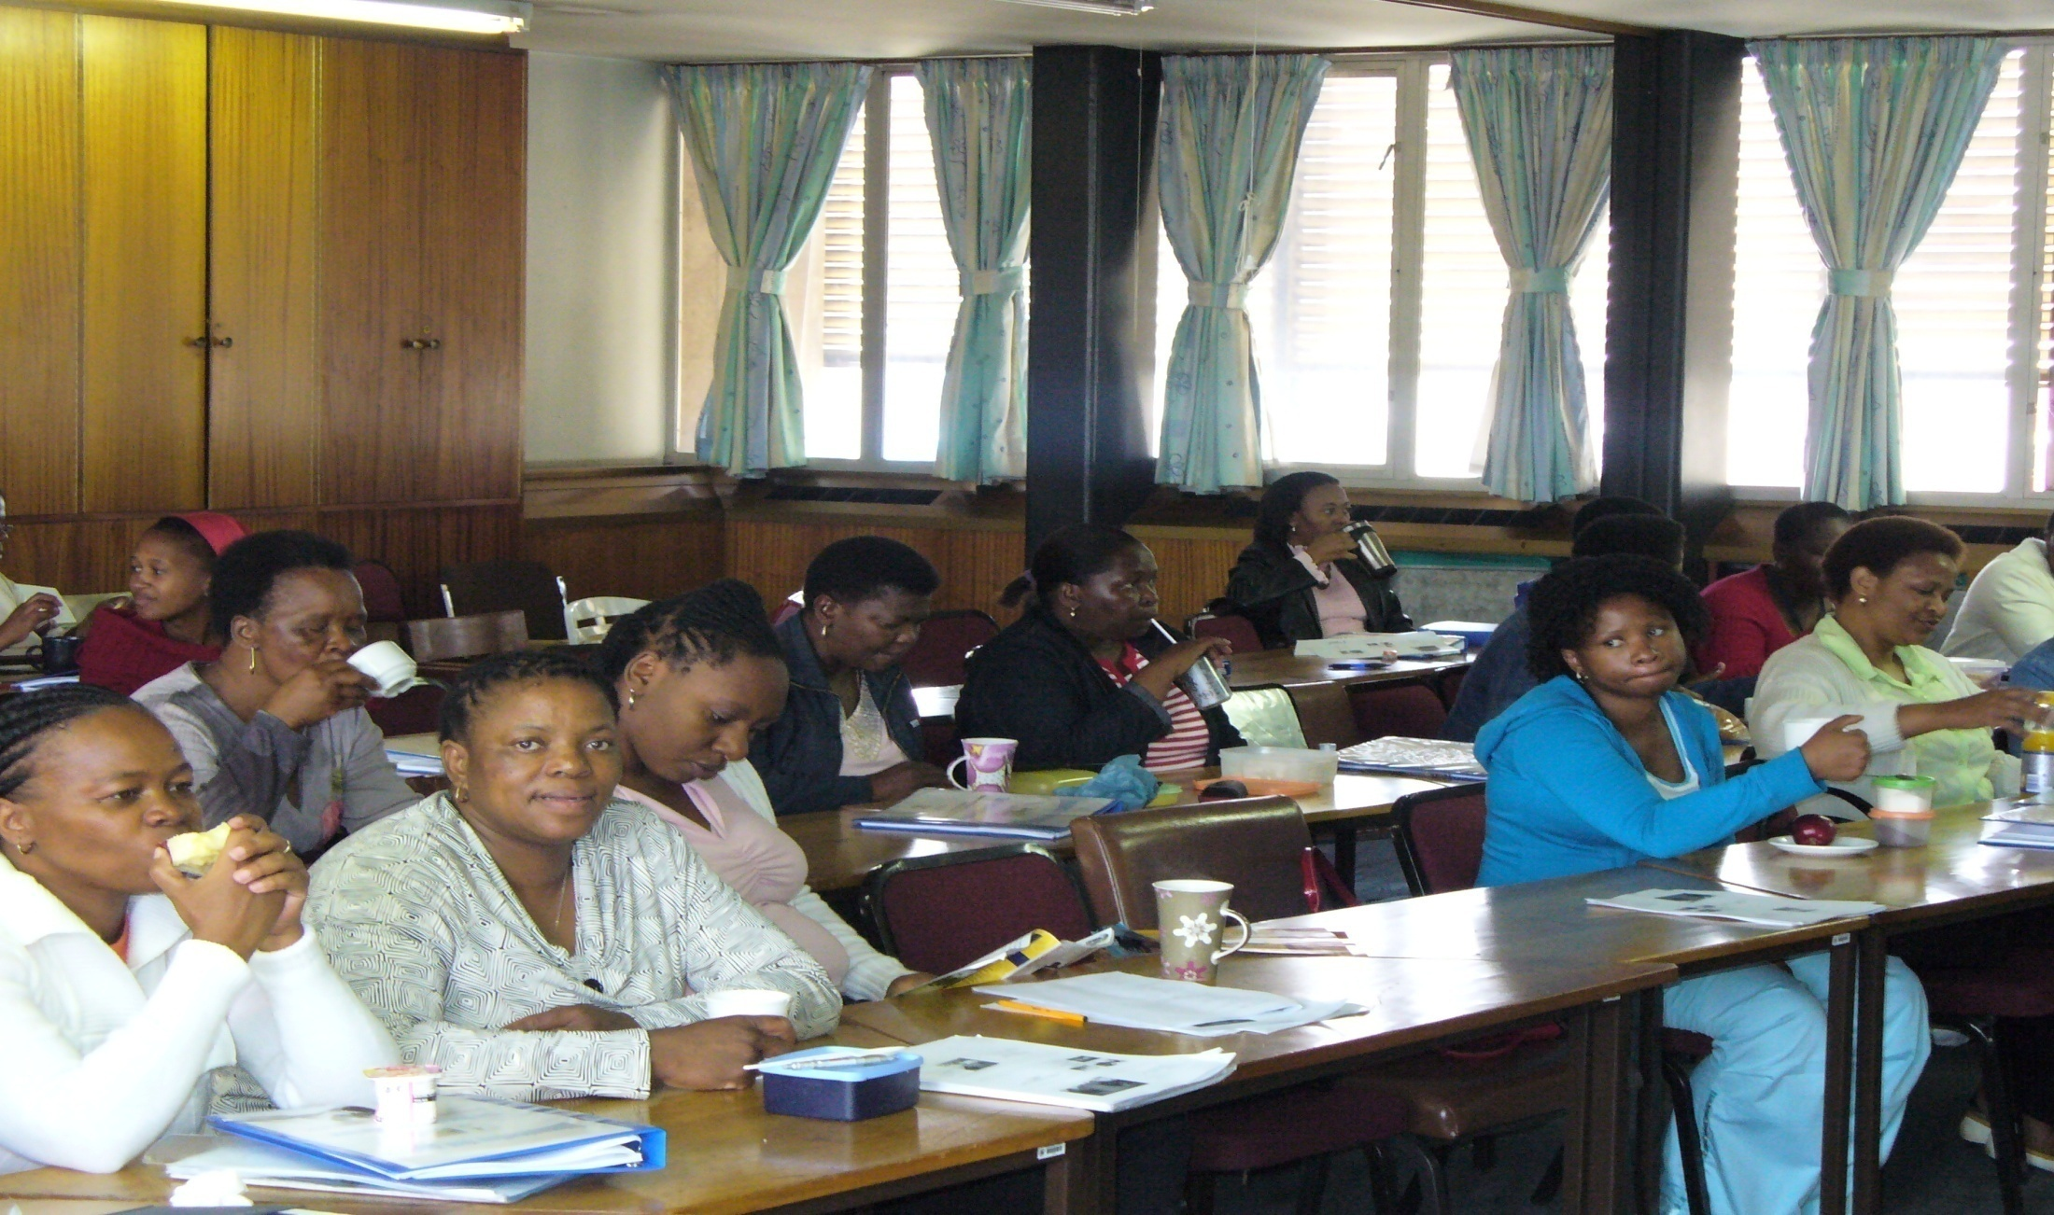
5.7 INVOLVEMENT OF OTHER STAFF MEMBERS

Slide 18
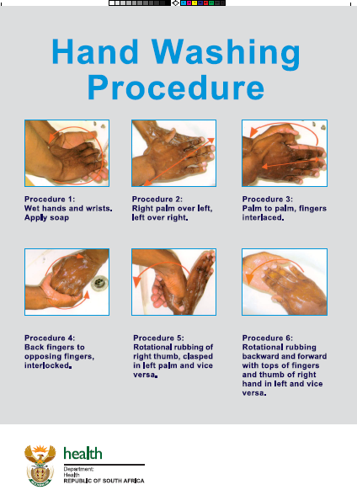
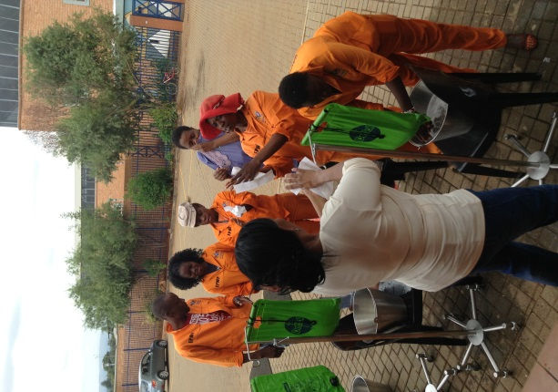
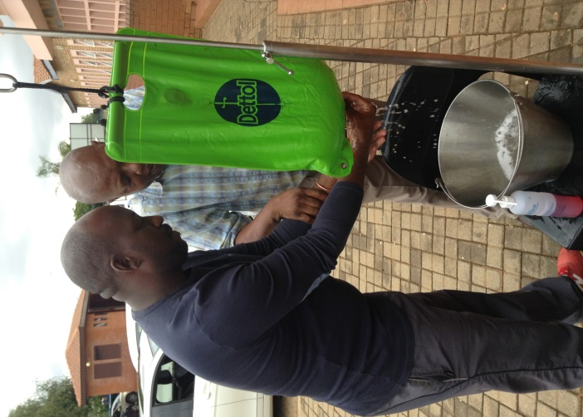
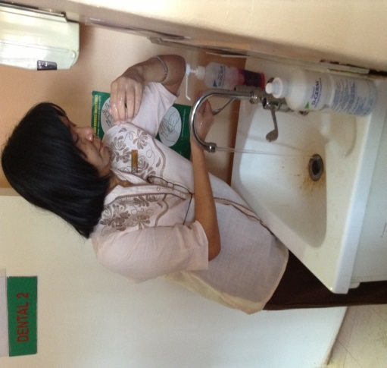
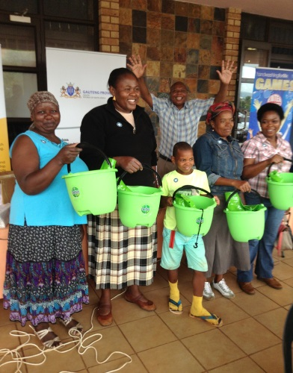

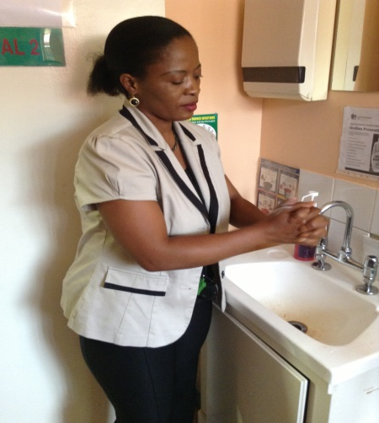
5.8 FACILITY Hand washing Program

Slide 19
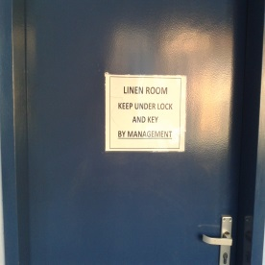
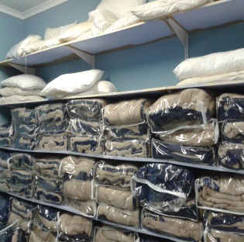
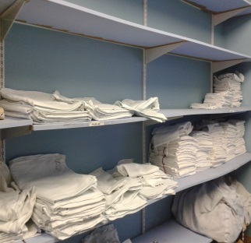
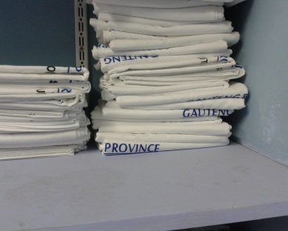
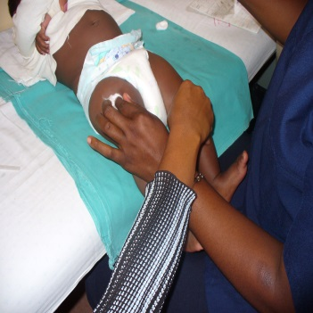
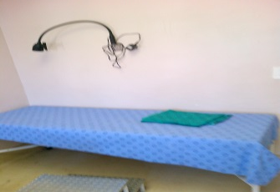
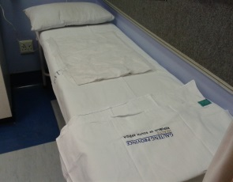
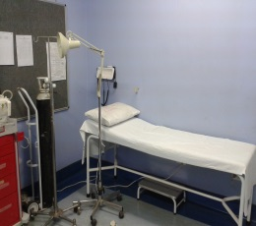
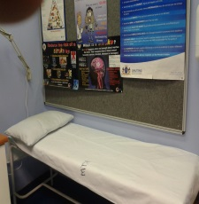
5.9 Clean Linen
Using IPC policy, Gauteng Facilities orientates all staff to the Principles of IPC on Linen Usage
Kt Motubatse has a Dedicated, well ventilated room solely for storage of clean linen
Determination of the stock levels for Linen and ordering by facility General assistants
The linen storage room under constant lock and key, and all staff are Orientated on the appropriate use of all linen for their intended purpose at all times.
Gauteng Linen are clearly branded and
Masakhane laundry Services is responsible for ensuring the regular and Timeous availability of clean Linen at all times
The linen is appropriately used for its intended purpose as shown on the Pictures
All Facilities are supplied with Linen Savers at all times
Used Linen are processed in a Sluice room for onward Transportation to Masakhane Operations

Slide 20
5.10 Waste Management
Policy and Contract
The Provincial Government has initiated and signed a contract with a Service provider see picture
Training-Train all staff on the importance of waste handling, segregation and the purpose of the colour categorisation.
Waste Management Procedures
Waste boxes and containers are placed in prominent position at all waste generation points.
Designated and lockable waste storage areas as shown
Removal of Waste by Facility Staff to Storage and Final handling by Contractor
Monitoring of waste management is on going
Proper Record Keeping for future reference is in Place with Certification

Slide 21

5.10.1Waste Management in Gauteng Province

Slide 22
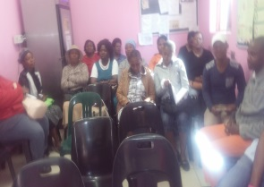

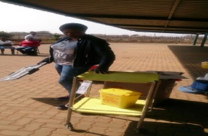
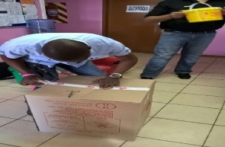
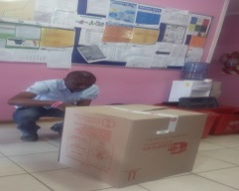
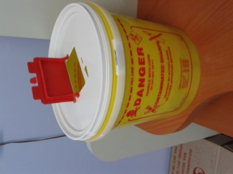
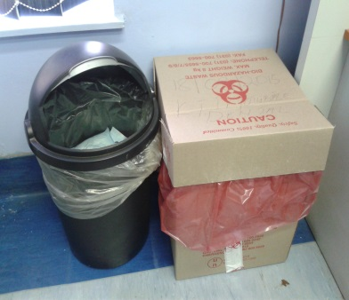
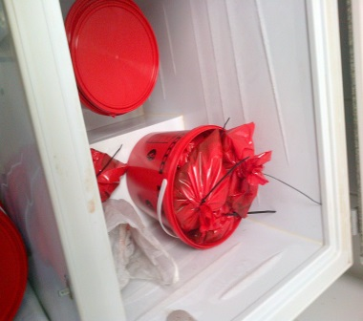
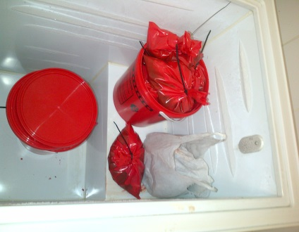
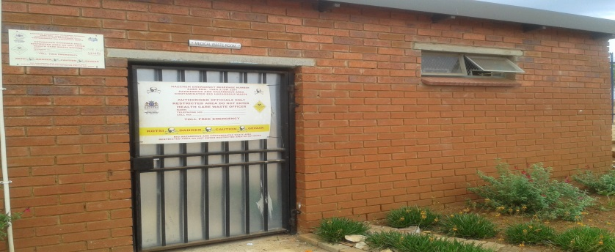
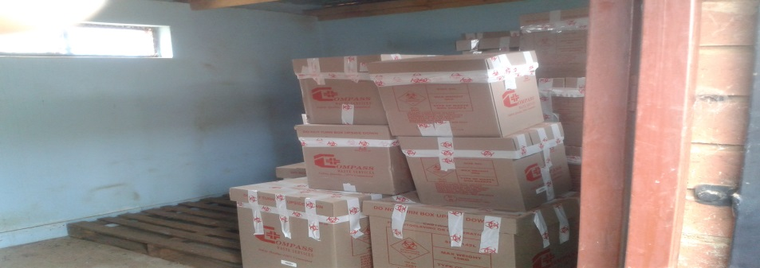
5.11Facility Waste Management
Medical Waste Training
Medical Waste Segregation
Medical Waste Storage

Slide 23
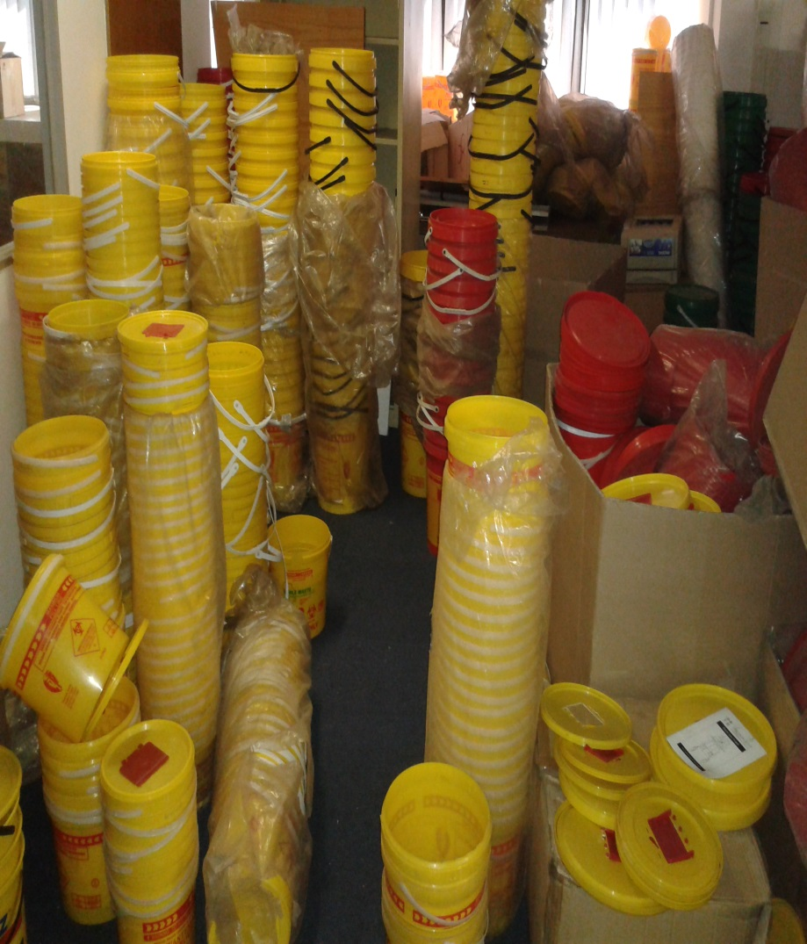
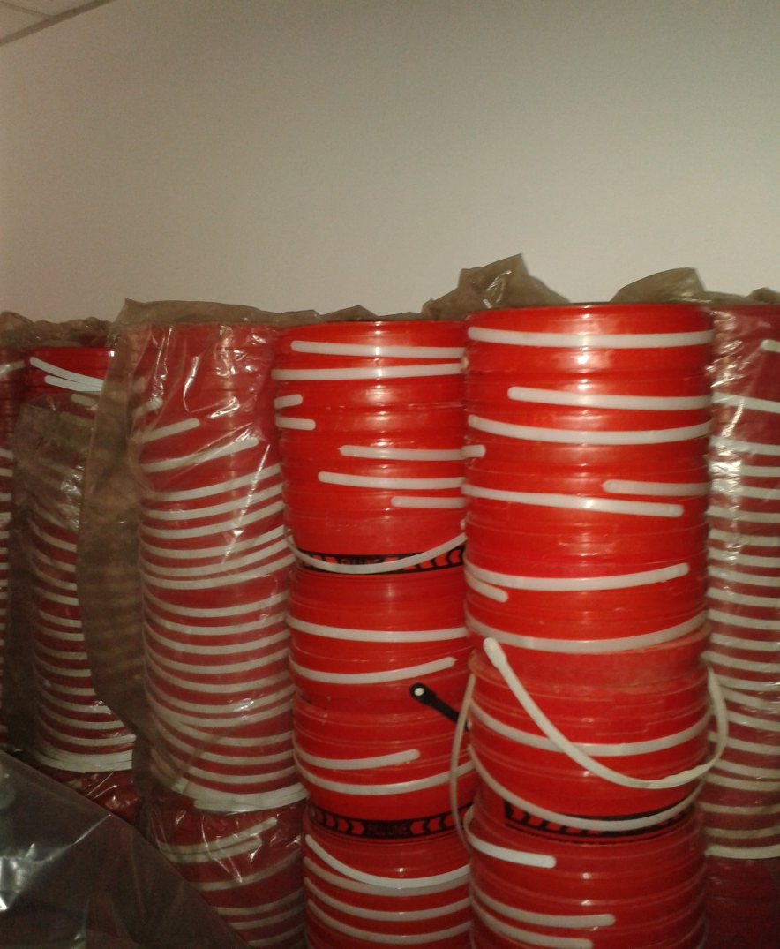
5.12 Availability of Medical Waste Equipment

Slide 24
6. Patient Waiting Time
Policy and SOP
National Policy on Waiting Time is yet to be finalized by NDOH
In Gauteng an SOP for waiting Time is used and the contents of the SOP are shared with all staff members.
Management of waiting Policy and SOP
We Determine and adhere to waiting time for every service area.as shown and this is Visibly displayed with the prescribed total patient waiting time for the facility at the reception area of the facility.
Reduction in Waiting Times is a Major Goal of an Ideal Clinic
Gauteng Patients are intermittently informed of any delays and improvement measures they are taken.
The Facility Manager and the QA coordinator monitors adherence to this policy

Slide 25
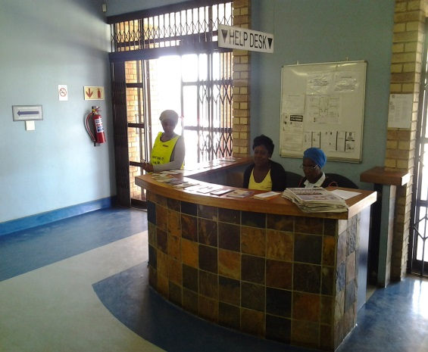

Slide 26
6.2 Waiting Time Recording Tool

Slide 27
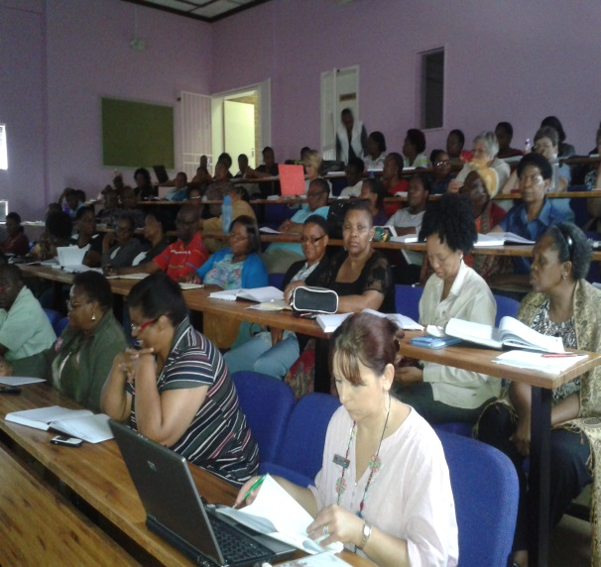
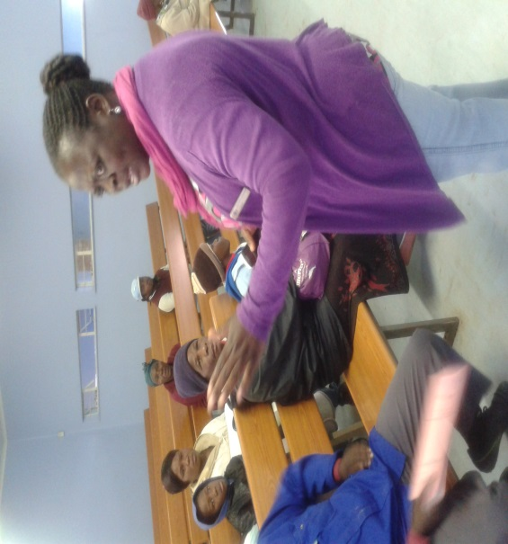
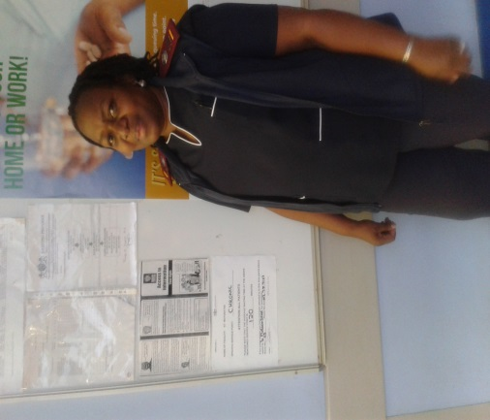
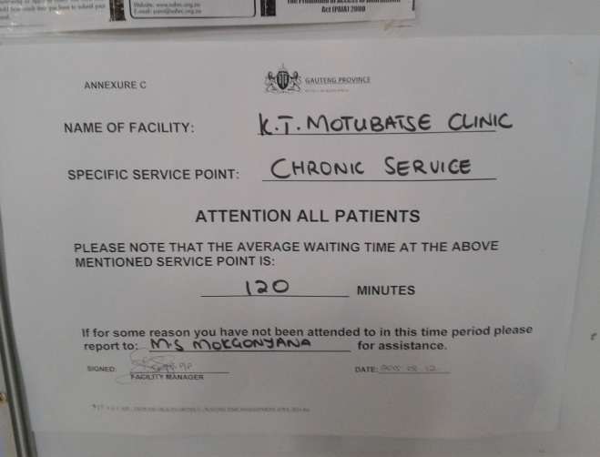
6.3 Adherence to Waiting Time Standards

Slide 28
7. Patient Experience of Care11 7.1 Patient Experience of Care Strategy
Policy
National Patient Experience of Care (PEC) guideline is in progress -THE NATIONAL GUIDELINE ON CONDUCTING PATIENT EXPERIENCE OF CARE SURVEY IN PUBLIC HEALTH ESTABLISHMENTS
Dissemination of its Contents to All Managers/Facility Staff Members
Patient Satisfaction Survey is Conducted in the Facility
Using the designed Tools
Survey Results Published
Survey Results and Graphs are Discussed and Displayed
Results are used for Quality Improvement
Implementation

Slide 29
11: Patient Experience of Care
7.2 : Patient Experience of Care SOP

Slide 30
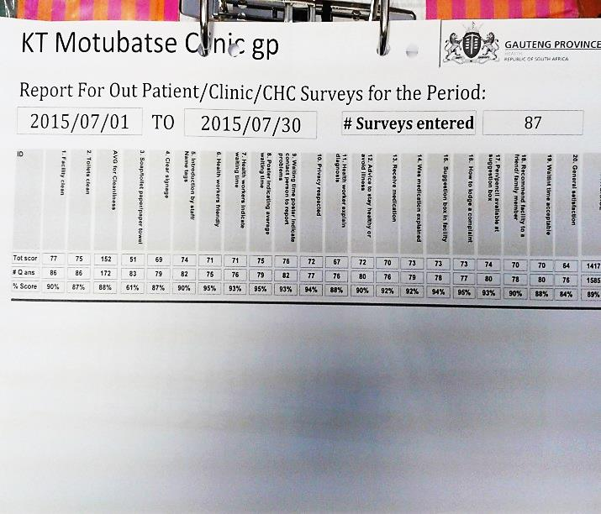
7.3 Patient Experience of Care Processes

Slide 31
7.4 Patient Experience of Care Commitment

Slide 32
7.5 Ideal Clinic Elements 71 and 72
Policy and SOP
National Complaint Management protocol
Gauteng – Specific SOP is available
Engagement
Implementation and Managing the Process
Resolution
Evidence for Implementation
Complaint Resolution and Feedback-3days
Engagement and sharing with all Stakeholders

Slide 33

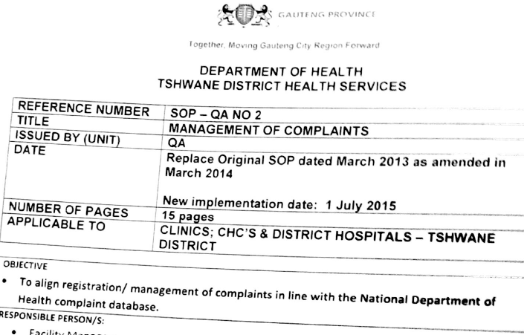
7.8 Complaints Management System

Slide 34
7.9 Facility Complaints System
Complaints Box according to Specification
Pens , Pencil , copies of official Compliments/Complaints forms
Standardized Posters above the Box as Shown

Slide 35
7.10 Complaints Resolution and Record Keeping
Facility Complaints System and Resolution
Complaint is lodged by the Patient
Acknowledgement by the Complaints officer
Resolution within 3days

Slide 36
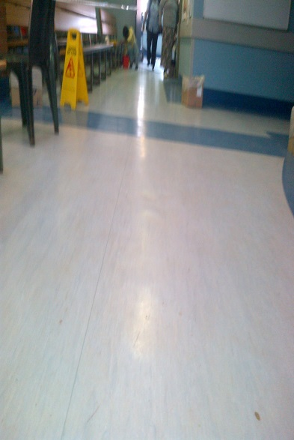
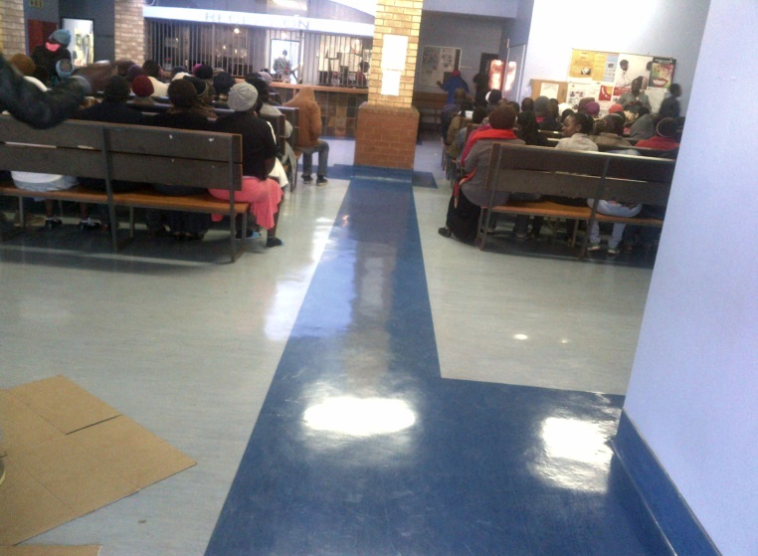
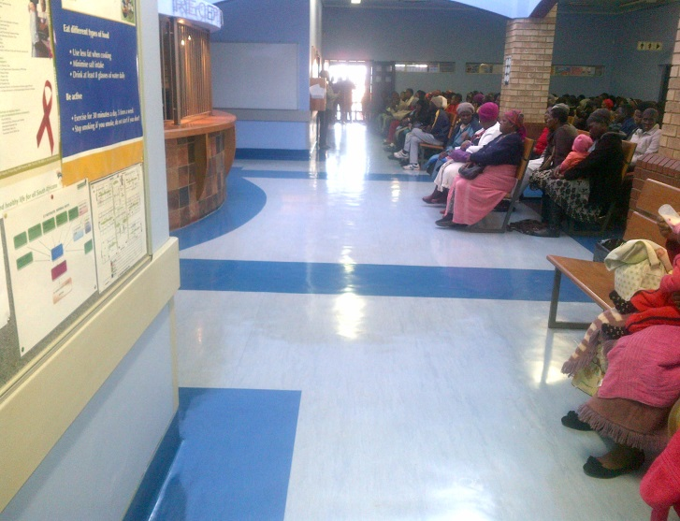



8. Expectations and Results

Slide 37
KT MOTUBATSE CLINIC–2013 PERFORMANCE OVERVIEW
DATES OF ASSESSMENT | 28TH AUGUST 2013 | 11 Sep 2013 | Nov-2013
OVERALL PERFORMANCE | 47% | 58% | 82%
Priority Area | Score | Score | Score
Availability of medicines and supplies | 69% | 56% | 91%
Cleanliness | 37% | 53% | 69%
Improve patient safety and security | 45% | 59% | 82%
Infection prevention and control | 47% | 73% | 89%
Positive and caring attitudes | 67% | 78% | 69%
Waiting times | 64% | 44% | 100%

Slide 38
KT MOTUBATSE CLINIC Performance Overview
DATES OF ASSESSMENT | 28TH AUGUST 2013 | 11 Sep 2013 | Nov-2013
OVERALL PERFORMANCE | 47% | 58% | 82%
Domain |  | Score | Score
1 Patients Rights | 54% | 68% | 79%
2 Patient Safety / Clinical Governance / Clinical Care | 44% | 75% | 84%
3 Clinical Support Services | 62% | 57% | 87%
4 Public Health | 26% | 51% | 89%
5 Leadership and Corporate Governance | 33% | 17% | 100%
6 Operational Management | 30% | 30% | 67%
7 Facilities and Infrastructure | 42% | 52% | 82%

Slide 39

Ideal Clinic Dashboard Results Gauteng Province ICSM
NA 63%
NA 84%
NA 64%

Slide 40

Ideal Clinic Dashboard Results National ICSM

Slide 41
9. SUCCESS FACTORS
A Successful, sustainable and consistent Ideal clinic green scores is dependent on
Team work and team support
Quality and effective Leadership
A highly Alert ,highly sensitive, and a Patient centred team approach
Dedicated District and Sub District Teams
Using Innovative Methods and working within the Policies and Standards

Slide 42
10. Systems that has Contributed to Quality Improvement
Implementation of ICSM
Re-organization of Patients Files
Removal and Archiving of Old and Redundant files
Implementation of the Integrated Patient Files-Adult and Child
Efficient Filing Delivery systems procured
Procurement and Implementation of the Electronic Patient registration System(additionally-in Some Gauteng Provincial Facilities-Finger Identification system)
Patient Appointment system-Manual and Electronic
Effective Monitoring and Management of the Patients’ Waiting time
Pre-packing of Patients’ Medications
HR Appointment for Various Vacant Medical, Nursing, Allied and Support Staff positions
Many Stable Chronic Patients referred to Central Chronic Medicine Dispensing and Distribution(in Partnership with Pharmacy Direct)
Improvement in Patient Complaints Resolution Turn around Times

Slide 43
11. CHALLENGES
Commitment to conduct Status determination
Some Unavailable policies e.g IPC, PEC, Waiting time
Supply Chain Management Related Issues
Managing Change in a Facility

Slide 44
12. Feedback from Our Clients

Slide 45
13.Lessons Learned

Slide 46

13.1. Why is change needed?
Many times, in order to survive
we have to start a change process.
We sometimes need
to get rid of old memories,
habits and other past traditions.
Only freed from past burdens,
can we take advantage of the present.

Slide 47
13.2 . What Should we be Doing? SCM
SMILE
COMPASSION
Maintain and Maximize the Services
From BBC

Slide 48

13.3. Lessons from the First Lady(USA)

Slide 49

THANK YOU
?
?

