Slide 1
Integrated Clinical Services Management
ICRM Orientation for scale up
Dr Shaidah Asmall –PHC
14.09.2015

Slide 2
2. ICSM/ICDM
5. Clinical Service provision
Elements |  | W | MM | R
25 | There is an area for monitoring vital signs for the different streams of care | I | K | HF
26 | Clients' privacy is respected at all times and in all service areas | E | K | HF
27 | TB treatment success rate is at least 85% or has increased by at least 10% from the previous year | E | & | HF
28 | TB (new pulmonary) defaulter rate is <5% | E | & | HF
29 | Ante-natal visit rate before 20 weeks gestation is at least 70% | E | & | HF
30 | Ante-natal clients initiated on ART rate is at least 95% | E | & | HF
31 | Immunisation coverage under one year (annualised) is at least 94% | E | & | HF
32 | Screening of clients for high blood pressure has increased by 10% since the previous financial year | E | & | HF
33 | Screening of clients for raised blood sugar has increased by 10% since the previous financial year | E | & | HF

Slide 3
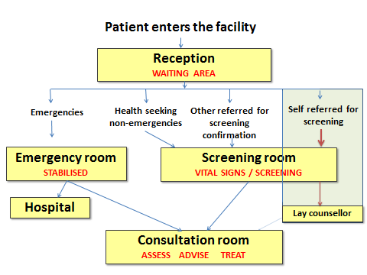
Patient Process Flow at PHC facility
Note: The direct referral to the Lay Counsellor will be implemented after the required training and evaluation are completed. Hence interpretation of patient flow must be interpreted with caution.

Slide 4
1. ICSM/ICDM
6. Management of client appointments
Elements |  | W | MM | R
34 | An ICSM compliant client appointment system for clients with stablised chronic health conditions and MCWH clients is in use | E | & | HF
35 | The records of booked clients are pre retrieved 72 hours before the appointment | E | K | HF
36 | Clients that did not honour their appointments within one week are followed up by referral to WBPHCOT to facilitate booking of new appointment | E | ? & | HF
37 | Pre-dispensed medication for clinically stable chronic patients is prepared for collection 48 hours prior to collection date. | E | ? K | HF

Slide 5
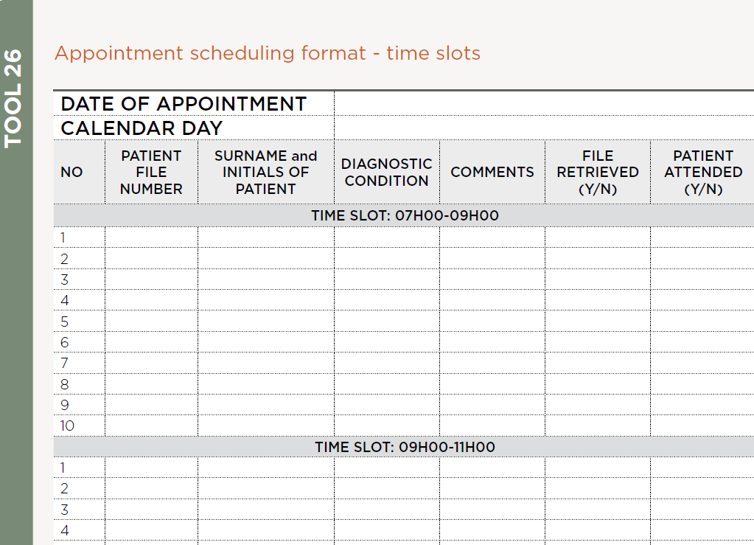

Slide 6
2. ICSM/ICDM
7. Coordination of PHC Services
Elements |  | W | MM | R
38 | There is cooperation with School health teams in providing health services to learners | I | & | D
39 | The facility refers patients with chronic but stable health conditions to WBPHCOT for support. | E | & | HF
40 | There is evidence of two-way referral of patients between the PHC facility and WBPHCOT using prescribed stationary | E | & | HF
41 | Quarterly clinical improvement report from DCST available | E | & | D

Slide 7
2. ICSM/ICDM
8. Clinical guidelines and protocols
Elements |  | W | MM | R
42 | The ICSM compliant package of clinical guidelines is available in all consulting rooms | E | & | D
43 | All professional nurses and doctors have been fully trained on ICSM compliant package of clinical guidelines | E | & | D
44 | All health care professionals have been trained on the management of medical emergencies | V | & | D
45 | The National Adverse Event Management Protocol is available | E | & | NDoH
46 | The facility's Adverse Event Management Standard Operating Procedure is available | E | & | HF
47 | The Adverse Event Management records show compliance to the adverse event management protocol | E | & | HF
48 | The National Clinical Audit guideline is available | E | & | NDoH
49 | Clinical audit meetings are conducted quarterly in line with the guidelines | E | & | D

Slide 8
Clinical Guidelines
For General Practitioners (GPs)
[2013_vers1]

Slide 9
How to Use these slides
The following 2 slides contains link to the most important Clinical Guidelines for both Adults and Children
To Search a specific Guideline:
Double click on the relevant picture (the document will open in Adobe PDF reader)
To search: press Shift+Ctrl+f (a search window will appear); type in the search term to navigate to the relevant page.

Slide 10
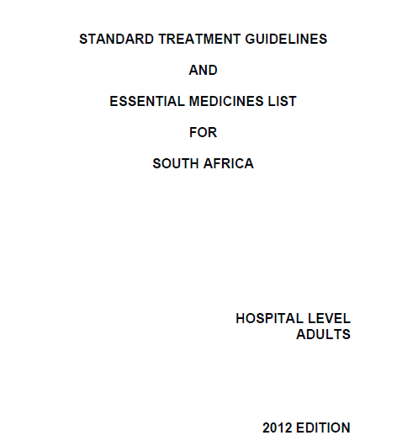

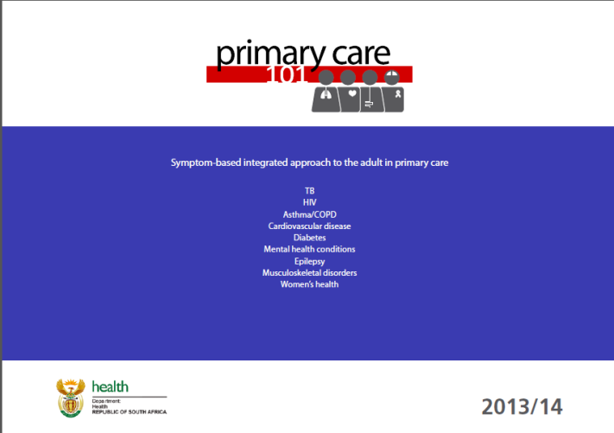
ADULTS
Primary Care 101
Standard Treatment Guidelines and Essential Medicines List –
HOSPITAL LEVEL (ADULTS) 2012
Standard Treatment Guidelines and Essential Medicines List –
PRIMARY HEALTH CARE LEVEL 2008

Slide 11

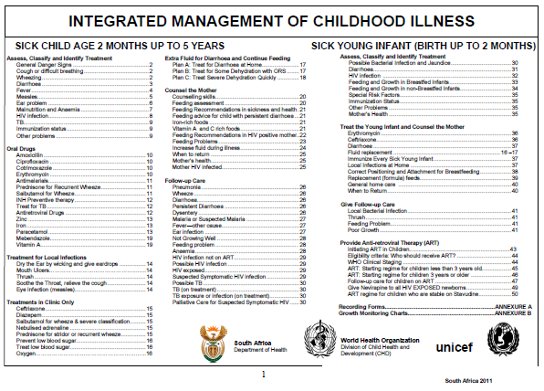


CHILDREN
Expanded Programme on Immunisation – April 2009
Integrated Management of Childhood Illness – SA 2011
Road to Health for Boys
Newborn Care Charts

Slide 12
3. Medicines, supplies and Laboratory Services
12. Medicines and supplies
Elements |  | W | MM | R
77 | There is at least one functional wall mounted minimum/maximum room thermometer in all rooms where medication is kept | V | K | HF
78 | The temperature of the rooms where medication is kept is recorded twice daily | V | & | HF
79 | The temperature of the rooms where medication is kept is constantly within the safety range | V | & | HF
80 | There is a contingency plan to manage inappropriate room temperatures | I | & | HF
81 | The temperature of the medicine refrigerator is recorded twice daily | V | & | HF
82 | The temperature of the medicine refrigerator is constantly within the safety range | V | & | HF

Slide 13
3. Medicines, supplies and Laboratory Services
12. Medicines and supplies
Elements |  | W | MM | R
83 | There is access to an automated supply chain system for medicines | E | K | HF
84 | All medicines on the Essential Medicine List (EML) are consistently available | V | & | HF
85 | The facility has sufficient stock to dispense chronic medication for 2 months | E | K& | HF
86 | Re-ordering stock levels (min/max) is determined for each item on the EML | E | K& | HF
87 | Medicines that expire within three months are returned to the depot | E | K | HF
88 | A list of required basic surgical supplies (consumables) indicating the re-ordering stock levels (min/max) is available | E | & | HF

Slide 14
3. Medicines, supplies and Laboratory Services
13. Management of Laboratory Services
Elements |  | W | MM | R
89 | The PHC Laboratory Handbook is available | E | & | NDoH
90 | Specimens are handled according to the National Health Laboratory Services Handbook | E | K | HF
91 | Required functional diagnostic equipment and concurrent consumables are consistently available | V | ?& | HF
92 | The PHC laboratory results are received from the lab within 72 hours | E | & | HF
93 | Laboratory results are filed in the client's record within 24 hours after receiving them from the lab | E | & | HF

Slide 15


Slide 16
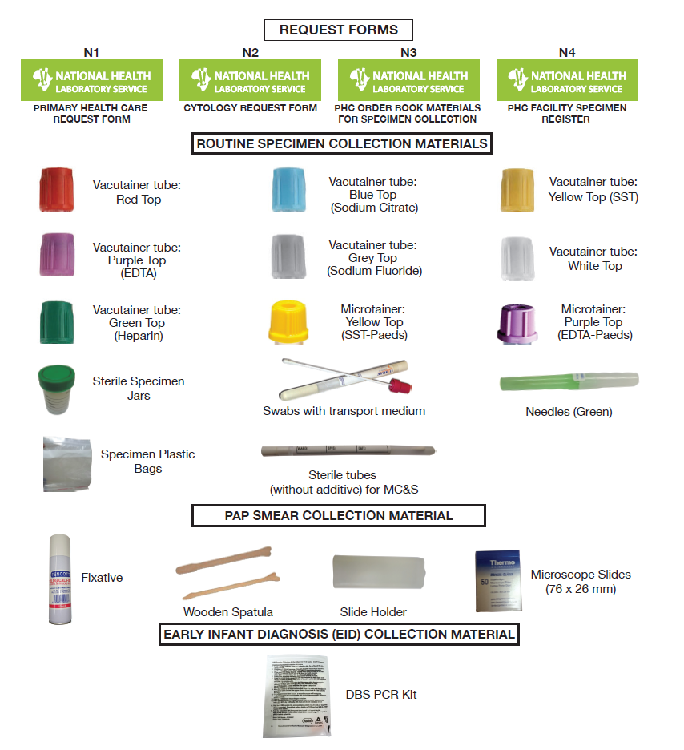

Slide 18
6. Infrastructure
21. Physical Space and Routine Maintenance
Elements |  | W | MM | R
151 | Clinic space accommodates all services/disciplines and staff | E | K& | HF
152 | The clinic has access to a functional District infrastructure maintenance hub | I | ? | D
153 | Minor repairs are promptly carried out | I | K& | D
154 | Major infrastructure repairs are carried out as planned | I | & | D
155 | Routine maintenance of the infrastructure is conducted | I | K& | D

Slide 19
6. Infrastructure
22. Essential Equipment and Furniture
Elements |  | W | MM | R
156 | Consulting room furniture is available in every consulting room | I | K | HF
157 | Essential equipment is available and functional in every consulting room | E | K | HF
158 | Resuscitation room is well equipped with functional basic equipment for resuscitation | V | K& | HF
159 | Oxygen supply is available | V | K | HF
160 | Emergency trolley is cleaned and filled up at least daily and after being used | V | K& | HF
161 | There is a protocol on resuscitation in a health facility. | E | & | HF
162 | PHC facility staff are familiar with resuscitation and emergency procedures | E | ?& | HF
163 | There is sterile emergency delivery pack. | V | K | HF
164 | Equipment for minor surgery is available | E | K | HF
165 | Redundant and non-functional equipment is promptly removed from the facility | I | K | HF

Slide 20
6. Infrastructure
23. Bulk Supplies
Elements |  | W | MM | R
166 | There is consistent supply of clean, running water to the facility | V | ?H | HF
167 | There is emergency water supply in the facility | E | ?H | HF
168 | Water is quarterly checked for quality | I | ?& | HF
169 | There is functional back-up electrical supply | V | ?H | HF
170 | The back-up electrical power supply is weekly checked to determine its functionality | V | & | HF
171 | The sewerage system is functional | E | & | HF

Slide 21
6. Infrastructure
24. ICT Infrastructure and Hardware
Elements |  | W | MM | R
172 | There is a functional telephone system in the facility | E | ?H | HF
173 | A functional public address system is available | I | ?H | HF
174 | There is functional computer | I | ?H | HF
175 | There is functional printer connected to the computer | I | ?H | HF
176 | There is web access | I | ?H | D

Slide 22
6. Infrastructure
24. ICT Infrastructure and Hardware
Elements |  | W | MM | R
172 | There is a functional telephone system in the facility | E | ?H | HF
173 | A functional public address system is available | I | ?H | HF
174 | There is functional computer | I | ?H | HF
175 | There is functional printer connected to the computer | I | ?H | HF
176 | There is web access | I | ?H | D

